Slide 1
PHYS 1441 – Section 002
Lecture #15
Monday, Oct. 26, 2020
Dr. Jaehoon Yu
CH25
  Microscopic View of Electric Current
  Ohm’s Law in Microscopic View
CH26
  EMF and Terminal Voltage
  Resistors in Series and Parallel
  Kirchhoff’s Rules
Today’s homework is homework #8, due 11pm, Friday, Nov. 6!!

Slide 2
Announcements
Reminder for reading assignments: CH25 – 9, 25 – 10 and CH26 – 7
We will have the mid-term grade discussion this Wednesday, Oct. 28, starting 11:30am ending at 4:30pm on a separate zoom link below
  You MUST sign up on the doodle poll for the discussion https://doodle.com/poll/zpad5me89scp2whd
  Each 30min slot is limited to 15 students
  Only 37 of you have signed up for this discussion ➔ Without signing up to the time slot, you will not be able to have the discussion
  Grade discussion zoom link: https://uta.zoom.us/j/98724294579?pwd=MlBJQXF3RnNZamtUbzQ3b3FXd2VIdz09
  Will be counted attendance extra credit
Those of you with additional COVID-19 questions can send email to Dr. Linda Lee at lindalee.17@gmail.com.
  To ensure that she reads your email, please be sure to use subject: “Questions from Dr. Yu’s student fall20”

Slide 3
SP#5 – Civic Duty II: Election Participation
Election on Nov. 3 with early voting Tue. Oct. 13 – Fri. Oct. 30
For those with legal voting rights: You can submit three access code green sheet for 20 points total – one your own and two others who voted, 5 points each. Any additional ones will earn 2 points each
For those without legal voting rights: You can submit for the first four access code green sheets for 20 points total, 5 points each and any additional combinations 2 points each.
Be sure to tape one side of the access code (or “I Voted” sticker if the voting was not using an electronic machine) on a sheet of paper with the date, the precinct number, the name of the person voted
None of the stickers can be from the same person on someone else’s extra credit or on your own. All of those with any of the identical persons on your extra credit sheet will get 0 credit.
Deadline: Beginning of the class Monday, Nov. 9

Slide 4

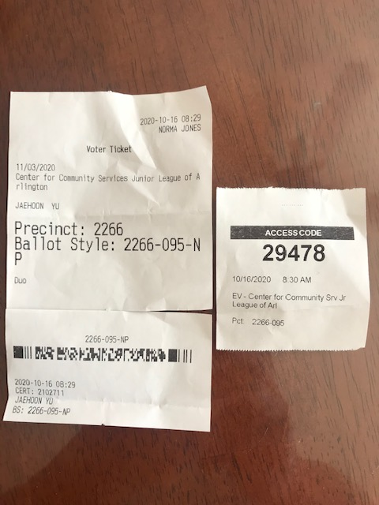
Access code sheet/Sticker
This must be accompanied with date of the vote, the county name, the precinct number, the full name of the person voted and the signature of the person

Slide 5
Reminder: Special Project #7 – Electric Power Usage
Make a list of the power consumption and the resistance of all electric and electronic devices at your home and compile them in a table. (10 points total for the first 10 items and 0.5 points each additional item.)
Estimate the cost of electricity for each of the items on the table using your own electric cost per kWh (if you don’t find your own, use $0.12/kWh) and put them in the relevant column. (5 points total for the first 10 items and 0.2 points each additional items)
Estimate the the total amount of energy in Joules and the total electricity cost per day, per month and per year for your home. (8 points)
Due: Beginning of the class Monday, Nov. 2
  Scan all pages of your special project into the pdf format
  Save all pages into one file with the filename SP7-YourLastName-YourFirstName.pdf
  Submit on CANVAS
  Download the spreadsheet ASAP

Slide 7
Power Delivered by Alternating Current
The square root of means of the squares of the current and voltage are called root-mean-square, or rms ➔ effective I & V
AC Average Power using rms quantities

Slide 8
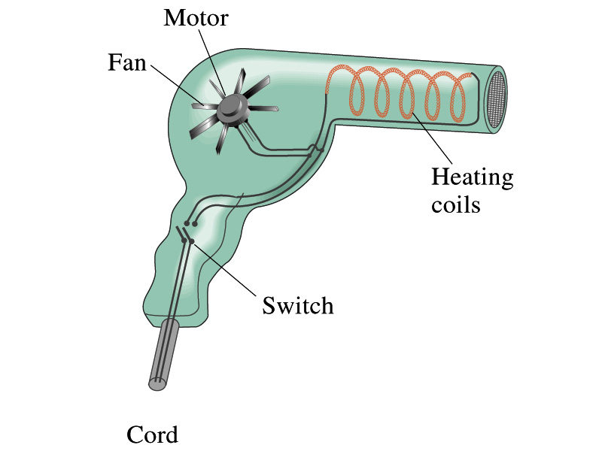
Example 25 – 13
Hair Dryer. (a) Calculate the resistance and the peak current in a 1000-W hair dryer connected to a 120-V AC line. (b) What happens if it is connected to a 240-V line in Britain?
The rms current is:
The peak current is:
Thus the resistance is:
(b) If connected to 240V in Britain …
The average power provide by the AC in UK is
So?
The heating coils in the dryer will melt!

Slide 9
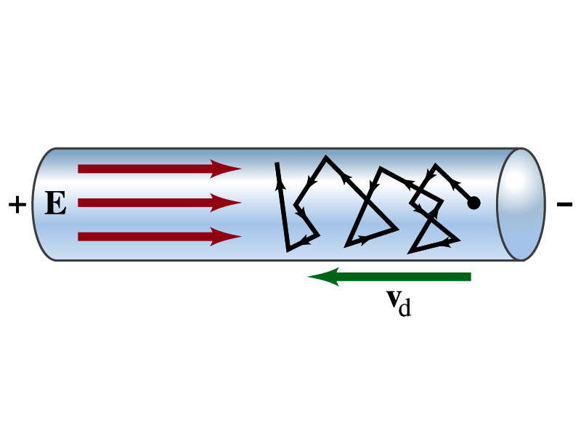
Microscopic View of Electric Current
When voltage is applied across the ends of a wire
Electric field is generated by the potential difference
Electrons feel the force and get accelerated
Electrons soon reach to a steady average speed due to collisions with atoms in the wire, called drift velocity, v_{d}
The drift velocity is normally much smaller than electrons’ average random speed.

Slide 10
Microscopic View of Electric Current
The drift velocity of electrons in a wire is only about 0.05mm/s. How could we get light turned on immediately then?
  While the electrons in the wire travels slow, the electric field travels essentially at the speed of light. Then what is all the talk about electrons flowing through?
    It is just like water. When you turn on the facet, water flows right off the facet despite the fact that the water travels slow.
    Electricity is the same. Electrons fill the conductor wire and when the switch is flipped on or a potential difference is applied, the electrons close to the positive terminal flows into the bulb.
    Interesting, isn’t it? Why is the field travel at the speed of light then?

Slide 11
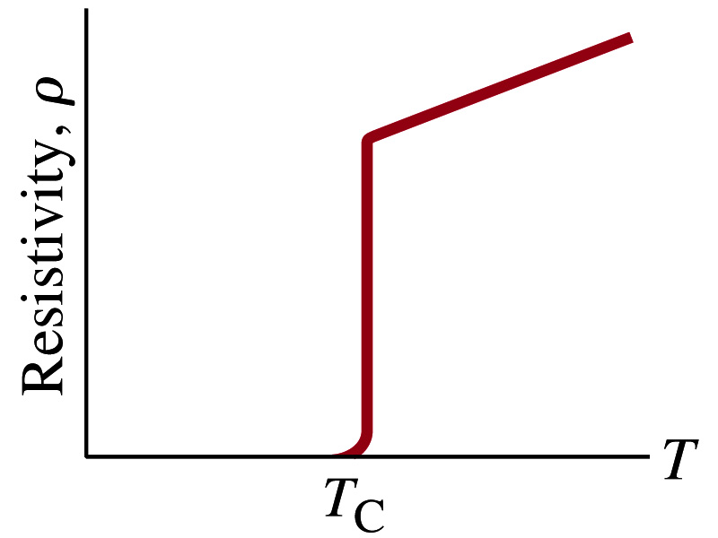
Superconductivity
At the temperature near absolute 0K, resistivity of certain material becomes 0.
  This state is called the “superconducting” state.
  Observed in 1911 by H. K. Onnes when he cooled mercury to 4.2K (-269ºC).
    Resistance of mercury suddenly dropped to 0.
  In general superconducting materials become superconducting below a transition temperature (T_{c}).
  The highest temperature superconductivity seen is 160K
    First observation above the boiling temperature of liquid nitrogen is in 1986 at 90k observed from a compound of yttrium, barium, copper and oxygen.
Since much smaller amount of material can carry just as much current more efficiently, superconductivity can make electric cars more practical, computers faster, and capacitors store higher energy

Slide 12
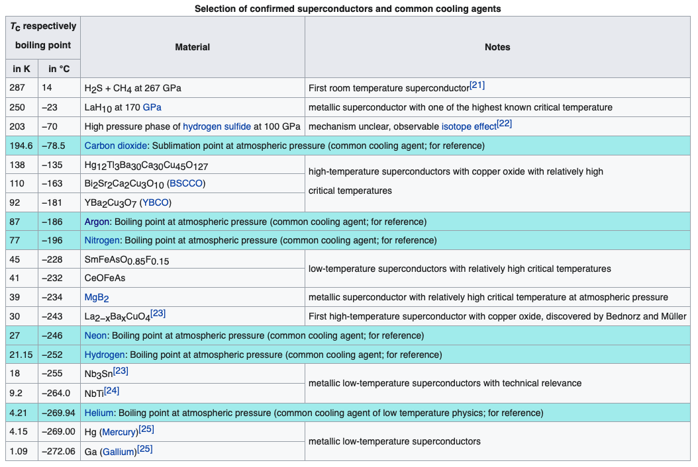
Critical Temperature of Superconductors
@p=267GPa
Oct. 14, 2020

Slide 13
Some Devices with Super-conductor
LHC Dipole
Future Circular Collider Dipole
LHC Dipole being installed

Slide 14
Electric Hazards: Leakage Currents
How does one feel shock by electricity?
  Electric current stimulates nerves and muscles, and we feel a shock
  The severity of the shock depends on the amount of current, how long it acts and through what part of the body it passes
  Electric current heats the tissue and can cause burns
Currents above 70mA on a torso for a second or more is fatal, causing heart to function irregularly, “ventricular fibrillation”.
  Tissue is burn above 5A current
  See http://www.elcosh.org/document/1624/888/d000543/section2.html
A dry human body between two points on the opposite side of the body is about 10⁴ to 10⁶ Ω.
But when wet, it could be 10³Ω.
A person in good contact with the ground who touches 120V DC line with wet hands can get the current:
  Could be lethal

Slide 15
EMF and Terminal Voltage
What do we need to have a current in an electric circuit?
  A device that provides a potential difference, such as a battery or a generator
    They normally convert some types of energy into the electric energy
    These devices are called source of electromotive force (emf)
      This is does NOT refer to a real “force”.
The potential difference between the terminals of an emf source, when no current flows to an external circuit, is called the emf (E) of the source.
The battery itself has some internal resistance (r), however, due to the flow of charges in the electrolyte
  Why does the headlight dim when you start the car?
    The starter needs a large amount of current but the battery cannot provide charge fast enough to supply current to both the starter and the headlight

Slide 16
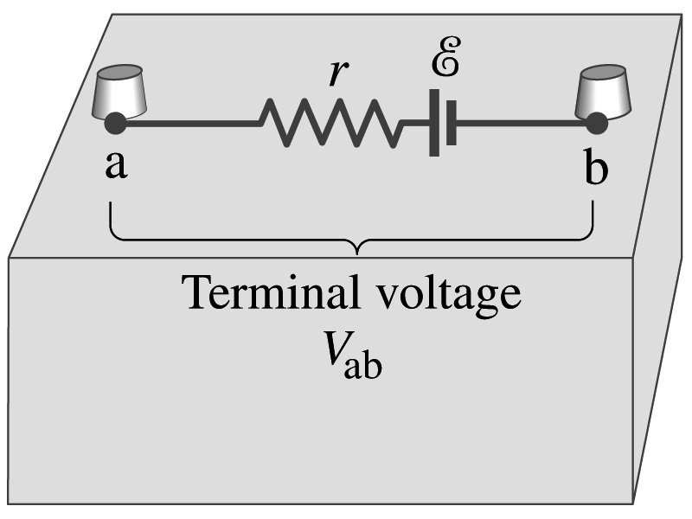
EMF and Terminal Voltage
Since the internal resistance is inside the battery, we can never separate them out.
The terminal voltage difference is V_{ab}=V_{a}-V_{b}.
When no current is drawn from the battery, the terminal voltage equals the emf which is determined by the chemical reaction; V_{ab}= E.
However when the current I flows naturally from the battery, there is a voltage drop due to the internal resistance which is equal to Ir. Thus the actual delivered terminal voltage is

Slide 17
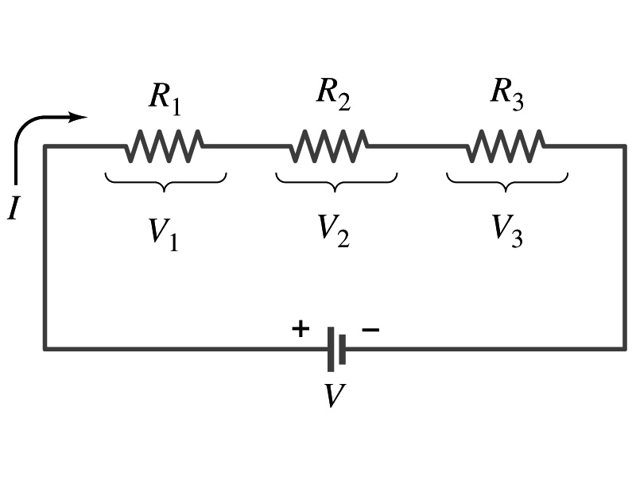
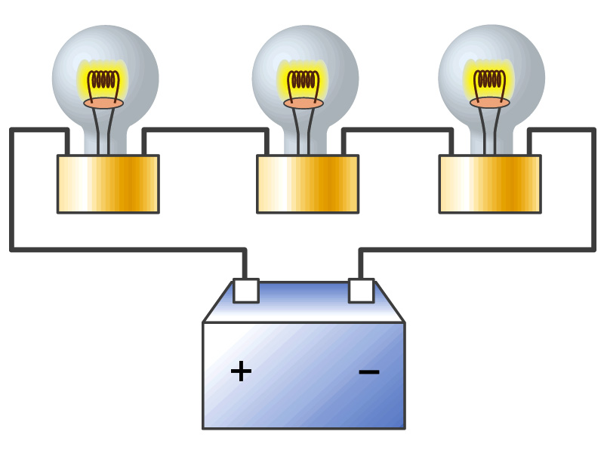
Resistors in Series
Resistors are in series when two or more resistors are connected end to end
  These resistors represent simple resistors in a circuit of electric devices, such as light bulbs, heaters, dryers, etc
What is common in a circuit connected in series?
  The current is the same through all the elements in series
Potential difference across every element in the circuit is
  V₁=IR₁, V₂=IR₂ and V₃=IR₃
Since the total potential difference is V, we obtain
  V=IR_{eq}=V₁+V₂+V₃=I(R₁+R₂+R₃)
  Thus, R_{eq}=R₁+R₂+R₃
Resistors in series
When resistors are connected in series, the total resistance increases and the current decreases.

Slide 18
Energy Losses in Resistors
Why is it true that V=V₁+V₂+V₃?
What is the potential energy loss when charge q passes through resistors R₁, R₂ and R₃
  ΔU₁=qV₁, ΔU₂=qV₂, ΔU₃=qV₃
Since the total energy loss should be the same as the total energy provided to the system, we obtain
  ΔU=qV=ΔU₁+ΔU₂+ΔU₃=q(V₁+V₂+V₃)
  Thus, V=V₁+V₂+V₃

Slide 19
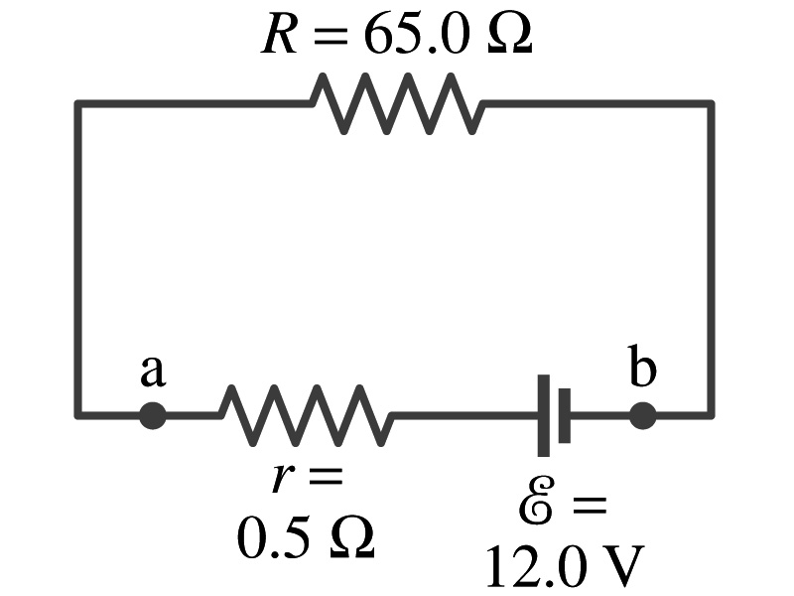
Example 26 – 1
Battery with internal resistance. A 65.0-Ω resistor is connected to the terminals of a battery whose emf is 12.0V and whose internal resistance is 0.5-Ω. Calculate (a) the current in the circuit, (b) the terminal voltage of the battery, V_{ab}, and (c) the power dissipated in the resistor R and in the battery’s internal resistor.
(a) Since
We obtain
What is this?
Solve for I
A battery or a source of emf.
(b) The terminal voltage V_{ab} is
(c) The power dissipated in R and r are

Slide 20
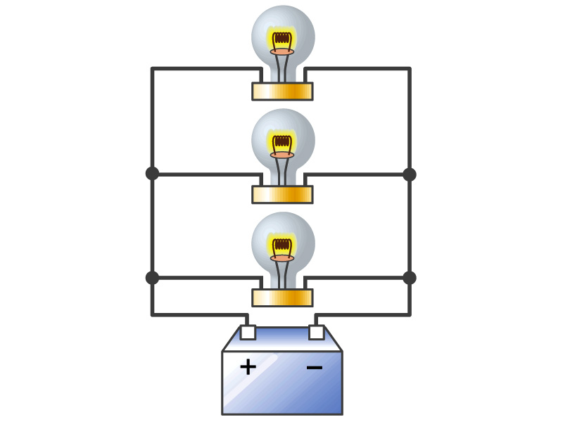
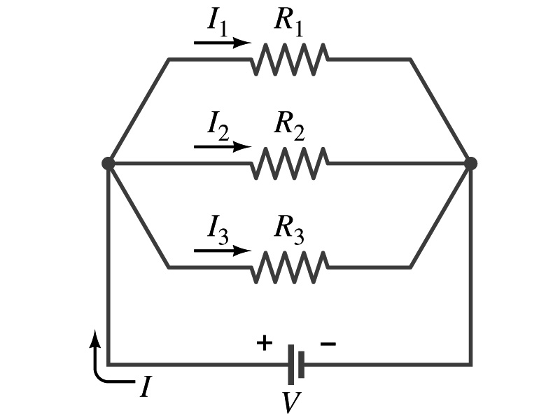
Resistors in Parallel
Resistors are in parallel when two or more resistors are connected in separate branches
  Most the house and building wirings are arranged this way.
What is common in a circuit connected in parallel?
  The voltage is the same across all the resistors.
  The total current that leaves the battery, is however, split.
The current that passes through each element is
  I₁=V/R₁, I₂=V/R₂, I₃=V/R₃
Since the total current is I, we obtain
  I=V/R_{eq}=I₁+I₂+I₃=V(1/R₁+1/R₂+1/R₃)
  Thus, 1/R_{eq}=1/R₁+1/R₂+1/R₃
resistors in parallel
When resistors are connected in parallel, the total resistance decreases and the current increases.

Slide 21
Resistor and Capacitor Arrangements
Parallel Capacitor arrangements
Parallel Resistor arrangements
Series Capacitor arrangements
Series Resistor arrangements

Slide 22
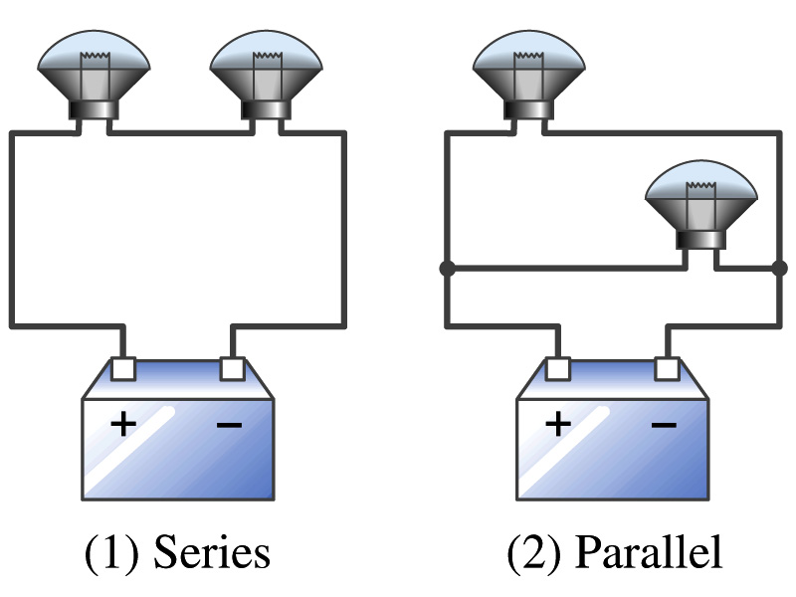
Example 26 – 2
Series or parallel? (a) The light bulbs in the figure are identical and have identical resistance R. Which configuration produces more light? (b) Which way do you think the headlights of a car are wired?
(a) What are the equivalent resistances for the two cases?
Series
Parallel
So
The bulbs get brighter when the total power transformed is larger.
series
parallel
So parallel circuit provides brighter lighting.
(b) Car’s headlights are in parallel to provide brighter lighting and also to prevent both lights going out at the same time when one burns out.
So what is bad about parallel circuits?
Uses more energy in a given time.

Slide 23
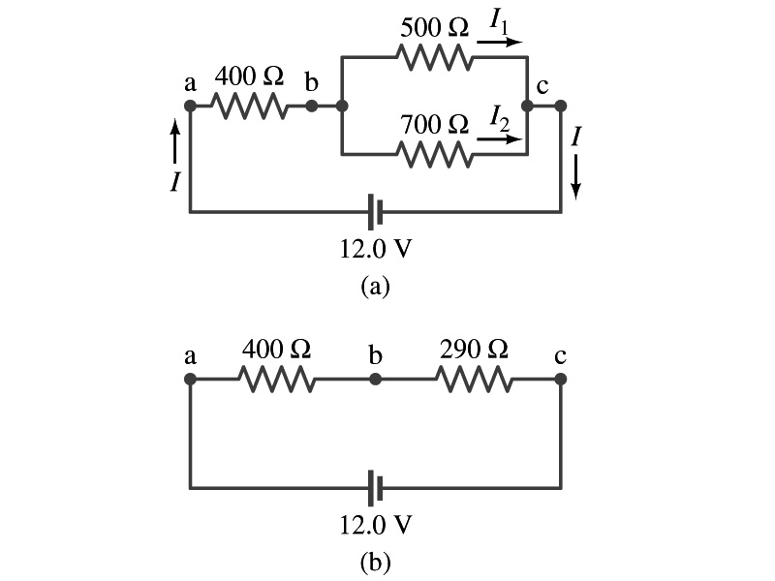
Example 26 – 5
Current in one branch. What is the current flowing through the 500-Ω resistor in the figure?
We need to find the total current.
What do we need to find first?
To do that we need to compute the equivalent resistance.
R_{eq} of the small parallel branch is:
R_{eq} of the circuit is:
Thus the total current in the circuit is
The voltage drop across the parallel branch is
The current flowing across 500-Ω resistor is therefore
What is the current flowing 700-Ω resistor?

