Slide 1
PHYS 1441 – Section 002
Lecture #16
Monday, Nov. 2, 2020
Dr. Jaehoon Yu
CH26
  Kirchhoff’s Rules
  EMFs in Series and Parallel
  RC Circuits
  Charging and Discharging through RC circuit
  Application of RC circuit
CH27
  Electric Current and Magnetism
Today’s homework is homework #9, due 11pm,Tuesday, Nov. 17!!

Slide 2
Announcements
Reminder for reading assignments: CH26 – 7 and CH27.6 – 8
Quiz 3 on Quest
  At the start of the class this Wednesday, Nov. 4
  Covers: CH25.4 – CH26.7
  BYOF: You may bring a one 8.5x11.5 sheet (front and back) of handwritten formulae and values of constants for the exam
  No derivations, word definitions, setups or solutions of any problems, figures, pictures, diagrams or arrows, etc!
  No additional formulae or values of constants will be provided!
  Must send me the photos of front and back of the formula sheet, including the blank, no later than 11am the day of the test
    Once submitted, you cannot change, unless I ask you to delete some part of the sheet!
Those of you with additional COVID-19 questions can send email to Dr. Linda Lee at lindalee.17@gmail.com.
  To ensure that she reads your email, please be sure to use subject: “Questions from Dr. Yu’s student fall20”

Slide 3
SP#5 – Civic Duty II: Election Participation
Election tomorrow, Tuesday, Nov. 3!!
For those with legal voting rights: You can submit three access code green sheet for 20 points total – one your own and two others who voted, 5 points each. Any additional ones will earn 2 points each
For those without legal voting rights: You can submit for the first four access code green sheets for 20 points total, 5 points each and any additional combinations 2 points each.
Be sure to tape one side of the access code (or “I Voted” sticker if the voting was not using an electronic machine) on a sheet of paper with the date, the precinct number, the name of the person voted
None of the stickers can be from the same person on someone else’s extra credit or on your own. All of those with any of the identical persons on your extra credit sheet will get 0 credit.
Deadline: Beginning of the class Monday, Nov. 9

Slide 4

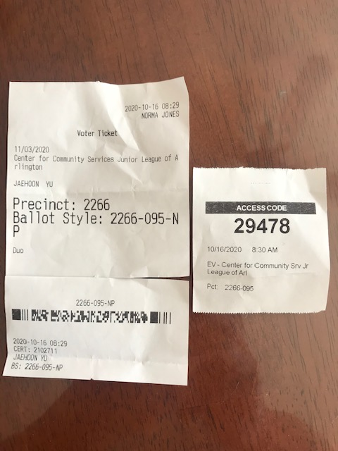
Access code sheet/Sticker
This must be accompanied with date of the vote, the county name, the precinct number, the full name of the person voted and the signature of the person

Slide 5
Resistor and Capacitor Arrangements
Parallel Capacitor arrangements
Parallel Resistor arrangements
Series Capacitor arrangements
Series Resistor arrangements

Slide 6
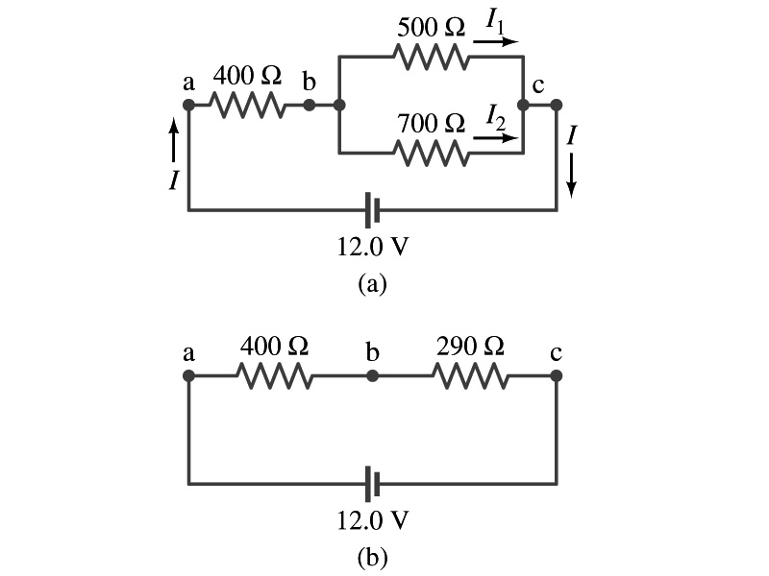
Example 26 – 5
Current in one branch. What is the current flowing through the 500-Ω resistor in the figure?
We need to find the total current.
What do we need to find first?
To do that we need to compute the equivalent resistance.
R_{eq} of the small parallel branch is:
R_{eq} of the circuit is:
Thus the total current in the circuit is
The voltage drop across the parallel branch is
The current flowing across 500-Ω resistor is therefore
What is the current flowing 700-Ω resistor?

Slide 7
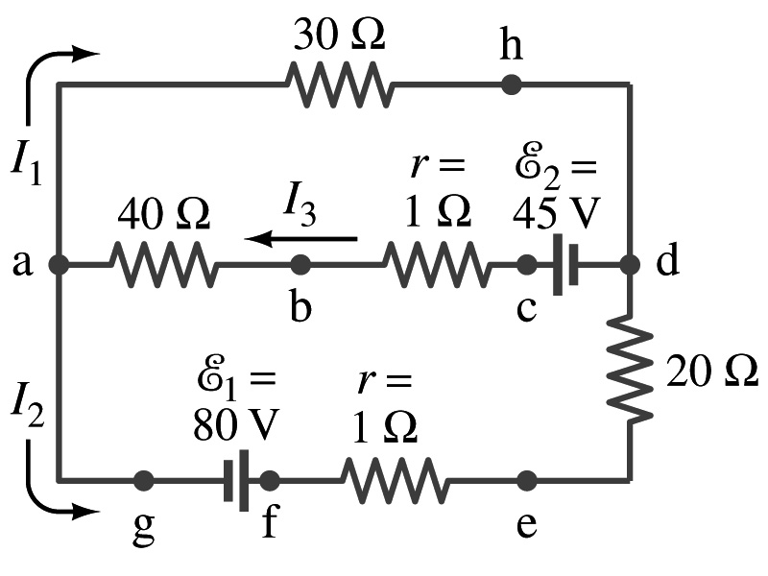
Kirchhoff’s Rules – the 1st Rule
Some circuits are very complicated to do the analysis using the simple combinations of resistors
  G. R. Kirchhoff devised two rules to deal with complicated circuits.
Kirchhoff’s rules are based on conservation of charge and conservation of energy
  Kirchhoff’s 1st rule: The junction rule, charge conservation.
    At any junction point, the sum of all currents entering the junction must equal to the sum of all currents leaving the junction. (poll 5)
    In other words, what goes in must come out.
    At junction a in the figure, I₃ comes into the junction while I₁ and I₂ leaves: I₃ = I₁+ I₂

Slide 8
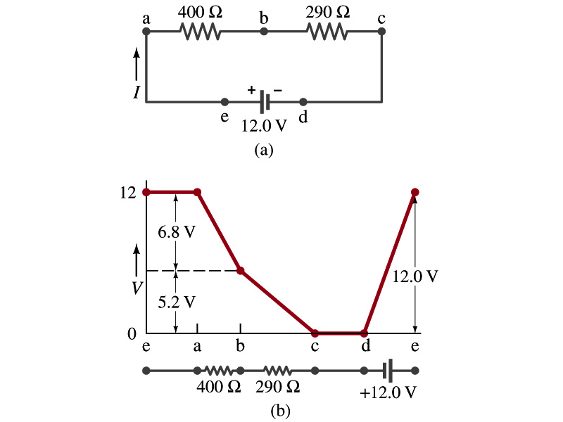
Kirchhoff’s Rules – the 2nd Rule
Kirchoff’s 2nd rule: The loop rule, Conservation of energy
  The sum of the changes in potential in any closed path of a circuit must be zero. (poll 5)
I=12/690=0.017A
The current in the circuit in the figure is .
  Point e is the highest potential point while point d is the lowest potential.
  When the test charge starts at e and returns to e, the total potential change is 0.
  Between point e and a, no potential change since there is no source of potential nor any resistance.
  Between a and b, there is a 400Ω resistance, causing drop.
  Between b and c, there is a 290Ω resistance, causing drop.
  Since these are voltage drops, we use negative sign for these, -6.8V and -5.2V.
  No change between c and d while from d to e there is +12V change.
  Thus the total change of the voltage through the loop is: .
IR=0.017*400=6.8V
IR=0.017*290=5.2V
-6.8V-5.2V+12V=0V

Slide 9
Using Kirchhoff’s Rules
Determine directions of the flow of currents at the junctions and label each and everyone of the currents.
  It does not matter which direction, you decide but keep it!
  If the value of the current after completing the calculations are negative, you just need to flip the direction of the current flow.
Write down the current equation based on Kirchhoff’s 1st rule at various junctions. (based on conservation of? Poll 5)
  Be sure to see if any of equations are the same.
Choose closed loops in the circuit (poll 5)
Write down the potential in each interval of the junctions, keeping the sign properly.
Write down the potential equations for each loop.
Solve the equations for the unknowns.

Slide 10
Example 26 – 9
Use Kirchhoff’s rules. Calculate the currents I₁, I₂ and I₃ in each of the branches of the circuit in the figure.
The directions of the current through the circuit is not known a priori but since the current tends to move away from the positive terminal of a battery, we arbitrarily choose the direction of the currents as shown.
We have three unknowns so we need three equations.
Using Kirchhoff’s junction rule at point a, we obtain
This is the same for junction d as well, so no additional information.
Now the second rule on the loop ahdcba.
The total voltage change in the loop ahdcba is.

Slide 11
Example 26 – 9, cnt’d
Now the second rule on the other loop agfedcba.
The total voltage change in loop agfedcba is.
So the three equations become
We can obtain the three current by solving these equations for I₁, I₂ and I₃.
Do this yourselves!!

Slide 12
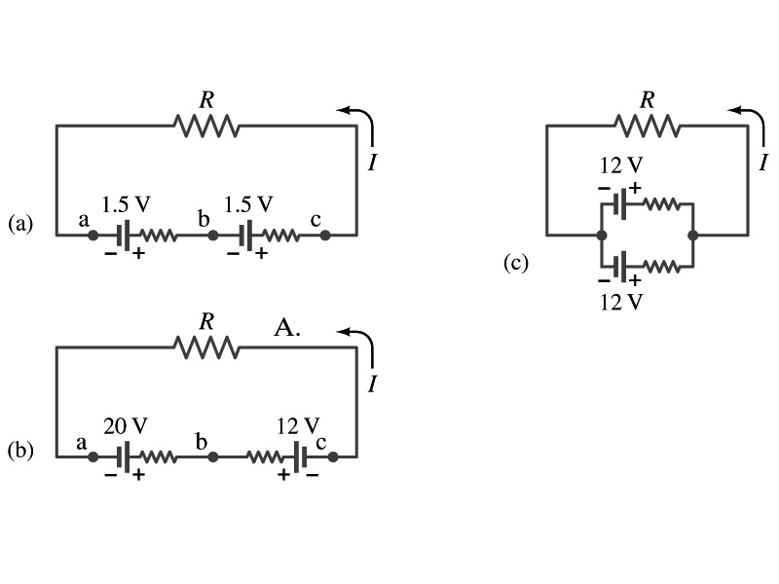
EMFs in Series and Parallel: Charging a Battery
When two or more sources of emfs, such as batteries, are connected in series
  The total voltage is the algebraic sum of their voltages (why? – poll 2), if their direction is the same
    V_{ab}= in figure (a).
  If the batteries are arranged in the opposite direction, the total voltage is the difference between them
1.5+1.5=3.0V
Parallel arrangements (c) are used only to increase currents. An example?
    V_{ac}= in figure (b)
    Connecting batteries in opposite direction is wasteful.
    This, however, is the way a battery charger works.
    Since the 20V battery is at a higher voltage, it forces charges into 12V battery
    Some battery are rechargeable since their chemical reactions are reversible but most the batteries do not reverse their chemical reactions
20 – 12 =8.0V

Slide 13
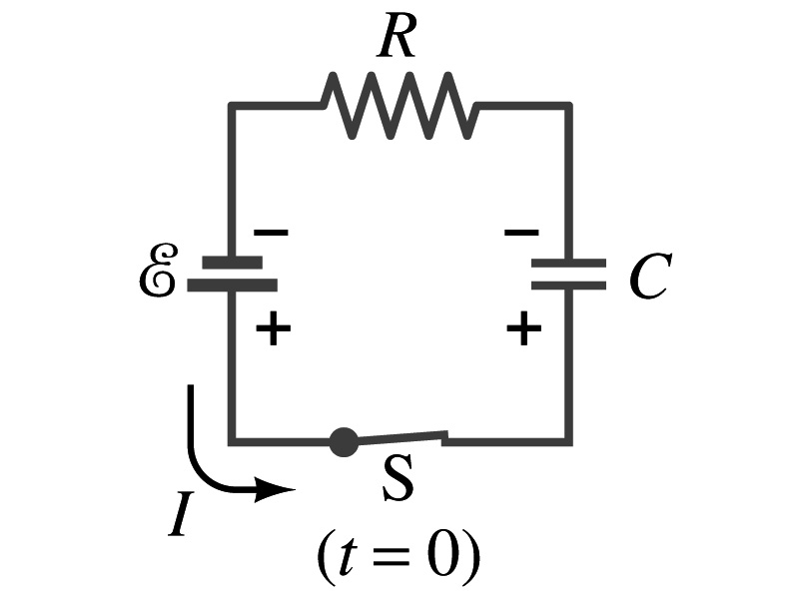
RC Circuits
Circuits containing both resistors and capacitors
  RC circuits are used commonly in everyday life
    Control windshield wiper
    Timing of traffic light from red to green
    Camera flashes and heart pacemakers
How does an RC circuit look?
  There should be a source of emf, capacitors and resisters
What happens when the switch S is closed?
  Current immediately starts flowing through the circuit.
  Electrons flow out of negative terminal of the emf source, through the resister R and accumulates on the upper plate of the capacitor.
  The electrons from the bottom plate of the capacitor will flow into the positive terminal of the battery, leaving only the positive charge on the bottom plate.
  As the charge accumulates on the capacitor plates, the potential difference across it increases
  The current reduces gradually to 0 until the voltage across the capacitor is the same as the emf.
  The charge on the capacitor increases until it reaches to its maximum CE.

Slide 14
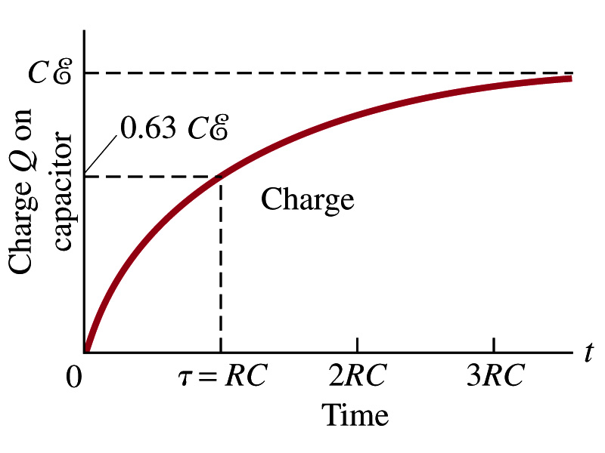
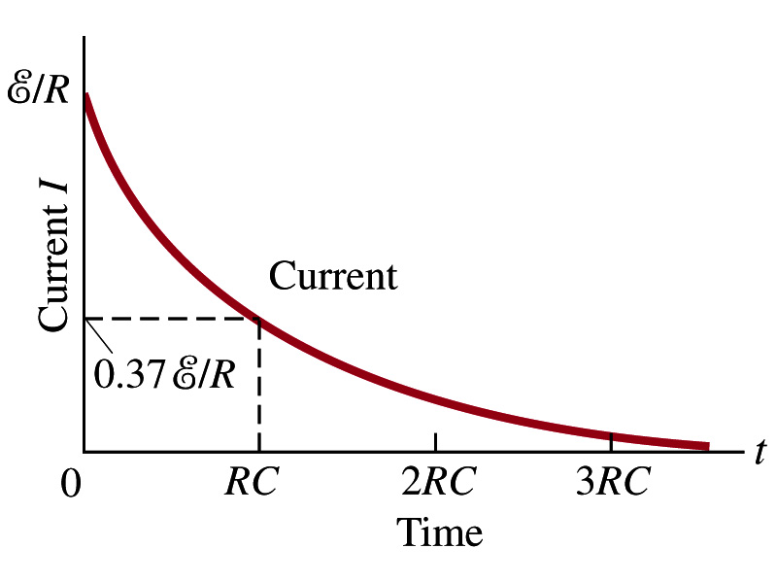
RC Circuits
How does all this look like in graphs?
  The charge and the current on the capacitor as a function of time
  From energy conservation (Kirchhoff’s 2nd rule), the emf E must be equal to the sum of voltage drop across the capacitor and the resister
    E=IR+Q/C
    R includes all resistance in the circuit, including the internal resistance of the battery, I is the current in the circuit at any instance, and Q is the charge of the capacitor at that same instance.

Slide 15
Analysis of RC Circuits
In an RC circuit and
What can we see from the above equations?
  Q and V_{C} increase from 0 at t=0 to maximum value Q_{max}=CE and V_{C}= E.
In how much time?
  The quantity RC is called the time constant of the circuit, τ
    τ=RC, What is the unit? (poll 1)
  What is the physical meaning? (calculate!)
    The time required for the capacitor to reach (1 - e⁻¹)=0.63 or 63% of the full charge
The current is
Sec.

Slide 16
Example 26 – 12
RC circuit, with emf. The capacitance in the circuit of the figure is C=0.30μF, the total resistance is 20kΩ, and the battery emf is 12V. Determine (a) the time constant, (b) the maximum charge the capacitor could acquire, (c) the time it takes for the charge to reach 99% of this value, (d) the current I when the charge Q is half its maximum value, (e) the maximum current, and (f) the charge Q when the current I is 0.20 its maximum value.
(a) Since
We obtain
(b) Maximum charge is
(c) Since
For 99% we obtain
(d) Since
We obtain
The current when Q is 0.5Q_{max}
(e) When is I maximum?
when Q=0:
(f) What is Q when I=120μA?

