Slide 1
PHYS 1441 – Section 002
Lecture #17
Wednesday, Nov. 4, 2020
Dr. Jaehoon Yu
CH26
  Discharging through RC circuit
  Application of RC circuit
CH27
  Electric Current and Magnetism
  Magnetic Force on Electric Current
  Magnetic Force on a Moving Charge

Slide 2
Announcements
Reading assignments: CH27.6 – 8
2nd Non-comprehensive exam on Quest
  At the start of the class next Wednesday, Nov. 11
  Covers: CH25.1 – What we finish coming Monday, Nov. 9
  BYOF: You may bring a one 8.5x11.5 sheet (front and back) of handwritten formulae and values of constants for the exam
  No derivations, word definitions, setups or solutions of any problems, figures, pictures, diagrams or arrows, etc!
  No additional formulae or values of constants will be provided!
  Must send me the photos of front and back of the formula sheet, including the blank, no later than 11am the day of the test
    Once submitted, you cannot change, unless I ask you to delete some part of the sheet!

Slide 3
SP#5 – Civic Duty II: Election Participation
Election is over! Deadline: 1pm, Monday, Nov. 9
For those with legal voting rights: You can submit three access code green sheet for 20 points total – one your own and two others who voted, 5 points each. Any additional ones will earn 2 points each
For those without legal voting rights: You can submit for the first four access code green sheets for 20 points total, 5 points each and any additional combinations 2 points each.
Be sure to tape one side of the access code (or “I Voted” sticker if the voting was not using an electronic machine) on a sheet of paper with the date, the precinct number, the name of the person voted
None of the stickers can be from the same person on someone else’s extra credit or on your own. All of those with any of the identical persons on your extra credit sheet will get 0 credit.
Deadline: Beginning of the class Monday, Nov. 9

Slide 4
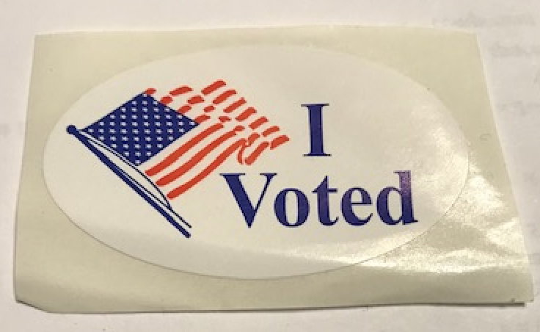
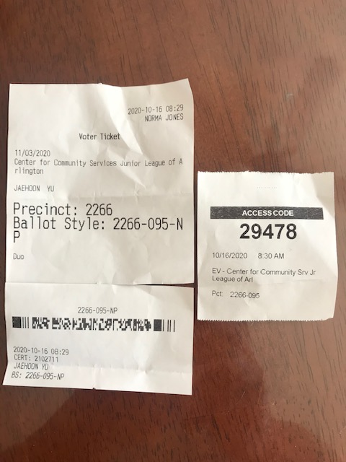
Access code sheet/Sticker
This must be accompanied with date of the vote, the county name, the precinct number, the full name of the person voted and the signature of the person

Slide 5
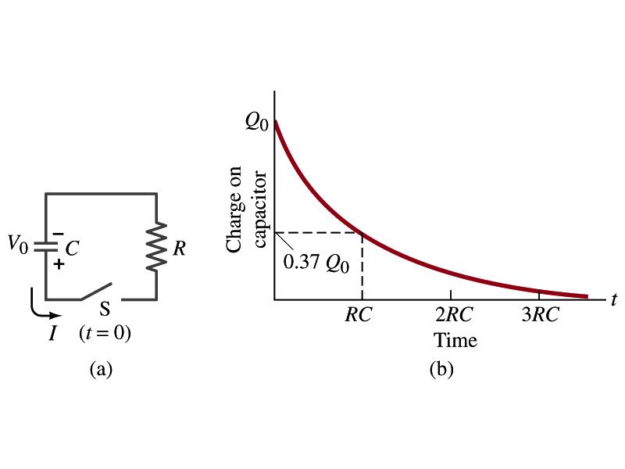
Discharging RC Circuits
When a capacitor is already charged, it is allowed to discharge through a resistance R.
  When the switch S is closed, the voltage across the resistor at any instant equals that across the capacitor. Thus IR=Q/C.
  The rate at which the charge leaves the capacitor equals the negative of the current flows through the resistor
    I= - dQ/dt
    This is because the current is leaving the capacitor
  Then the voltage equation becomes a differential equation
Rearrange terms

Slide 6
Discharging RC Circuits
  Now, let’s integrate from t=0 when the charge is Q₀ to t when the charge is Q
  The result is
  Thus, we obtain
  What does this tell you about the charge on the capacitor?
    It decreases exponentially w/ time at the time constant RC
    Just like the case of charging
  The current is:
    The current also decreases exponentially w/ time w/ the time constant RC
What is this?

Slide 7
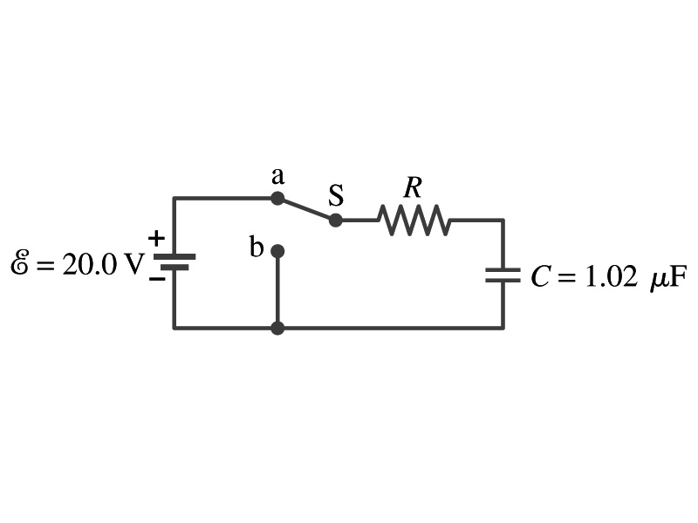
Example 26 – 13
Discharging RC circuit. In the RC circuit shown in the figure the battery has fully charged the capacitor, so Q₀=CE. Then at t=0, the switch is thrown from position a to b. The battery emf is 20.0V, and the capacitance C=1.02μF. The current I is observed to decrease to
0.50 of its initial value in 40μs. (a) what is the value of R? (b) What is the value of Q, the charge on the capacitor, at t=0? (c) What is the value of Q at t=60μs?
(a) Since the current reaches to 50% of its initial value in 40μs, we can obtain
For 0.5I₀
Rearrange terms
Solve for R
(b) The value of Q at t=0 is
(c) What do we need to know first for the value of Q at t=60μs?
The RC time
Thus

Slide 8
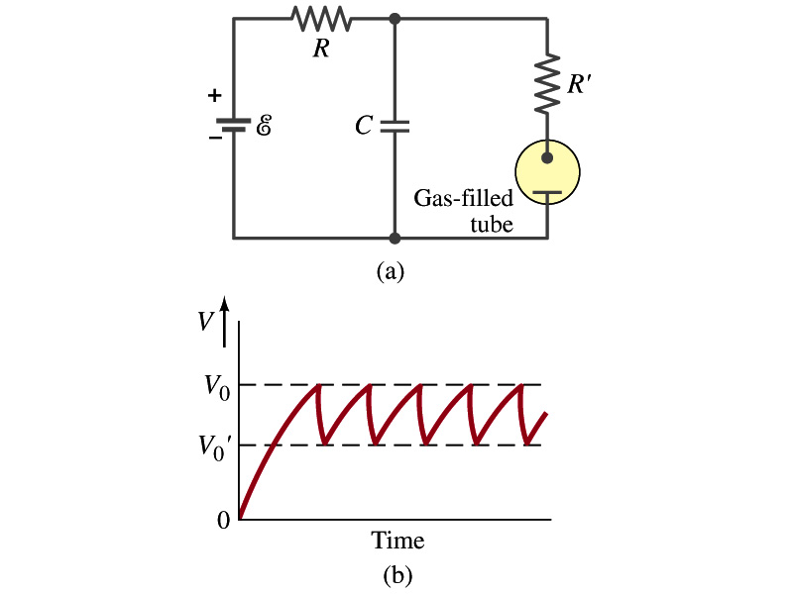
Application of RC Circuits
What do you think the charging and discharging characteristics of RC circuits can be used for?
  To produce voltage pulses at a regular frequency
  How?
    The capacitor charges up to a particular voltage and discharges
    A simple way of doing this is to use breakdown of voltage in a gas filled tube
      The discharge occurs when the voltage breaks down at V₀
      After the completion of discharge, the tube no longer conducts
      Then the voltage is at V₀’ and it starts charging up
      How do you think the voltage as a function of time look?
        A sawtooth shape
    Pacemaker, intermittent windshield wiper, etc

Slide 9
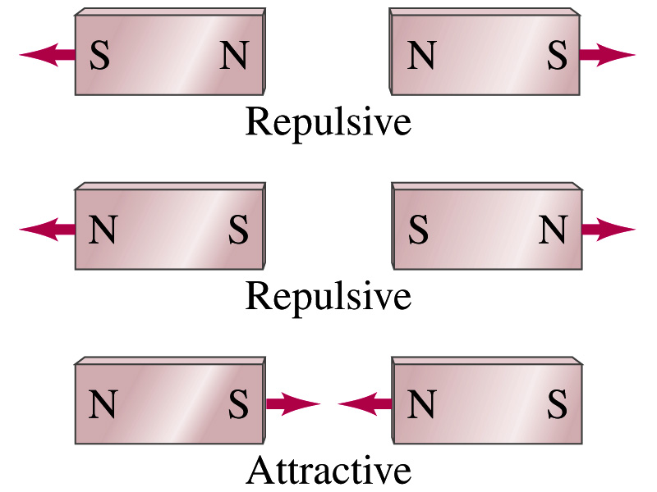
Magnetism
What are magnets?
  Objects with two poles, North and South poles
    The pole that points to the geographical North is the North pole and the other is the South pole
      Principle of compass
  These are called the magnet due to the name of the region, Magnesia, where the rocks that attract each other were found
What happens when two magnets are brought to each other?
  They exert force onto each other
  What kind?
  Both repulsive and attractive forces depending on the configurations
    Like poles repel each other while the unlike poles attract

Slide 10
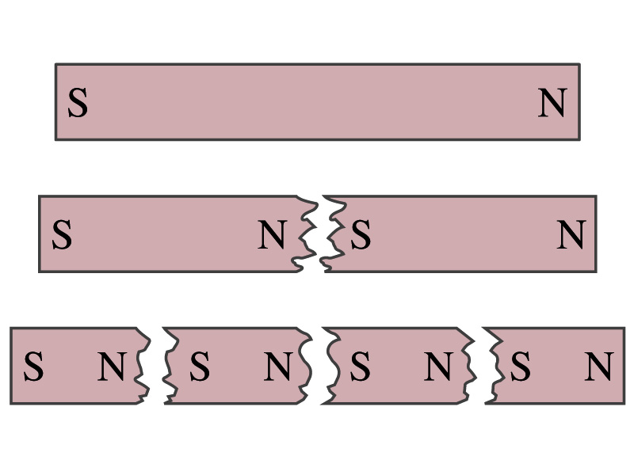
Magnetism
So the magnetic poles are the same as the electric charge? (poll 14)
  No. Why not?
  While the electric charges (positive and negative) can be isolated, the magnetic poles cannot be isolated.
  So what happens when a magnet is cut?
    If a magnet is cut, two magnets are made.
    The more they get cut, the more magnets are made
  Single pole magnet is called the monopole but it has not been seen yet
Ferromagnetic materials: Materials that show strong magnetic effects
  Iron, cobalt, nickel, gadolinium and certain alloys
Other materials show very weak magnetic effects

Slide 11
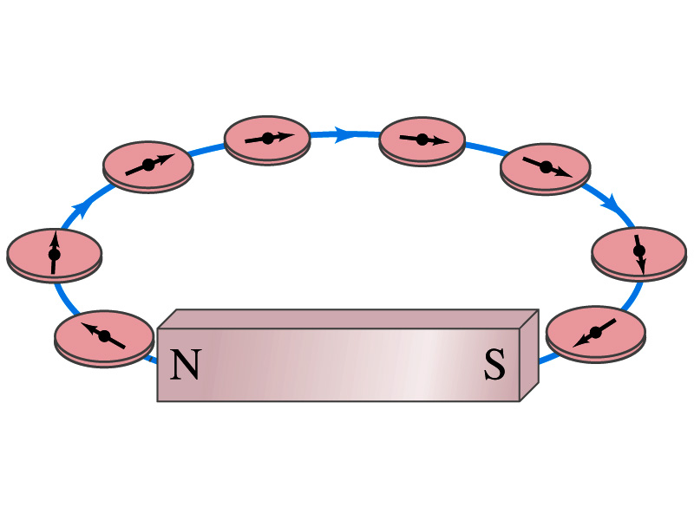
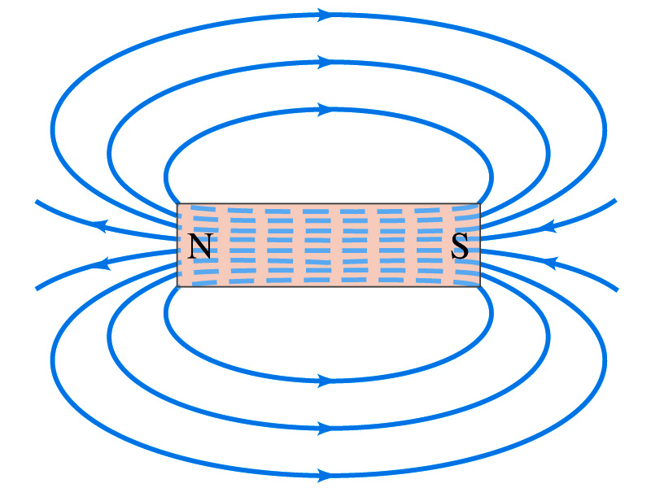
Magnetic Field
Just like the electric field that surrounds electric charge, the magnetic field surrounds a magnet
What does this mean?
  Magnetic force is also a field force
  The force one magnet exerts onto another can be viewed as the interaction between the magnet and the magnetic field produced by the other magnet
  What kind of quantity is the magnetic field? (poll 2)
So one can draw magnetic field lines, too.
Vector
  The direction of the magnetic field is tangential to the field line at any point
  The direction of the field is the direction the north pole of a compass would point to; out of N and into S
  The number of lines per unit area is proportional to the strength of the magnetic field
  Magnetic field lines continue inside the magnet
  Since magnets always have both the poles, magnetic field lines form closed loops unlike electric field lines

