Slide 1
PHYS 1441 – Section 002
Lecture #19
Monday, Nov. 16, 2020
Dr. Jaehoon Yu
CH27
  Cyclotron Frequency
  Torque on a Current Loop
  Magnetic Dipole Moment
CH28
  Source of Magnetic Field
  Magnetic Field Due to a Straight Wire
  Ampere’s Law
Today’s homework is homework #10, due 11pm,Tuesday, Dec. 1!!

Slide 2
Announcements
Reading assignments: CH28.6 – 10
The final exam date and time
  11am – 12:20pm, 80min, Wed. Dec. 16
  No class Monday, Dec. 14
Term 2 results
  Class average: 62.2/104 equivalent to 58.5/100
    Previous quizzes: 65.7/100 and 58.6/100
  Top score: 104/104

Slide 3
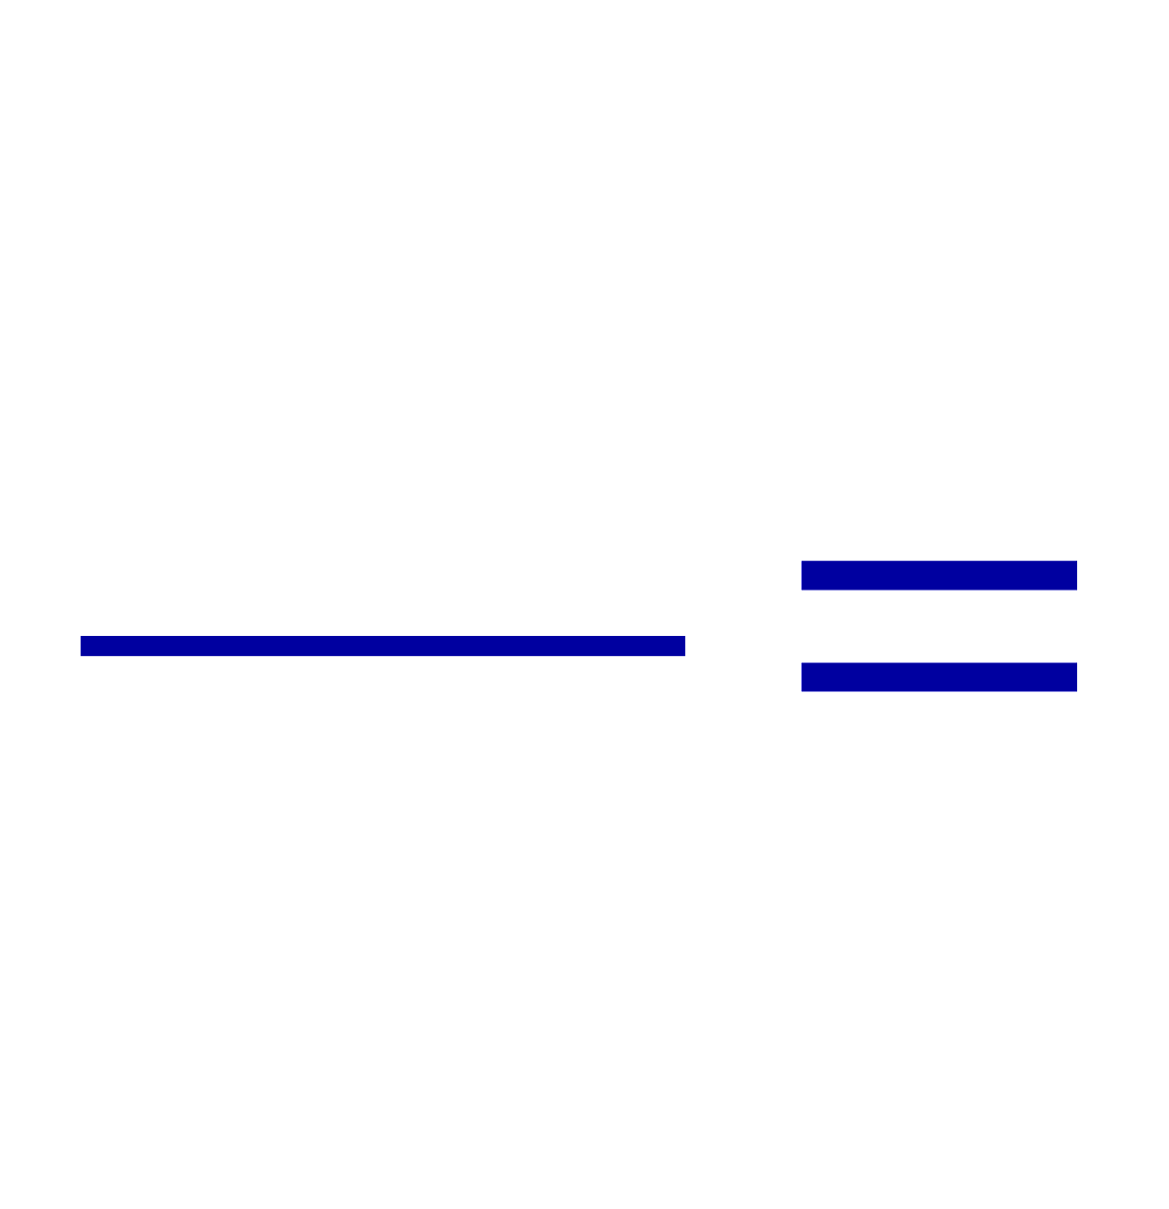
Example 27 – 7
Electron’s path in a uniform magnetic field. An electron travels at the speed of 2.0x10⁷m/s in a plane perpendicular to a 0.010-T magnetic field. What is the radius of the electron’s path?
What is formula for the centripetal force?
Since the magnetic field is perpendicular to the motion of the electron, the magnitude of the magnetic force is
Since the magnetic force provides the centripetal force, we can establish an equation with the two forces
Solving for r

Slide 4
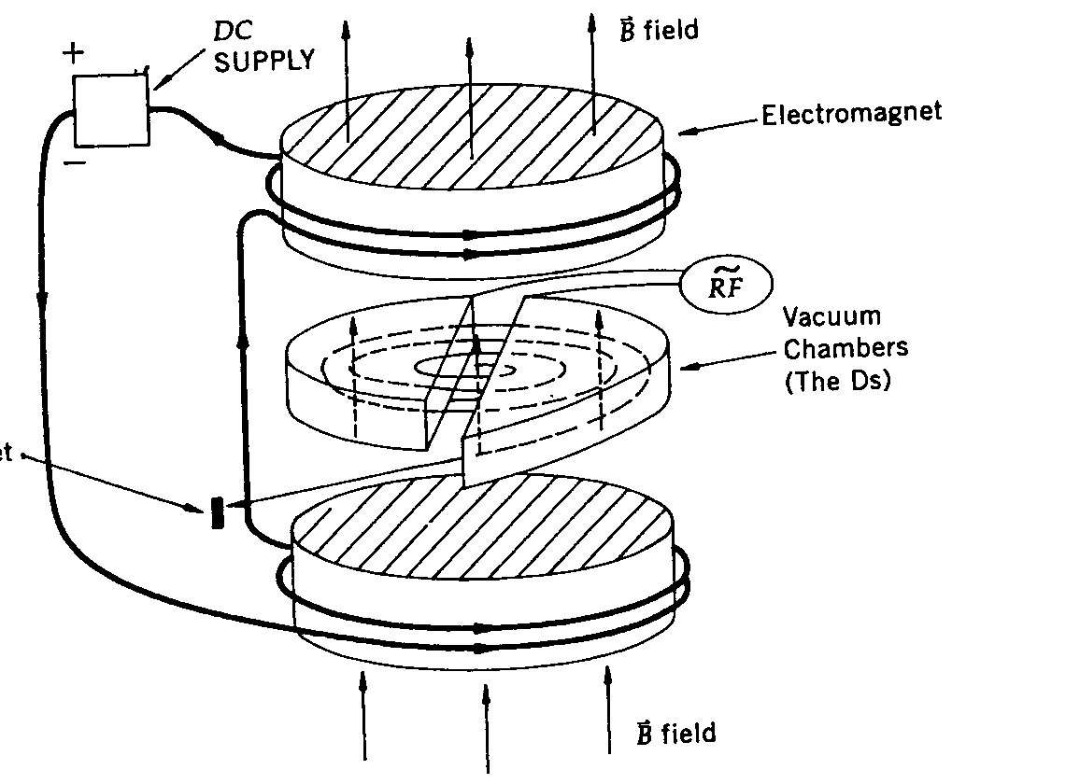
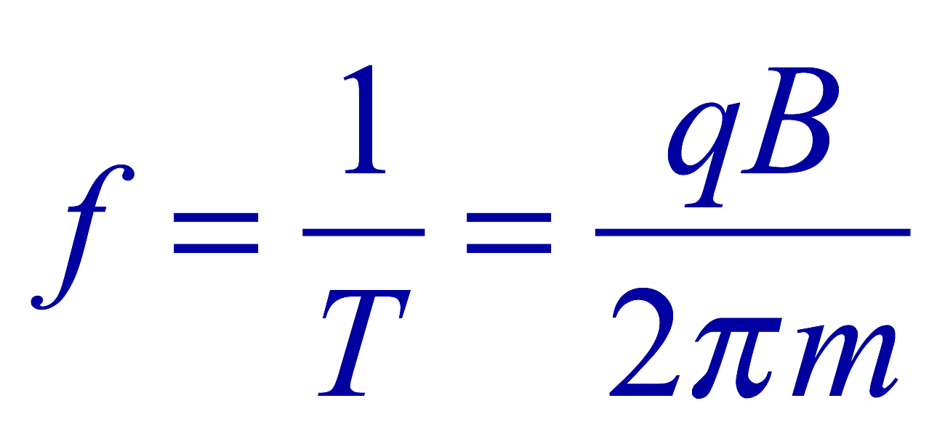
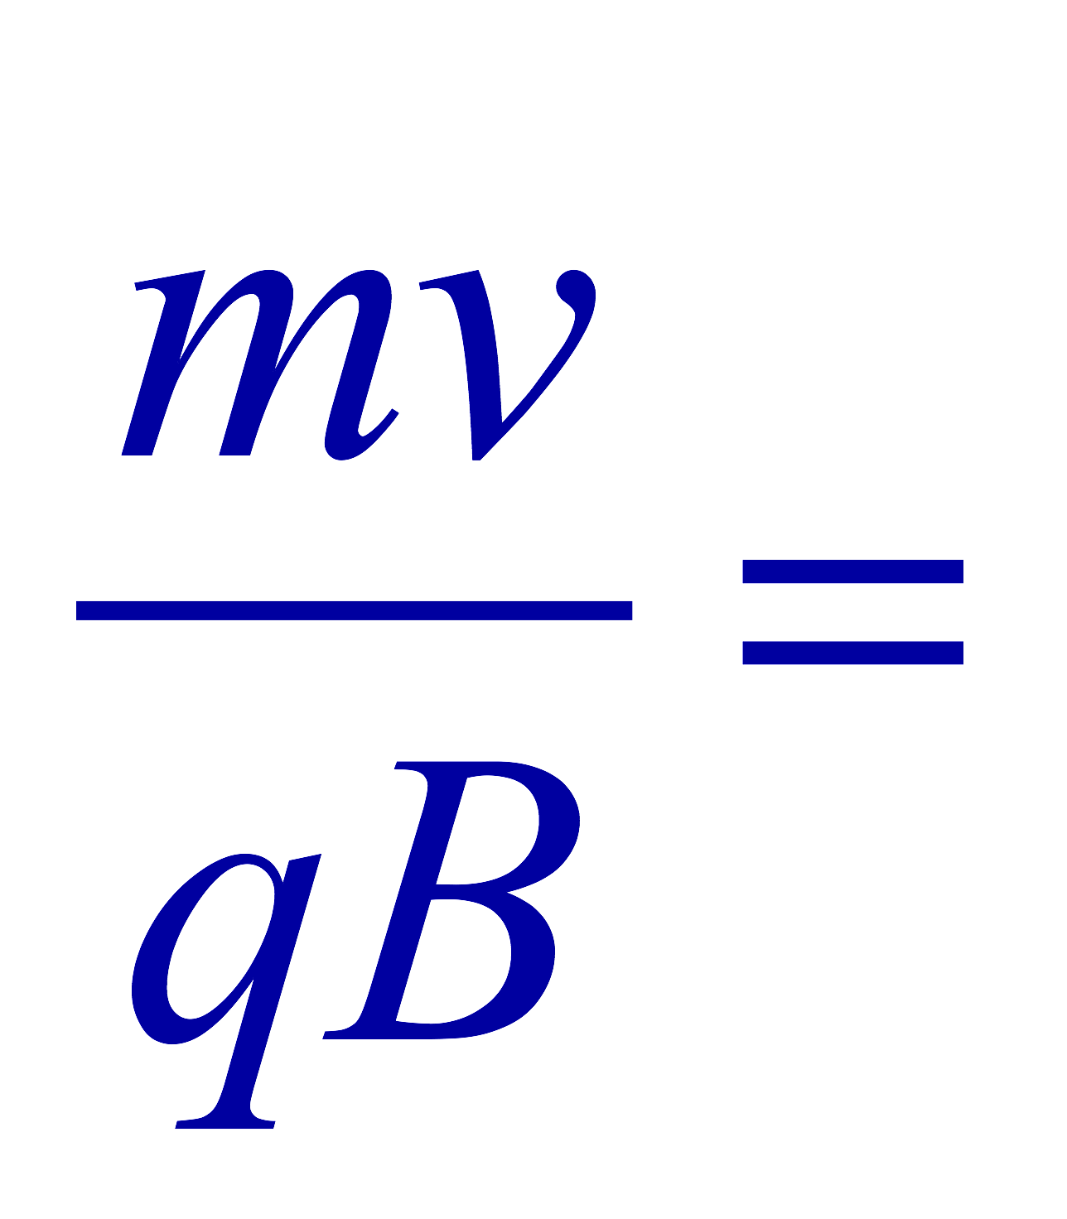
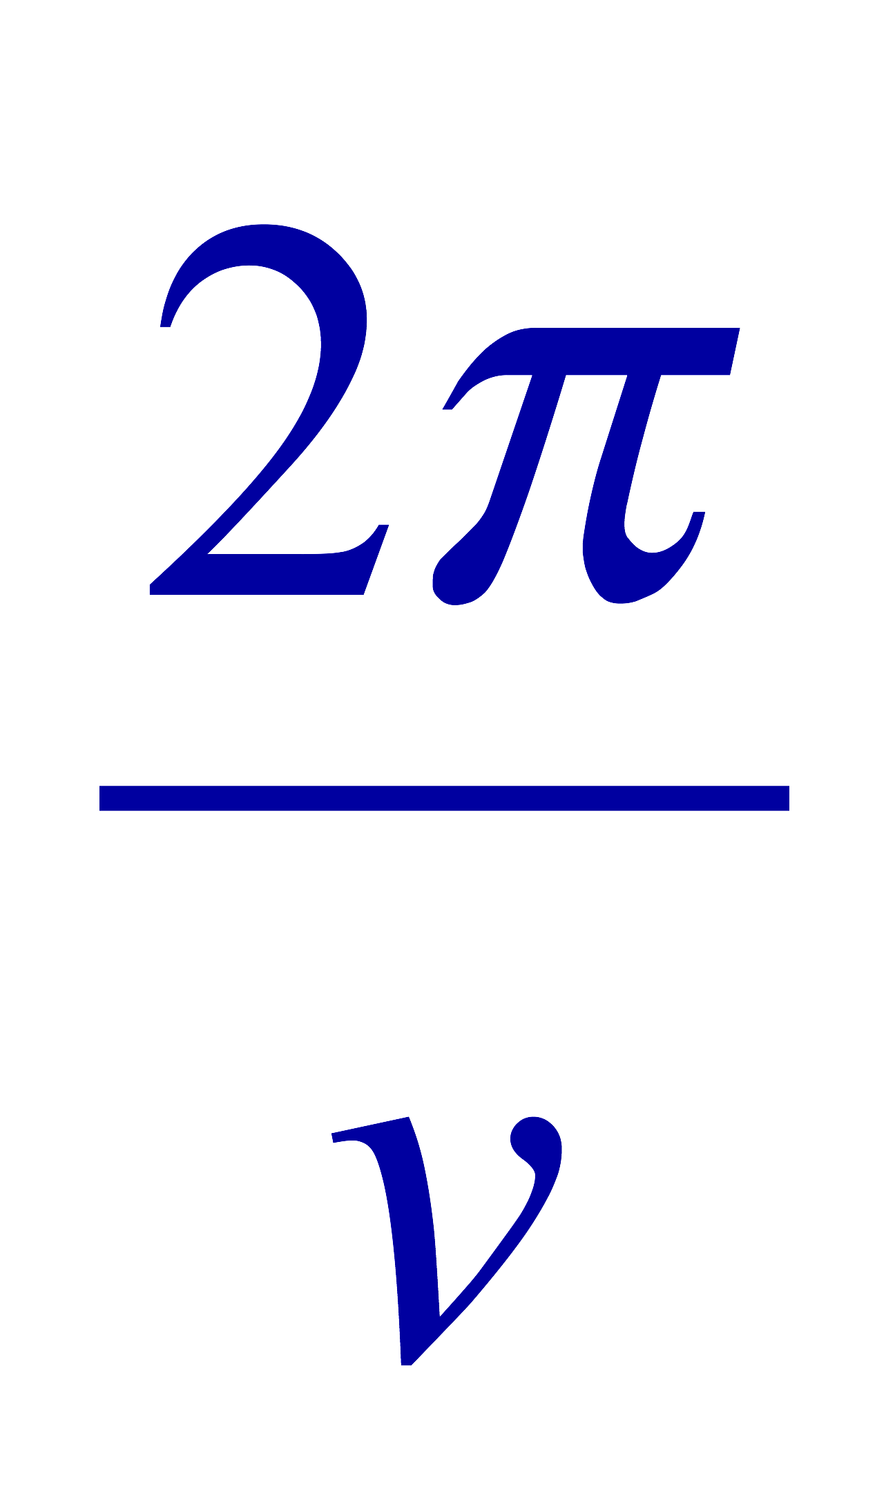
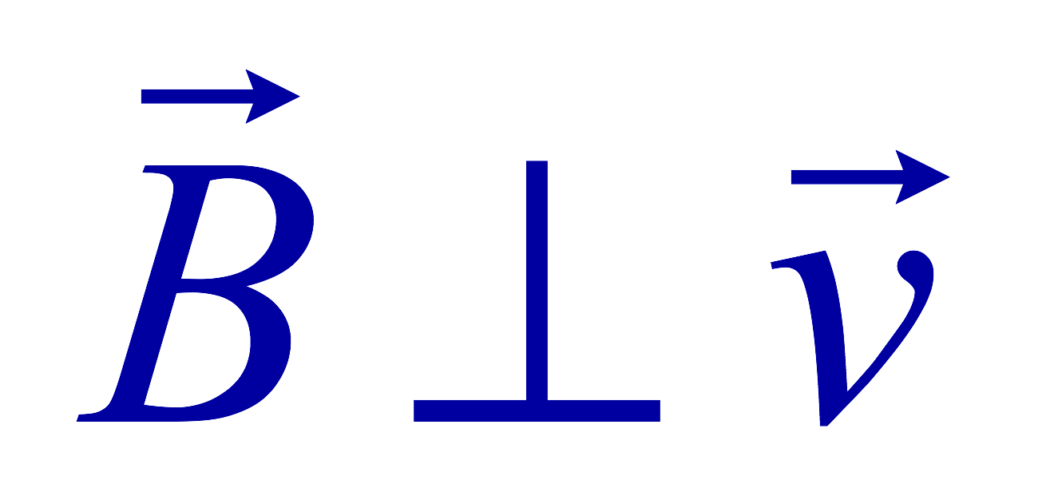
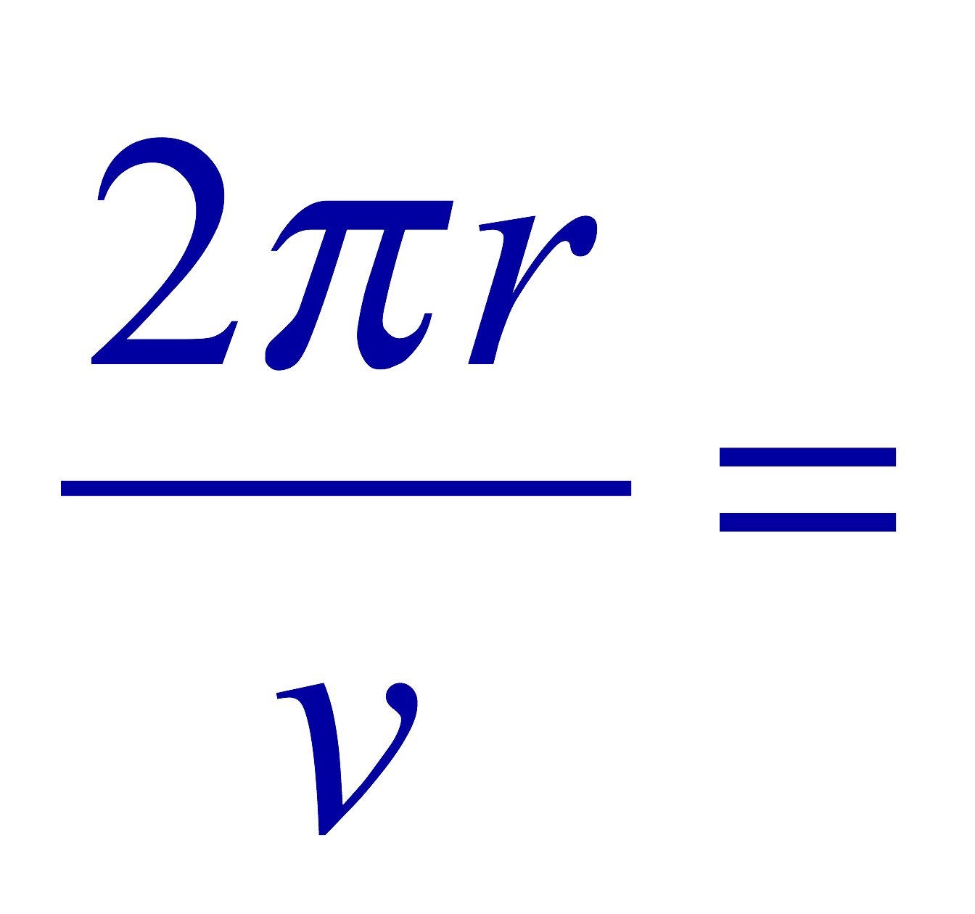
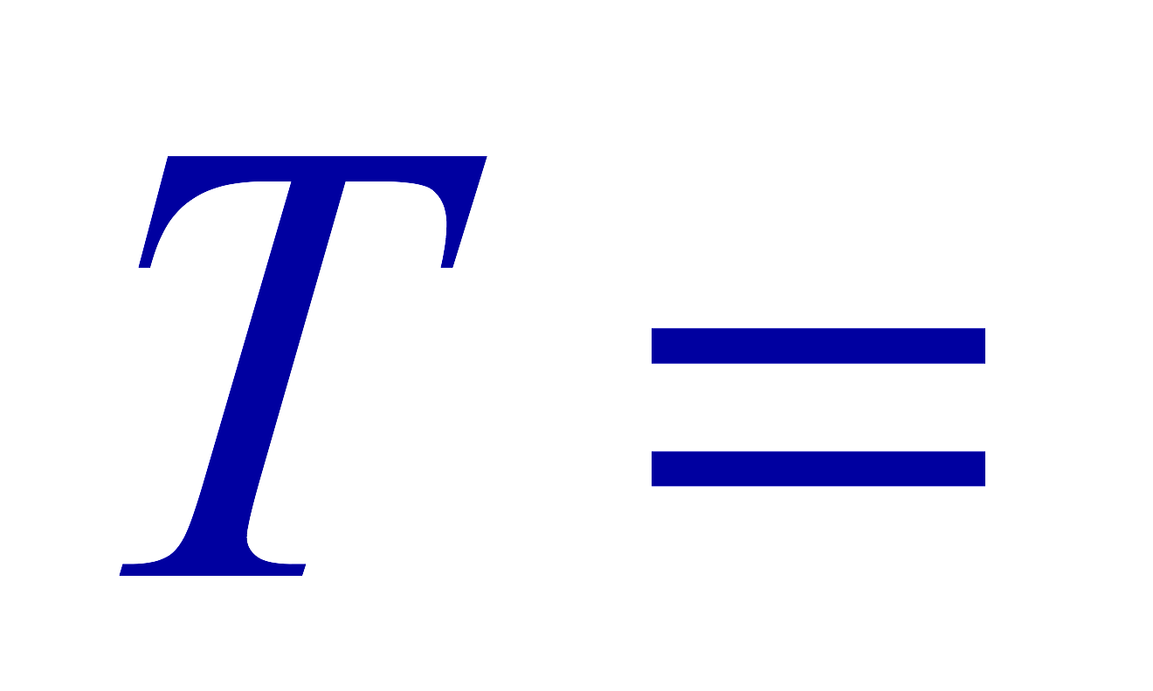
Cyclotron Frequency
The time required for a particle of charge q moving w/ a constant speed v to make one circular revolution in a uniform magnetic field, , is
Since T is the period of rotation, the frequency of the rotation is
This is the cyclotron frequency, the frequency of a particle with charge q in a cyclotron accelerator
  While r depends on v, the frequency is independent of v and r.

Slide 5
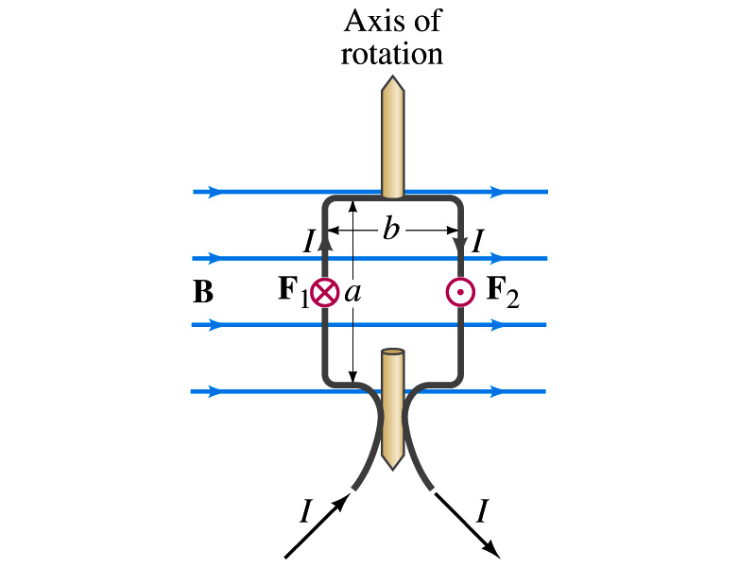
Torque on a Current Loop
What do you think will happen to a closed rectangular loop of wire with an electric current as shown in the figure?
  It will rotate! Why?
  The magnetic field exerts force on both vertical sections of wire.
  Where is this principle used in?
    Ammeters, motors, volt-meters, speedometers, etc
The two forces on the different sections of the wire exerts net torque in the same direction about the rotational axis along the symmetry axis of the wire.
What happens when the wire? (Poll 20)
  It will not turn beyond 90 degrees without changing current direction

Slide 6
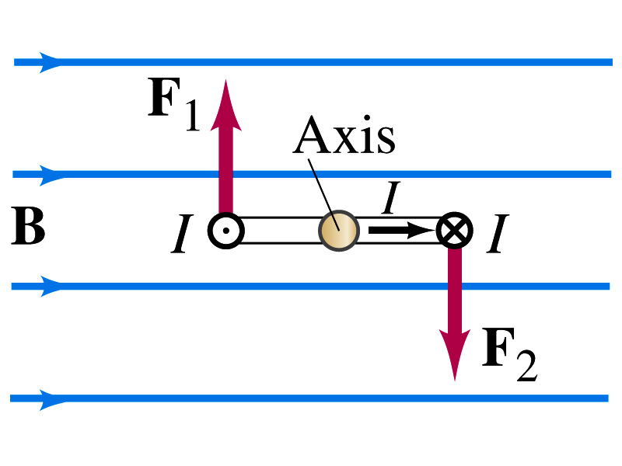
Torque on a Current Loop
So what would be the magnitude of this torque?
  What is the magnitude of the force on the section of the wire with length a?
    F_{a}=IaB
    The moment arm of the coil is b/2
  So the total torque is the sum of the torques by each of the forces
    Where A=ab is the area of the coil loop
  What is the total net torque if the coil consists of N loops of wire?
  If the coil makes an angle θ w/ the field

Slide 7
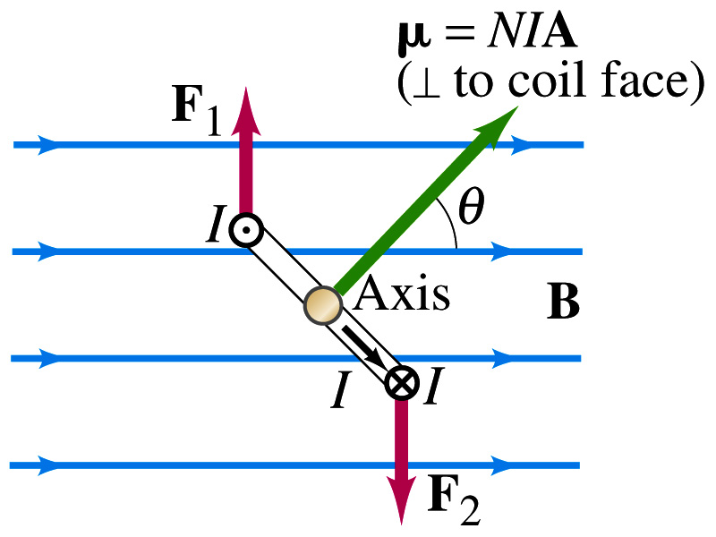
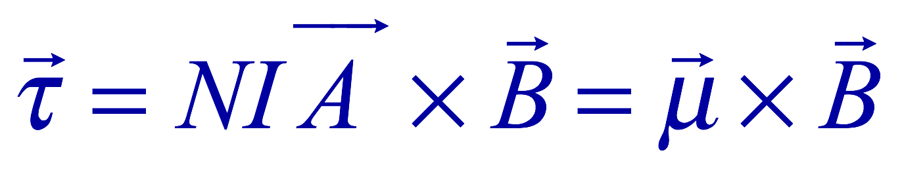
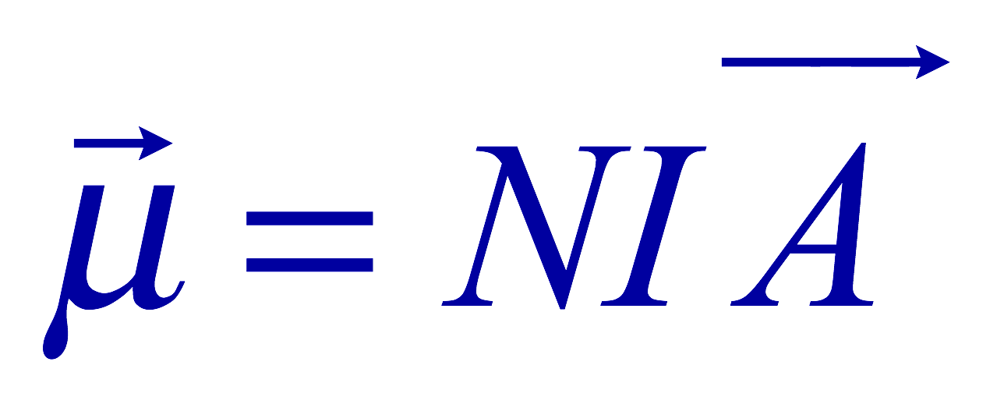
Magnetic Dipole Moment
The formula derived in the previous page for a rectangular coil is valid for any shape of the coil
The quantity NIA is called the magnetic dipole moment of the coil (Poll 2)
  It is a vector quantity
  Its direction is the same as that of the area vector A and is perpendicular to the plane of the coil consistent with the right-hand rule
      When your fingers cup around the loop in the same direction as the current, your thumb points to the direction of the magnetic moment
  The tendency of an object to interact with an external magnetic field
  Using the definition of magnetic moment, the torque can be rewritten in vector form

Slide 8
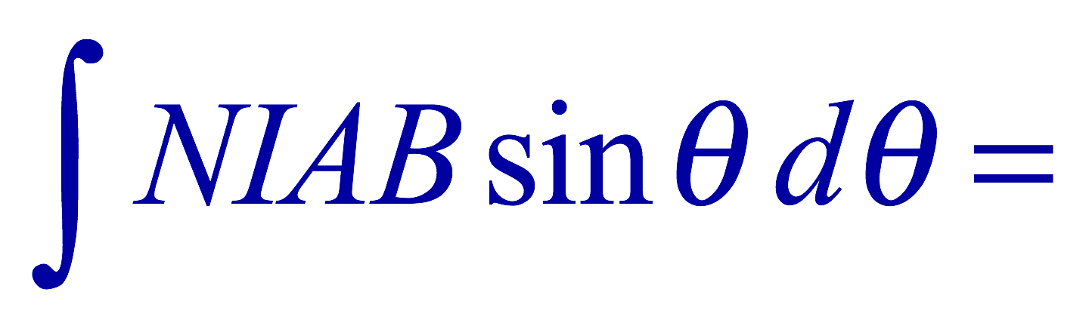
Magnetic Dipole Potential Energy
Where else did you see the same form of the torque?
  Remember the torque due to electric field on an electric dipole?
  The potential energy of the electric dipole is
How about the potential energy of a magnetic dipole?
  The work done by the torque is
  If we chose U=0 at θ=π/2, then C=0
  Thus the potential energy is
    Very similar to the electric dipole

Slide 9
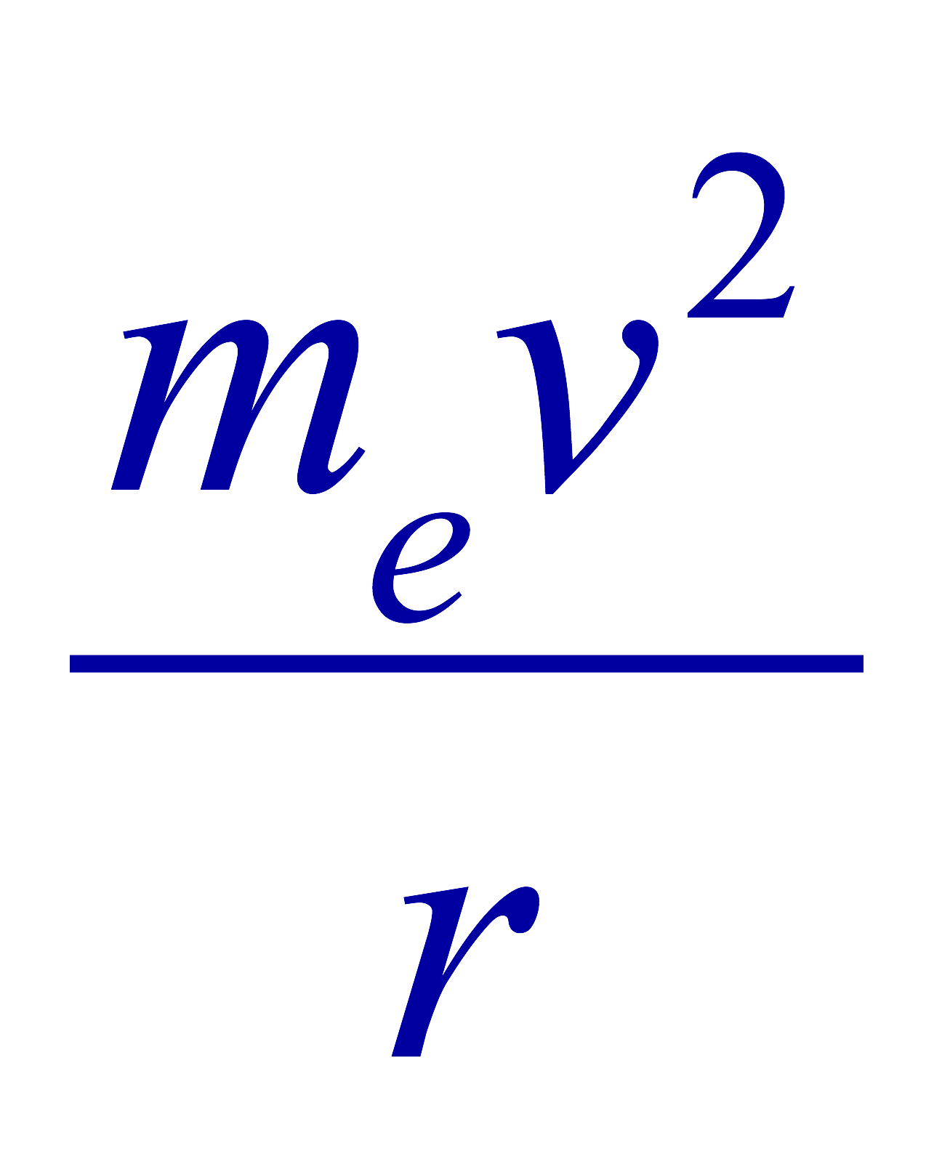



Example 27 – 12
Magnetic moment of a hydrogen atom. Determine the magnetic dipole moment of the electron orbiting the proton of a hydrogen atom, assuming (in the Bohr model) it is in its ground state with a circular orbit of radius 0.529x10⁻¹⁰m.
What provides the centripetal force?
The Coulomb force
So we can obtain the speed of the electron from
Solving for v
Since the electric current is the charge that passes through the given point per unit time, we can obtain the current
Since the area of the orbit is A=πr², we obtain the hydrogen magnetic moment

Slide 10
Sources of Magnetic Field
We have learned so far about the effects of magnetic field on the electric current and the moving charge
We will now learn about the dynamics of magnetism
  How do we determine magnetic field strengths in certain situations?
  How do two wires with electric current interact?
  What is the general approach to finding the connection between current and magnetic field?

Slide 11
Magnetic Field due to a Straight Wire
The magnetic field due to the current flowing through a straight wire forms a circular pattern around the wire
  What do you imagine the strength of the field is as a function of the distance from the wire?
    It must be weaker as the distance increases
  How about as a function of current?
    Directly proportional to the current
  Indeed, the above are experimentally verified
    This is valid as long as r << the length of the wire
  The proportionality constant is μ₀/2π, thus the field strength becomes
  μ₀ is the permeability of free space

Slide 12
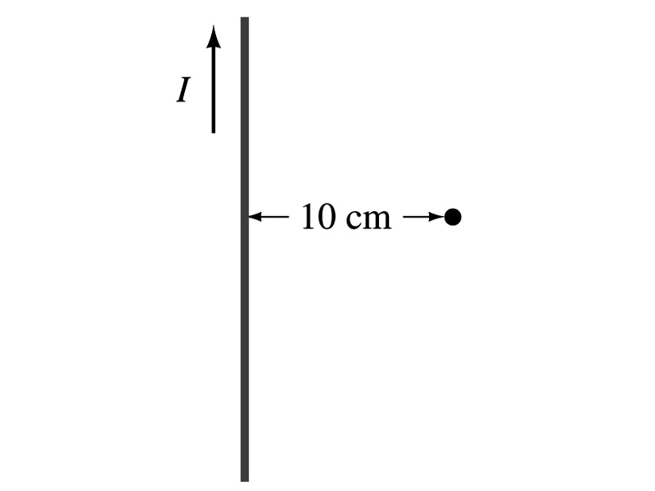
Example 28 – 1
Calculation of B near a wire. A vertical electric wire in the wall of a building carries a DC current of 25A upward. What is the magnetic field at a point 10cm due East of this wire?
Using the formula for the magnetic field near a straight wire
So we can obtain the magnetic field at 10cm away as

