Slide 1
PHYS 1441 – Section 002
Lecture #23
Wednesday, Dec. 2, 2020
Dr. Jaehoon Yu
CH29
  Electric Field due to Changing Magnetic Flux
  Generalized Faraday’s Law
CH30
  Inductance
  Mutual and Self Inductance
  Inductor
  Energy Stored in Magnetic Field

Slide 2
Announcements
Reading assignments: CH30.7 – 30.11 and CH31.4
Final comprehensive exam on Quest
  11am – 12:30pm, Wednesday, Dec. 16
    Roll call begins at 10:45am, Wed. Dec. 16
  Covers: CH21.1 – what we finish next Monday, Dec. 7 + math refresher
  BYOF: You may bring a one 8.5x11.5 sheet (front and back) of handwritten formulae and values of constants for the exam
  No derivations, word definitions, setups or solutions of any problems, figures, pictures, diagrams or arrows, etc!
  No additional formulae or values of constants will be provided!
  Must send me the photos of front and back of the formula sheet, including the blank, no later than 9:00am the day of the test
    Once submitted, you cannot change, unless I ask you to delete part of the sheet!
Quiz 4 results
  Class average: 30.7/50 equivalent to 61.4/100
    Previous quizzes: 80.3/100, 58.8/100, 68.3/100
  Top score: 50/50
Course feedback survey should be done ASAP! (only 29 of you submitted!)

Slide 3
Ex. 29 – 13 Power Transmission – Why HV?
Transmission lines. An average of 120kW of electric power is sent to a small town from a power plant 10km away. The transmission lines have a total resistance of 0.4Ω. Calculate the power loss if the power is transmitted at (a) 240V and (b) 24,000V.
We cannot use P=V²/R for the power loss since we do not know the voltage along the transmission line. We, however, can use P=I²R since the current is the same along the entire transmission line.
(a) If 120kW is sent at 240V, the total current is
Thus the power loss due to transmission line is
(b) If 120kW is sent at 24,000V, the total current is
Thus the power loss due to transmission line is
The higher the transmission voltage, the smaller the current, causing less loss of energy. This is why power is transmitted w/ HV, as high as 170kV.

Slide 4
Electric Field due to Magnetic Flux Change
When the electric current flows through a wire, there is an electric field in the wire that moves electrons
We also learned that changing magnetic flux induces a current in the wire. (poll 17) What does this mean?
  There must be an electric field induced by the changing magnetic flux.
In other words, a changing magnetic flux produces an electric field
This results apply not just to wires but to any conductor or any region in space

Slide 5
Generalized Form of Faraday’s Law
Recall the relationship between the electric field and the potential difference
Induced emf in a circuit is equal to the work done per unit charge by the electric field
So we obtain
The integral is taken around a path enclosing the area through which the magnetic flux Φ_{Β} is changing.

Slide 6
Inductance
Changing magnetic flux through a circuit induce an emf in that circuit (Poll 17)
An electric current produces a magnetic field
From these, we can deduce
  A changing current in one circuit must induce an emf in a nearby circuit ➔ Mutual inductance
  and induce an emf in itself ➔ Self inductance

Slide 7
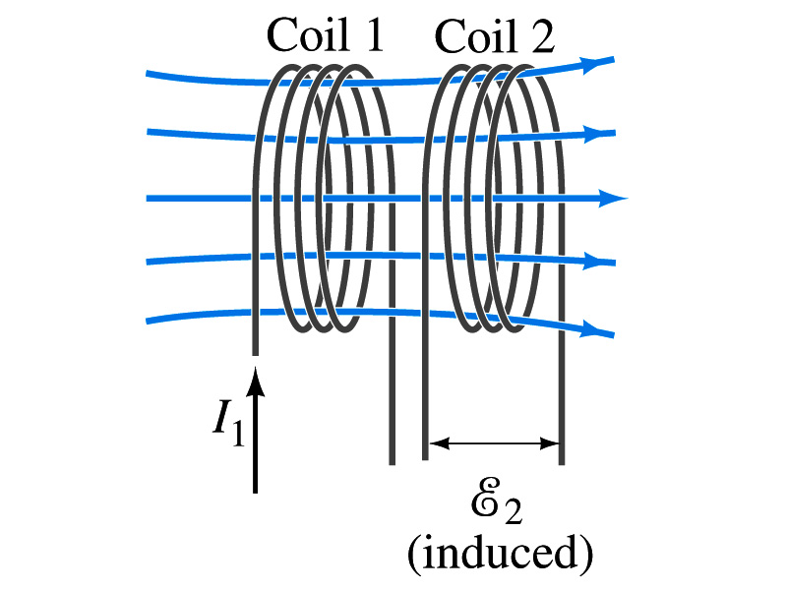
Mutual Inductance
If two coils of wire are placed near each other, a changing current in one will induce an emf in the other.
What is the induced emf, ε₂, in coil2 proportional to?
  Rate of the change of the magnetic flux passing through it
This flux is due to current I₁ in coil 1
If Φ₂₁ is the magnetic flux in each loop of coil2 created by coil1 and N₂ is the number of closely packed loops in coil2, then N₂Φ₂₁ is the total flux passing through coil2.
If the two coils are fixed in space, N₂Φ₂₁ is proportional to the current I₁ in coil 1, .
The proportionality constant for this is called the Mutual Inductance and defined as .
The emf induced in coil2 due to the changing current in coil1 is

Slide 8
Mutual Inductance
The mutual induction of coil2 with respect to coil1, M₂₁,
  is a constant and does not depend on I₁.
  depends only on “geometric” factors such as the size, shape, number of turns and relative position of the two coils, and whether a ferromagnetic material is present
    The farther apart the two coils are the less flux can pass through coil, 2, so M₂₁ will be smaller.
  In most cases the mutual inductance is determined experimentally
Conversely, the changing current in coil2 will induce an emf in coil1
  M₁₂ is the mutual inductance of coil1 with respect to coil2 and M₁₂ = M₂₁
  We can put M=M₁₂=M₂₁ and obtain
  SI unit for mutual inductance is Henry (H)

Slide 9
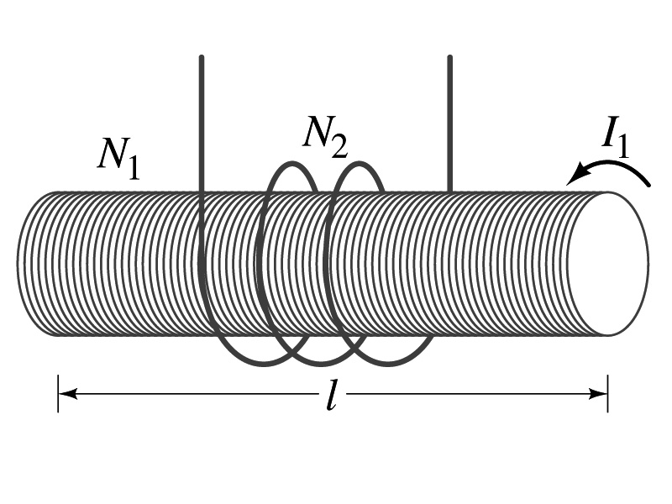
Example 30 – 1
Solenoid and coil. A long thin solenoid of length l and cross-sectional area A contains N₁ closely packed turns of wire. Wrapped around it is an insulated coil of N₂ turns. Assuming all the flux from coil 1 (the solenoid) passes through coil 2, calculate the mutual inductance.
First we need to determine the flux produced by the solenoid.
What is the magnetic field inside the solenoid?
Since the solenoid is closely packed, we can assume that the field lines are perpendicular to the surface area of the coils. Thus the flux through coil 2 is
Thus the mutual inductance of coil 2 is
Note that M₂₁ only depends on geometric factors!

Slide 10
Self Inductance
The concept of inductance applies to a single isolated coil of N turns. How does this happen?
  When a changing current passes through a coil
  A changing magnetic flux is produced inside the coil
  The changing magnetic flux in turn induces an emf in the same coil
  This emf opposes the change in flux. Whose law is this? (Poll 17)
    Lenz’s law
What would this do?
  When the current through the coil is increasing?
    The increasing magnetic flux induces an emf that opposes the original current
    This tends to impedes its increase, trying to maintain the original current
  When the current through the coil is decreasing?
    The decreasing flux induces an emf in the same direction as the current
    This tends to increase the flux, trying to maintain the original current

Slide 11
Self Inductance
Since the magnetic flux Φ_{B} passing through an N turn coil is proportional to current I in the coil,
We define self-inductance, L:
The induced emf in a coil of self-inductance L is
  What is the unit for self-inductance?
What does magnitude of L depend on?
  Geometry and the presence of a ferromagnetic material
Self inductance can be defined for any circuit or part of a circuit
Self Inductance

Slide 12
So what in the world is the Inductance?
It is an impediment on the electrical current due to the existence of changing flux (poll 25)
So what?
In other words, it behaves like a resistance to the varying current, such as AC, that causes the constant change of magnetic flux
But it also provides means to store energy, just like the capacitance

Slide 13
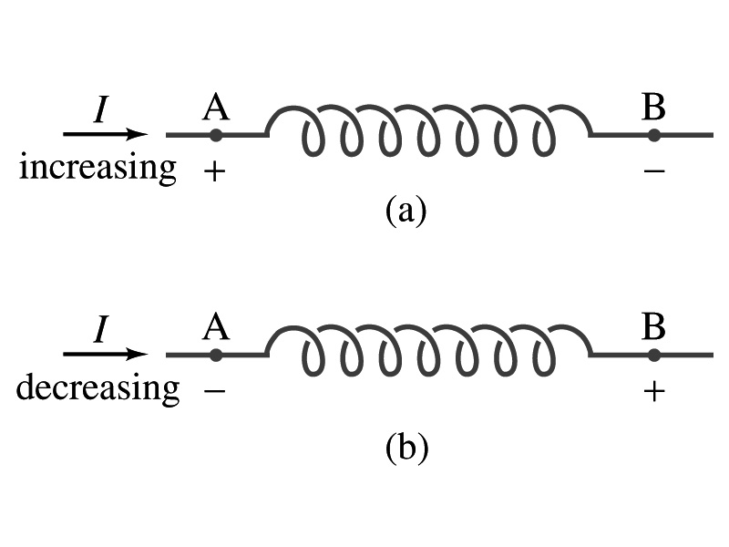
Inductor
An electrical circuit always contains some inductance but is normally negligibly small
  If a circuit contains a coil of many turns, it could have large inductance
A coil that has significant inductance, L, is called an inductor and is express with the symbol
  Precision resisters are normally wire wound
    Would have both resistance and inductance
    The inductance can be minimized by winding the wire back on itself in the opposite direction to cancel the magnetic flux
    This is called a “non-inductive winding”
If an inductor has negligible resistance, inductance controls the changing current
For an AC current, the greater the inductance the less the AC current
  An inductor thus acts like a resistor to impede the flow of alternating current (not to DC, though. Why?)
  The quality of an inductor is indicated by the term reactance or impedance

Slide 14
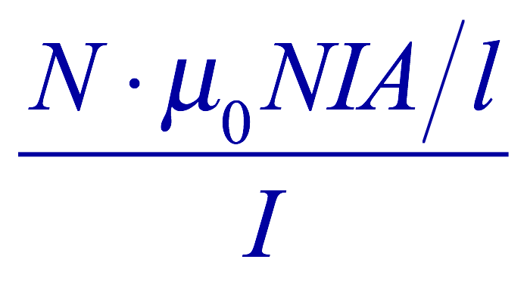
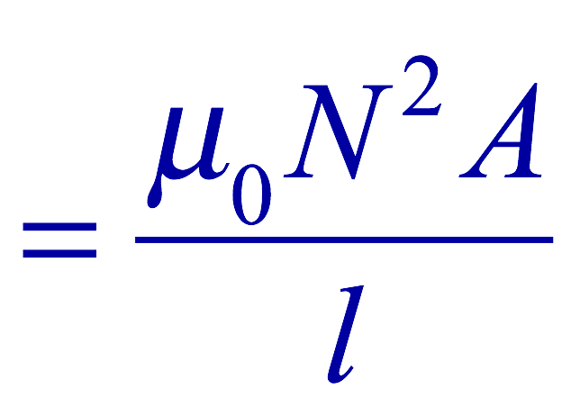
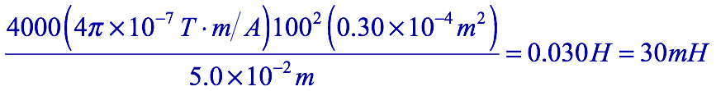
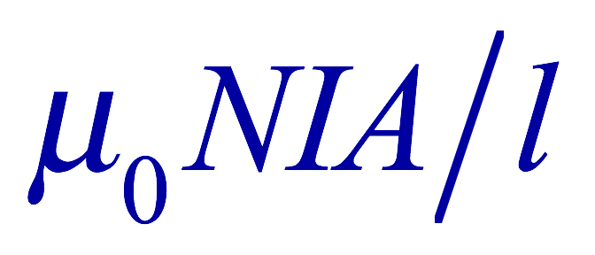
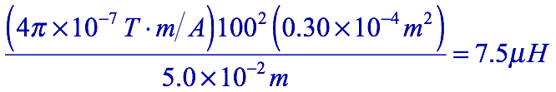
Example 30 – 3
Solenoid inductance. (a) Determine the formula for the self inductance L of a tightly wrapped solenoid ( a long coil) containing N turns of wire in its length l and whose cross-sectional area is A. (b) Calculate the value of L if N=100, l=5.0cm, A=0.30cm² and the solenoid is air filled. (c) calculate L if the solenoid has an iron core with μ=4000μ₀.
What is the magnetic field inside a solenoid?
The flux is, therefore,
Using the formula for self inductance:
(b) Using the formula above
(c) The magnetic field with an iron core solenoid is

