Slide 1
PHYS 1441 – Section 002
Lecture #24
Monday, Dec. 7, 2020
Dr. Jaehoon Yu
CH30
  Energy Stored in Magnetic Field
CH31
  Expansion of Ampere’s Law
  Gauss’ Law for Magnetism
  Production of EM Waves

Slide 2
The Pass/Fail Option
You can choose pass or fail option for your course grade for this course.
  The valid letter grades for P/F option choice are A, B, C or D
  F, I or W cannot be turned to P/F
You must be the one making the choice
  Must speak to your department advisor to make sure the P/F choice does not impact fulfilling your major prerequisite requirements
Some FAQ:
  Is it allowed for a student to be assigned an incomplete, and then after they have completed the work receive a P in the class?
    Answer: No. For a given class a student can either get an I (in consultation with professor), or a P/F, but not both.
  What is the minimum grade needed to get a P?
    Answer: Any non-failing grade (A,B,C,D) qualifies the student for a Pass. This is true across the university, although whether a Pass meets a prerequisite requirement varies from department to department (Some departments require a C or better to advance to the next class, so since a Pass only corresponds to D or better, the student will have to retake the class to meet the prereq) .

Slide 3
Announcements
Reading assignments: CH30.7 – 30.11 and CH31.4
Final comprehensive exam: 11am – 12:30pm, Wednesday, Dec. 16
    Roll call begins at 10:45am, Wed. Dec. 16
  Do NOT miss the exam! Must be in a quiet place to take the exam on Quest!
    You will get an F no matter how well you’ve been doing!!
  Covers: CH21.1 – CH31.4 + math refresher
  BYOF: You may bring a one 8.5x11.5 sheet (front and back) of handwritten formulae and values of constants for the exam
  No derivations, word definitions, setups or solutions of any problems, figures, pictures, diagrams or arrows, etc!
  No additional formulae or values of constants will be provided!
  Must send me the photos of front and back of the formula sheet, including the blank, no later than 9:00am the day of the test
    Once submitted, you cannot change, unless I ask you to delete part of the sheet!
Only 37 of you (<25%) filled the course feedback survey

Slide 4
Final Words
I deeply appreciate your resilience and patience in the terrible circumstance
Covid-19 was imposed on us what seems to be a natural mutation process
  The whole humanity must work together to defeat the disease
    One country alone CANNOT win over this kind of natural disaster
  Human disregard to nature could have contributed to this disaster
  We must realize that it is our responsibility to care for what is given to us
Science must help and serve the entire humanity as a whole
When you go out to the society, you must remember why you are do what you are do, for the whole humanity not for the selfish few
Let’s remember what happened in COVID-19 and think how we can prepare well and avoid this kind of disaster in the future
  The climate change is something each and everyone of us must be responsible for our next generations
Be a good person with true fundamental human decency!

Slide 5
Example 30 – 9
Reactance of a coil. A coil has a resistance R=1.00Ω and an inductance of 0.300H. Determine the current in the coil if (a) 120 V DC is applied to it; (b) 120 V AC (rms) at 60.0Hz is applied.
Is there a reactance for DC?
Nope. Why not?
Since ω=0,
So for DC power, the current is from Kirchhoff’s rule
For an AC power with f =60Hz, the reactance is
Since the resistance can be ignored compared to the reactance, the rms current is

Slide 6
Energy Stored in the Magnetic Field
When an inductor of inductance L is carrying current I which is changing at a rate dI/dt, the energy is supplied to the inductor at a rate
What is the work needed to increase the current in an inductor from 0 to I?
  The work, dW, done in time dt is
  Thus the total work needed to bring the current from 0 to I in an inductor is

Slide 7
Energy Stored in the Magnetic Field
The work done to the system is the same as the energy stored in the inductor when it is carrying current I
  This is compared to the energy stored in a capacitor, C, when the potential difference across it is V:
  Just like the energy stored in a capacitor is considered to reside in the electric field between its plates
  The energy in an inductor can be considered to be stored in its magnetic field
Energy Stored in the magnetic field inside an inductor

Slide 8
Stored Energy in terms of B
So how is the stored energy written in terms of magnetic field B?
  The self inductance of an ideal solenoid without a fringe effect
  The magnetic field in a solenoid is
  Thus the energy stored in an inductor is
  Thus the energy density is
  This formula is valid in any region of space
  If a ferromagnetic material is present, μ₀ becomes μ.
E
What is this?
E density
Volume V
What volume does Al represent?
The volume inside a solenoid!!

Slide 9
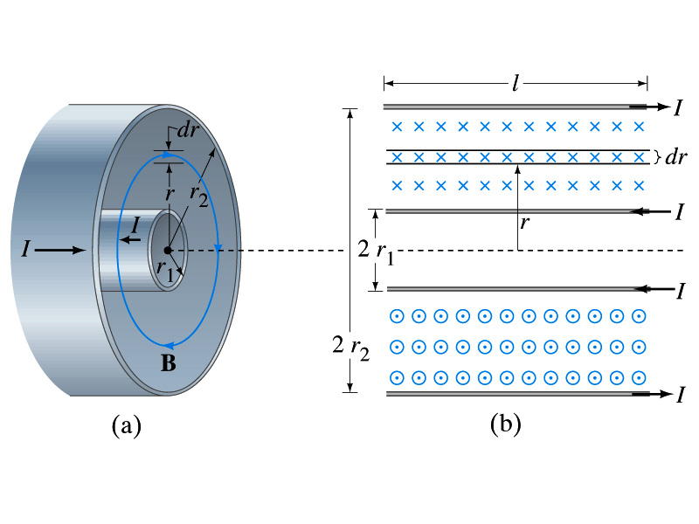
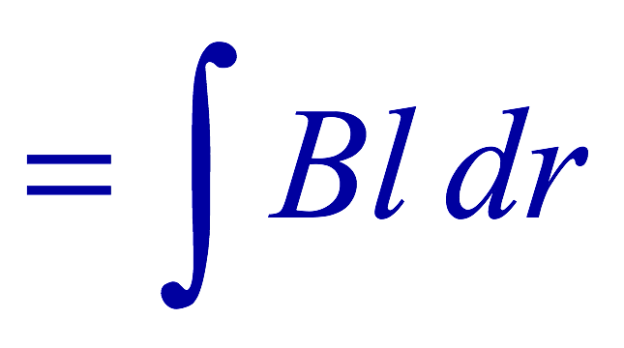
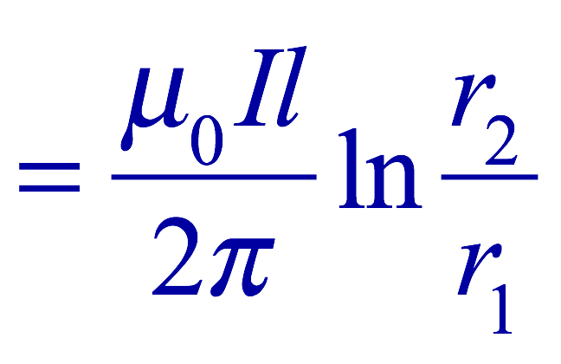
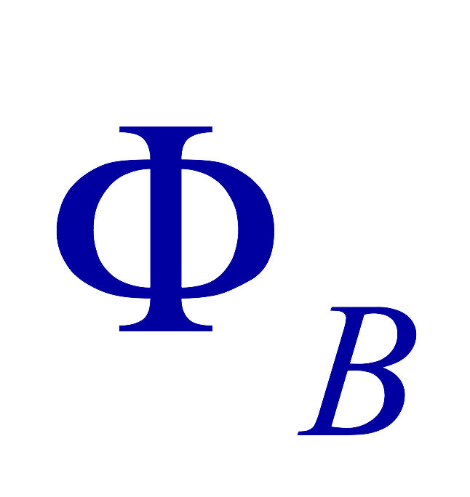
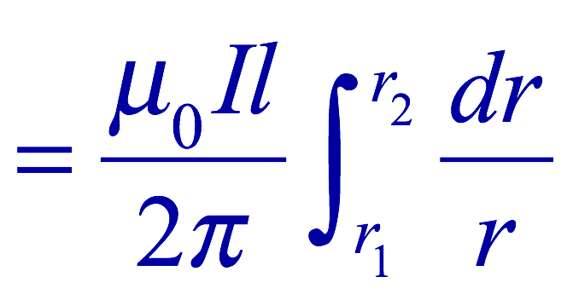
Example 30 – 5
Energy stored in a coaxial cable. (a) How much energy is being stored per unit length in a coaxial cable whose conductors have radii r₁ and r₂ and which carry a current I? (b) Where is the energy density highest?
(a) The total flux through l of the cable is
Thus inductance per unit length for a coaxial cable is
Thus the energy stored per unit length is
(b) Since the magnetic field is
The energy density is highest where B is highest, close to r=r₁, near the surface of the inner conductor.
And the energy density is

Slide 10
Maxwell’s Equations
The development of EM theory by Oersted, Ampere and others was not done in terms of EM fields
  The idea of fields was introduced somewhat by Faraday
Scottish physicist James C. Maxwell unified all the phenomena of electricity and magnetism in one theory with only four equations (Maxwell’s Equations) using the concept of fields
  This theory provided the prediction of EM waves
  As important as Newton’s law since it provides dynamics of electromagnetism
  This theory is also in agreement with Einstein’s special relativity
The biggest achievement of 19th century electromagnetic theory is the prediction and experimental verifications that the electromagnetic waves can travel through the empty space
  What do you think this accomplishment did?
    Open a new world of communication
    It also yielded the prediction that the light is an EM wave
Since all of Electromagnetism is contained in the four Maxwell’s equations, this is considered as one of the greatest achievements of human intellect

Slide 11
Ampere’s Law
Do you remember the mathematical expression of Oersted discovery of a magnetic field produced by an electric current, given by Ampere?
We’ve learned that a varying magnetic field produces an electric field
Then, can the reverse phenomena, that a changing electric field producing a magnetic field, possible?
  If this is the case, it would demonstrate a beautiful symmetry in nature between electricity and magnetism

Slide 12
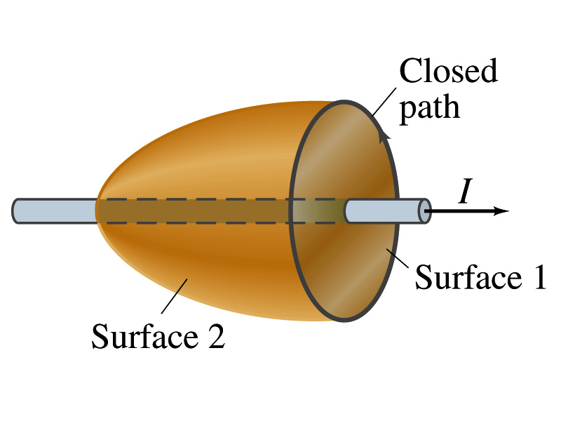
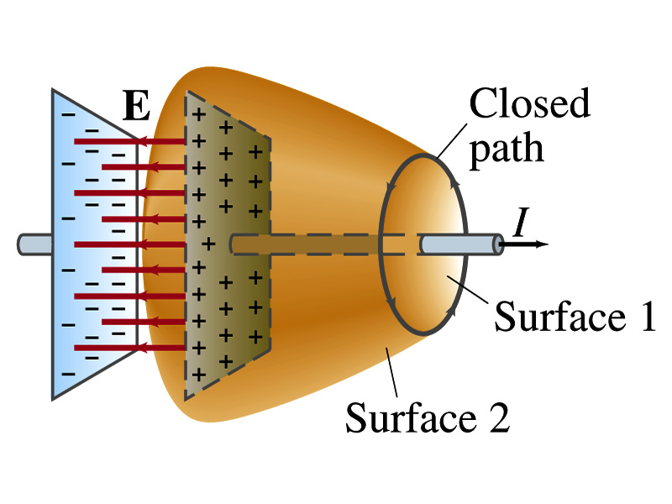
Expanding Ampere’s Law
Let’s consider a wire carrying current Ι
  The current that is enclosed in the loop passes through the surface # 1 in the figure
  We could imagine a different surface # 2 that shares the same enclosed path but cuts through the wire in a different location. What is the current that passes through the surface?
    Still Ι.
  So the Ampere’s law still works
We could then consider a capacitor being charged up or being discharged.
  The current Ι enclosed in the loop passes through the surface #1
  However the surface #2 that shares the same closed loop do not have any current passing through it.
    There is magnetic field present since there is current ➔ In other words there is a changing electric field in between the plates
    Maxwell resolved this by adding an additional term to Ampere’s law involving the changing electric field

Slide 13
Modifying Ampere’s Law
To determine what the extra term should be, we have to first figure out what the electric field between the two plates is
  The charge Q on the capacitor with capacitance C is Q=CV
    Where V is the potential difference between the plates
  Since V=Ed
    Where E is the uniform field between the plates, and d is the separation of the plates
  And for parallel plate capacitor C=ε₀A/d
  We obtain

Slide 14
Modifying Ampere’s Law
  If the charge on the plate changes with time, we can write
  Using the relationship between the current and charge we obtain
    Where Φ_{Ε}=EA is the electric flux through the surface between the plates
  In order to make Ampere’s law work for the surface 2 in the figure, we must write it in the following form
  This equation represents the general form of Ampere’s law
    This means that a magnetic field can be caused not only by an ordinary electric current but also by a changing electric flux
Extra term by Maxwell

Slide 15
Example 31 – 1
Charging a capacitor. A 30-pF air-gap capacitor has circular plates of area A=100cm². It is charged by a 70-V battery through a 2.0-Ω resistor. At the instance the battery is connected, the electric field between the plates is changing most rapidly. At this instance, calculate (a) the current into the plates, and (b) the rate of change of electric field between the plates. (c) Determine the magnetic field induced between the plates. Assume E is uniform between the plates at any instant and is zero at all points beyond the edges of the plates.
Since this is an RC circuit, the charge on the plates is:
For the initial current (t=0), we differentiate the charge with respect to time.
The electric field is
Change of the electric field is

Slide 16
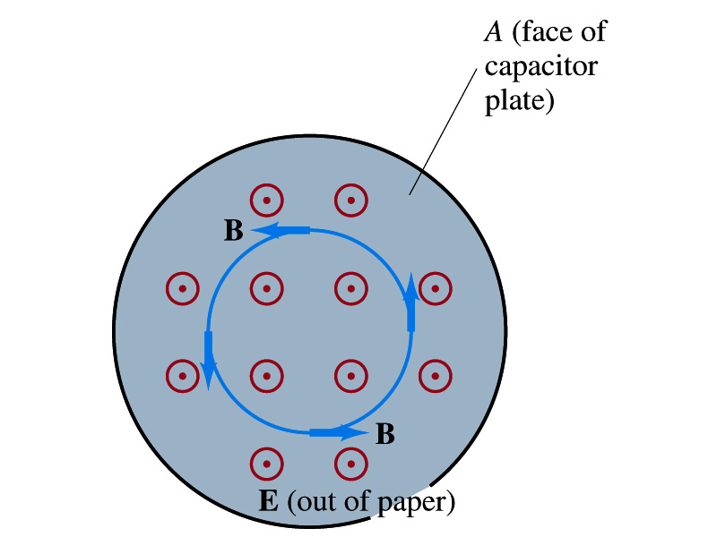
Example 31 – 1, cnt’d
(c) Determine the magnetic field induced between the plates. Assume E is uniform between the plates at any instant and is zero at all points beyond the edges of the plates.
The magnetic field lines generated by changing electric field is perpendicular to E and is circular due to symmetry
Whose law can we use to determine B?
Extended Ampere’s Law w/ Ι_{encl}=0!
We choose a circular path of radius r, centered at the center of the plane, following the B.
For r<r_{plate}, the electric flux is
since E is uniform throughout the plate
So from Ampere’s law, we obtain
Solving for B
For r<r_{plate}
Since we assume E=0 for r>r_{plate}, the electric flux beyond the plate is fully contained inside the surface.
So from Ampere’s law, we obtain
Solving for B
For r>r_{plate}

Slide 17
Displacement Current
Maxwell interpreted the second term in the generalized Ampere’s law equivalent to an electric current
  He called this term as the displacement current, Ι_{D}
  While the other term is called as the conduction current, Ι
Ampere’s law then can be written as
  Where
  While it is in effect equivalent to an electric current, a flow of electric charge, this actually does not have anything to do with the flow itself

Slide 18
Gauss’ Law for Magnetism
If there is a symmetry between electricity and magnetism, there must be an equivalent law in magnetism as the Gauss’ Law in electricity
For a magnetic field B, the magnetic flux Φ_{B} through the surface is defined as
  Where the integration is over the area of either an open or a closed surface
The magnetic flux through a closed surface which completely encloses a volume is
What was the Gauss’ law in the electric case?
  The electric flux through a closed surface is equal to the total net charge Q enclosed by the surface divided by ε₀.
Similarly, we can write Gauss’ law for magnetism as
Why is result of the integral zero?
  There is no isolated magnetic poles, the magnetic equivalent of single electric charges
Gauss’ Law for electricity
Gauss’ Law for magnetism

Slide 19
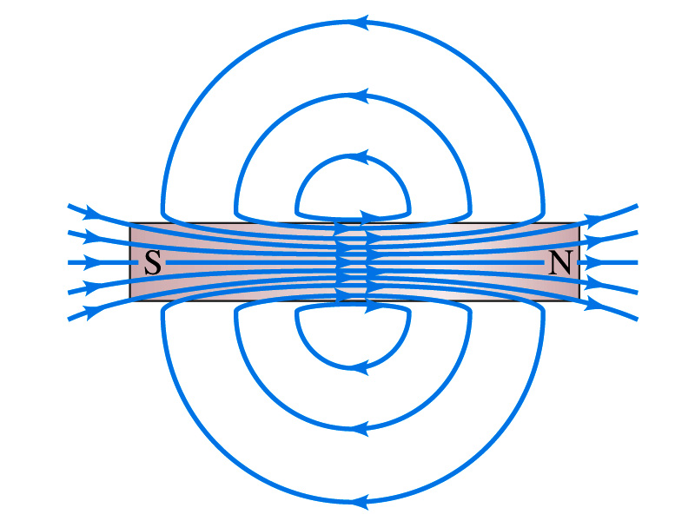
Gauss’ Law for Magnetism
What does the Gauss’ law in magnetism mean physically?
  There are as many magnetic flux lines that enter the enclosed volume as leave it
  If magnetic monopole does not exist, there is no starting or stopping point of the flux lines
    Electricity do have the source and the sink
  Magnetic field lines must be continuous
  Even for bar magnets, the field lines exist both insides and outside of the magnet

Slide 20
Maxwell’s Equations
In the absence of dielectric or magnetic materials, the four equations developed by Maxwell are:
Gauss’ Law for electricity
A generalized form of Coulomb’s law relating electric field to its sources, the electric charge
Gauss’ Law for magnetism
A magnetic equivalent of Coulomb’s law relating magnetic field to its sources. This says there are no magnetic monopoles.
Faraday’s Law
An electric field is produced by a changing magnetic field
Ampére’s Law
A magnetic field is produced by an electric current or by a changing electric field

Slide 21
Maxwell’s Amazing Leap of Faith
According to Maxwell, a magnetic field will be produced even in an empty space if there is a changing electric field
  He then took this concept one step further and concluded that
    If a changing magnetic field produces an electric field, the electric field is also changing in time.
    This changing electric field in turn produces the magnetic field that also changes.
    This changing magnetic field then in turn produces the electric field that changes.
    This process continues.
  With the manipulation of the equations, Maxwell found that the net result of this interacting changing fields is a wave of electric and magnetic fields that can actually propagate (travel) through the space

Slide 22
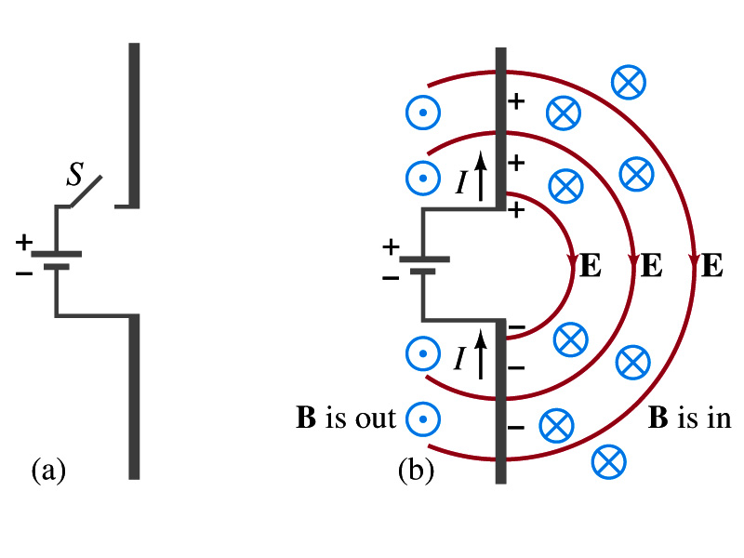
Production of EM Waves
Consider two conducting rods that will serve as an antenna are connected to a DC power source
  What do you think will happen when the switch is closed?
    The rod connected to the positive terminal is charged positively and the other negatively
    Then the electric field will be generated between the two rods
    Since there is the current that flows through, the rods generates a magnetic field around them
How far would the electric and magnetic fields extend?
  In static case, the field extends indefinitely
  When the switch is closed, the fields are formed nearby the rods quickly but
  The stored energy in the fields won’t propagate w/ infinite speed

Slide 23
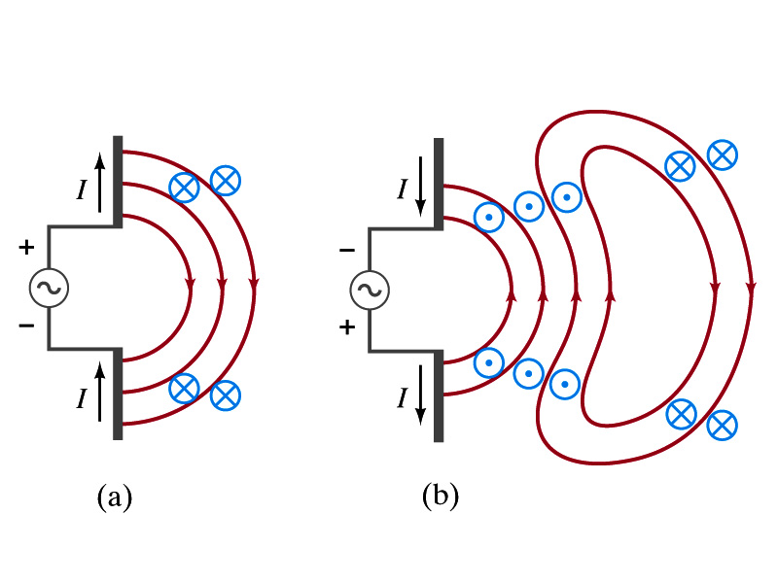
Production of EM Waves
What happens if the antenna is connected to an AC power source?
  When the connection was initially made, the rods are charging up quickly w/ the current flowing in one direction as shown in the figure
    The field lines form as in the dc case
    The field lines propagate away from the antenna
  Then the direction of the voltage reverses
    The new field lines with the opposite direction forms
    While the original field lines still propagates away from the rod reaching out far
      Since the original field propagates through an empty space, the field lines must form a closed loop (no charge exist)
    Since changing electric and magnetic fields produce changing magnetic and electric fields, the fields moving outward is self supporting and do not need antenna with flowing charge
  The fields far from the antenna is called the radiation field
  Both electric and magnetic fields form closed loops perpendicular to each other

Slide 24
Properties of Radiation Fields – I
The fields travel on the other side of the antenna as well
The field strength is the greatest in the direction perpendicular to the oscillating charge while it is 0 along the direction of the current
The magnitude of E and B in the radiation field decrease with distance as 1/r
The energy carried by the EM wave is proportional to the square of the amplitude, E² or B²
  So the intensity of wave decreases as 1/r²

Slide 25
Properties of Radiation Fields – II
The electric and magnetic fields at any point are perpendicular to each other and to the direction of the propagation (or motion)
The fields alternate in direction
  The field strengths vary from maximum in one direction, to 0 and to max in the opposite direction
The electric and magnetic fields are in phase
  B is maximum when E is maximum, vise versa
Very far from the antenna, the field lines are quite flat over a reasonably large area
  Called plane waves

Slide 26
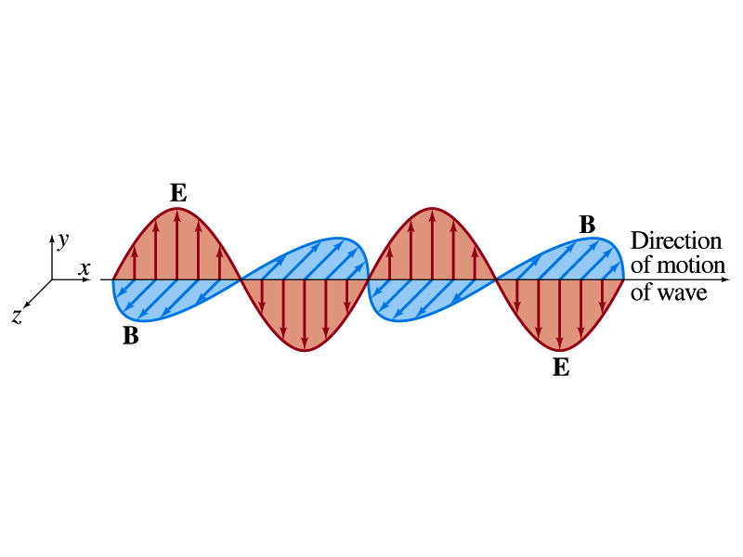
EM Waves
If the voltage of the source varies sinusoidal, the field strengths of the radiation field vary sinusoidal
We call these waves EM waves
They are transverse waves
EM waves are always those of fields
  Since these are fields, they can propagate through an empty space
In general accelerating electric charges give rise to electromagnetic waves
This prediction from Maxwell’s equations was experimentally proven by Heinrich Hertz through the discovery of radio waves

Slide 27
EM Waves and Their Speeds
Let’s consider a region of free space. What’s a free space?
  An area of space where there is no charges or conduction currents
  In other words, far from emf sources so that the wave fronts are essentially flat or not distorted over a reasonable area
  What are these flat waves called?
    Plane waves
    At any instance E and B are uniform over a large plane perpendicular to the direction of propagation
  So we can also assume that the wave is traveling in the x-direction w/ velocity, v=vi, and that E is parallel to y axis and B is parallel to z axis

Slide 28
Maxwell’s Equations w/ Q=Ι=0
In this region of free space, Q=0 and Ι=0, thus the four Maxwell’s equations become
Q_{encl}=0
No Changes
No Changes
I_{encl}=0
One can observe the symmetry between electricity and magnetism.
The last equation is the most important one for EM waves and their propagation!!

