Slide 1
PHYS 1444 – Section 004
Lecture #2
Monday, Jan. 23, 2012
Dr. Jaehoon Yu
Brief history of physics
Some basics …
Chapter 21
  Static Electricity and Charge Conservation
  Charges in Atom, Insulators and Conductors & Induced Charge
  Coulomb’s Law
  The Electric Field & Field Lines
  Electric Fields and Conductors
Today’s homework is homework #2, due 10pm, Tuesday, Jan. 31!!

Slide 2
Announcements
Make sure to subscribe to the class e-mail distribution list PHYS1444-004-SP12 by clicking on the link https://listserv.uta.edu/cgi-bin/wa.exe?A0=PHYS1444-004-SP12
  3 point extra credit if done by Tuesday, Jan. 24
  A test message will be sent out Wednesday, Jan. 25
Homework registration
  36/38 of you have registered for homework!!
    30/36 submitted the homework #1 (The deadline is 10pm TODAY!!)
    You must download and submit the homework to obtain 100% credit!
  Please register for the homework ASAP!
    You need my approval in order to be submitting homework. Don’t wait till the last minute!
Reading assignment #1: Read and follow through all sections in appendices A and B by Tuesday, Jan. 24
  A-1 through A-7 and B1 through B5
  There will be a quiz on these and Ch. 21 on Wednesday, Jan. 25.

Slide 3
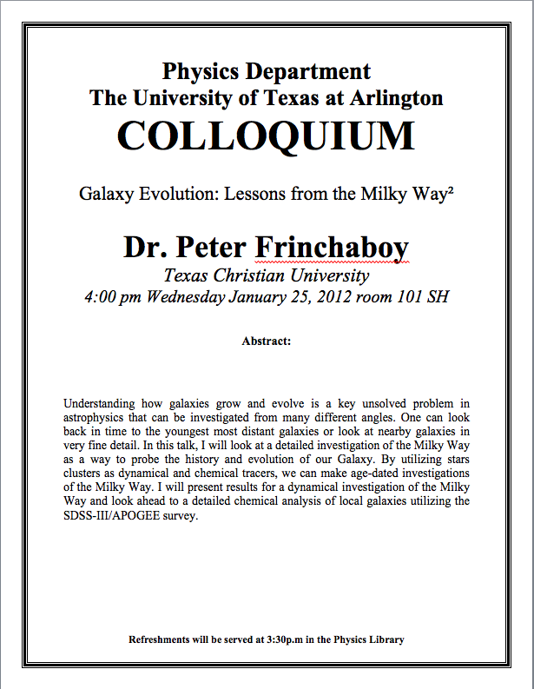

Slide 4
Valid Planetarium Shows
Regular running shows
  We are Astronomers
Shows that need special arrangements
  Black Holes
  Ice Worlds
  Magnificent Sun
  Stars of the Pharaohs
  Time Space
  Two Small Pieces of Glass
  SOFIA
  Violent Universe
  Nanocam: Trip into Biodiversity
How to submit for extra credit?
  Obtain the ticket stub that is signed and dated by the planetarium star lecturer of the day
  Collect the ticket stubs
  Tape all of them on a sheet of paper with your name and ID written on it
  Submit the sheet at the end of the semester when asked

Slide 5
Extra Credit Special Project #1
Compare the Coulomb force to the Gravitational force in the following cases by expressing Coulomb force (F_{C}) in terms of the gravitational force (F_{G})
  Between two protons separated by 1m
  Between two protons separated by an arbitrary distance R
  Between two electrons separated by 1m
  Between two electrons separated by an arbitrary distance R
Five points each, totaling 20 points
BE SURE to show all the details of your work, including all formulae, and properly referring them
Please staple them before the submission
Due at the beginning of the class Monday, Jan. 30

Slide 6
Brief History of Physics
AD 18th century:
  Newton’s Classical Mechanics: A theory of mechanics based on observations and measurements
AD 19th Century:
  Electricity, Magnetism, and Thermodynamics
Late AD 19th and early 20th century (Modern Physics Era)
  Einstein’s theory of relativity: Generalized theory of space, time, and energy (mechanics)
  Quantum Mechanics: Theory of atomic phenomena
Physics has come very far, very fast, and is still progressing, yet we’ve got a long way to go
  What is matter made of?
  How do matters get mass?
  How and why do matters interact with each other?
  How is universe created?

Slide 7
SI Base Quantities and Units
Quantity | Unit | Unit Abbrevation
Length | Meter | m
Time | Second | s
Mass | Kilogram | kg
Electric current | Ampere | A
Temperature | Kelvin | k
Amount of substance | Mole | mol
Luminous Intensity | Candela | cd
There are prefixes that scales the units larger or smaller for convenience (see pg. 7)

Slide 8
Prefixes, expressions and their meanings
deca (da): 10¹
hecto (h): 10²
kilo (k): 10³
mega (M): 10⁶
giga (G): 10⁹
tera (T): 10¹²
peta (P): 10¹⁵
exa (E): 10¹⁸
deci (d): 10⁻¹
centi (c): 10⁻²
milli (m): 10⁻³
micro (μ): 10⁻⁶
nano (n): 10⁻⁹
pico (p): 10⁻¹²
femto (f): 10⁻¹⁵
atto (a): 10⁻¹⁸

Slide 9
How do we convert quantities from one unit to another?
Unit 1 =
Conversion factor X
Unit 2
1 inch | 2.54 | cm
1 inch | 0.0254 | m
1 inch | 2.54x10⁻⁵ | km
1 ft | 30.3 | cm
1 ft | 0.303 | M
1 ft | 3.03x10⁻⁴ | km
1 hr | 60 | minutes
1 hr | 3600 | seconds
And many | More | Here….

Slide 10
What does the Electric Force do?
Electric force is the bases of modern technology
  Virtually everything we use every day uses electric force
    Can you give a few examples?
But this force also affects many others
  Making up materials with atoms and molecules
  Biological metabolic processes
    Nerve signals, heart pumping, etc
Virtually all the forces we have learned in Physics I:
  Friction, normal force, elastic force and other contact forces are the results of electric forces acting at the atomic level

Slide 11
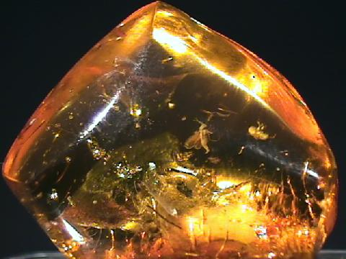
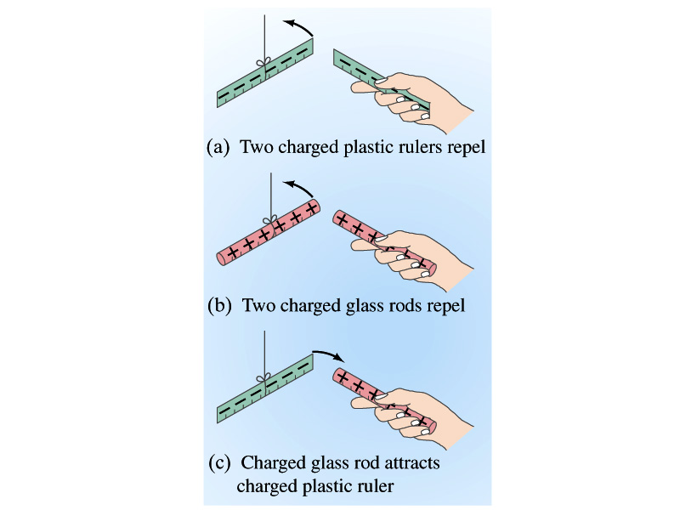
Static Electricity; Electric Charge and Its Conservation
Electricity is from Greek word elecktron=amber, a petrified tree resin that attracts matter when rubbed
Static Electricity: an amber effect
  An object becomes charged or “posses a net electric charge” due to rubbing
  Can you give some examples?
Two types of the electric charge
  Like charges repel while unlike charges attract
  Benjamin Franklin referred the charge on glass rod as the positive, arbitrarily. Thus the charge that attracts glass rod is negative. ➔ This convention is still used.

Slide 12
Static Electricity; Electric Charge and Its Conservation
Franklin argued that when a certain amount of charge is produced on one body in a process, an equal amount of opposite type of charge is produced on another body.
  The positive and negative are treated algebraically so that at any time in the process the net change in the amount of produced charge is 0.
    When you comb your hair with a plastic comb, the comb acquires a negative charge and the hair an equal amount of positive charge.
This is the law of conservation of electric charge.
  The net amount of electric charge produced in any process is ZERO!!
  No net electric charge can be created or destroyed
    If one object or one region of the space acquires a positive charge, then an equal amount of negative charge will be found in neighboring areas or objects.
    No violations have ever been observed.
    This conservation law is as firmly established as that of energy or momentum.

Slide 13
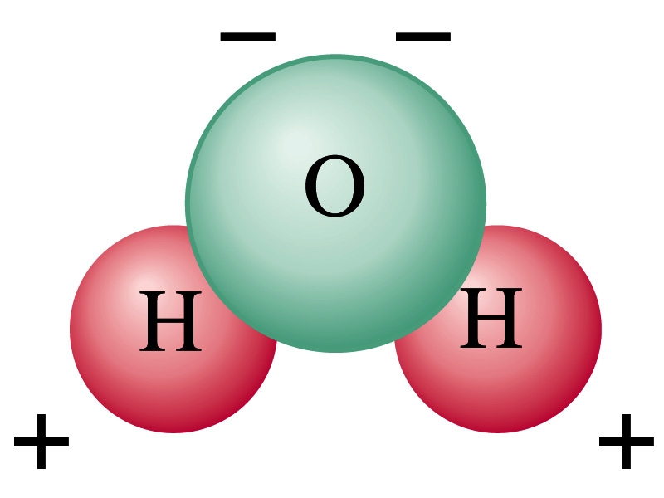
Electric Charge in the Atom
It has been understood through the past century that an atom consists of
  A positively charged heavy core ⬅ What is the name?
    This core is nucleus and consists of neutrons and protons.
  Many negatively charged light particles surround the core ⬅ What is the name of these light particles?
    These are called electrons
    How many of these?
So what is the net electrical charge of an atom?
  Zero!!! Electrically neutral!!!
Can you explain what happens when a comb is rubbed on a towel?
  Electrons from towel get transferred to the comb, making the comb negatively charged while leaving positive ions on the towel.
  These charges eventually get neutralized primarily by water molecules in the air.
As many as the number of protons!!

Slide 14
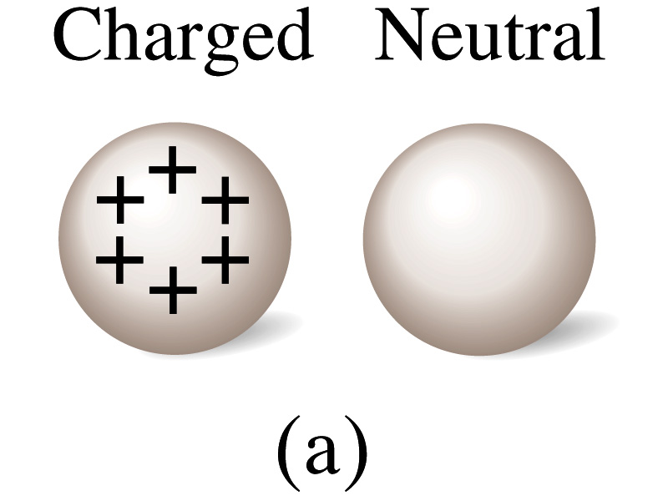
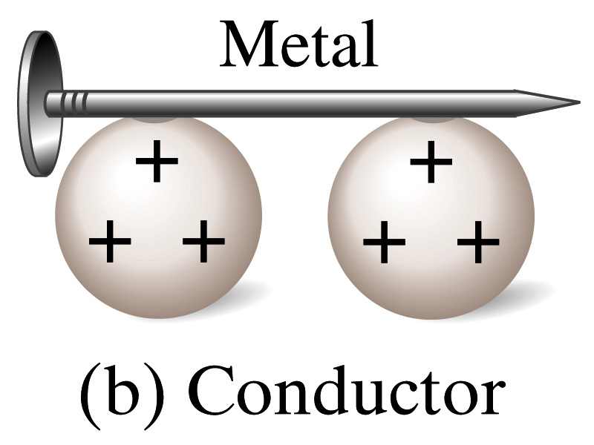
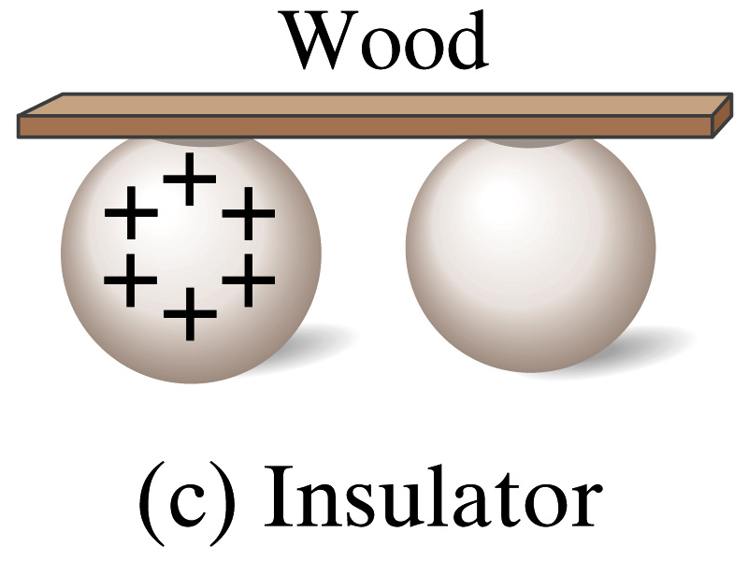
Insulators and Conductors
Let’s imagine two metal balls of which one is charged
What will happen if they are connected by
  A metallic object?
    Some charge is transferred.
    These objects are called conductors of electricity.
  A wooden object?
    No charge is transferred
    These objects are called nonconductors or insulators.
Metals are generally good conductors whereas most other materials are insulators.
  There are third kind of materials called, semi-conductors, like silicon or germanium ➔ conduct only in certain conditions
Atomically, conductors have loosely bound electrons while insulators have them tightly bound!

Slide 15
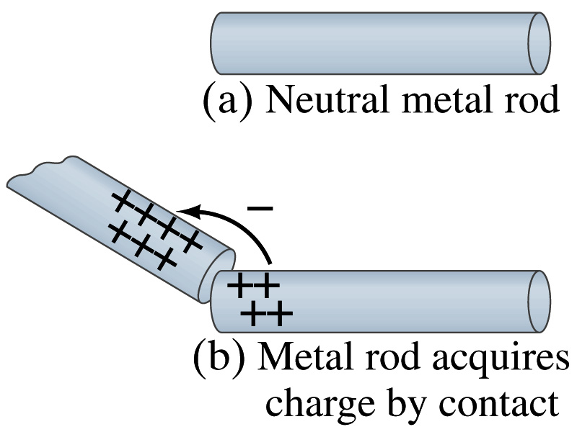
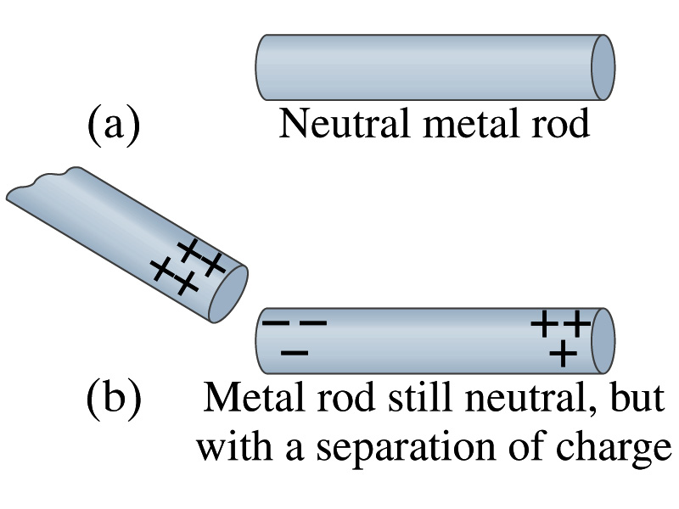
Induced Charge
When a positively charged metal object is brought close to an uncharged metal object
  If two objects touch each other, the free electrons in the neutral ones are attracted to the positively charged object and some will pass over to it, leaving the neutral object positively charged. ➔ Charging by conduction
  If the objects get close, the free electrons in the neutral ones still move within the metal toward the charged object leaving the opposite of the object positively charged.
    The charges have been “induced” in the opposite ends of the object.

Slide 16
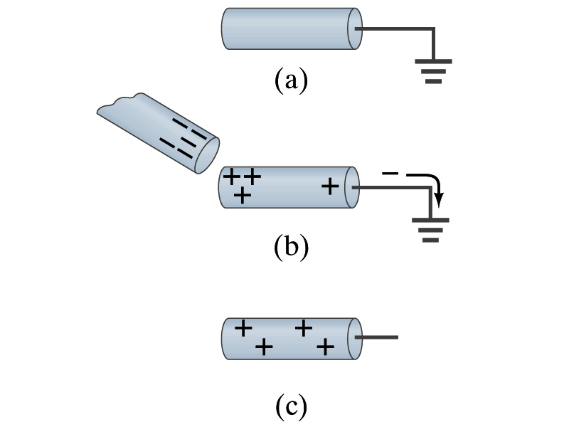
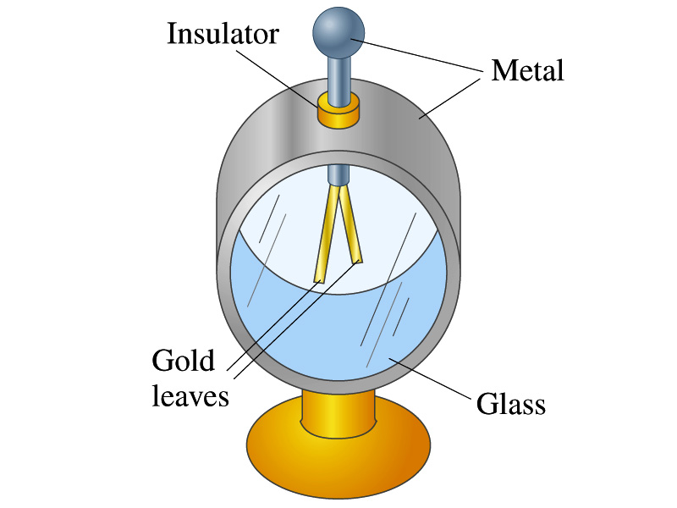
Induced Charge
ground
We can induce a net charge on a metal object by connecting a wire to the ground.
  The object is “grounded” or “earthed”.
Since it is so large and conducts, the Earth can give or accept charge.
  The Earth acts as a reservoir for charge.
If the negative charge is brought close to a neutral metal
  The positive charges will be induced toward the negatively charged metal.
  The negative charges in the neutral metal will be gathered on the opposite side, transferring through the wire to the Earth.
  If the wire is cut, the metal bar has net positive charge.
An electroscope is a device that can be used for detecting charge and signs.
  How does this work?

Slide 17
Coulomb’s Law
Electric charges exert force to each other. What factors affect the magnitude of this force?
  Any guesses?
Charles Coulomb figured this out in 1780’s.
Coulomb found that the electrical force is
  Proportional to the multiplication of the two charges
    If one of the charges doubles, the force doubles.
    If both the charges double, the force quadruples.
  Inversely proportional to the square of the distances between them.
  Electric charge is a fundamental property of matter, just like mass.
How would you put the above into a formula?

Slide 18
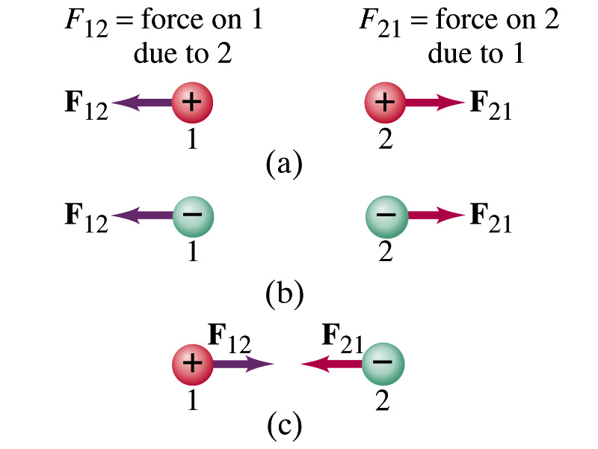
Coulomb’s Law – The Formula
Formula
Is Coulomb force a scalar quantity or a vector quantity? Unit?
  A vector quantity. The unit is Newtons (N)!
The direction of electric (Coulomb) force is always along the line joining the two objects.
  If the two charges are the same: forces are directed away from each other.
  If the two charges are opposite: forces are directed toward each other.
Coulomb force is precise to 1 part in 10¹⁶.
Unit of charge is called Coulomb, C, in SI.
The value of the proportionality constant, k, in SI unit is
Thus, 1C is the charge that gives F~9x10⁹N of force when placed 1m apart from each other.

Slide 19
Electric Force
and Gravitational Force
Extremely
Similar
Does the electric force look similar to another force? What is it?
  Gravitational Force
What are the sources of the forces?
  Electric Force: Electric charges, fundamental properties of matter
  Gravitational Force: Masses, fundamental properties of matter
What else is similar?
  Inversely proportional to the square of the distance between the sources of the force ➔ What is this kind law called?
    Inverse Square Law
What is the biggest difference?
  Gravitational force is always attractive.
  Electric force depends on the type of the two charges.

Slide 20
The Elementary Charge and Permittivity
Elementary charge, the smallest charge, is that of an electron:
  Since electron is a negatively charged particle, its charge is –e.
Object cannot gain or lose fraction of an electron.
  Electric charge is quantized.
    It changes always in integer multiples of e.
The proportionality constant k is often written in terms of another constant, ε₀, the permittivity* of free space. They are related and .
Thus the electric force can be written:
Note that this force is for “point” charges at rest.
*Mirriam-Webster, Permittivity: The ability of a material to store electric potential energy under the influence of an electric field

Slide 21
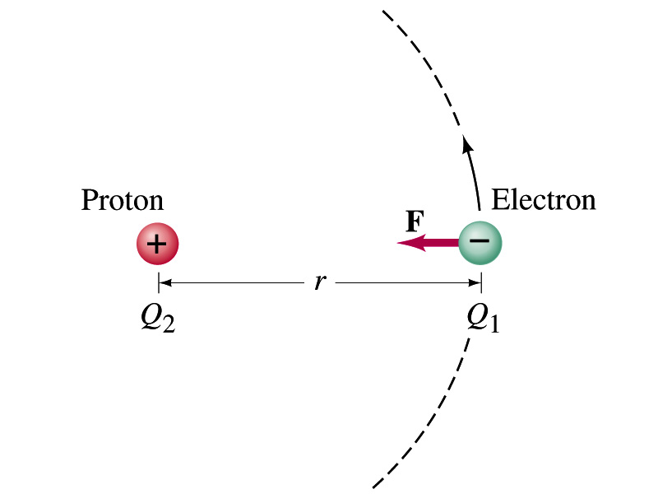
Example 21 – 1
Electric force on electron by proton. Determine the magnitude of the electric force on the electron of a hydrogen atom exerted by the single proton (Q₂=+e) that is its nucleus. Assume the electron “orbits” the proton at its average distance of r=0.53x10⁻¹⁰m.
Using Coulomb’s law
Each charge is
and
So the magnitude of the force is
Which direction?
Toward each other…

Slide 22
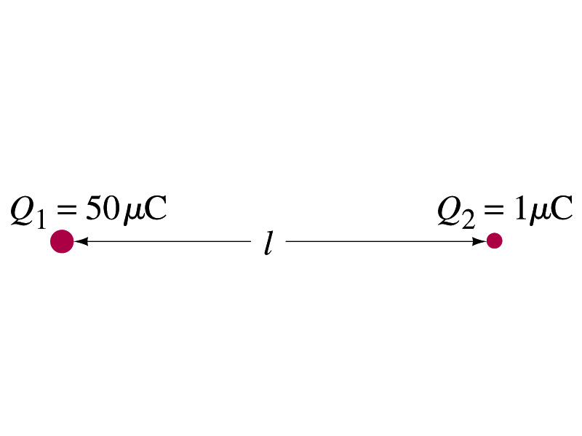
Example 21 – 2
Which charge exerts greater force? Two positive point charges, Q₁=50μC and Q₂=1μC, are separated by a distance L. Which is larger in magnitude, the force that Q₁ exerts on Q₂ or the force that Q₂ exerts on Q₁?
What is the force that Q₁ exerts on Q₂?
What is the force that Q₂ exerts on Q₁?
Therefore the magnitudes of the two forces are identical!!
Well then what is different?
The direction.
Which direction?
Opposite to each other!
What is this law?
Newton’s third law, the law of action and reaction!!

