Slide 1
PHYS 1444 – Section 004 Lecture #3
Wednesday, Jan. 25, 2012
Dr. Jaehoon Yu
Chapter 21
The Electric Field
Electric Field Lines
Electric Fields and Conductors
Motion of a Charged Particle in an Electric Field
Electric Dipoles

Slide 2
Announcements
Make sure to subscribe to the class e-mail distribution list PHYS1444-004-SP12 by clicking on the link https://listserv.uta.edu/cgi-bin/wa.exe?A0=PHYS1444-004-SP12
Only 12 of you have registered
A test message will be sent out today, Jan. 25
Homework registration
37/38 of you have registered for homework!!
37/37 submitted the homework #1 !! Yeah!!
You all got the 100% credit!
9/37 have already started working on HW2! Very good!

Slide 3
Reminder: Extra Credit Special Project #1
Compare the Coulomb force to the Gravitational force in the following cases by expressing Coulomb force (F_{C}) in terms of the gravitational force (F_{G})
Between two protons separated by 1m
Between two protons separated by an arbitrary distance R
Between two electrons separated by 1m
Between two electrons separated by an arbitrary distance R
Five points each, totaling 20 points
BE SURE to show all the details of your work, including all formulae, and properly referring them
Please staple them before the submission
Due at the beginning of the class Monday, Jan. 30

Slide 4
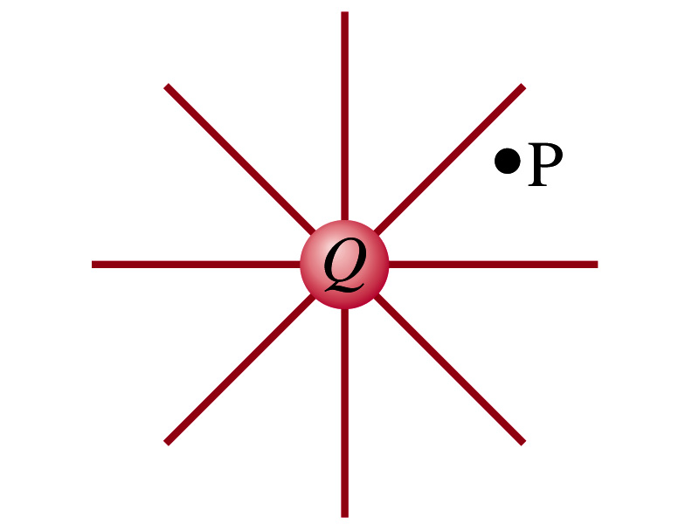
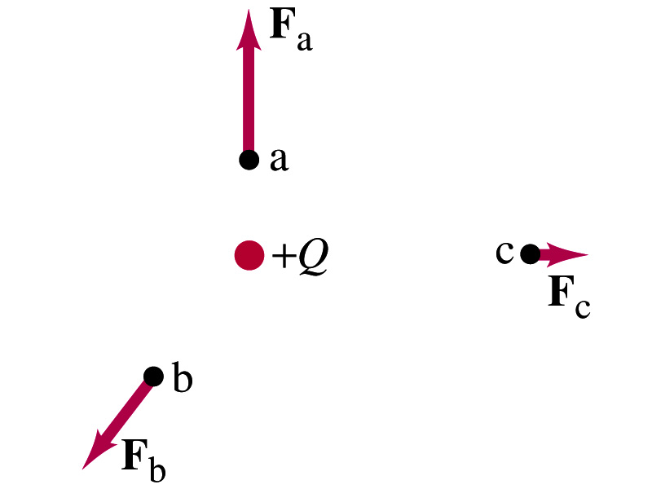
The Electric Field
Both gravitational and electric forces act over a distance without touching objects ➔ What kind of forces are these?
Field forces
Michael Faraday developed an idea of field.
Faraday (1791 – 1867) argued that the electric field extends outward from every charge and permeates through all of space.
Field by a charge or a group of charges can be inspected by placing a small positive test charge in the vicinity and measuring the force on it.

Slide 5
The Electric Field, cnt’d
The electric field at any point in space is defined as the force exerted on a tiny positive test charge divide by magnitude of the test charge
Electric force per unit charge
What kind of quantity is the electric field?
A vector quantity. Why?
What is the unit of the electric field?
N/C
What is the magnitude of the electric field at a distance r from a single point charge Q?

Slide 6
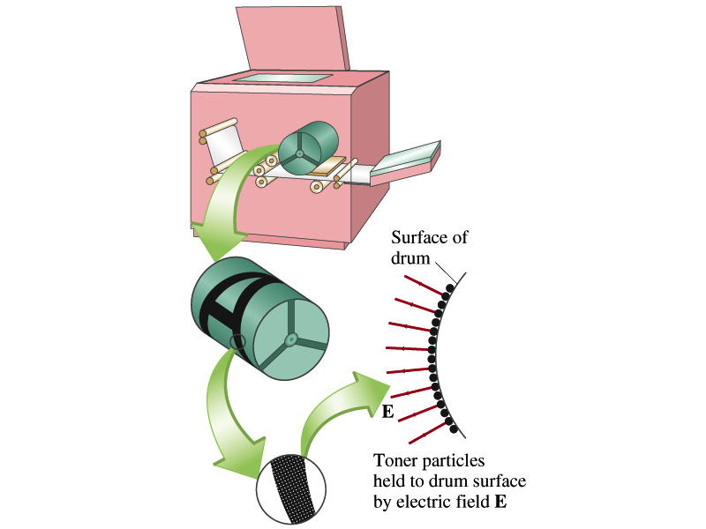
Example 21 – 5
Electrostatic copier. An electrostatic copier works by selectively arranging positive charges (in a pattern to be copied) on the surface of a nonconducting drum, then gently sprinkling negatively charged dry toner (ink) onto the drum. The toner particles temporarily stick to the pattern on the drum and are later transferred to paper and “melted” to produce the copy. Suppose each toner particle has a mass of 9.0x10⁻¹⁶kg and carries the average of 20 extra electrons to provide an electric charge. Assuming that the electric force on a toner particle must exceed twice its weight in order to ensure sufficient attraction, compute the required electric field strength near the surface of the drum.
The electric force must be the same as twice the gravitational force on the toner particle.
So we can write
Thus, the magnitude of the electric field is

Slide 7
Direction of the Electric Field
If there are more than one charge, the individual fields due to each charge are added vectorially to obtain the total field at any point.
This superposition principle of electric field has been verified experimentally.
For a given electric field E at a given point in space, we can calculate the force F on any charge q, F=qE.
What happens to the direction of the force and the field depending on the sign of the charge q?
The two are in the same directions if q>0
The two are in opposite directions if q<0

Slide 8
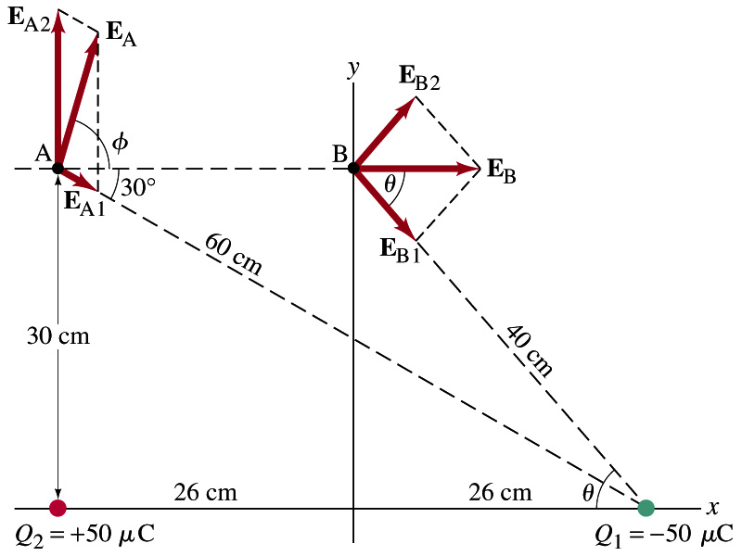
Example 21 – 8
E above two point charges: Calculate the total electric field (a) at point A and (b) at point B in the figure on the right due to the both charges Q₁ and Q₂.
How do we solve this problem?
First, compute the magnitude of fields at each point due to each of the two charges.
Then add them at each point vectorially!
First, the electric field at point A by Q₁ and then Q₂.

Slide 9
Example 21 – 8, cnt’d
Now the components of the electric field vectors by the two charges at point A.
So the electric field at point A is
The magnitude of the electric field at point A is
Now onto the electric field at point B

Slide 10
Example 21 – 8, cnt’d
Electric field at point B is easier due to symmetry!
Since the magnitude of the charges are the same and the distance to point B from the two charges are the same, the magnitude of the electric field by the two charges at point B are the same!!
Now the components!
First, the y-component!
Now, the x-component!
So the electric field at point B is
The magnitude of the electric field at point B

Slide 11
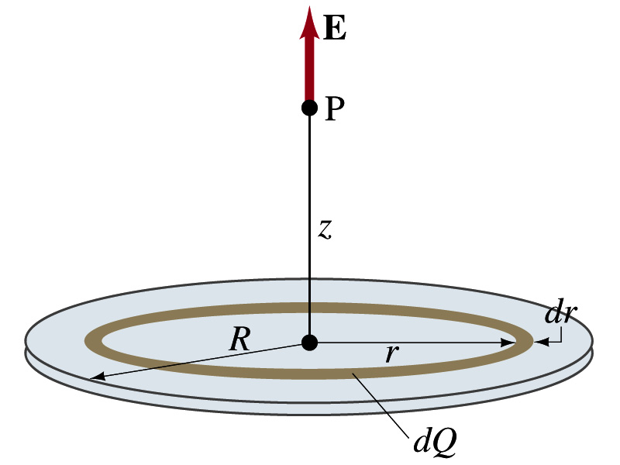
Example 21 – 12
Uniformly charged disk: Charge is distributed uniformly over a thin circular disk of radius R. The charge per unit area (C/m²) is σ. Calculate he electric field at a point P on the axis of the disk, a distance z above its center.
How do we solve this problem?
First, compute the magnitude of the field (dE) at point P due to the charge (dQ) on the ring of infinitesimal width dr.
From the result of example 21 – 11 (please do this problem yourself)
Since the surface charge density is constant, σ, and the ring has an area of 2πrdr, the infinitesimal charge of dQ is
So the infinitesimal field dE can be written

Slide 12
Example 21 – 12 cnt’d
Now integrating dE over 0 through R, we get
What happens if the disk has infinitely large area?
So the electric field due to an evenly distributed surface charge with density, σ, is

Slide 13
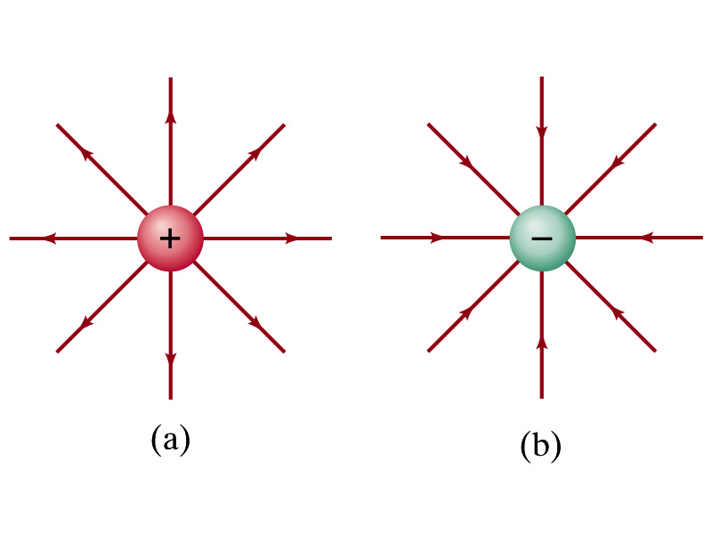
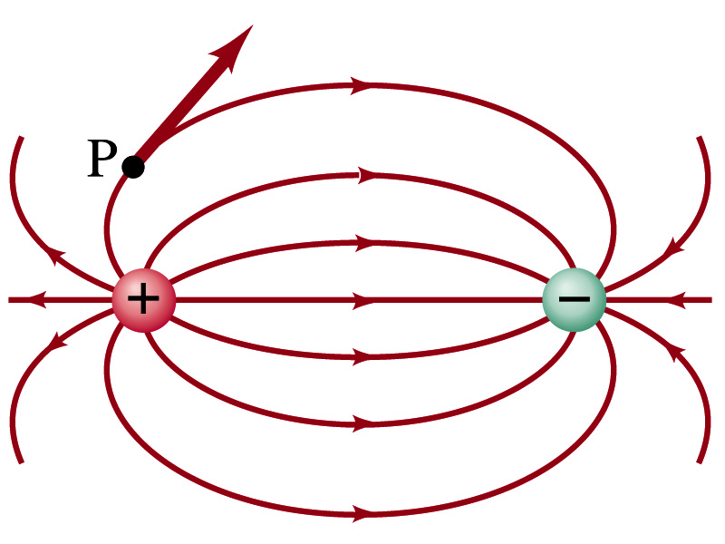
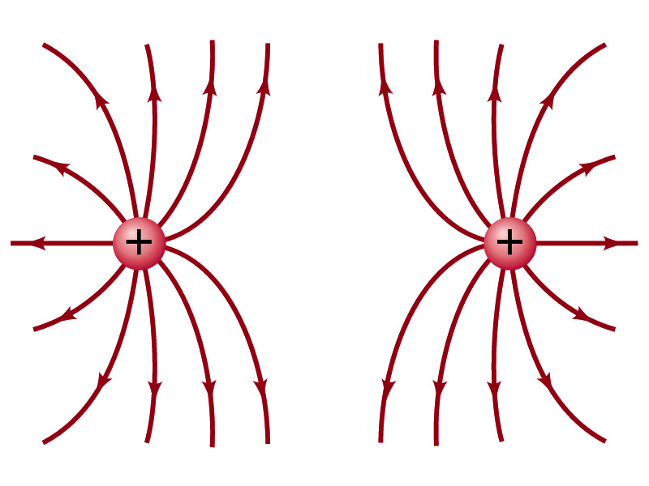
Field Lines
The electric field is a vector quantity. Thus, its magnitude can be expressed by the length of the vector and the direction by the direction the arrowhead points.
Since the field permeates through the entire space, drawing vector arrows is not a good way of expressing the field.
Electric field lines are drawn to indicate the direction of the force due to the given field on a positive test charge.
Number of lines crossing unit area perpendicular to E is proportional to the magnitude of the electric field.
The closer the lines are together, the stronger the electric field in that region.
Start on positive charges and end on negative charges.
Earth’s G-field lines

