Slide 1
PHYS 1444 – Section 004 Lecture #4
Monday, Jan. 30, 2012
Dr. Jaehoon Yu
Chapter 21
Electric Field Lines
Electric Fields and Conductors
Motion of a Charged Particle in an Electric Field
Electric Dipoles
Today’s homework is homework #3, due 10pm, Tuesday, Feb. 7!!

Slide 2
Announcements
I still have about half of you who haven’t subscribed to the class e-mail distribution list PHYS1444-004-SP12. Please be sure to subscribe by clicking on the link https://listserv.uta.edu/cgi-bin/wa.exe?A0=PHYS1444-004-SP12
Only 14 of you have registered
A test message was sent out Saturday, Jan. 28
Quiz results
Class Average: 17/45
Equivalent to 36.7/100
Top score: 33/45
Reading assignments
CH21.12 and CH21.13
Colloquium this Wednesday
4:00pm in SH101

Slide 3
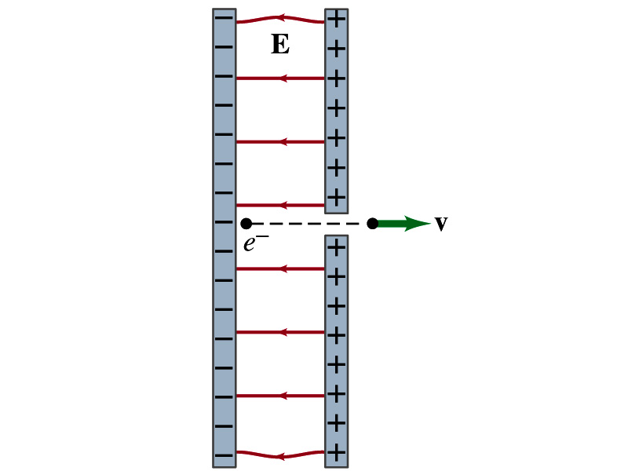
Special Project
Particle Accelerator. A charged particle of mass M with charge -Q is accelerated in the uniform field E between two parallel charged plates whose separation is D as shown in the figure on the right. The charged particle is accelerated from an initial speed v₀ near the negative plate and passes through a tiny hole in the positive plate.
Derive the formula for the electric field E to accelerate the charged particle to fraction f of the speed of light c. Express E in terms of M, Q, D, f, c and v₀.
(a) Using the Coulomb force and kinematic equations. (8 points)
(b) Using the work-kinetic energy theorem. ( 8 points)
(c) Using the formula above, evaluate the strength of the electric field E to accelerate an electron from 0.1% of the speed of light to 90% of the speed of light. You need to look up the relevant constants, such as mass of the electron, charge of the electron and the speed of light. (5 points)
Due beginning of the class Monday, Feb. 13

Slide 5
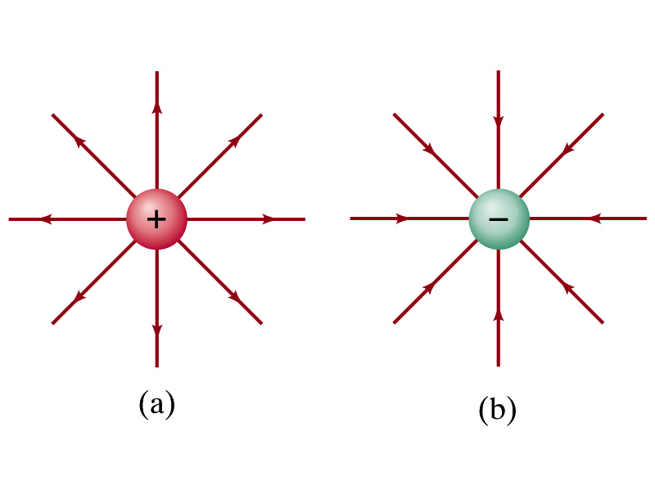
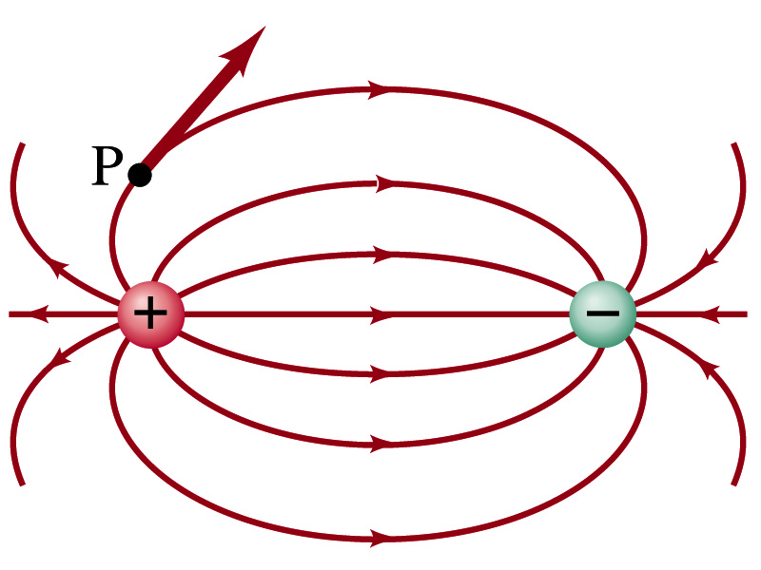
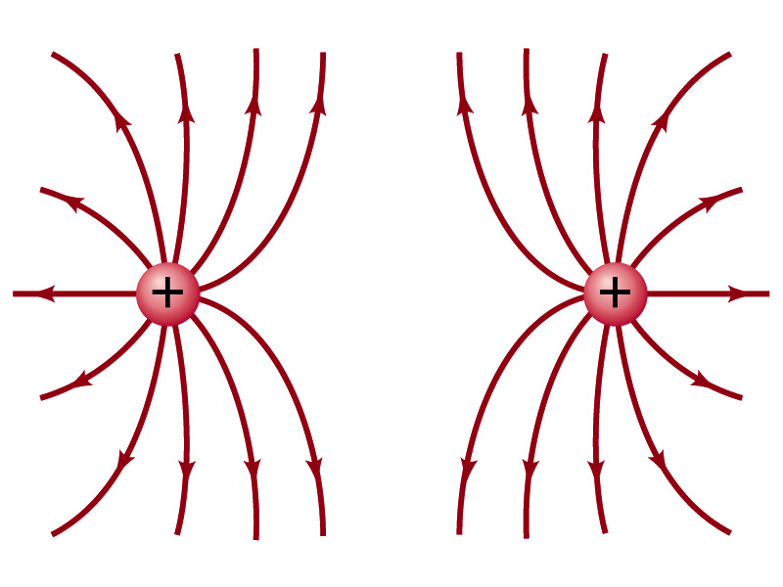
Field Lines
The electric field is a vector quantity. Thus, its magnitude can be expressed by the length of the vector and the direction by the direction the arrowhead points.
Since the field permeates through the entire space, drawing vector arrows is not a good way of expressing the field.
Electric field lines are drawn to indicate the direction of the force due to the given field on a positive test charge.
Number of lines crossing unit area perpendicular to E is proportional to the magnitude of the electric field.
The closer the lines are together, the stronger the electric field in that region.
Start on positive charges and end on negative charges.
Earth’s G-field lines

Slide 6
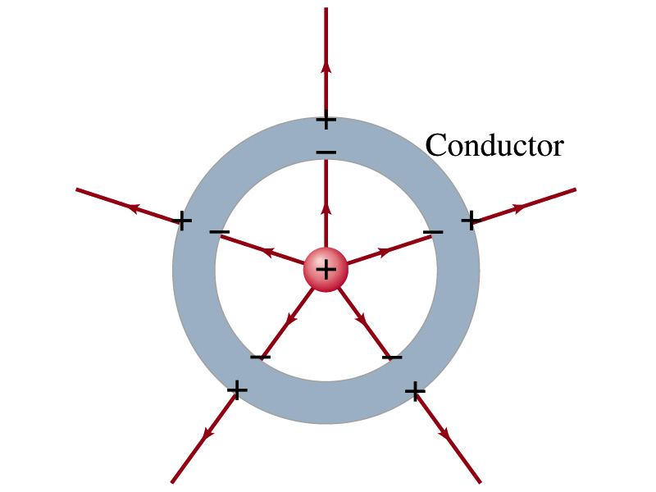
Electric Fields and Conductors
The electric field inside a conductor is ZERO in the static situation. (If the charge is at rest.) Why?
If there were an electric field within a conductor, there would be force on its free electrons.
The electrons will move until they reached positions where the electric field become zero.
Electric field can exist inside a non-conductor.
Consequences of the above
Any net charge on a conductor distributes itself on the surface.
Although no field exists inside a conductor, the fields can exist outside the conductor due to induced charges on either surface
The electric field is always perpendicular to the surface outside of a conductor.

Slide 7
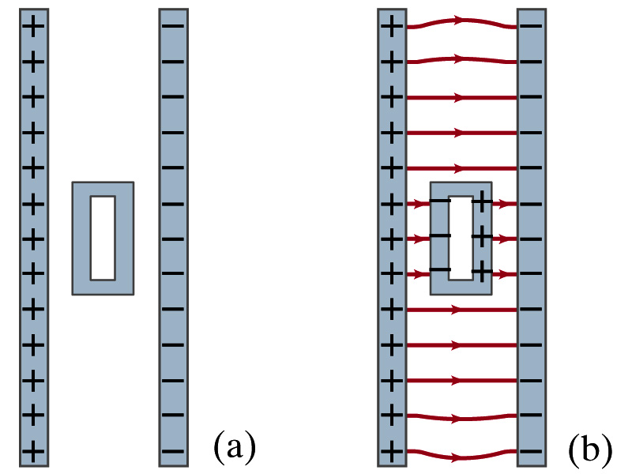
Example 21-13
Shielding, and safety in a storm. A hollow metal box is placed between two parallel charged plates. What is the field like in the box?
If the metal box were solid
The free electrons in the box would redistribute themselves along the surface so that the field lines would not penetrate into the metal.
The free electrons do the same in hollow metal boxes just as well as it did in a solid metal box.
Thus a conducting box is an effective device for shielding. ➔ Faraday cage
So what do you think will happen if you were inside a car when the car was struck by a lightening?

Slide 8
Motion of a Charged Particle in an Electric Field
If an object with an electric charge q is at a point in space where electric field is E, the force exerting on the object is .
What do you think will happen to the charge?
Let’s think about the cases like these on the right.
The object will move along the field line…Which way?
Depends on the sign of the charge
The charge gets accelerated under an electric field.

Slide 9
Example 21 – 14
Electron accelerated by electric field. An electron (mass m = 9.1x10⁻³¹kg) is accelerated in the uniform field E (E=2.0x10⁴N/C) between two parallel charged plates. The separation of the plates is 1.5cm. The electron is accelerated from rest near the negative plate and passes through a tiny hole in the positive plate. (a) With what speed does it leave the hole? (b) Show that the gravitational force can be ignored. Assume the hole is so small that it does not affect the uniform field between the plates.
The magnitude of the force on the electron is F=qE and is directed to the right. The equation to solve this problem is
The magnitude of the electron’s acceleration is
Between the plates the field E is uniform, thus the electron undergoes a uniform acceleration

Slide 10
Example 21 – 14
Since the travel distance is 1.5x10⁻²m, using one of the kinetic eq. of motions,
Since there is no electric field outside the conductor, the electron continues moving with this speed after passing through the hole.
(b) Show that the gravitational force can be ignored. Assume the hole is so small that it does not affect the uniform field between the plates.
The magnitude of the electric force on the electron is
The magnitude of the gravitational force on the electron is
Thus the gravitational force on the electron is negligible compared to the electromagnetic force.

Slide 11
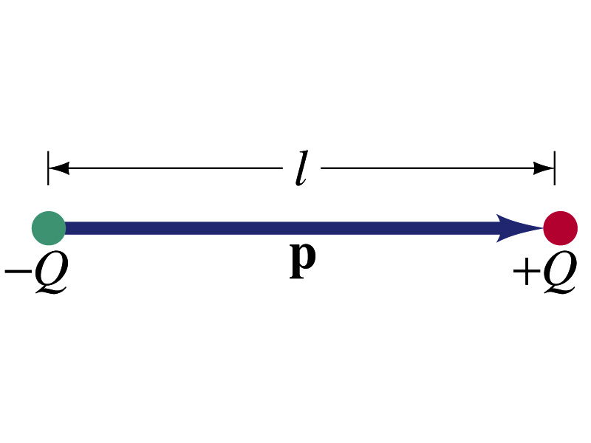
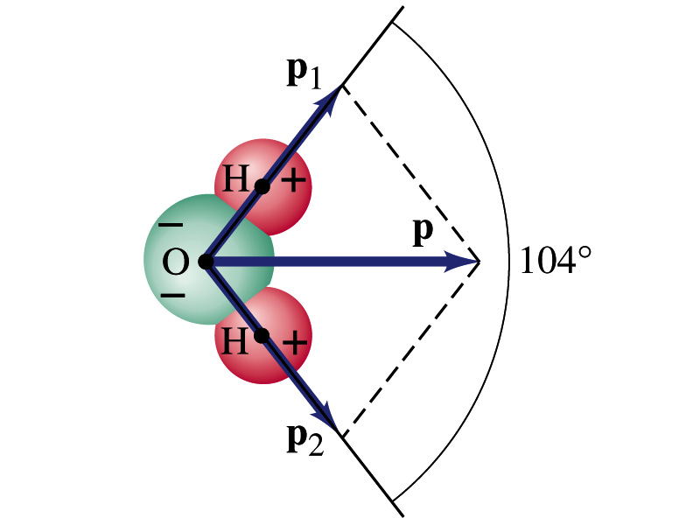
Electric Dipoles
An electric dipole is the combination of two equal charges of opposite signs, +Q and –Q, separated by a distance l, which behaves as one entity.
The quantity Ql is called the electric dipole moment and is represented by the symbol p.
The dipole moment is a vector quantity, p
The magnitude of the dipole moment is Ql. Unit?
Its direction is from the negative to the positive charge.
Many of diatomic molecules like CO have a dipole moment. ➔ These are referred as polar molecules.
Even if the molecule is electrically neutral, their sharing of electron causes separation of charges
Symmetric diatomic molecules, such as O₂, do not have dipole moment.
C-m
The water molecule also has a dipole moment which is the vector sum of two dipole moments between Oxygen and each of Hydrogen atoms.

Slide 12
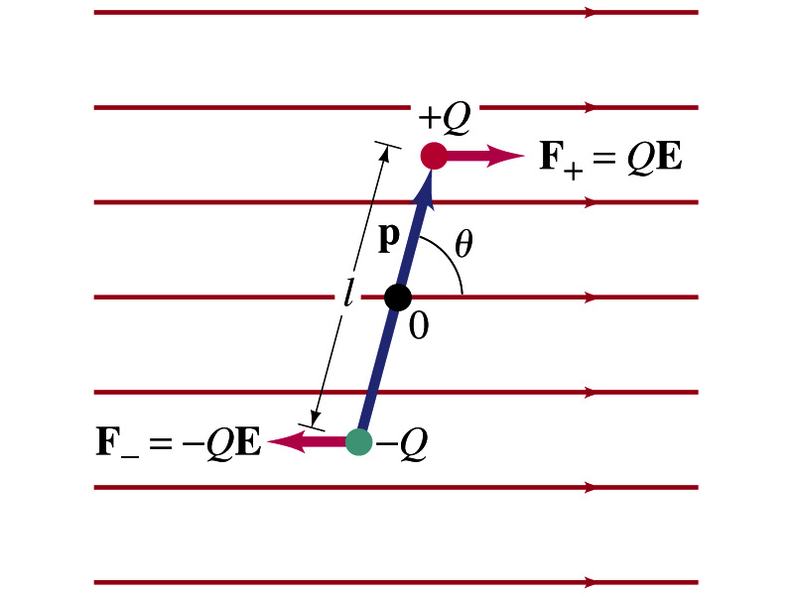
Dipoles in an External Field
Let’s consider a dipole placed in a uniform electric field E.
What do you think will happen to the dipole in the figure?
Forces will be exerted on the charges.
The positive charge will get pushed toward right while the negative charge will get pulled toward left.
What is the net force acting on the dipole?
Zero
So will the dipole not move?
Yes, it will.
Why?
There is a torque applied on the dipole.

Slide 13
Dipoles in an External Field, cnt’d
How much is the torque on the dipole?
Do you remember the formula for torque?
The magnitude of the torque exerting on each of the charges with respect to the rotational axis at the center is
Thus, the total torque is
So the torque on a dipole in vector notation is
The effect of the torque is to try to turn the dipole so that the dipole moment is parallel to E. Which direction?

Slide 14
Potential Energy of a Dipole in an External Field
What is the work done on the dipole by the electric field to change the angle from θ₁ to θ₂?
The torque is .
Thus the work done on the dipole by the field is
What happens to the dipole’s potential energy, U, when a positive work is done on it by the field?
It decreases.
We choose U=0 when θ₁=90 degrees, then the potential energy at θ₂=θ becomes
Why negative?
Because τ and θ are opposite directions to each other.

Slide 15
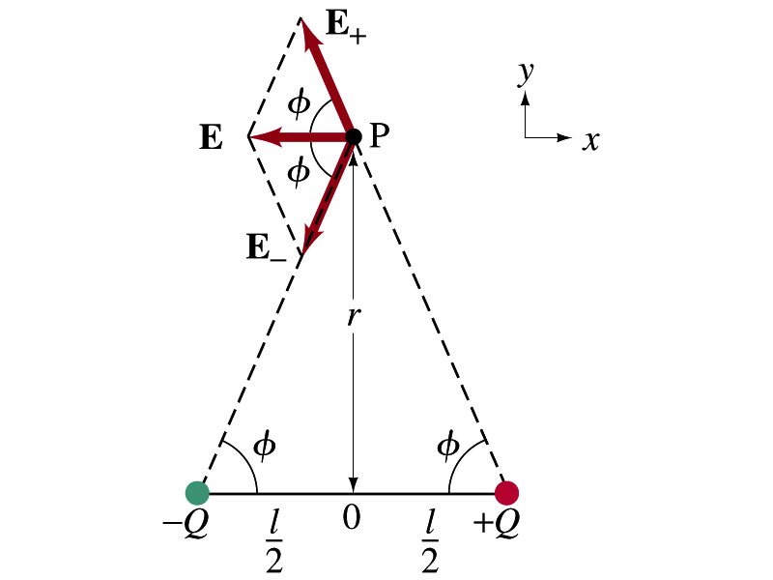
Electric Field by a Dipole
Let’s consider the case in the picture.
There are fields by both the charges. So the total electric field by the dipole is
The magnitudes of the two fields are equal
Now we must work out the x and y components of the total field.
Sum of the two y components is
Zero since they are the same but in opposite direction
So the magnitude of the total field is the same as the sum of the two x-components:

Slide 16
Dipole Electric Field from Afar
What happens when r>>l?.
Why does this make sense?
Since from a long distance, the two charges are very close so that the overall charge gets close to 0!!
This dependence works for the point not on the bisecting line as well

Slide 17
Example 21 – 17
Dipole in a field. The dipole moment of a water molecule is 6.1x10⁻³⁰C-m. A water molecule is placed in a uniform electric field with magnitude 2.0x10⁵N/C. (a) What is the magnitude of the maximum torque that the field can exert on the molecule? (b) What is the potential energy when the torque is at its maximum? (c) In what position will the potential energy take on its greatest value? Why is this different than the position where the torque is maximized?
(a) The torque is maximized when θ=90 degrees. Thus the magnitude of the maximum torque is
What is the distance between a hydrogen atom and the oxygen atom?

Slide 18
Example 21 – 17
(b) What is the potential energy when the torque is at its maximum?
Since the dipole potential energy is
And τ is at its maximum at θ=90 degrees, the potential energy, U, is
Is the potential energy at its minimum at θ=90 degrees?
No
Why not?
Because U will become negative as θ increases.
(c) In what position will the potential energy take on its greatest value?
The potential energy is maximum when cosθ= -1, θ=180 degrees.
Why is this different than the position where the torque is maximized?
The potential energy is maximized when the dipole is oriented so that it has to rotate through the largest angle against the direction of the field, to reach the equilibrium position at θ=0.
Torque is maximized when the field is perpendicular to the dipole, θ=90.

