Slide 1
PHYS 1444 – Section 004 Lecture #7
Wednesday, Feb. 8, 2012
Dr. Alden Stradeling
Chapter 23 Electric Potential
Electric Potential & Electric Field
Electric Potential due to Point Charges
Shape of the Electric Potential
V due to Charge Distributions
Equi-potential Lines and Surfaces
Electric Potential Due to Electric Dipole

Slide 2
Announcements
First term exam
5:30 – 6:50pm, Wednesday, Feb. 22
SH103
CH21.1 through what we learn on Monday, Feb. 20 plus appendices A and B
Reading assignments
CH23.9

Slide 3
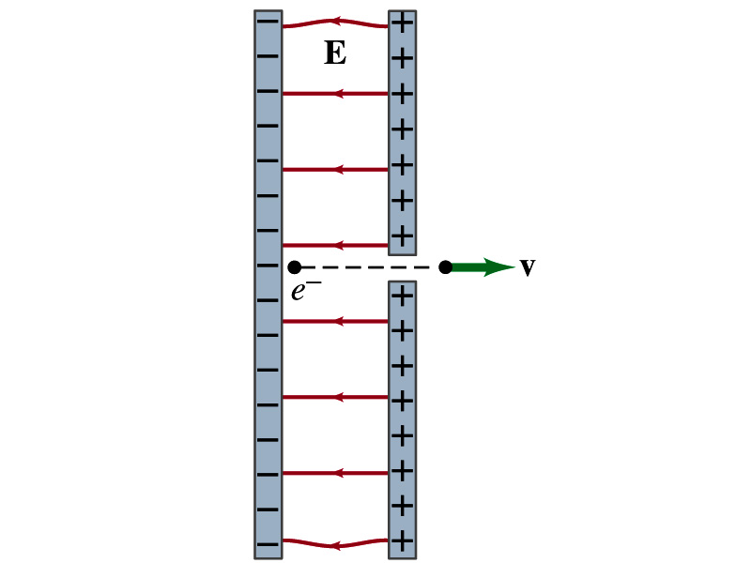
Reminder: Special Project
Particle Accelerator. A charged particle of mass M with charge -Q is accelerated in the uniform field E between two parallel charged plates whose separation is D as shown in the figure on the right. The charged particle is accelerated from an initial speed v₀ near the negative plate and passes through a tiny hole in the positive plate.
Derive the formula for the electric field E to accelerate the charged particle to a fraction f of the speed of light c. Express E in terms of M, Q, D, f, c and v₀.
(a) Using the Coulomb force and kinematic equations. (8 points)
(b) Using the work-kinetic energy theorem. ( 8 points)
(c) Using the formula above, evaluate the strength of the electric field E to accelerate an electron from 0.1% of the speed of light to 90% of the speed of light. You need to look up the relevant constants, such as mass of the electron, charge of the electron and the speed of light. (5 points)
Due beginning of the class Monday, Feb. 13

Slide 4
Electric Potential and Electric Field
The effect of a charge distribution can be described in terms of electric field or electric potential.
What kind of quantities are the electric field and the electric potential?
Electric Field:
Electric Potential:
Since electric potential is a scalar quantity, it is often easier to handle.
Well other than the above, what are the connections between these two quantities?
Vector
Scalar

Slide 5
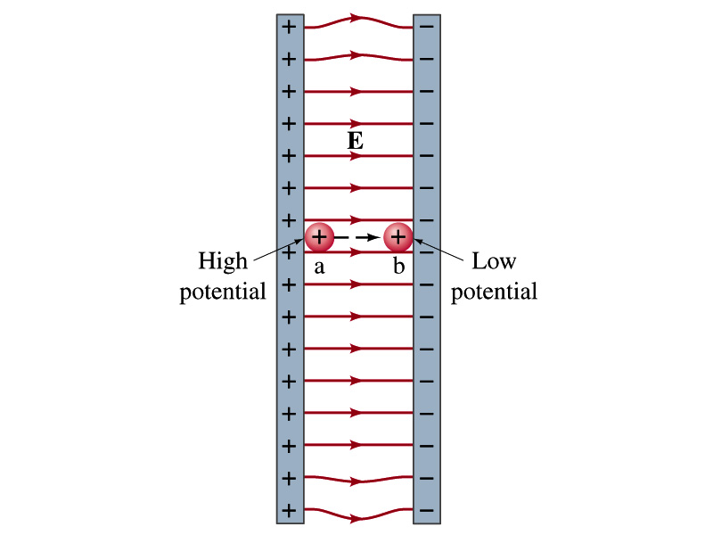
Electric Potential and Electric Field
The potential energy is expressed in terms of a conservative force
For the electrical case, we are more interested in the potential difference:
This formula can be used to determine V_{ba} when the electric field is given.
When the field is uniform and parallel to the path
or
Unit of the electric field in terms of potential?
V/m
Can you derive this from N/C?

Slide 6
Example 23 – 3
Uniform electric field obtained from voltage: Two parallel plates are charged to a voltage of 50V. If the separation between the plates is 5.0cm, calculate the magnitude of the electric field between them, ignoring any fringe effect.
5cm
50V
What is the relationship between electric field and the potential for a uniform field?
Solving for E

Slide 7
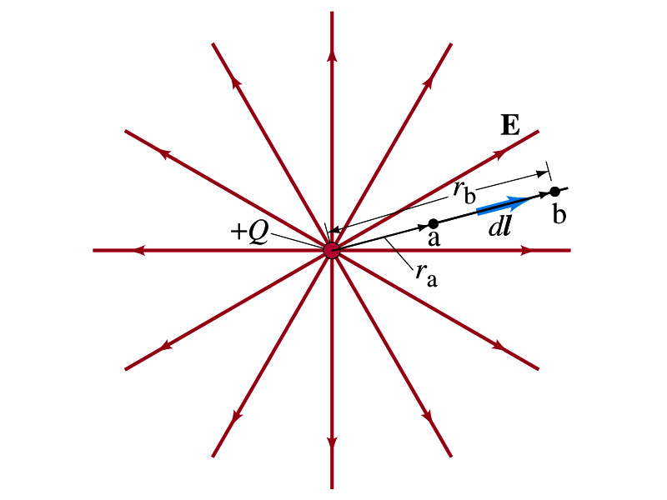
Electric Potential due to Point Charges
What is the electric field by a single point charge Q at a distance r?
Electric potential due to the field E for moving from point r_{a} to r_{b} in radial direction away from the charge Q is

Slide 8
Electric Potential due to Point Charges
Since only the differences in potential have physical meaning, we can choose at .
The electrical potential V at a distance r from a single point charge Q is
So the absolute potential by a single point charge can be thought of the potential difference by a single point charge between r and infinity

Slide 9
Properties of the Electric Potential
What are the differences between the electric potential and the electric field?
Electric potential
Electric potential energy per unit charge
Inversely proportional to the distance
Simply add the potential by each of the charges to obtain the total potential from multiple charges, since potential is a scalar quantity
Electric field
Electric force per unit charge
Inversely proportional to the square of the distance
Need vector sums to obtain the total field from multiple charges
Potential for the positive charge is larger near the charge and decreases towards 0 at large distance.
Potential for the negative charge is large negative near the charge and increases towards 0 at a large distance.

Slide 10
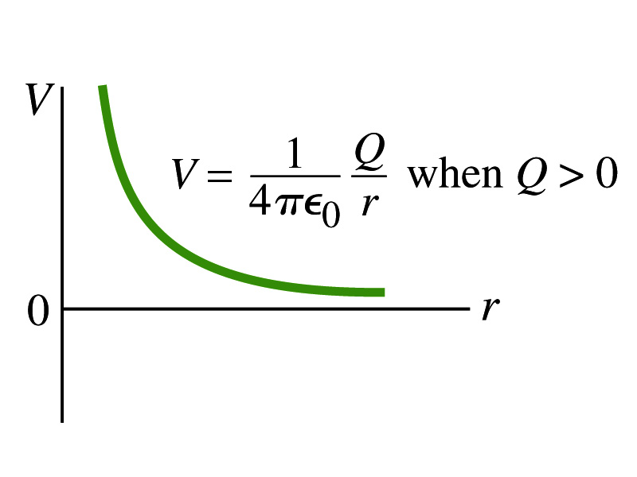
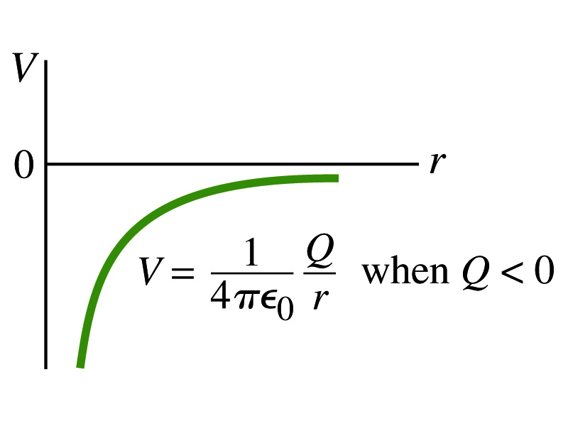
Shape of the Electric Potential
So, how does the electric potential look like as a function of distance?
What is the formula for the potential by a single charge?
Positive Charge
Negative Charge
Uniformly charged sphere would have the potential the same as a single point charge.
What does this mean?
Uniformly charged sphere behaves like all the charge is on the single point in the center.

Slide 11
Example 23 – 6
Work to bring two positive charges close together: What minimum work is required by an external force to bring a charge q=3.00μC from a great distance away (r=∞) to a point 0.500m from a charge Q=20.0 μC?
What is the work done by the electric field in terms of potential energy and potential?
Since we obtain
Electric force does negative work. In other words, the external force must work +1.08J to bring the charge 3.00μC from infinity to 0.500m to the charge 20.0μC.

Slide 12
Electric Potential by Charge Distributions
Let’s consider a case of n individual point charges in a given space and V=0 at r=∞.
Then the potential Via due to the charge Q_{i} at a point a, distance r_{ia} from Q_{i} is
Thus the total potential V_{a} by all n point charges is
For a continuous charge distribution, we obtain

Slide 13
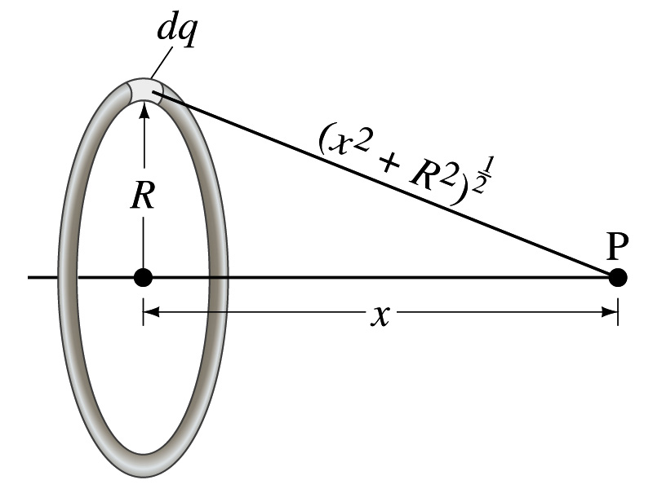
Example 23 – 8
Potential due to a ring of charge: A thin circular ring of radius R carries a uniformly distributed charge Q. Determine the electric potential at a point P on the axis of the ring a distance x from its center.
Each point on the ring is at the same distance from the point P. What is the distance?
So the potential at P is
What’s this?

Slide 14
Equi-potential Surfaces
Electric potential can be graphically shown using the equipotential lines in 2-D or the equipotential surfaces in 3-D
Any two points on the equipotential surfaces (lines) are on the same potential
What does this mean in terms of the potential difference?
The potential difference between two points on an equipotential surface is 0.
How about the potential energy difference?
Also 0.
What does this mean in terms of the work to move a charge along the surface between these two points?
No work is necessary to move a charge between these two points.

Slide 15
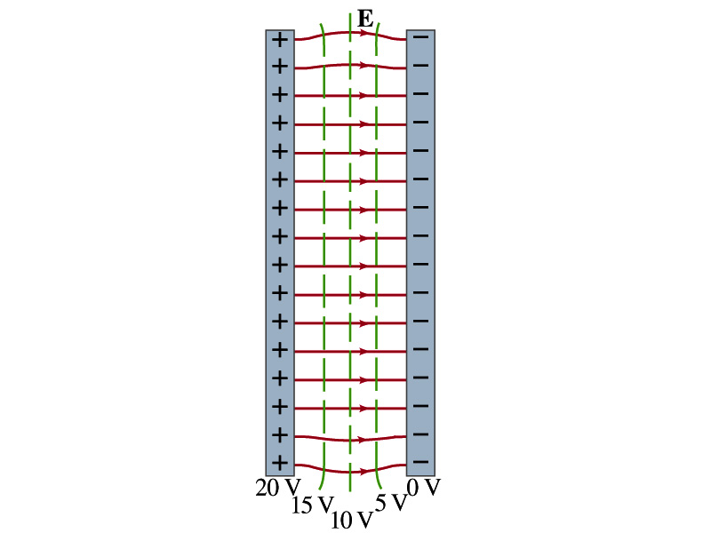
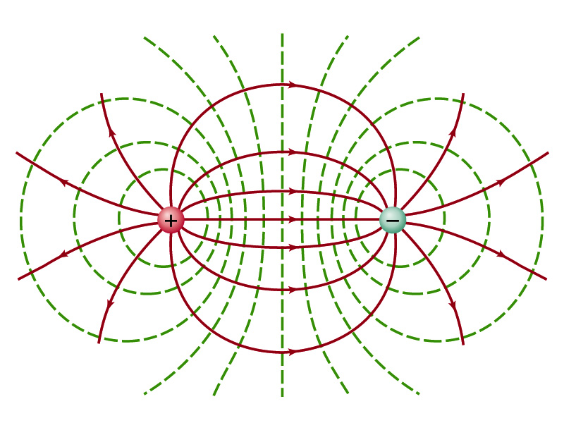
Equi-potential Surfaces
An equipotential surface (line) must be perpendicular to the electric field. Why?
If there are any parallel components to the electric field, it would require work to move a charge along the surface.
Since the equipotential surface (line) is perpendicular to the electric field, we can draw these surfaces or lines easily.
Since there can be no electric field within a conductor in a static case, the entire volume of a conductor must be at the same potential.
So the electric field must be perpendicular to the conductor surface.
Parallel Plate
Point charges
Just like a topological map

Slide 16
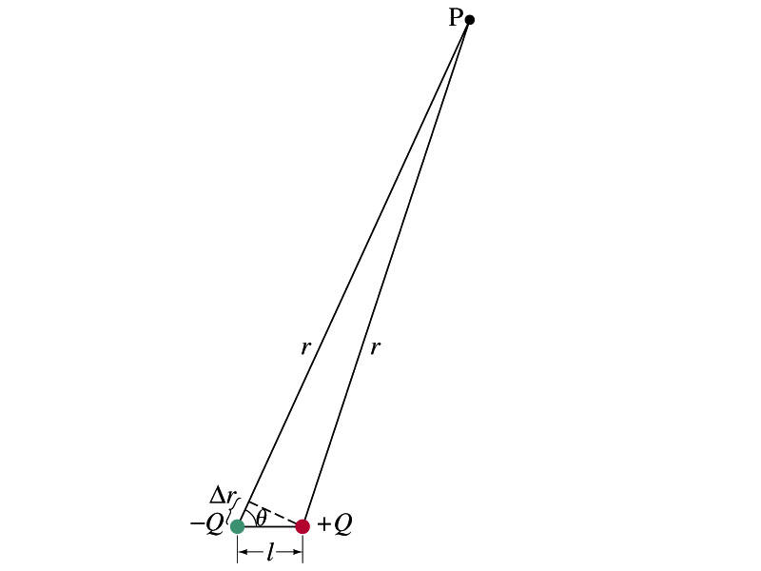
Electric Potential due to Electric Dipoles
What is an electric dipole?
Two equal point charge Q of opposite signs separated by a distance l and behaves like one entity: P=Ql
For the electric potential due to a dipole at a point p
We take V=0 at r=∞
The simple sum of the potential at p by the two charges is
Since Δr=lcosθ and if r>>l, r>>Δr, thus r~r+Δr and
V by a dipole at a
distance r from
the dipole

