Slide 1
PHYS 1444 – Section 004
Lecture #8
Monday, Feb. 13, 2012
Dr. Jae Yu
Chapter Chapter 23 Electric Potential
  E Determined from V
  Electrostatic Potential
Chapter 24 Capacitance etc..
  Capacitors
  Determination of Capacitance
  Capacitors in Series or Parallel
Today’s homework is homework #5, due 10pm, Tuesday, Feb. 21!!

Slide 2
Announcements
First term exam
  5:30 – 6:50pm, Wednesday, Feb. 22
  SH103
  CH21.1 through what we learn on Monday, Feb. 20 plus appendices A and B
Reading assignments
  CH23.9
Colloquium this week
  4pm Wednesday, SH101
  Dr. Haiying Huang, UTA MAE
  Mark your calendar on triple credit colloquium on April 4.
    Dr. Youngkee Kim

Slide 3
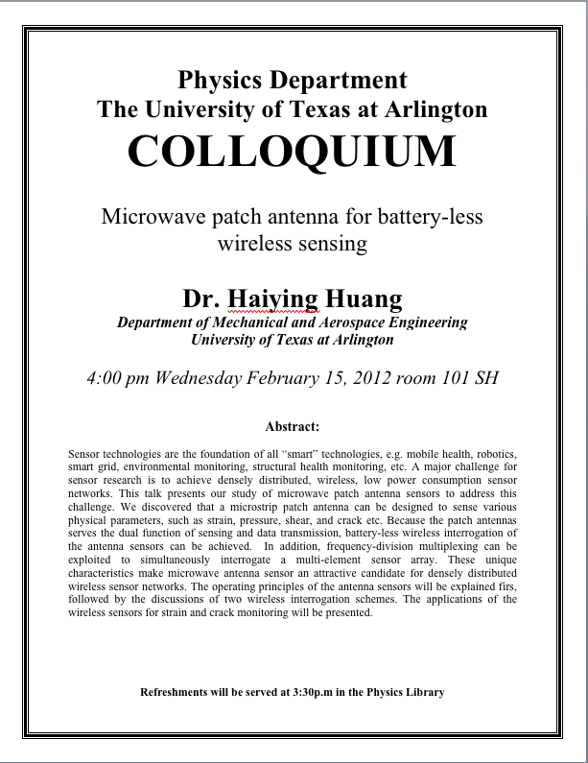

Slide 4
E Determined from V
Potential difference between two points under the electric field is
So in the differential form, we can write
  What are dV and E_{l}?
    dV is the infinitesimal potential difference between the two points separated by the distance dl
    E_{l} is the field component along the direction of dl.
Thus we can write the field component E_{l} as
The component of the electric field in any direction is equal to the negative rate of change of the electric potential as a function of distance in that direction.!!
Physical Meaning?

Slide 5
E Determined from V
The quantity dV/dl is called the gradient of V in a particular direction
  If no direction is specified, the term gradient refers to the direction on which V changes most rapidly and this would be the direction of the field vector E at that point.
  So if E and dl are parallel to each other,
If E is written as a function x, y and z, then l refers to x, y and z
is the “partial derivative” of V with respect to x, with y and z held constant
In vector form,
is called the del or the gradient operator and is a vector operator.

Slide 6
Electrostatic Potential Energy
Consider a case in which a point charge q is moved between points a and b where the electrostatic potential due to other charges in the system is V_{a} and V_{b}
The change in electrostatic potential energy of q in the field by other charges is
Now what is the electrostatic potential energy of a system of charges?
  Let’s choose V=0 at r=∞
  If there are no other charges around, single point charge Q₁ in isolation has no potential energy and is exerted on with no electric force

Slide 7
Electrostatic Potential Energy; Two charges
If a second point charge Q₂ is brought close to Q₁ at the distance r₁₂, the potential due to Q₁ at the position of Q₂ is
The potential energy of the two charges relative to V=0 at r= ∞ is
  This is the work that needs to be done by an external force to bring Q₂ from infinity to a distance r₁₂ from Q₁.
  It is also the negative of the work needed to separate them to infinity.

Slide 8
Electrostatic Potential Energy; Three Charges
So what do we do for three charges?
Work is needed to bring all three charges together
  Work needed to bring Q₁ to a certain location without the presence of any charge is 0.
  Work needed to bring Q₂ to a distance to Q₁ is
  Work need to bring Q₃ to a distance to Q₁ and Q₂ is
So the total electrostatic potential of a three charge system is
  What about a four charge system or N charge system?

Slide 9
Electrostatic Potential Energy: electron Volt
What is the unit of the electrostatic potential energy?
  Joules
Joules is a very large unit in atomic scale problems, dealing with electrons, atoms or molecules
For convenience, a new unit, electron volt (eV), is defined
  1 eV is defined as the energy acquired by a particle carrying the charge equal to that of an electron (q=e) when it moves across a potential difference of 1V.
  How many Joules is 1 eV then?
eV however is NOT a standard SI unit. You must convert the energy to Joules for computations.
What is the speed of an electron with kinetic energy 5000eV?

Slide 10
Capacitors (or Condensers)
What is a capacitor?
  A device that can store electric charge
  But does not let them flow through
What does it consist of?
  Usually consists of two conducting objects (plates or sheets) placed near each other without touching
  Why can’t they touch each other?
    The charge will neutralize…
Can you give some examples?
  Camera flash, UPS, Surge protectors, binary circuits, memory, etc…
How is a capacitor different than a battery?
  Battery provides potential difference by storing energy (usually chemical energy) while the capacitor stores charges but very little energy.

Slide 11
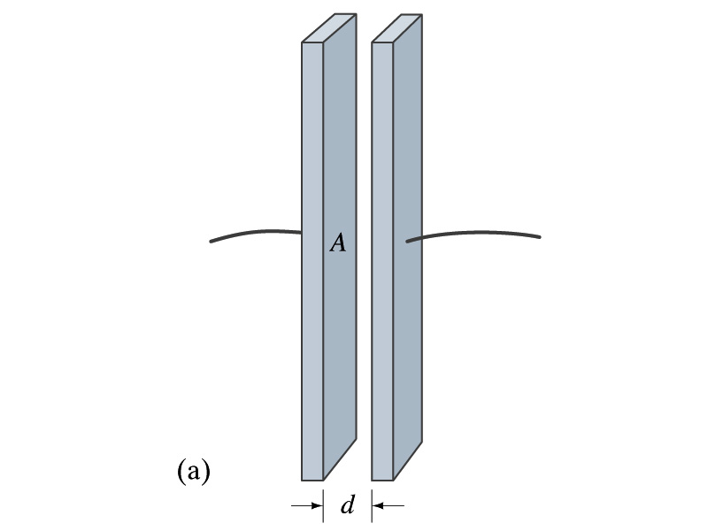
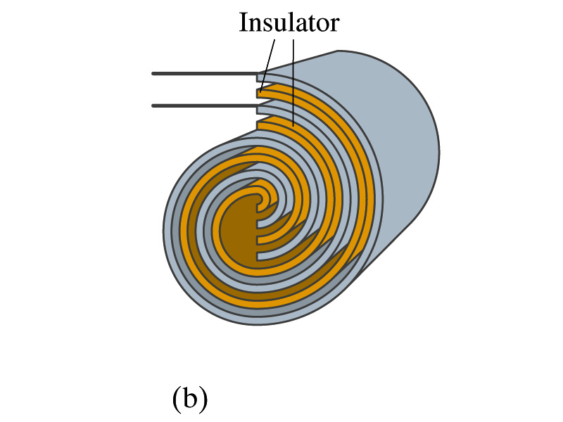
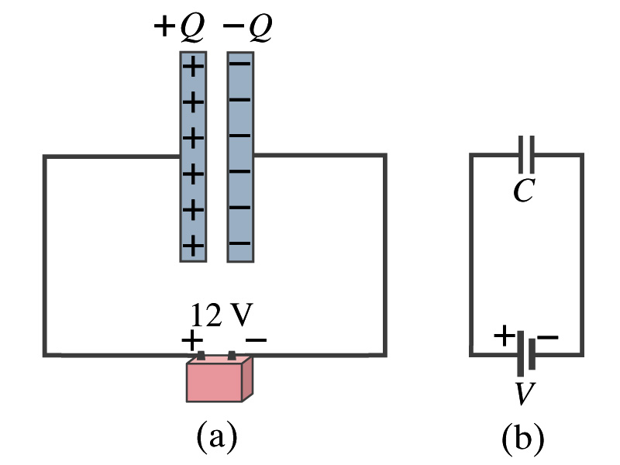
Capacitors
A simple capacitor consists of a pair of parallel plates of area A separated by a distance d.
  A cylindrical capacitors are essentially parallel plates wrapped around as a cylinder.
How would you draw symbols for a capacitor and a battery?
  Capacitor -||-
  Battery (+) -|i- (-)
Circuit
Diagram

Slide 12
Capacitors
What do you think will happen if a battery is connected ( or the voltage is applied) to a capacitor?
  The capacitor gets charged quickly, one plate positive and the other negative in equal amount.
Each battery terminal, the wires and the plates are conductors. What does this mean?
  All conductors are at the same potential. And?
  So the full battery voltage is applied across the capacitor plates.
So for a given capacitor, the amount of charge stored on each capacitor plate is proportional to the potential difference V_{ba} between the plates. How would you write this formula?
  C is a proportionality constant, called capacitance of the device.
  What is the unit?
C is the property of a capacitor so does not depend on Q or V.
C/V
or
Farad (F)
Normally use μF or pF.

Slide 13
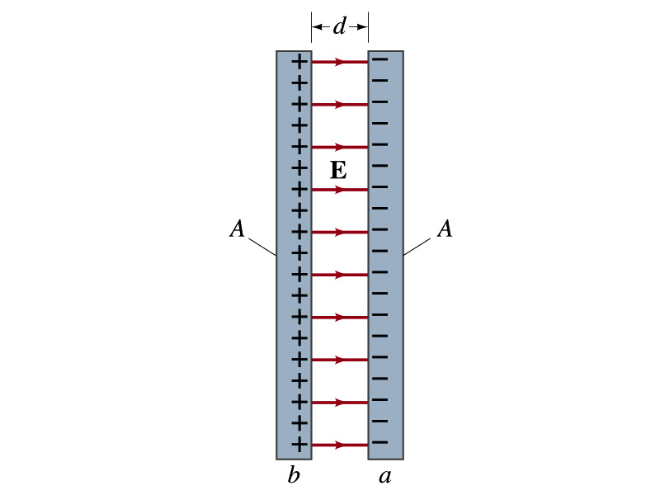
Determination of Capacitance
C can be determined analytically for capacitors w/ simple geometry and air in between.
Let’s consider a parallel plate capacitor.
  Plates have area A each and separated by d.
    d is smaller than the length, and so E is uniform.
  E for parallel plates is E=σ/ε₀, σ is the surface charge density.
E and V are related
Since we take the integral from lower potential (a) to higher potential (b) along the field line, we obtain
So from the formula:
  What do you notice?
C only depends on the area and the distance of the plates and the permittivity of the medium between them.

Slide 14
Example 24 – 1
Capacitor calculations: (a) Calculate the capacitance of a capacitor whose plates are 20cmx3.0cm and are separated by a 1.0mm air gap. (b) What is the charge on each plate if the capacitor is connected to a 12-V battery? (c) What is the electric field between the plates? (d) Estimate the area of the plates needed to achieve a capacitance of 1F, given the same air gap.
(a) Using the formula for a parallel plate capacitor, we obtain
(b) From Q=CV, the charge on each plate is

Slide 15
Example 24 – 1
(C) Using the formula for the electric field in two parallel plates
Or, since
we can obtain
(d) Solving the capacitance formula for A, we obtain
Solve for A
About 40% the area of Arlington (256km²).

Slide 16
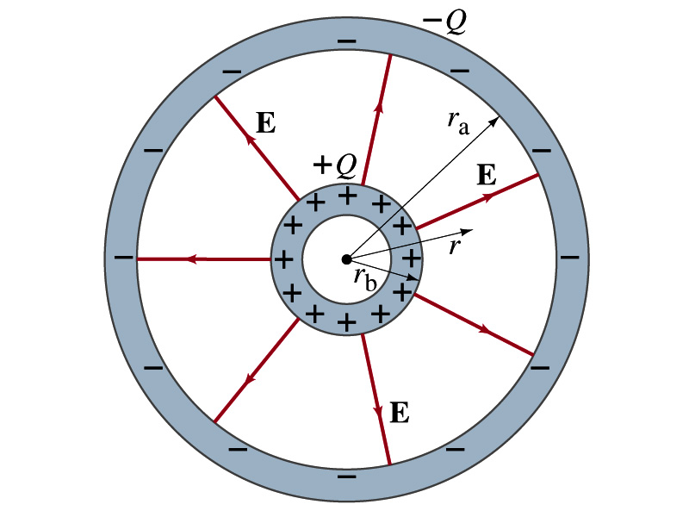
Example 24 – 3
Spherical capacitor: A spherical capacitor consists of two thin concentric spherical conducting shells, of radius r_{a} and r_{b}, as in the figure. The inner shell carries a uniformly distributed charge Q on its surface and the outer shell and equal but opposite charge –Q. Determine the capacitance of the two shells.
Using Gauss’ law, the electric field outside a uniformly charged conducting sphere is
So the potential difference between a and b is
Thus capacitance is

Slide 17
Capacitor Cont’d
A single isolated conductor can be said to have a capacitance, C.
C can still be defined as the ratio of the charge to absolute potential V on the conductor.
  So Q=CV.
The potential of a single conducting sphere of radius r_{b} can be obtained as
where
So its capacitance is

