Slide 1
PHYS 1444 – Section 004
Lecture #10
Monday, Feb. 20, 2012
Dr. Jaehoon Yu
Electric Current and Resistance
The Battery
Ohm’s Law: Resisters
Resistivity
Electric Power
Alternating Current
Power Delivered by AC
Today’s homework is #6, due 10pm, Tuesday, Feb. 28!!

Slide 2
Announcements
First term exam
  5:30 – 6:50pm, this Wednesday, Feb. 22
  SH103
  CH21.1 through 24.6, plus appendices A and B
Reading assignments
  CH24.6
Colloquium this week
  4pm Wednesday, SH101
    Dr. G. Fiete, UTAustin
  Mark your calendar on triple credit colloquium on April 4.
    Dr. Youngkee Kim

Slide 3


Slide 4
Electric Current and Resistance
So far we have been studying static electricity
  What the heck is the static electricity?
    The charges so far has not been moving but staying put at the location they are placed.
Now we will learn dynamics of electricity
What is the electric current?
  A flow of electric charge
  A few examples of the things that use electric current in everyday lives?
In an electrostatic situation, there is no electric field inside a conductor but when there is current, there is field inside a conductor
  Electric field is needed to keep charges moving

Slide 5
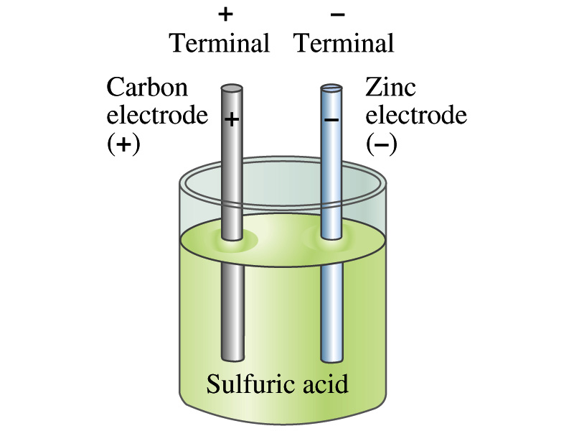
The Electric Battery
What is a battery?
  A device that produces electrical energy from the stored chemical energy and produces electricity.
Electric battery was invented by Volta in 1790s in Italy
  It was made of disks of zinc and silver based on his research that certain combinations of materials produce a greater electromotive force (emf), or potential, than others
Simplest batteries contain two plates made of dissimilar metals, electrodes
  Electrodes are immersed in a solution, electrolyte
  This unit is called a cell and many of these form a battery
Zinc and Iron in the figure are the terminals

Slide 6
How does a battery work?
One of the electrodes in the figure is zinc and the other carbon
The acid electrolyte reacts with the zinc electrode and dissolves it.
Each zinc atom leaves two electrons in the electrode and enters into the solution as a positive ion ➔ zinc electrode acquires negative charge and electrolyte becomes positively charged and pulls off electrons from carbon, getting neutralized
Thus the carbon electrode become positively charged
Since the two terminals are oppositely charged, there is potential difference between them

Slide 7
How does a battery work, cnt’d?
When the terminals are not connected, only small amount of zinc is dissolved into the solution.
How is a particular potential maintained?
  If the terminals are not connected, as large number of zinc ion get produced,
  zinc electrode gets increasingly charged up negative
  zinc ions get recombined with the electrons in zinc electrode
Why does battery go dead?
  When the terminals are connected, the negative charges will flow away from the zinc electrode
  More zinc atoms dissolve into the electrolyte to produce more charge
  One or more electrode get used up not producing any more charge.

Slide 8
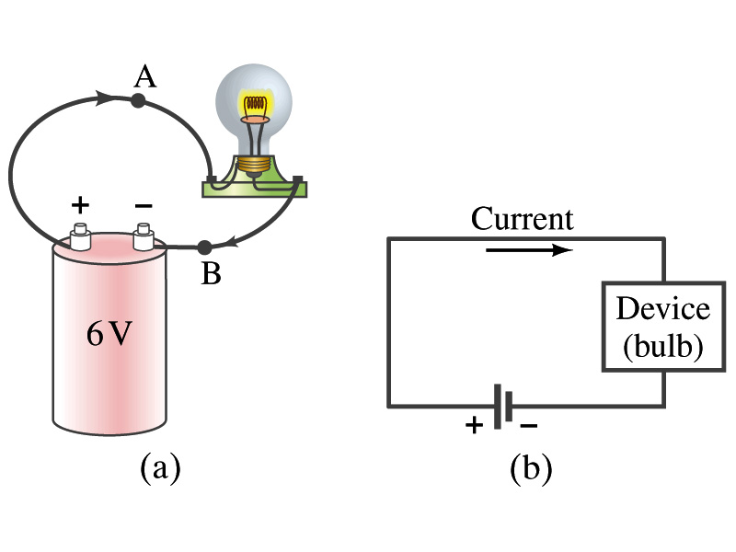
Electric Current
When a circuit is powered by a battery (or a source of emf) the charge can flow through the circuit.
Electric Current: Any flow of charge
  Current can flow whenever there is potential difference between the ends of a conductor (or when the two ends have opposite charges)
    The current can flow even through the empty space
  Electric current in a wire can be defined as the net amount of charge that passes through the wire’s full cross section at any point per unit time (just like the flow of water through a conduit…)
  Average current is defined as:
  The instantaneous current is:
  What kind of a quantity is the current?
Unit of the current?
C/s
1A=1C/s
Scalar
In a single circuit, conservation of electric charge guarantees that the current at one point of the circuit is the same as any other points on the circuit.

Slide 9
Example 25 – 1
Current is flow of charge: A steady current of 2.5A flows in a wire for 4.0min. (a) How much charge has passed by any point in the circuit? (b) How many electrons would this be?
Current is total amount charge flow through a circuit in a given time. So from we obtain
The total number of electrons passed through the circuit is

Slide 10
Direction of the Electric Current
What do conductors have in abundance?
  Free electrons
What happens if a continuous loop of conducting wire is connected to the terminals of a battery?
  Electrons start flowing through the wire continuously as soon as both the terminals are connected to the wire. How?
    The potential difference between the battery terminals sets up an electric field inside the wire and in the direction parallel to it
    Free electrons in the conducting wire get attracted to the positive terminal
    The electrons leaving negative terminal flow through the wire and arrive at the positive terminal
      Electrons flow from negative to positive terminal
  Due to historical convention, the direction of the current is opposite to the direction of flow of electrons ➔ Conventional Current

Slide 11
Ohm’s Law: Resistance and Resistors
What do we need to produce electric current?
  Potential difference
Georg S. Ohm experimentally established that the current is proportional to the potential difference ( )
  If we connect a wire to a 12V battery, the current flowing through the wire is twice that of 6V, three times that of 4V and four times that of 3V battery.
  What happens if we reverse the sign of the voltage?
    It changes the direction of the current flow.
    Does not change the magnitude of the current.
  Just as in water flow cases, if the height difference is large the flow rate is large ➔ If the potential difference is large, the current is large.

Slide 12
Ohm’s Law: Resistance
The exact amount of current flow in a wire depends on
  The voltage
  The resistance of the wire to the flow of electrons
    Just like the gunk in water pipe slows down water flow
    Electrons are slowed down due to interactions with the atoms of the wire
The higher the resistance the less the current for the given potential difference V
  So how would you define resistance?
    So that current is inversely proportional to the resistance
  Often this is rewritten as
  The metal conductor’s resistance R is a constant independent of V.
  When the current I passes through resistance R, the voltage drop V occurs.
  This linear relationship is not valid for some materials like diodes, vacuum tubes, transistors etc. ➔ These are called non-ohmic
Unit?
Ohm’s Law
ohms

Slide 13
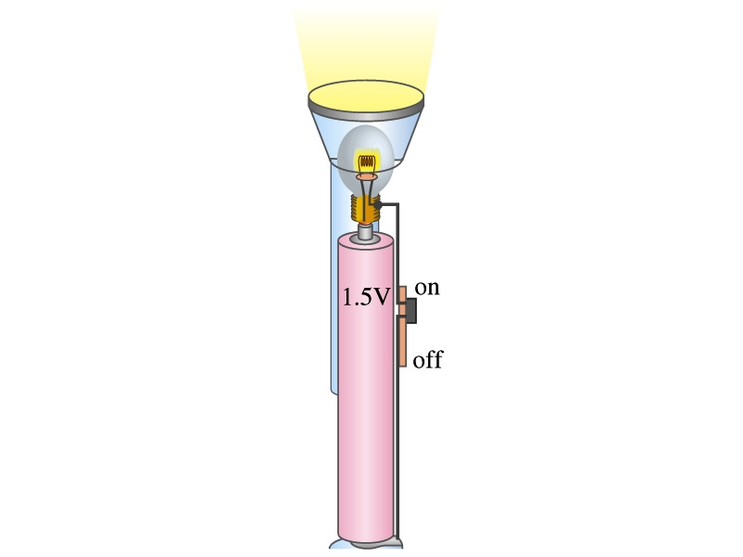
Example 25 – 4
Flashlight bulb resistance: A small flashlight bulb draws 300mA from its 1.5V battery. (a) What is the resistance of the bulb? (b) If the voltage drops to 1.2V, how would the current change?
From Ohm’s law, we obtain
Would the current increase or decrease, if the voltage reduces to 1.2V?
If the resistance did not change, the current is

Slide 14
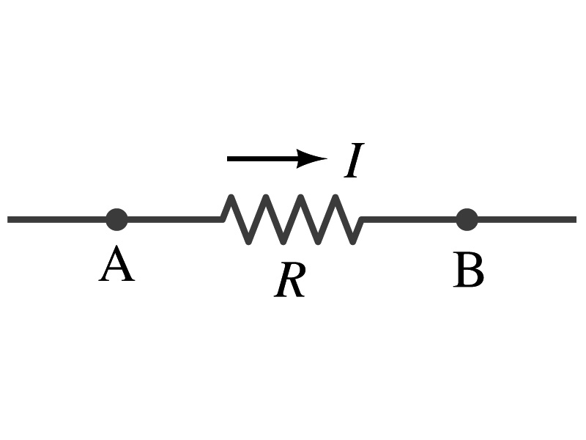
Ohm’s Law: Resistors
All electric devices provide resistance to the flow of current.
  Filaments of light bulbs or heaters are wires with high resistance to cause electrons to lose their energy in the wire
  In general connecting wires have low resistance compared to other devices in the circuit
In circuits, resistors are used to control the amount of current
  Resistors offer resistance of less than one ohm to millions of ohms
  Main types are
    “wire-wound” resistors which consists of a coil of fine wire
    “composition” resistors which are usually made of semiconductor carbon
    thin metal films
When drawn in the circuit, the symbol for a resistor is:
Wires are drawn simply as straight lines

Slide 15
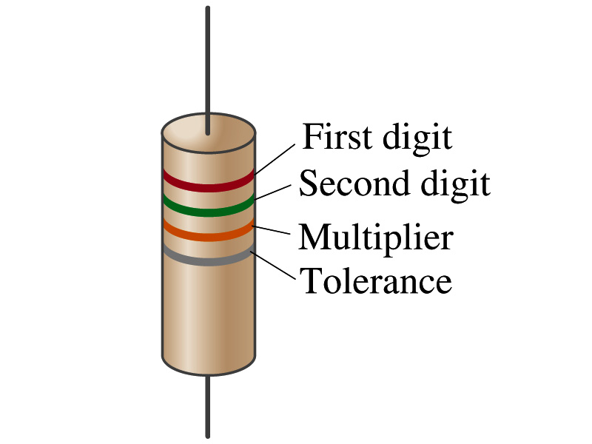
Ohm’s Law: Resistor Values
Resistors have its resistance color-coded on its body
The color-coding follows the convention below:
Color | Number | Multiplier | Tolerance
Black | 0 | 1=10⁰
Brown | 1 | 10¹ | +/-1%
Red | 2 | 10² | +/-2%
Orange | 3 | 10³
Yellow | 4 | 10⁴
Green | 5 | 10⁵ | +/-0.5%
Blue | 6 | 10⁶ | +/-0.25%
Violet | 7 | 10⁷ | +/-0.1%
Gray | 8 | 10⁸ | +/-0.05%
White | 9 | 10⁹
Gold |  | 10⁻¹ | 5%
Silver |  | 10⁻² | 10%
None |  |  | 20%
What is the resistance of the resistor in this figure?

Slide 16
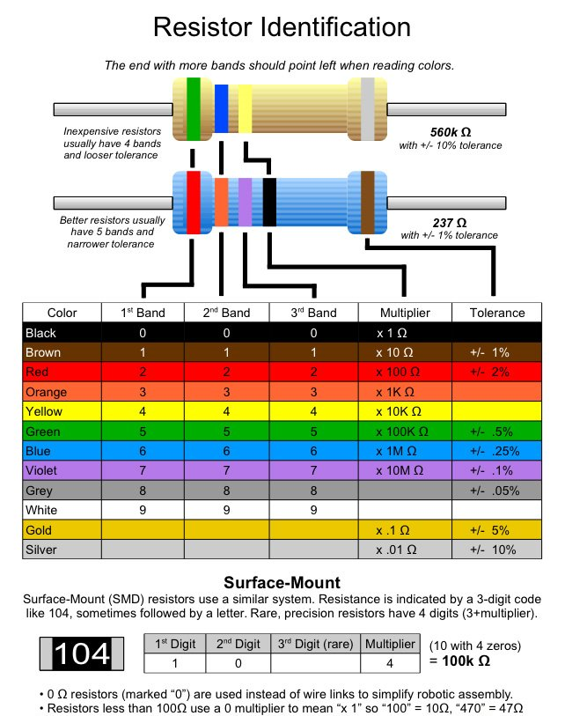

Slide 17
Resistivity
It is experimentally found that the resistance R of a metal wire is directly proportional to its length l and inversely proportional to its cross-sectional area A
  How would you formularize this?
  The proportionality constant ρ is called the resistivity and depends on the material used. What is the unit of this constant?
    ohm-m or Ω−m
    The values depends on purity, heat treatment, temperature, etc
  How would you interpret the resistivity?
    The higher the resistivity the higher the resistance
    The lower the resistivity the lower the resistance and the higher the conductivity ➔ Silver has the lowest resistivity.
      So the silver is the best conductor
  The reciprocal of the resistivity is called the conductivity, σ,
A
l

Slide 18
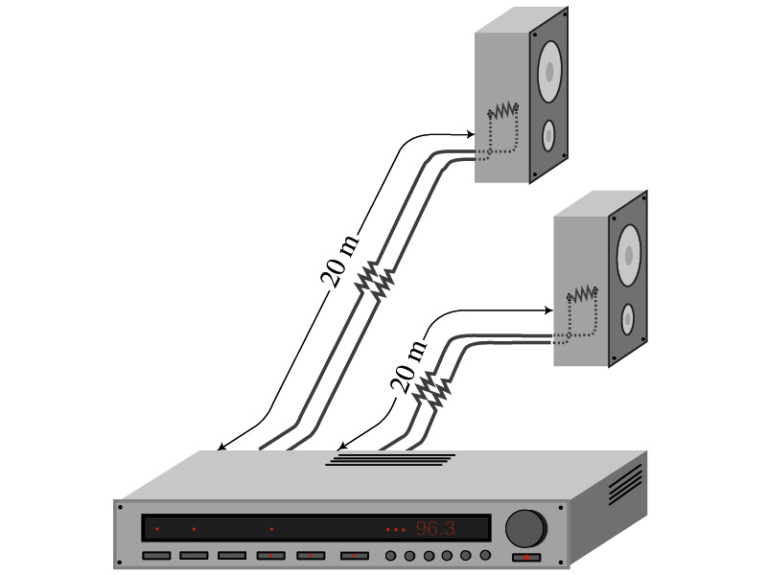
Example 25 – 5
Speaker wires: Suppose you want to connect your stereo to remote speakers. (a) If each wire must be 20m long, what diameter copper wire should you use to keep the resistance less than 0.1-Ω per wire? (b) If the current on each speaker is 4.0A, what is the voltage drop across each wire?
The resistivity of a copper is
Table 25.1
From the formula for resistance, we can obtain the formula for area
Solve for A
Solve for d
From Ohm’s law, V=IR, we obtain

Slide 19
Example 25 – 6
Stretching changes resistance: A wire of resistance R is stretched uniformly until it is twice its original length. What happens to its resistance?
What is the constant quantity in this problem?
The volume!
What is the volume of a cylinder of length L and radius r?
What happens to A if L increases factor two, L’=2L?
The cross-sectional area, A, halves. A’=A/2
The original resistance is
The new resistance is
The resistance of the wire increases by a factor of four if the length increases twice.

Slide 20
Temperature Dependence of Resistivity
Do you think the resistivity depends on temperature?
  Yes
Would it increase or decrease with the temperature?
  Increase
  Why?
  Because the atoms are vibrating more rapidly as temperature increases and are arranged in a less orderly fashion. So?
    They might interfere more with the flow of electrons.
If the temperature change is not too large, the resistivity of metals usually increase nearly linearly w/ temperature
  α is the temperature coefficient of resistivity
  α of some semiconductors can be negative due to increased number of freed electrons.

