Slide 1
PHYS 1444 – Section 004
Lecture #11
Monday, Feb. 27, 2012
Dr. Jaehoon Yu
Electric Power
Alternating Current
Power Delivered by AC
Microscopic View of Electric Current
Ohm’s Law in Microscopic View
EMF and Terminal Voltage
Today’s homework is #7, due 10pm, Tuesday, Mar. 6!!

Slide 2
Announcements
Reading assignments
  CH25. 8 – 25.10
Colloquium this week
  4pm Wednesday, SH101
    Dr. P. Slaine
  Mark your calendar on triple credit colloquium on April 4.
    Dr. Youngkee Kim

Slide 3
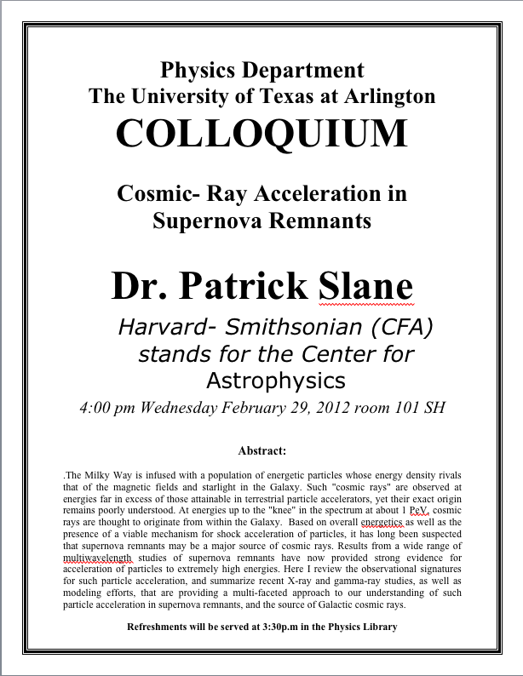

Slide 4
Special Project #3
Make a list of the rated power and the resistance of all electric and electronic devices at your home and compiled them in a table. (0.5 points each for the first 10 items and 0.1 points each additional item.)
  What is an item?
    Similar electric devices count as one item.
      All light bulbs make up one item, computers another, refrigerators, TVs, dryers (hair and clothes), electric cooktops, heaters, microwave ovens, electric ovens, dishwashers, etc.
      All you have to do is to count add all wattages of the light bulbs together as the power of the item
Estimate the cost of electricity for each of the items (taking into account the number of hours you use the device) on the table using the electricity cost per kWh of the power company that serves you and put them in a separate column in the above table for each of the items. (0.2 points each for the first 10 items and 0.1 points each additional items). Clearly write down what the unit cost of the power is per kWh above the table.
Estimate the the total amount of energy in Joules and the total electricity cost per month and per year for your home. (4 points)
Due: Beginning of the class Wednesday, Mar. 7

Slide 5
Electric Power
Why is the electric energy useful?
  It can transform into different forms of energy easily.
    Motors, pumps, etc, transform electric energy to mechanical energy
    Heaters, dryers, cook-tops, etc, transforms electricity to thermal energy
    Light bulb filament transforms electric energy to light energy
      Only about 10% of the energy turns to light and the 90% lost via heat
      Typical household light bulb and heating elements have resistance of order a few ohms to a few hundred ohms
How does electric energy transforms to thermal energy?
  Flowing electrons collide with the vibrating atoms in the wire.
  In each collision, part of electron’s kinetic energy is transferred to the atom it collides with.
  The kinetic energy of the wire’s atoms increases, and thus the temperature of the wire increases.
  The increased thermal energy can be transferred as heat through conduction and convection to the air in a heater or to food on a pan, through radiation to bread in a toaster or radiated as light.

Slide 6
Electric Power
How do we find out the power transformed by an electric device?
  What is definition of the power?
    The rate at which work is done or the energy is transformed
What is the energy transformed when an infinitesimal charge dq moves through a potential difference V?
  dU=Vdq
  If dt is the time required for an amount of charge dq to move through the potential difference V, the power P is
  Thus, we obtain .
  What is the unit?
  What kind of quantity is the electrical power?
    Scalar
  P=IV can apply to any devices while the formula with resistance can only apply to resistors.
What is this?
In terms of resistance
Watts = J/s

Slide 7
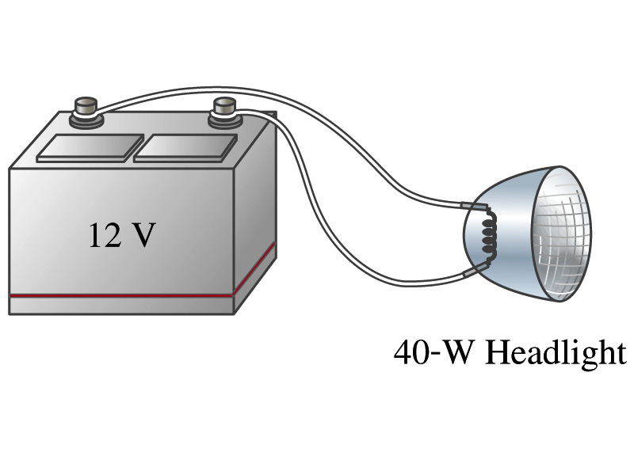
Example 25 – 8
Headlights: Calculate the resistance of a 40-W automobile headlight designed for 12V.
Since the power is 40W and the voltage is 12V, we use the formula with V and R.
Solve for R

Slide 8
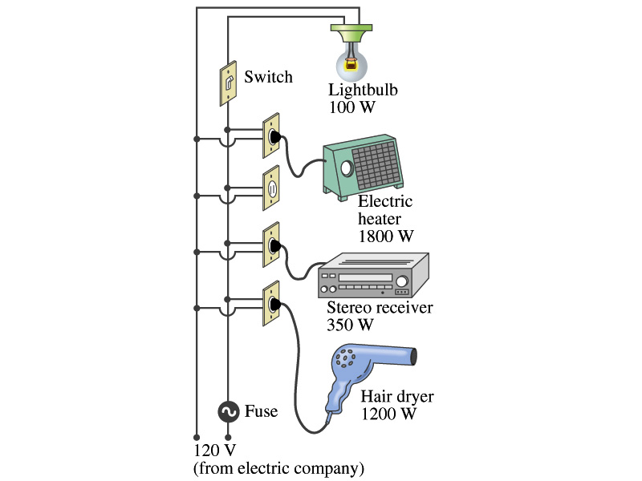
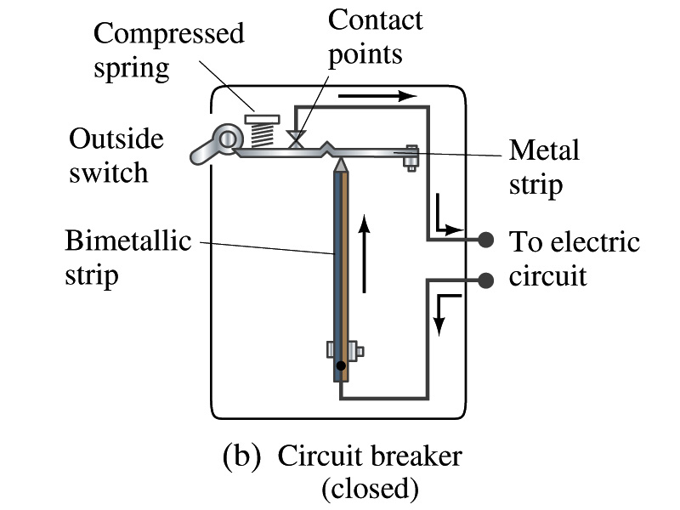
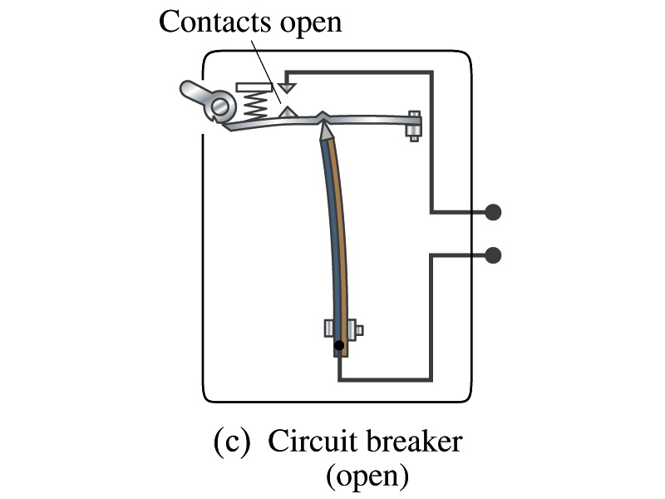
Power in Household Circuits
Household devices usually have small resistance
  But since they draw current, if they become large enough, wires can heat up (overloaded)
    Why is using thicker wires safer?
      Thicker wires has less resistance, lower heat
  Overloaded wire can set off a fire at home
How do we prevent this?
  Put in a switch that would disconnect the circuit when overloaded
    Fuse or circuit breakers
    They open up the circuit when the current is over certain value
Overload

Slide 9
Example 25 – 11
Will a fuse blow?: Determine the total current drawn by all the devices in the circuit in the figure.
The total current is the sum of current drawn by individual device.
Solve for I
Bulb
Heater
Stereo
Dryer
Total current
What is the total power?

Slide 10
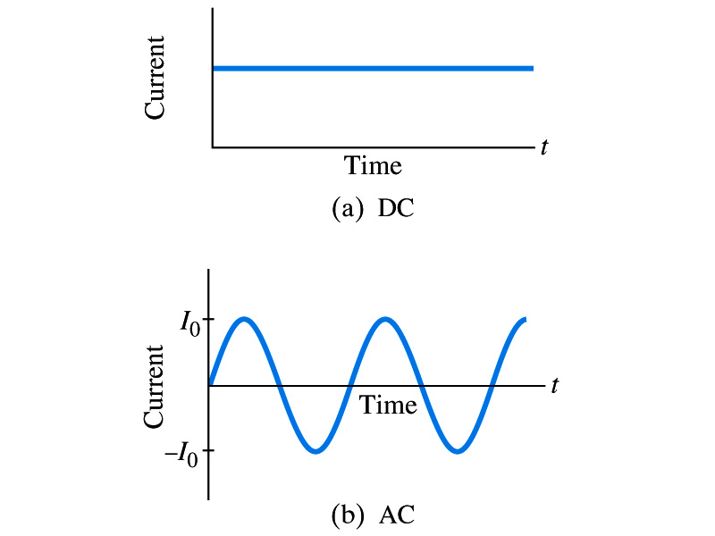
Alternating Current
Does the direction of the flow of current change while a battery is connected to a circuit?
  No. Why?
    Because its source of potential difference stays put.
  This kind of current is called the Direct Current (DC), and it does not change its direction of flow while the battery is connected.
    How would DC look as a function of time?
      A straight line
Generators at electric power plant produce alternating current (AC)
  AC reverses direction many times a second
  AC is sinusoidal as a function of time
Most the currents supplied to homes and business are AC.

Slide 11
The Alternating Current
The voltage produced by an AC electric generator is sinusoidal
  This is why the current is sinusoidal
Voltage produced can be written as
What are the maximum and minimum voltages?
  V₀ (–V₀) and 0
  The potential oscillates between +V₀ and –V₀, the peak voltages or amplitude
  What is f?
    The frequency, the number of complete oscillations made per second. What is the unit of f? What is the normal size of f in the US?
      f=60Hz in the US and Canada.
      Many European countries have f=50Hz.
  ω=2πf

Slide 12
Alternating Current
Since V=IR, if a voltage V exists across a resistance R, the current I is
What are the maximum and minimum currents?
  I₀ (–I₀) and 0.
  The current oscillates between +I₀ and –I₀, the peak currents or amplitude. The current is positive when electron flows to one direction and negative when they flow opposite.
  AC is as many times positive as negative. What’s the average current?
    Zero. So there is no power and no heat is produced in a heater?
      Yes there is! The electrons actually flow back and forth, so power is delivered.
What is this?

Slide 13
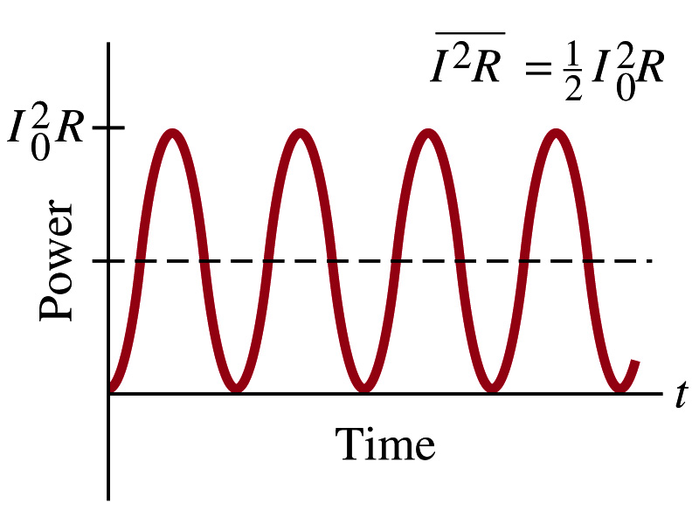
Power Delivered by Alternating Current
AC power delivered to a resistance is:
  Since the current is squared, the power is always positive
The average power delivered is
Since the power is also P=V²/R, we can obtain
The average of the square of current and voltage are important in calculating power:
Average power

Slide 14
Power Delivered by Alternating Current
The square root of each of these are called root-mean-square, or rms:
rms values are sometimes called effective values
  These are useful quantities since they can substitute current and voltage directly in power, as if they are in DC
  In other words, an AC of peak voltage V₀ or peak current I₀ produces as much power as DC voltage of V_{rms} or DC current I_{rms}.
  So normally, rms values in AC are specified or measured.
    US uses 115V rms voltage. What is the peak voltage?
    Europe uses 240V

Slide 15
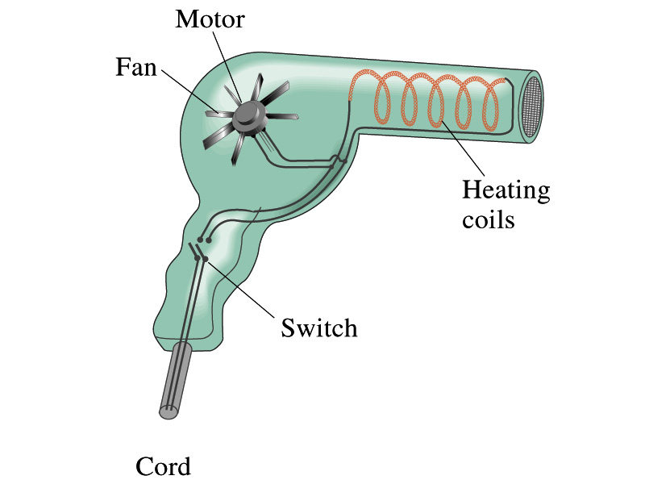
Example 25 – 13
Hair Dryer. (a) Calculate the resistance and the peak current in a 1000-W hair dryer connected to a 120-V AC line. (b) What happens if it is connected to a 240-V line in Britain?
The rms current is:
The peak current is:
Thus the resistance is:
(b) If connected to 240V in Britain …
The average power provide by the AC in UK is
So?
The heating coils in the dryer will melt!

Slide 16
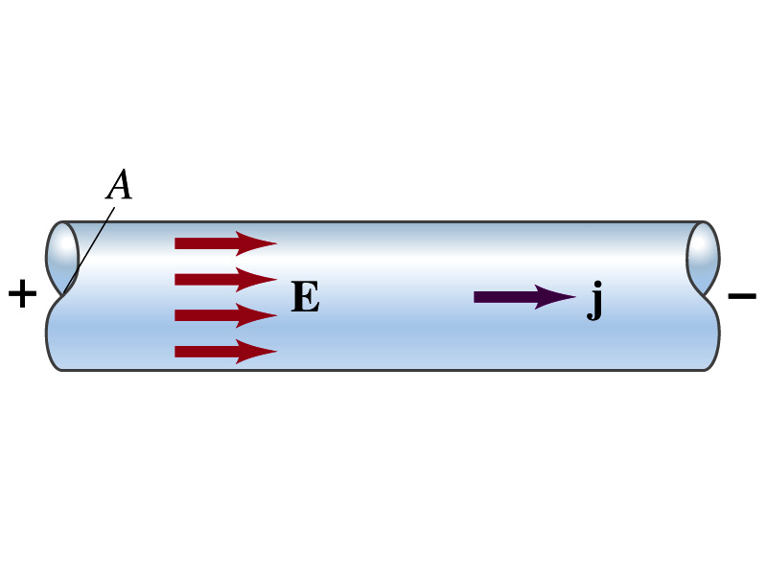
Microscopic View of Electric Current
When a potential difference is applied to the two ends of a wire w/ uniform cross-section, the direction of electric field is parallel to the walls of the wire, this is possible since the charges are moving
Let’s define a microscopic vector quantity, the current density, j, the electric current per unit cross-sectional area
  j=I/A or I = jA if the current density is uniform
  If not uniform
  The direction of j is the direction the positive charge would move when placed at that position, generally the same as E
The current density exists on any point in space while the current I refers to a conductor as a whole so a macroscopic

Slide 17
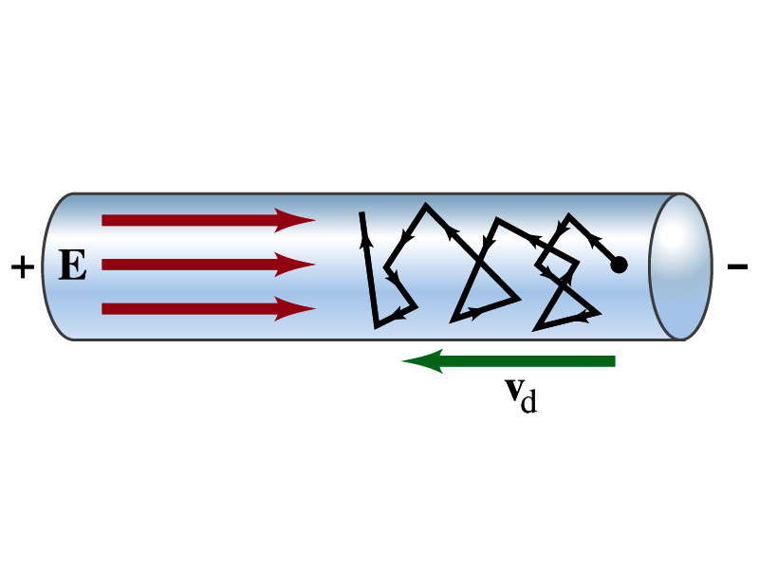
Microscopic View of Electric Current
The direction of j is the direction of a positive charge. So in a conductor, since negatively charged electrons move, the direction is –j.
Let’s think about the current in a microscopic view again:
  When voltage is applied to the end of a wire
  Electric field is generated by the potential difference
  Electrons feel force and get accelerated
  Electrons soon reach to a steady average speed due to collisions with atoms in the wire, called drift velocity, v_{d}
  The drift velocity is normally much smaller than electrons’ average random speed.

Slide 18
Microscopic View of Electric Current
How do we relate v_{d} with the macroscopic current I?
  In time interval Δt, the electrons travel l =v_{d}Δt on average
  If wire’s x-sectional area is A, in time Δt electrons in a volume V=l A=Av_{d}Δt will pass through the area A
  If there are n free electrons ( of charge –e) per unit volume, the total charge ΔQ that pass through A in time Δt is
  The current I in the wire is
  The density in vector form is
  For any types of charge:

Slide 19
Microscopic View of Electric Current
The drift velocity of electrons in a wire is only about 0.05mm/s. How could we get light turned on immediately then?
  While the electrons in a wire travels slow, the electric field travels essentially at the speed of light. Then what is all the talk about electrons flowing through?
    It is just like water. When you turn on the facet, water flows right off the facet despite the fact that the water travels slow.
    Electricity is the same. Electrons fill the conductor wire and when the switch is flipped on or a potential difference is applied, the electrons closed to the positive terminal flows into the bulb.
    Interesting, isn’t it? Why is the field travel at the speed of light then?

Slide 20
Ohm’s Law in Microscopic View
Ohm’s law can be written in microscopic quantities.
  Resistance in terms of resistivity is
  We can rewrite the potential V and current I as: I=jA, V=El.
  If electric field is uniform, from V=IR, we obtain
  So
  In a metal conductor, ρ or σ does not depend on V, thus, the current density j is proportional to the electric field E ➔ Microscopic statement of Ohm’s Law
  In vector form, the density can be written as

Slide 21
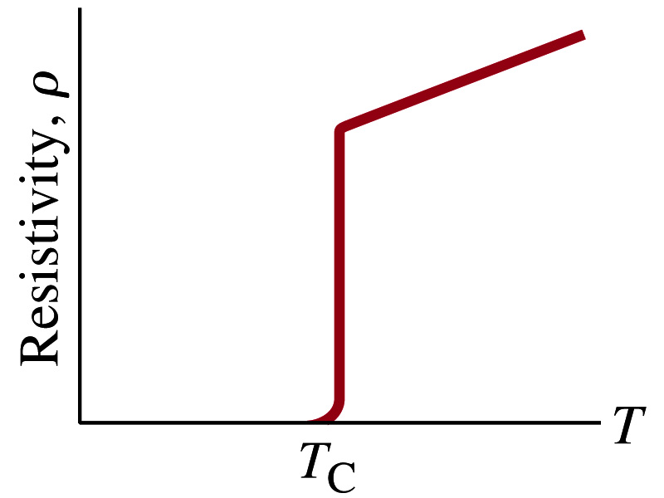
Superconductivity
At the temperature near absolute 0K, resistivity of certain material becomes 0.
  This state is called the “superconducting” state.
  Observed in 1911 by H. K. Onnes when he cooled mercury to 4.2K (-269ºC).
    Resistance of mercury suddenly dropped to 0.
  In general superconducting materials become superconducting below a transition temperature.
  The highest temperature superconductivity seen is 160K
    First observation above the boiling temperature of liquid nitrogen is in 1987 at 90k observed from a compound of yttrium, barium, copper and oxygen.
Since much smaller amount of material can carry just as much current more efficiently, superconductivity can make electric cars more practical, computers faster, and capacitors store higher energy

