Slide 1
PHYS 1444 – Section 004 Lecture #12
Wednesday, Feb. 29, 2012
Dr. Jaehoon Yu
Electric Hazard
DC Circuits
EMF and Terminal Voltage
Resistors in Series and Parallel
Energy losses in Resistors
Kirchhoff’s Rules
RC Circuits

Slide 2
Announcements
Quiz Monday, Mar. 5
At the beginning of the class
Covers: CH25.1 to what we finish today (CH 26.3?)
Mid-term comprehensive exam
Wednesday, Mar. 21
Time and place: 5:30 – 6:50pm, SH103
Comprehensive exam
Covers: CH21.1 through what we finish on Monday, Mar. 19 plus Appendices A and B
Please do NOT miss the exam! You will get an F!!

Slide 3
Reminder: Special Project #3
Make a list of the rated power and the resistance of all electric and electronic devices at your home and compiled them in a table. (0.5 points each for the first 10 items and 0.1 points each additional item.)
What is an item?
Similar electric devices count as one item.
All light bulbs make up one item, computers another, refrigerators, TVs, dryers (hair and clothes), electric cooktops, heaters, microwave ovens, electric ovens, dishwashers, etc.
All you have to do is to count add all wattages of the light bulbs together as the power of the item
Estimate the cost of electricity for each of the items (taking into account the number of hours you use the device) on the table using the electricity cost per kWh of the power company that serves you and put them in a separate column in the above table for each of the items. (0.2 points each for the first 10 items and 0.1 points each additional items). Clearly write down what the unit cost of the power is per kWh above the table.
Estimate the the total amount of energy in Joules and the total electricity cost per month and per year for your home. (4 points)
Due: Beginning of the class Wednesday, Mar. 7

Slide 4
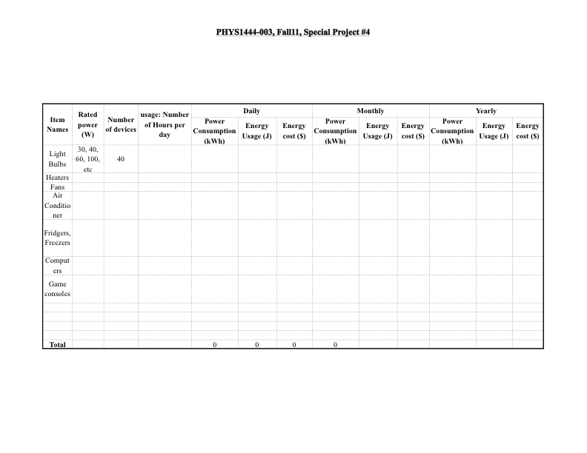
Special Project Spread Sheet

Slide 5
Electric Hazards: Leakage Currents
How does one feel shock by electricity?
Electric current stimulates nerves and muscles, and we feel a shock
The severity of the shock depends on the amount of the current, how long it acts and through what part of the body it passes
Electric current heats tissues and can cause burns
Currents above 70mA on a torso for a second or more is fatal, causing the heart to function irregularly, “ventricular fibrillation”
The resistance of a dry human body between two points on opposite side of the body is about 10⁴ to 10⁶ Ω.
When wet, it could be 10³Ω.
A person in good contact with the ground who touches 120V DC line with wet hands can get the current:
Could be lethal

Slide 6
EMF and Terminal Voltage
What do we need to have current in an electric circuit?
A device that provides a potential difference, such as a battery or a generator
They normally convert some types of energy into the electric energy
These devices are called the source of electromotive force (emf)
This is does NOT refer to a real “force”.
Potential difference between terminals of an emf source, when no current flows to an external circuit, is called the emf (E) of the source.
The battery itself has some internal resistance (r) due to the flow of charges in the electrolyte
Why does the headlight dim when you start the car?
The starter needs a large amount of current but the battery cannot provide charge fast enough to supply current to both the starter and the headlight

Slide 7
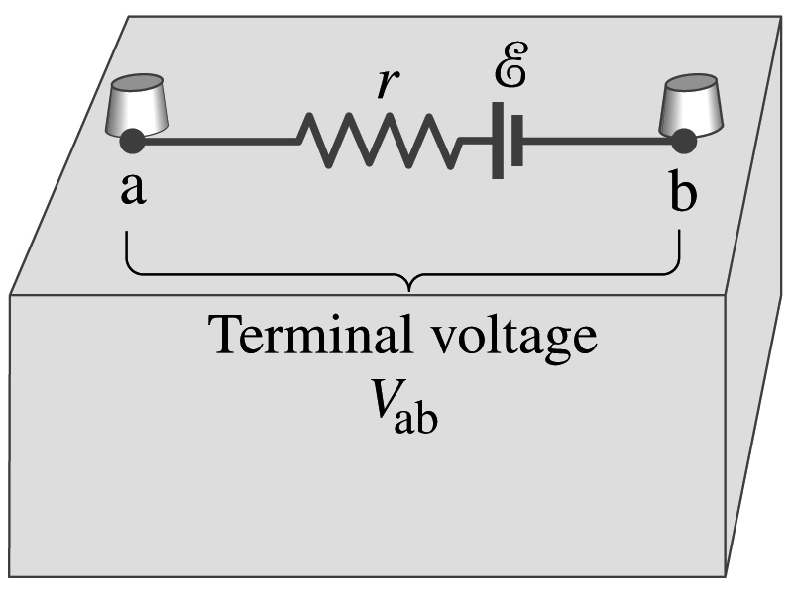
EMF and Terminal Voltage
Since the internal resistance is inside the battery, we can never separate them out.
So the terminal voltage difference is V_{ab}=V_{a}-V_{b}.
When no current is drawn from the battery, the terminal voltage equals the emf which is determined by the chemical reaction; V_{ab}= E.
However when the current I flows naturally from the battery, there is an internal drop in the voltage which is equal to Ir. Thus the actual delivered terminal voltage is

Slide 8
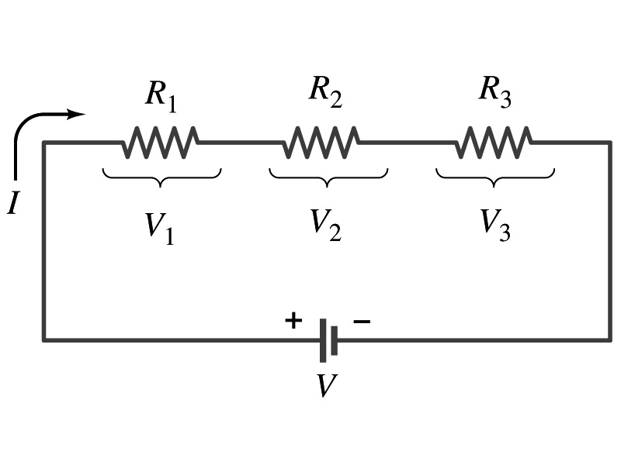
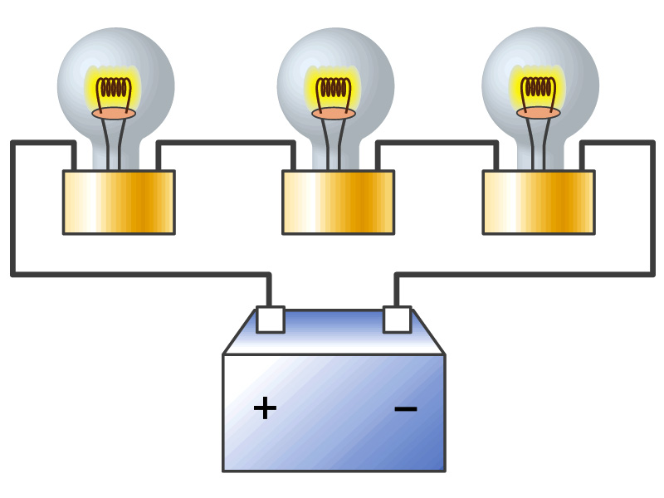
Resisters in Series
Resisters are in series when two or more resisters are connected end to end
These resisters represent simple resisters in circuit or electrical devices, such as light bulbs, heaters, dryers, etc
What is common in a circuit connected in series?
Current is the same through all the elements in series
The potential difference across every element in the circuit is
V₁=IR₁, V₂=IR₂ and V₃=IR₃
Since the total potential difference is V, we obtain
V=IR_{eq}=V₁+V₂+V₃=I(R₁+R₂+R₃)
Thus, R_{eq}=R₁+R₂+R₃
Resisters in series
When resisters are connected in series, the total resistance increases and the current decreases.

Slide 9
Energy Losses in Resisters
Why is it true that V=V₁+V₂+V₃?
What is the potential energy loss when charge q passes through resisters R₁, R₂ and R₃?
ΔU₁=qV₁, ΔU₂=qV₂, ΔU₃=qV₃
Since the total energy loss should be the same as the total energy provided to the system, we obtain
ΔU=qV=ΔU₁+ΔU₂+ΔU₃=q(V₁+V₂+V₃)
Thus, V=V₁+V₂+V₃

Slide 10
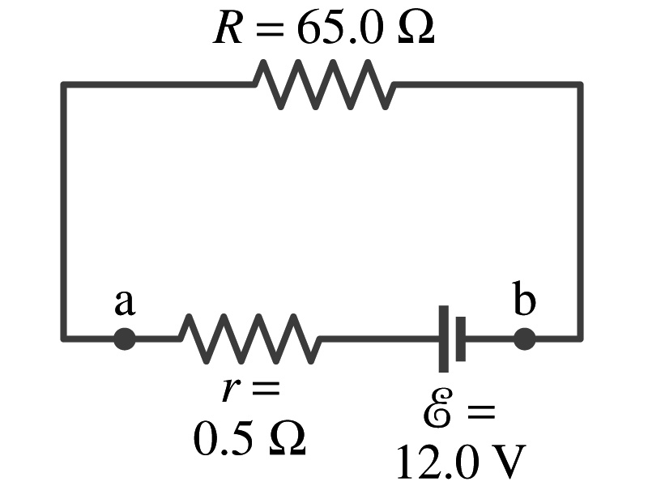
Example 26 – 1
Battery with internal resistance. A 65.0-Ω resistor is connected to the terminals of a battery whose emf is 12.0V and whose internal resistance is 0.5-Ω. Calculate (a) the current in the circuit, (b) the delivered terminal voltage of the battery, V_{ab}, and (c) the power dissipated in the resistor R and in the battery’s internal resistor.
(a) Since
We obtain
What is this?
Solve for I
A battery or a source of emf.
(b) The terminal voltage V_{ab} is
(c) The power dissipated in R and r are

Slide 11
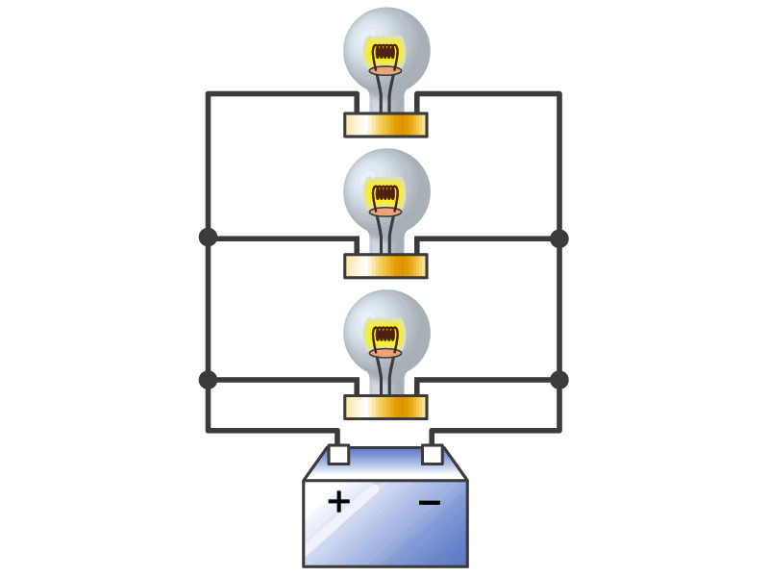
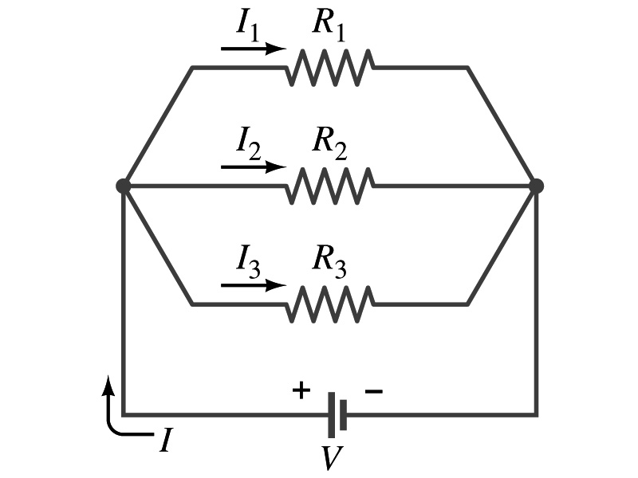
Resisters in Parallel
Resisters are in parallel when two or more resisters are connected in separate branches
Most the house and building wirings are arranged this way.
What is common in a circuit connected in parallel?
The voltage is the same across all the resisters.
The total current that leaves the battery, is however, split.
The current that passes through every element is
I₁=V/R₁, I₂=V/R₂, I₃=V/R₃
Since the total current is I, we obtain
I=V/R_{eq}=I₁+I₂+I₃=V(1/R₁+1/R₂+1/R₃)
Thus, 1/R_{eq}=1/R₁+1/R₂+1/R₃
Resisters in parallel
When resisters are connected in parallel, the total resistance decreases and the current increases.

Slide 12
Resister and Capacitor Arrangements
Parallel Capacitor arrangements
Parallel Resister arrangements
Series Capacitor arrangements
Series Resister arrangements

Slide 13
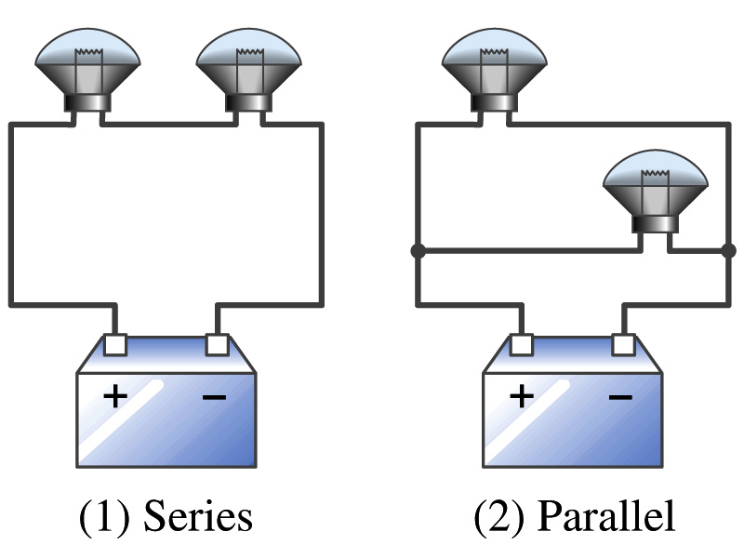
Example 26 – 2
Series or parallel? (a) The light bulbs in the figure are identical and have identical resistance R. Which configuration produces more light? (b) Which way do you think the headlights of a car are wired?
(a) What are the equivalent resistances for the two cases?
Series
Parallel
So
The bulbs get brighter when the total power transformed is larger.
series
parallel
So parallel circuit provides brighter lighting.
(b) Car’s headlights are in parallel to provide brighter lighting and also to prevent both lights from going out at the same time when one burns out.
So what is bad about parallel circuits?
Uses more energy in a given time.

Slide 14
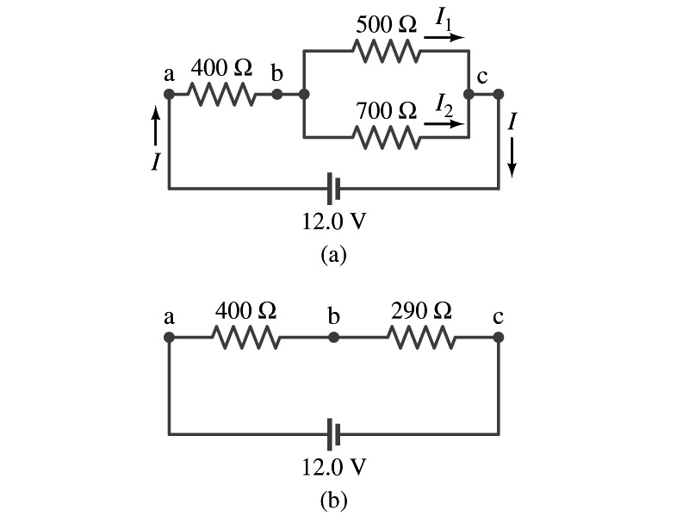
Example 26 – 5
Current in one branch. What is the current flowing through the 500-Ω resister in the figure?
We need to find the total current.
What do we need to find first?
To do that we need to compute the equivalent resistance.
R_{eq} of the small parallel branch is:
R_{eq} of the circuit is:
Thus the total current in the circuit is
The voltage drop across the parallel branch is
The current flowing across 500-Ω resister is therefore
What is the current flowing through 700-Ω resister?

