Slide 1
PHYS 1444 – Section 004 Lecture #13
Monday, Mar. 5, 2012
Dr. Jaehoon Yu
Kirchhoff’s Rules
EMFs in Series and Parallel
RC Circuits
Analysis of RC Circuits
Discharging of RC Circuits
Application of RC Circuits
Magnetism and Magnetic Field
Today’s homework is #8, due 10pm, Friday, Mar. 16!!

Slide 2
Announcements
Term exam results
Class average: 56.7/98
Equivalent to: 57.1/100
Top core: 88/98
This could be replaced by the 2nd non-comprehensive term exam on Apr. 25.
Mid-term comprehensive exam
Wednesday, Mar. 21
Time and place: 5:30 – 6:50pm, SH103
Comprehensive exam
Covers: CH21.1 through what we finish on Wednesday, Mar. 7 plus Appendices A and B
Please do NOT miss the exam! You will get an F!!
Reading assignment: CH26.7
Colloquium this week
Dr. Zhenhai Xia of UNT

Slide 3
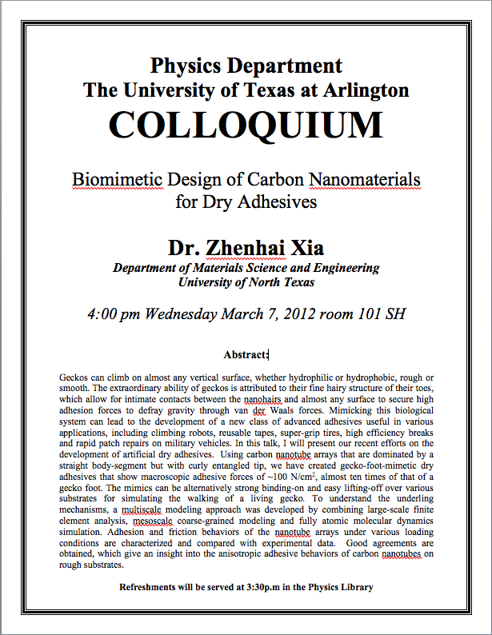

Slide 4
Reminder: Special Project #3
Make a list of the rated power and the resistance of all electric and electronic devices at your home and compiled them in a table. (0.5 points each for the first 10 items and 0.1 points each additional item.)
What is an item?
Similar electric devices count as one item.
All light bulbs make up one item, computers another, refrigerators, TVs, dryers (hair and clothes), electric cooktops, heaters, microwave ovens, electric ovens, dishwashers, etc.
All you have to do is to count add all wattages of the light bulbs together as the power of the item
Estimate the cost of electricity for each of the items (taking into account the number of hours you use the device) on the table using the electricity cost per kWh of the power company that serves you and put them in a separate column in the above table for each of the items. (0.2 points each for the first 10 items and 0.1 points each additional items). Clearly write down what the unit cost of the power is per kWh above the table.
Estimate the the total amount of energy in Joules and the total electricity cost per month and per year for your home. (4 points)
Due: Beginning of the class Wednesday, Mar. 7

Slide 5
Special Project Spread Sheet
Download this spread sheet from: http://www-hep.uta.edu/~yu/teaching/spring12-1444-004/sp3-spreadsheet.xlsx

Slide 6
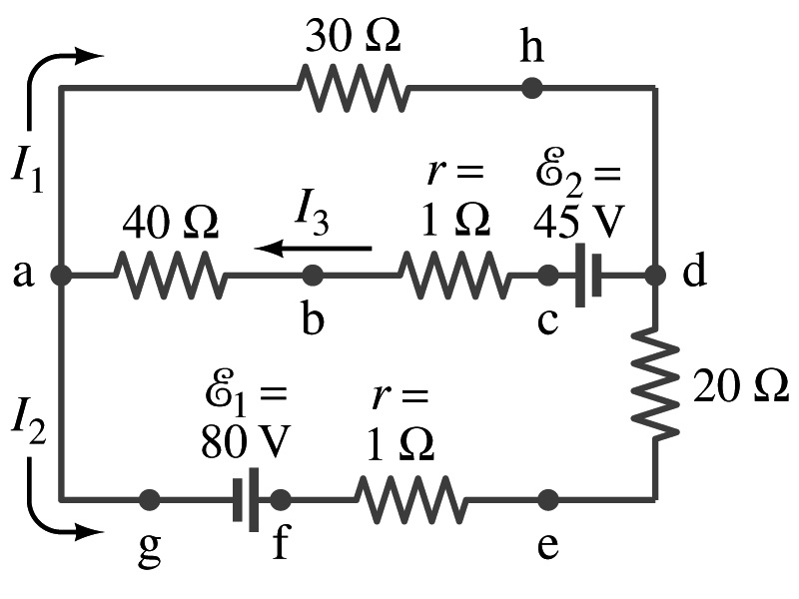
Special Project #4
In the circuit on the right, find out what the currents I₁, I₂ and I₃ are using Kirchhoff’s rules in the following two cases:
All the directions of the current flows are as shown in the figure. (3points)
When the directions of the flow of the current I₁ and I₃ are opposite than drawn in the figure but the direction of I₂ is the same. (5 points)
When the directions of the flow of the current I₂ and I₃ are opposite than drawn in the figure but the direction of I₁ is the same. (5 points)
Show the details of your OWN work to obtain credit.
Due is at the beginning of the class Monday, Mar. 26.

Slide 7
Kirchhoff’s Rules – 1st Rule
Some circuits are very complicated to analyze using the simple combinations of resisters
G. R. Kirchhoff devised two rules to deal with complicated circuits.
Kirchhoff’s rules are based on conservation of charge and energy
Kirchhoff’s 1st rule: The junction rule, charge conservation.
At any junction point, the sum of all currents entering the junction must be equal to the sum of all currents leaving the junction.
In other words, what goes in must come out.
At junction a in the figure, I₃ comes into the junction while I₁ and I₂ leaves: I₃ = I₁+ I₂

Slide 8
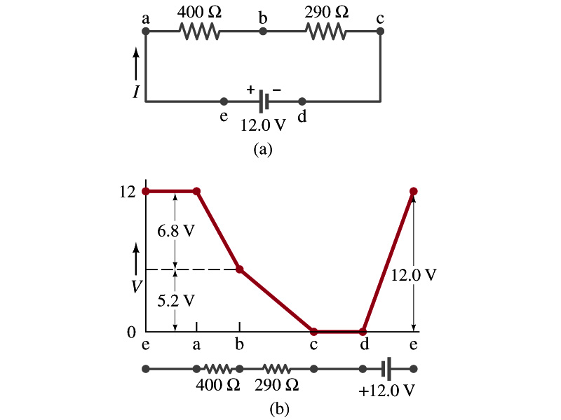
Kirchhoff’s Rules – 2nd Rule
Kirchoff’s 2nd rule: The loop rule, uses conservation of energy.
The sum of the changes in potential around any closed path of a circuit must be zero.
The current in the circuit in the figure is I=12/690=0.017A.
Point e is the high potential point while point d is the lowest potential.
When the test charge starts at e and returns to e, the total potential change is 0.
Between point e and a, no potential change since there is no source of potential nor any resister.
Between a and b, there is a 400Ω resister, causing IR=0.017*400 =6.8V drop.
Between b and c, there is a 290Ω resister, causing IR=0.017*290 =5.2V drop.
Since these are voltage drops, we use negative sign for these, -6.8V and -5.2V.
No change between c and d while from d to e there is +12V change.
Thus the total change of the voltage through the loop is: -6.8V-5.2V+12V=0V.

Slide 9
Using Kirchhoff’s Rules
Determine the flow of currents at circuit junctions and label each and everyone of the currents.
It does not matter which direction, you decide.
If the value of the current after completing the calculations are negative, you just need to flip the direction of the current flow.
Write down the current equation based on Kirchhoff’s 1st rule at various junctions.
Be sure to see if any of them are the same.
Choose closed loops in the circuit
Write down the potential in each interval of the junctions, keeping the signs properly.
Write down the potential equations for each loop.
Solve the equations for unknowns.

Slide 10
Example 26 – 9
Use Kirchhoff’s rules. Calculate the currents I₁, I₂ and I₃ in each of the branches of the circuit in the figure.
The directions of the current through the circuit is not known a priori but since the current tends to move away from the positive terminal of a battery, we arbitrarily choose the direction of the currents as shown.
We have three unknowns so we need three equations.
Using Kirchhoff’s junction rule at point a, we obtain
This is the same for junction d as well, so no additional information.
Now the second rule on the loop ahdcba.
The total voltage change in the loop ahdcba is.

Slide 11
Example 26 – 9, cnt’d
Now the second rule on the other loop agfedcba.
The total voltage change in loop agfedcba is.
So the three equations become
We can obtain the three current by solving these equations for I₁, I₂ and I₃.
Do this yourselves!!

Slide 12
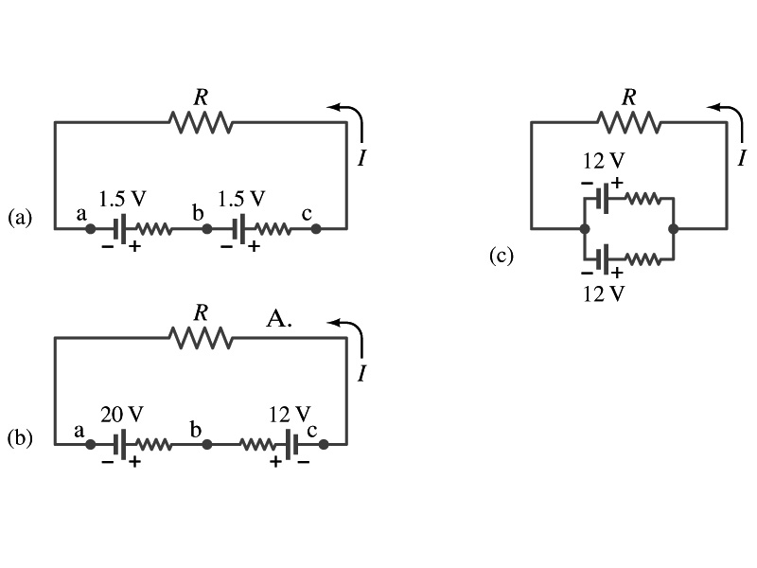
EMFs in Series and Parallel: Charging a Battery
When two or more sources of emfs, such as batteries, are connected in series
The total voltage is the algebraic sum of their voltages, if their direction is the same
V_{ab}=1.5 + 1.5=3.0V in figure (a).
If the batteries are arranged in an opposite direction, the total voltage is the difference between them
Parallel arrangements (c) are used only to increase currents. An example?
V_{ac}=20 – 12=8.0V in figure (b)
Connecting batteries in opposite direction is wasteful.
This, however, is the way a battery charger works.
Since the 20V battery is at a higher voltage, it forces charges into 12V battery
Some battery are rechargeable since their chemical reactions are reversible but most the batteries do not reverse their chemical reactions

Slide 13
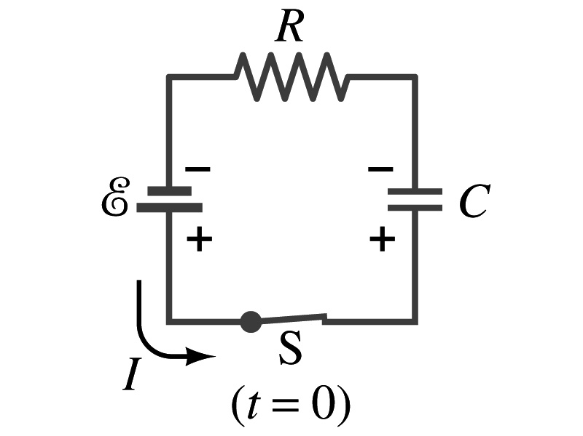
RC Circuits
Circuits containing both resisters and capacitors
RC circuits are used commonly in everyday life
Control windshield wiper
Timing of traffic light from red to green
Camera flashes and heart pacemakers
How does an RC circuit look?
There should be a source of emf, capacitors and resisters
What happens when the switch S is closed?
Current immediately starts flowing through the circuit.
Electrons flow out of negative terminal of the emf source, through the resister R and accumulates on the upper plate of the capacitor.
The electrons from the bottom plate of the capacitor will flow into the positive terminal of the battery, leaving only positive charges on the bottom plate.
As the charge accumulates on the capacitor, the potential difference across it increases
The current reduces gradually to 0 till the voltage across the capacitor is the same as emf.
The charge on the capacitor increases till it reaches to its maximum CE.

Slide 14
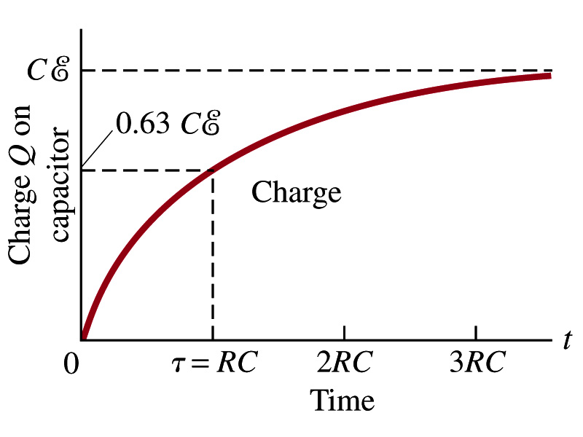
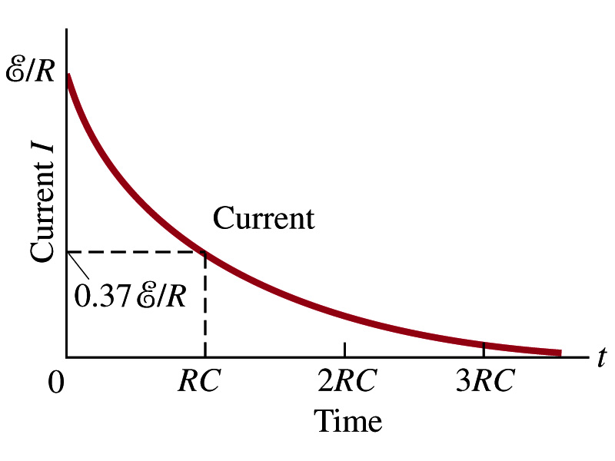
RC Circuits
How does all this look like in graphs?
The charge and the current on the capacitor as a function of time
From energy conservation (Kirchhoff’s 2nd rule), the emf E must be equal to the voltage drop across the capacitor and the resister
E=IR+Q/C
R includes all resistance in the circuit, including the internal resistance of the battery, I is the current in the circuit at any instance, and Q is the charge of the capacitor at that same instance.

Slide 15
Analysis of RC Circuits
From the energy conservation, we obtain E=IR+Q/C
Which ones are constants in the above equation?
E, R and C are constant
Q and I are functions of time
How do we write the rate at which the charge is accumulated on the capacitor?
We can rewrite the above equation as
This equation can be solved by rearranging the terms as

Slide 16
Analysis of RC Circuits
Now integrating from t=0 when there was no charge on the capacitor to t when the capacitor is fully charged, we obtain
➔
So, we obtain ➔
Or
The potential difference across the capacitor is V=Q/C, so

Slide 17
Analysis of RC Circuits
Since and
What can we see from the above equations?
Q and V_{C} increase from 0 at t=0 to maximum value Q_{max}=CE and V_{C}= E.
In how much time?
The quantity RC is called the time constant of the circuit, τ
τ=RC, What is the unit?
What is the physical meaning?
The time required for the capacitor to reach (1-e⁻¹)=0.63 or 63% of the full charge
The current is
Sec.

