Slide 1
PHYS 1444 – Section 004 Lecture #14
Wednesday, Mar. 7, 2012
Dr. Jaehoon Yu
RC Circuits
Discharging of RC Circuits
Application of RC Circuits
Magnetism and Magnetic Field
Electric Current and Magnetism
Magnetic Forces on Electric Current
About Magnetic Field

Slide 2
Announcements
Quiz #3 results
Class average: 41/85
Equivalent to:48.1/100
Previous quizzes: 37.6/100 and 66.7/100
Top core: 73/85
Mid-term comprehensive exam
Wednesday, Mar. 21
Time and place: 5:30 – 6:50pm, SH103
Comprehensive exam
Covers: CH21.1 through what we finish today (CH27.3) plus Appendices A and B
Please do NOT miss the exam! You will get an F!!
Reading assignment: CH26.7

Slide 3
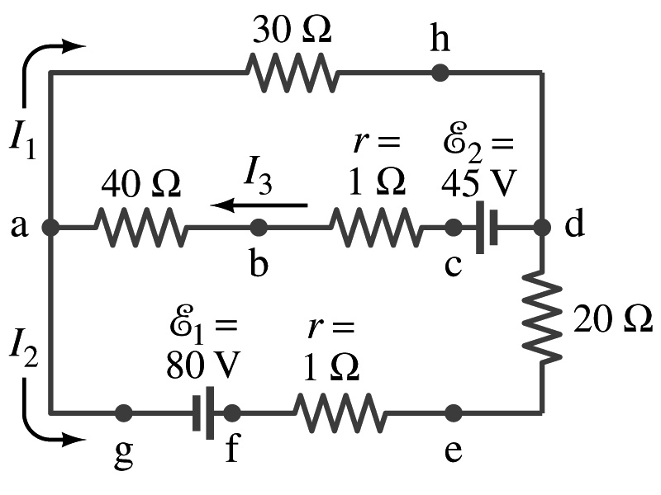
Reminder: Special Project #4
In the circuit on the right, find out what the currents I₁, I₂ and I₃ are using Kirchhoff’s rules in the following two cases:
All the directions of the current flows are as shown in the figure. (3points)
When the directions of the flow of the current I₁ and I₃ are opposite than drawn in the figure but the direction of I₂ is the same. (5 points)
When the directions of the flow of the current I₂ and I₃ are opposite than drawn in the figure but the direction of I₁ is the same. (5 points)
Show the details of your OWN work to obtain credit.
Due is at the beginning of the class Monday, Mar. 26.

Slide 4
Analysis of RC Circuits
Since and
What can we see from the above equations?
Q and V_{C} increase from 0 at t=0 to maximum value Q_{max}=CE and V_{C}= E.
In how much time?
The quantity RC is called the time constant of the circuit, τ
τ=RC, What is the unit?
What is the physical meaning?
The time required for the capacitor to reach (1-e⁻¹)=0.63 or 63% of the full charge
The current is
Sec.

Slide 5
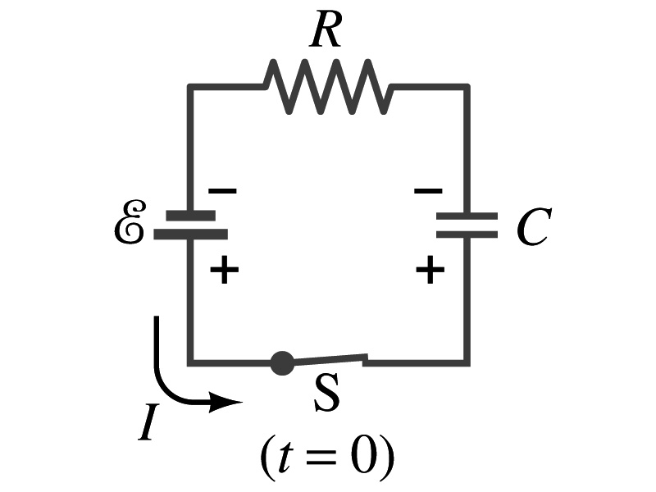
Example 26 – 12
RC circuit, with emf. The capacitance in the circuit of the figure is C=0.30μF, the total resistance is 20kΩ, and the battery emf is 12V. Determine (a) the time constant, (b) the maximum charge the capacitor could acquire, (c) the time it takes for the charge to reach 99% of this value, (d) the current I when the charge Q is half its maximum value, (e) the maximum current, and (f) the charge Q when, the current I is 20% of its maximum value.
(a) Since
We obtain
(b) Maximum charge is
(c) Since
For 99% we obtain
(d) Since
We obtain
The current when Q is 0.5Q_{max}
(e) When is I maximum?
when Q=0:
(f) What is Q when I=120mA?

Slide 6
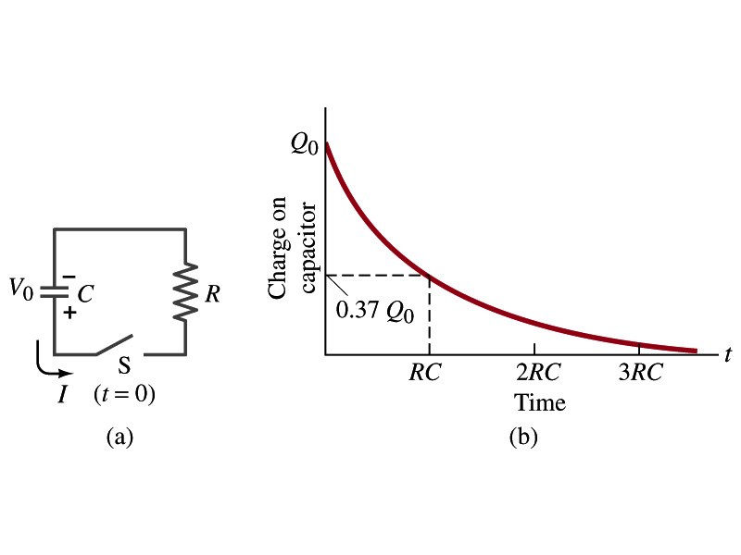
Discharging RC Circuits
When the capacitor is already charged, it is allowed to discharge through the resister R.
When the switch S is closed, the voltage across the resistor at any instance equals that across the capacitor. Thus IR=Q/C.
The rate at which the charge leaves the capacitor equals the negative of the current flows through the resistor
I= - dQ/dt. Why negative?
Since the current is leaving the capacitor
Thus the voltage equation becomes a differential equation
Rearrange terms

Slide 7
Discharging RC Circuits
Now, let’s integrate from t=0 when the charge is Q₀ to t when the charge is Q
The result is
Thus, we obtain
What does this tell you about the charge on the capacitor?
It decreases exponentially w/ time and w/ the time constant RC
Just like the case of charging
The current is:
The current also decreases exponentially w/ time w/ the constant RC
What is this?

Slide 8
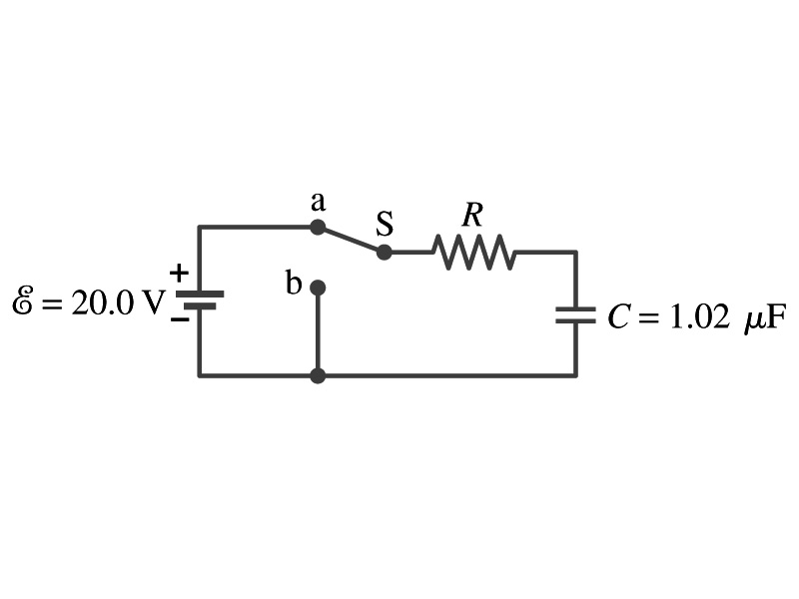
Example 26 – 13
Discharging RC circuit. In the RC circuit shown in the figure the battery has fully charged the capacitor, so Q₀=CE. Then at t=0, the switch is thrown from position a to b. The battery emf is 20.0V, and the capacitance C=1.02μF. The current I is observed to decrease to
0.50 of its initial value in 40μs. (a) what is the value of R? (b) What is the value of Q, the charge on the capacitor, at t=0? (c) What is Q at t=60μs?
(a) Since the current reaches to 0.5 of its initial value in 40μs, we can obtain
For 0.5I₀
Rearrange terms
Solve for R
(b) The value of Q at t=0 is
(c) What do we need to know first for the value of Q at t=60μs?
The RC time
Thus

Slide 9
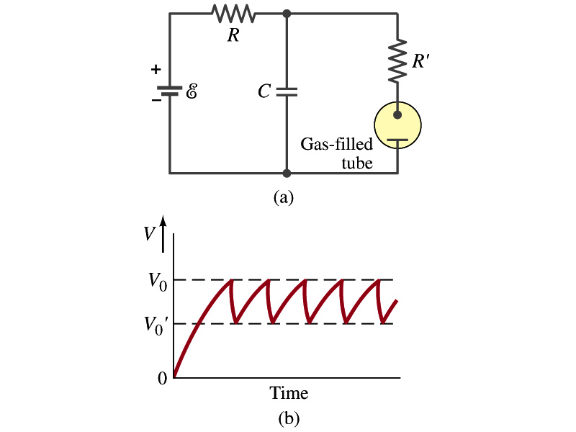
Application of RC Circuits
What do you think the charging and discharging characteristics of RC circuits can be used for?
To produce voltage pulses at a regular frequency
How?
The capacitor charges up to a particular voltage and discharges
A simple way of doing this is to use breakdown of voltage in a gas filled tube
The discharge occurs when the voltage breaks down at V₀
After the completion of discharge, the tube no longer conducts
Then the voltage is at V₀’ and it starts charging up
How do you think the voltage as a function of time look?
A sawtooth shape
Pace maker, intermittent windshield wiper, etc

Slide 10
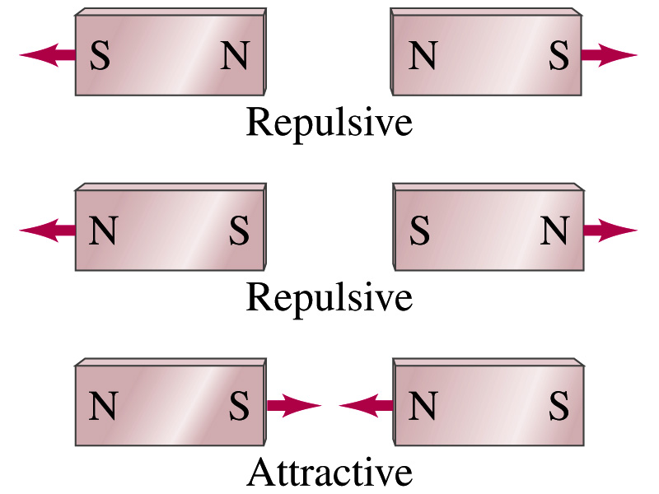
Magnetism
What are magnets?
Objects with two poles, north and south poles
The pole that points to geographical north is the north pole and the other is the south pole
Principle of compass
These are called magnets due to the name of the region, Magnesia, where rocks that attract each other were found
What happens when two magnets are brought to each other?
They exert force onto each other
What kind?
Both repulsive and attractive forces depending on the configurations
Like poles repel each other while the unlike poles attract

Slide 11
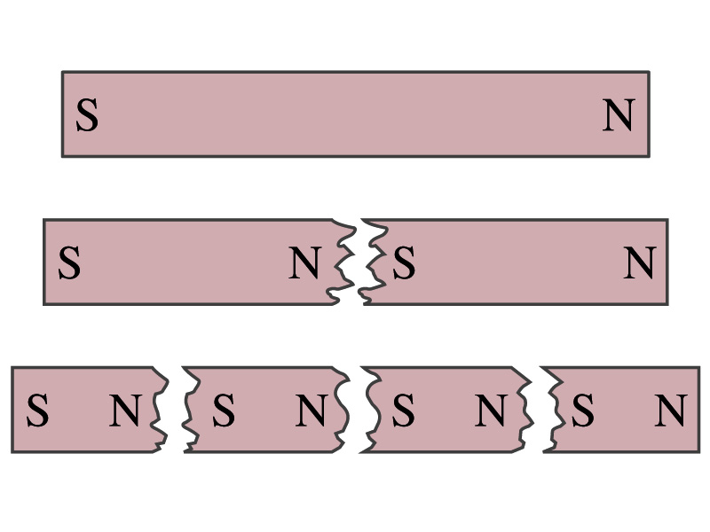
Magnetism
So the magnetic poles are the same as the electric charge?
No. Why not?
While the electric charges (positive and negative) can be isolated the magnetic poles cannot be isolated.
So what happens when a magnet is cut?
If a magnet is cut, two magnets are made.
The more they get cut, the more magnets are made
Single pole magnets are called the monopole but it has not been seen yet
Ferromagnetic materials: Materials that show strong magnetic effects
Iron, cobalt, nickel, gadolinium and certain alloys
Other materials show very weak magnetic effects

Slide 12
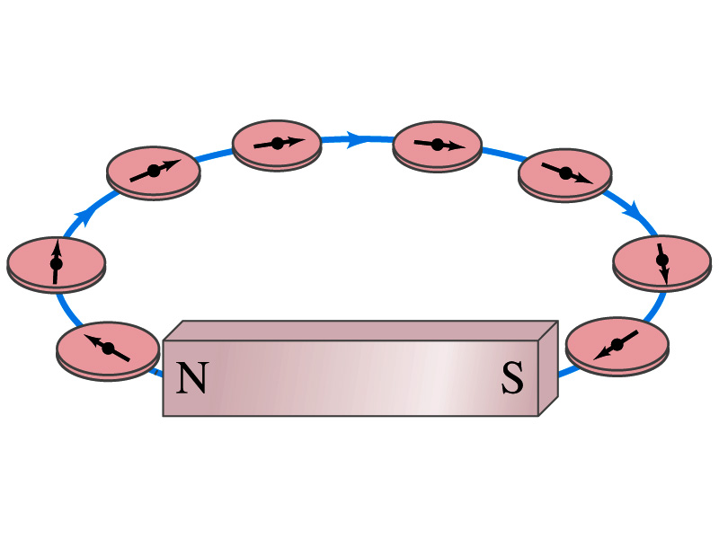
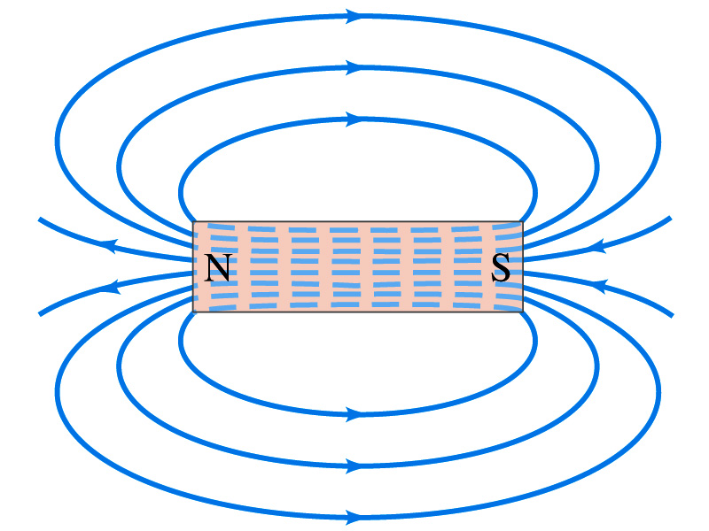
Magnetic Field
Just like the electric field that surrounds electric charge, a magnetic field surrounds a magnet
What does this mean?
Magnetic force is also a field force
The force one magnet exerts onto another can be viewed as the interaction between the magnet and the magnetic field produced by the other magnet
What kind of quantity is the magnetic field? Vector or Scalar?
So one can draw magnetic field lines, too.
Vector
The direction of the magnetic field is tangential to a line at any point
The direction of the field is the direction the north pole of a compass would point to
The number of lines per unit area is proportional to the strength of the magnetic field
Magnetic field lines continue inside the magnet
Since magnets always have both the poles, magnetic field lines form closed loops unlike electric field lines

Slide 13
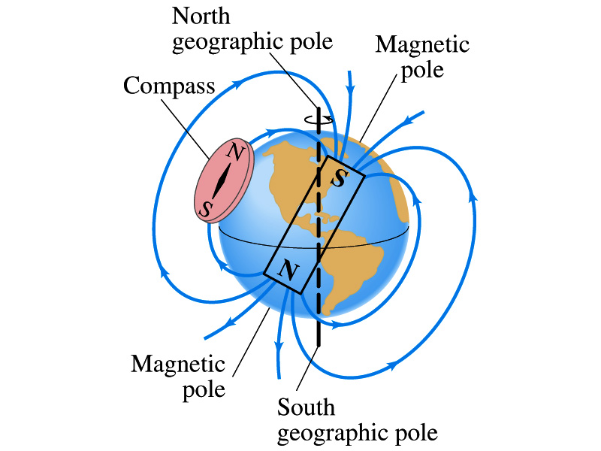
Earth’s Magnetic Field
What magnetic pole does the geographic north pole has to have?
Magnetic south pole. What? How do you know that?
Since the magnetic north pole points to the geographic north, the geographic north must have magnetic south pole
The pole in the north is still called geomagnetic north pole just because it is in the north
Similarly, south pole has magnetic north pole
The Earth’s magnetic poles do not coincide with the geographic poles ➔ magnetic declination
Geomagnetic north pole is in northern Canada, some 900km off the true north pole
Earth’s magnetic field line is not tangent to the earth’s surface at all points
The angle the Earth’s field makes to the horizontal line is called the angle dip

Slide 14
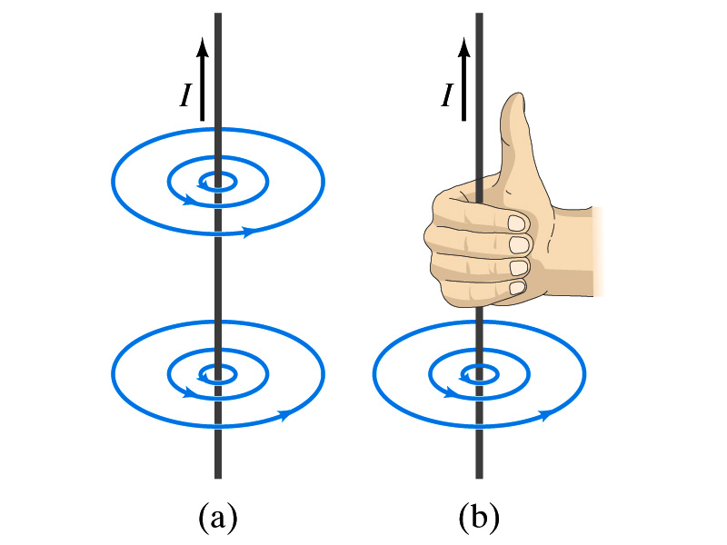
Electric Current and Magnetism
In 1820, Oersted found that when a compass needle is placed near an electric wire, the needle deflects as soon as the wire is connected to a battery and the current flows
Electric current produces a magnetic field
The first indication that electricity and magnetism are of the same origin
What about a stationary electric charge and magnet?
They don’t affect each other.
The magnetic field lines produced by a current in a straight wire is in the form of circles following the “right-hand” rule
The field lines follow right-hand fingers wrapped around the wire when the thumb points to the direction of the electric current

Slide 15
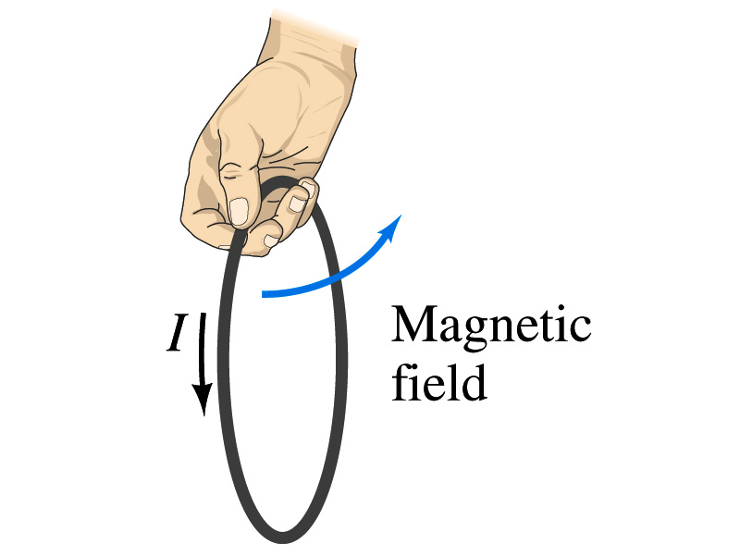
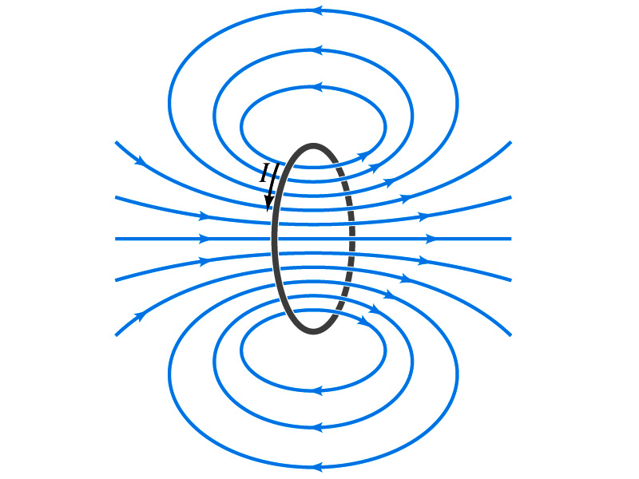
Directions in a Circular Wire?
OK, then what is the direction of the magnetic field generated by the current flowing through a circular loop?

Slide 16
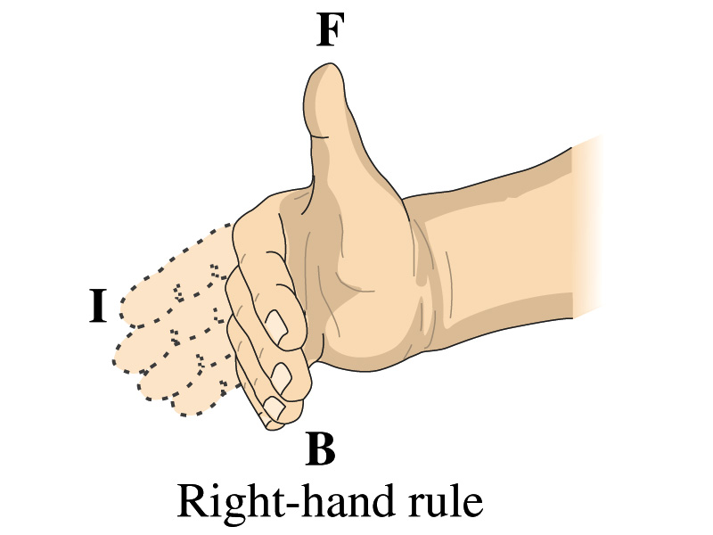
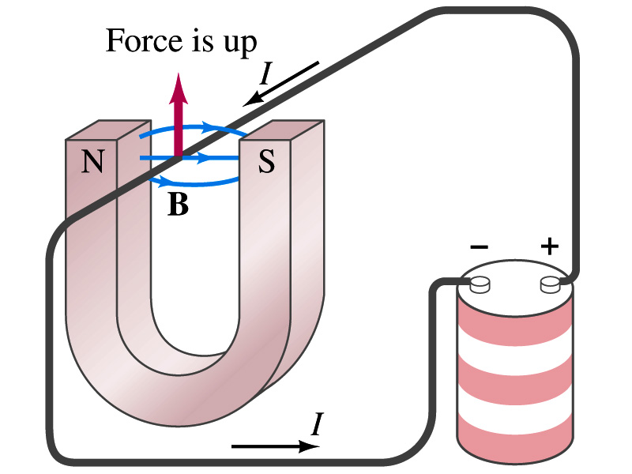
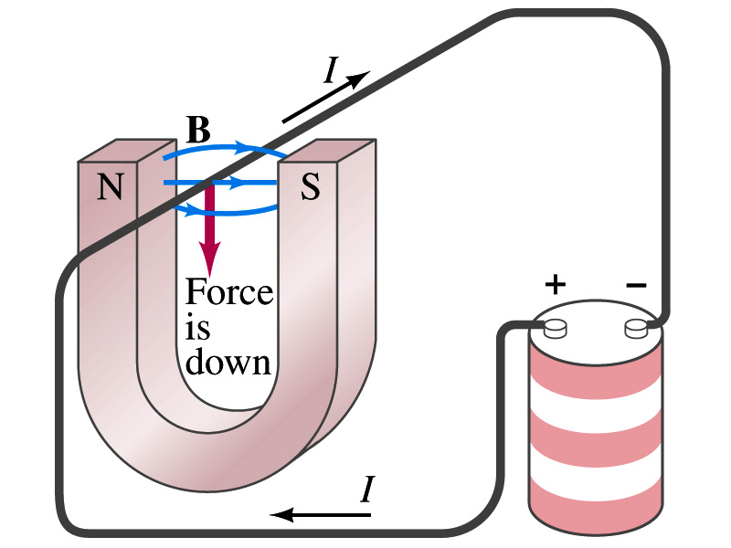
Magnetic Forces on Electric Current
Since the electric current exerts force on a magnet, the magnet should also exert force on the electric current
Which law justifies this?
Newton’s 3rd law
This was also discovered by Oersted
Direction of the force is always
perpendicular to the direction of the current
perpendicular to the direction of the magnetic field, B
Experimentally the direction of the force is given by another right-hand rule ➔ When the fingers of the right-hand points to the direction of the current and the finger tips bent to the direction of magnetic field B, the direction of thumb points to the direction of the force

Slide 17
Magnetic Forces on Electric Current
OK, we are set for the direction but what about the magnitude?
It is found that the magnitude of the force is directly proportional
To the current in the wire
To the length of the wire in the magnetic field (if the field is uniform)
To the strength of the magnetic field
The force also depends on the angle θ between the directions of the current and the magnetic field
When the wire is perpendicular to the field, the force is the strongest
When the wire is parallel to the field, there is no force at all
Thus the force on current I in the wire w/ length l in a uniform field B is

Slide 18
Magnetic Forces on Electric Current
Magnetic field strength B can be defined using the previous proportionality relationship w/ the constant 1:
if θ=90º, and if θ=0º
So the magnitude of the magnetic field B can be defined as
where F_{max} is the magnitude of the force on a straight length l of the wire carrying the current I when the wire is perpendicular to B
The relationship between F, B and I can be written in a vector formula:
l is the vector whose magnitude is the length of the wire and its direction is along the wire in the direction of the conventional current
This formula works if B is uniform.
If B is not uniform or l does not form the same angle with B everywhere, the infinitesimal force acting on a differential length dl is

Slide 19
Fundamentals on the Magnetic Field, B
The magnetic field is a vector quantity
The SI unit for B is tesla (T)
What is the definition of 1 Tesla in terms of other known units?
1T=1N/Am
In older names, tesla is the same as weber per meter-squared
1Wb/m²=1T
The cgs unit for B is gauss (G)
How many T is one G?
1G=10⁻⁴ T
For computation, one MUST convert G to T at all times
Magnetic field on the Earth’s surface is about 0.5G=0.5x10⁻⁴T
On a diagram, for field coming out and for going in.

Slide 20
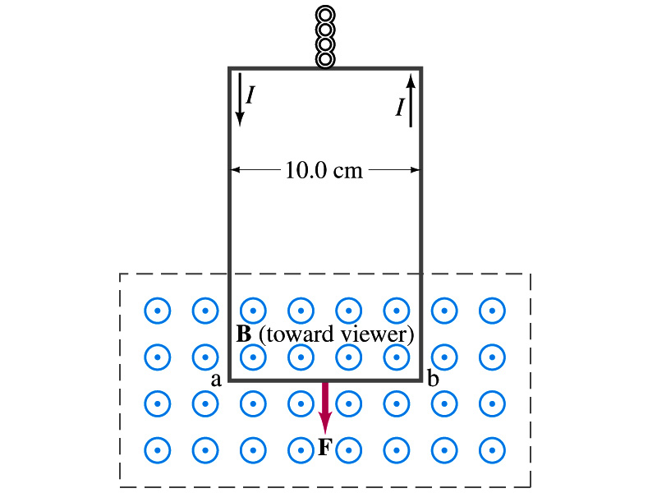
Example 27 – 2
Measuring a magnetic field. A rectangular loop of wire hangs vertically as shown in the figure. A magnetic field B is directed horizontally perpendicular to the wire, and points out of the page. The magnetic field B is very nearly uniform along the horizontal portion of wire ab (length l=10.0cm) which is near the center of a large magnet producing the field. The top portion of the wire loop is free of the field. The loop hangs from a balance which measures a downward force ( in addition to the gravitational force) of F=3.48x10⁻²N when the wire carries a current I=0.245A. What is the magnitude of the magnetic field B at the center of the magnet?
Magnetic force exerted on the wire due to the uniform field is
Since
Magnitude of the force is
Solving for B
Something is not right! What happened to the forces on the loop on the side?
The two forces cancel out since they are in opposite direction with the same magnitude.

Slide 21
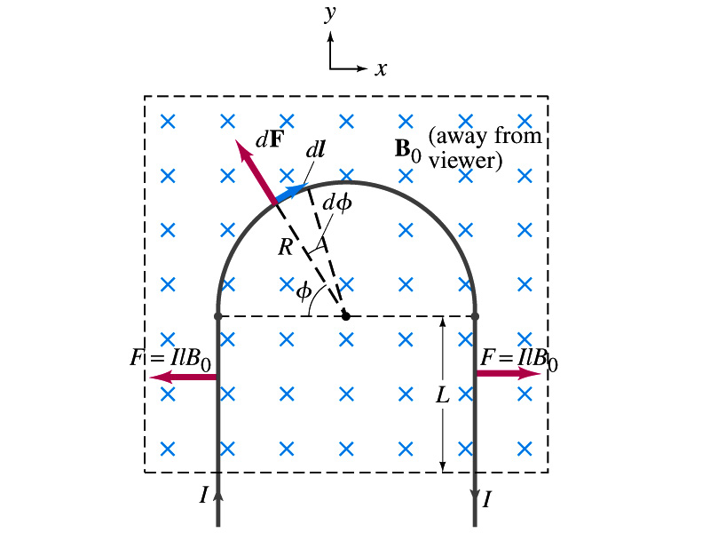
Example 27 – 3
Magnetic force on a semi-circular wire. A rigid wire, carrying the current I, consists of a semicircle of radius R and two straight portions as shown in the figure. The wire lies in a plane perpendicular to the uniform magnetic field B₀. The straight portions each have length l within the field. Determine the net force on the wire due to the magnetic field B₀.
As in the previous example, the forces on the straight sections of the wire is equal and in opposite direction. Thus they cancel.
What do we use to figure out the net force on the semicircle?
We divide the semicircle into infinitesimal straight sections.
What is the net x component of the force exerting on the circular section?
0
Why?
Because the forces on left and the right-hand sides of the semicircle balance.
Since
Y-component of the force dF is
Integrating over ϕ=0 - π
Which direction?
Vertically upward direction. The wire will be pulled deeper into the field.

