Slide 1
PHYS 1444 – Section 004 Lecture #16
Monday, April 2, 2012
Dr. Jaehoon Yu
Sources of Magnetic Field
Magnetic Field Due to Straight Wire
Forces Between Two Parallel Wires
Ampére’s Law and Its Verification
Solenoid and Toroidal Magnetic Field
Biot-Savart Law
Today’s homework is #10, due 10pm, Tuesday, Apr. 10!!

Slide 2
Announcements
If you haven’t come to meet me for your mid-term grade discussion, please make an arrangement via e-mail to talk to me this week.
Reading assignments
CH28 – 8, 9 and 10
Triple credit colloquium this Wednesday
Dr. Youngkee Kim, deputy director of Fermi National Accelerator Laboratory

Slide 3
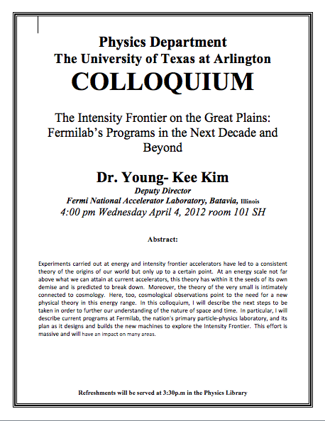

Slide 4
Sources of Magnetic Field
We have learned so far about the effects of magnetic field on electric currents and moving charge
We will now learn about the dynamics of magnetism
How do we determine magnetic field strengths in certain situations?
How do two wires with electric current interact?
What is the general approach to finding the connection between current and magnetic field?

Slide 5
Magnetic Field due to a Straight Wire
The magnetic field due to the current flowing through a straight wire forms a circular pattern around the wire
What do you imagine the strength of the field is as a function of the distance from the wire?
It must be weaker as the distance increases
How about as a function of current?
Directly proportional to the current
Indeed, the above are experimentally verified
This is valid as long as r << the length of the wire
The proportionality constant is μ₀/2π, thus the field strength becomes
μ₀ is the permeability of free space

Slide 6
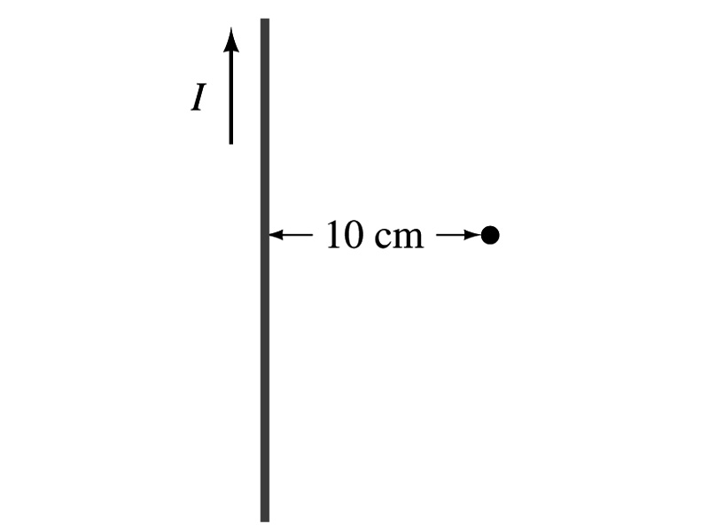
Example 28 – 1
Calculation of B near wire. A vertical electric wire in the wall of a building carries a DC current of 25A upward. What is the magnetic field at a point 10cm due north of this wire?
Using the formula for the magnetic field near a straight wire
So we can obtain the magnetic field at 10cm away as

Slide 7
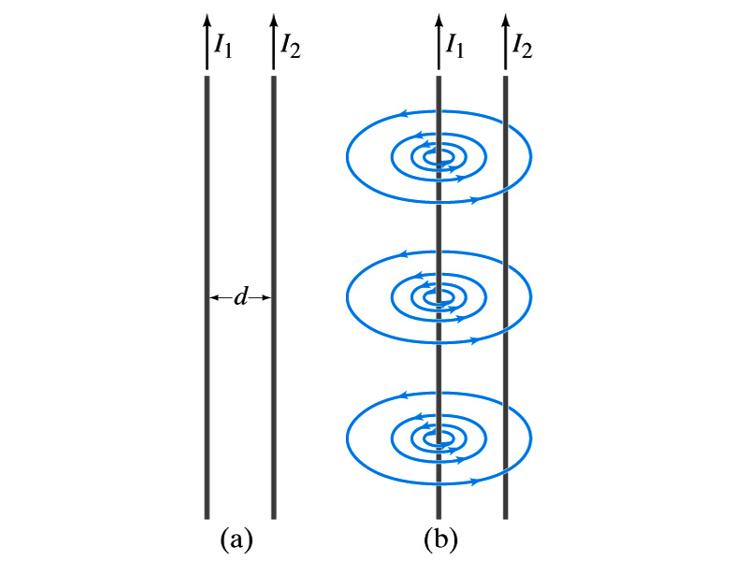
Force Between Two Parallel Wires
We have learned that a wire carrying the electric current produces magnetic field
Now what do you think will happen if we place two current carrying wires next to each other?
They will exert force onto each other. Repel or attract?
Depending on the direction of the currents
This was first pointed out by Ampére.
Let’s consider two long parallel conductors separated by a distance d, carrying currents I₁ and I₂.
At the location of the second conductor, the magnitude of the magnetic field produced by I₁ is

Slide 8
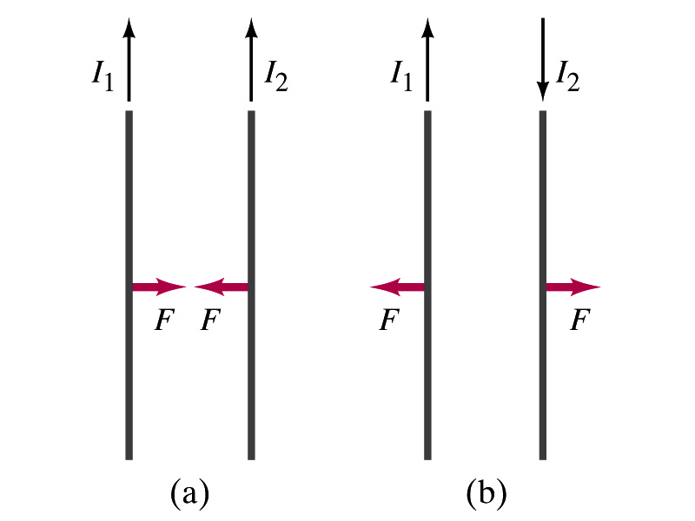
Force Between Two Parallel Wires
The force F by a magnetic field B₁ on a wire of length l, carrying the current I₂ when the field and the current are perpendicular to each other is:
So the force per unit length is
This force is only due to the magnetic field generated by the wire carrying the current I₁
There is the force exerted on the wire carrying the current I₁ by the wire carrying current I₂ of the same magnitude but in opposite direction
So the force per unit length is
How about the direction of the force?
If the currents are in the same direction, the attractive force. If opposite, repulsive.

Slide 9
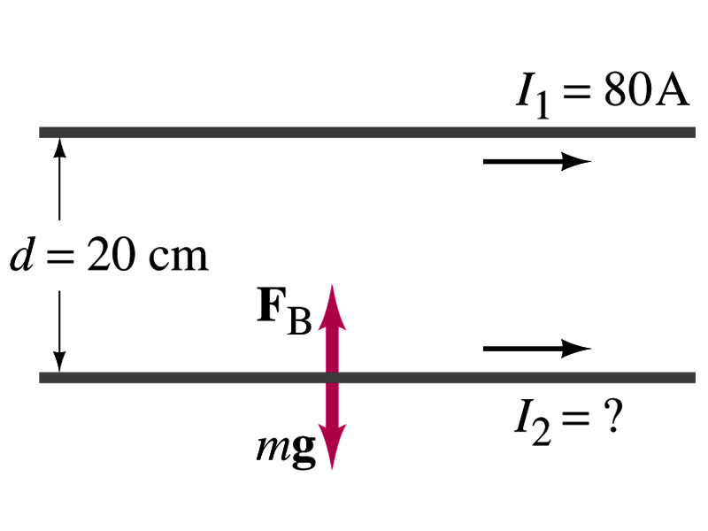
Example 28 – 5
Suspending a wire with current. A horizontal wire carries a current I₁=80A DC. A second parallel wire 20cm below it must carry how much current I₂ so that it doesn’t fall due to the gravity? The lower has a mass of 0.12g per meter of length.
Which direction is the gravitational force?
Down to the center of the Earth
This force must be balanced by the magnetic force exerted on the wire by the first wire.
Solving for I₂

Slide 10
Operational Definition of Ampere and Coulomb
The permeability of free space is defined to be exactly
The unit of current, ampere, is defined using the definition of the force between two wires each carrying 1A of current and separated by 1m
So 1A is defined as: the current flowing each of two long parallel conductors 1m apart, which results in a force of exactly 2x10⁻⁷N/m.
Coulomb is then defined as exactly 1C=1A s.
We do it this way since the electric current is measured more accurately and controlled more easily than the charge.

Slide 11
Ampére’s Law
What is the relationship between the magnetic field strength and the current?
Does this work in all cases?
Nope!
OK, then when?
Only valid for a long straight wire
Then what would be the more generalized relationship between the current and the magnetic field for any shapes of the wire?
French scientist André Marie Ampére proposed such a relationship soon after Oersted’s discovery

Slide 12
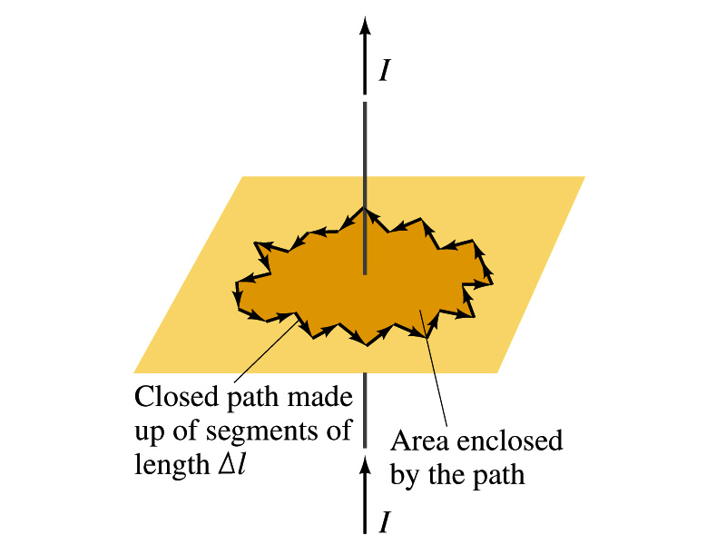
Ampére’s Law
Let’s consider an arbitrary closed path around the current as shown in the figure.
Let’s split this path with small segments each of Δl long.
The sum of all the products of the length of each segment and the component of B parallel to that segment is equal to μ₀ times the net current I_{encl} that passes through the surface enclosed by the path
In the limit Δl →0, this relation becomes
Ampére’s Law
Looks very similar to a law in the electricity. Which law is it?
Gauss’ Law

Slide 13
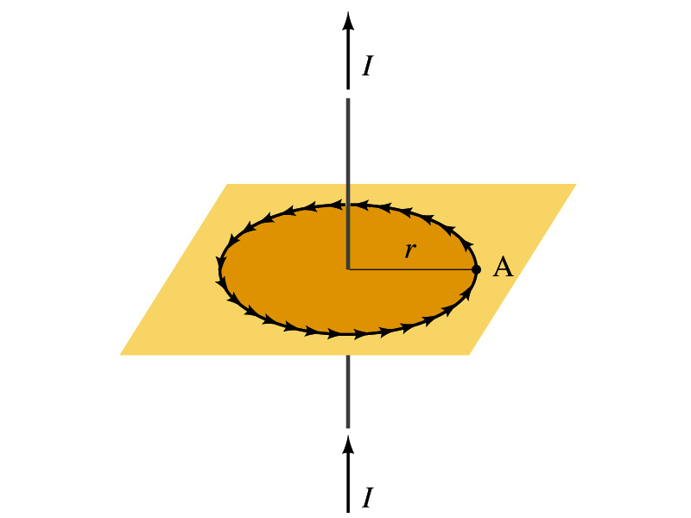
Verification of Ampére’s Law
Let’s find the magnitude of B at a distance r away from a long straight wire w/ current I
This is a verification of Ampere’s Law
We can apply Ampere’s law to a circular path of radius r.
Solving for B
We just verified that Ampere’s law works in a simple case
Experiments verified that it works for other cases too
The importance, however, is that it provides means to relate magnetic field to current

Slide 14
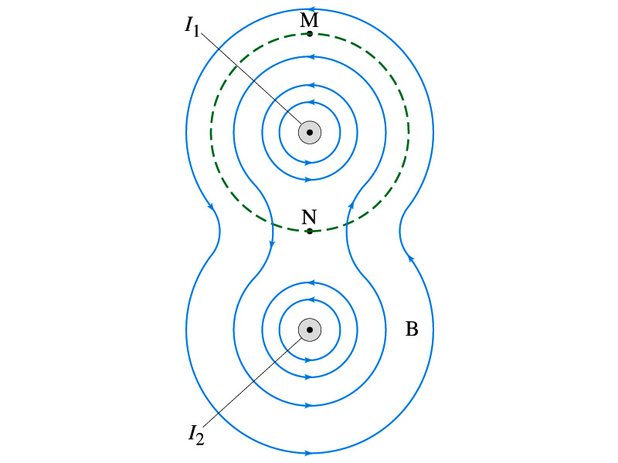
Verification of Ampére’s Law
Since Ampere’s law is valid in general, B in Ampere’s law is not just due to the current I_{encl}.
B is the field at each point in space along the chosen path due to all sources
Including the current I enclosed by the path but also due to any other sources
How do you obtain B in the figure at any point?
Vector sum of the field by the two currents
The result of the closed path integral in Ampere’s law for green dashed path is still μ₀I₁. Why?
While B in each point along the path varies, the integral over the closed path still comes out the same whether there is the second wire or not.

Slide 15
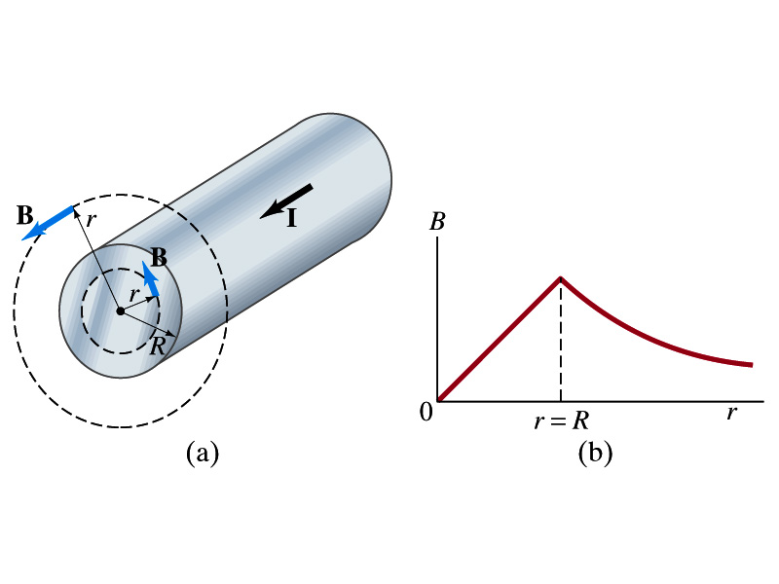
Example 28 – 6
Field inside and outside a wire. A long straight cylindrical wire conductor of radius R carries current I of uniform density in the conductor. Determine the magnetic field at (a) points outside the conductor (r>R) and (b) points inside the conductor (r<R). Assume that r, the radial distance from the axis, is much less than the length of the wire. (c) If R=2.0mm and I=60A, what is B at r=1.0mm, r=2.0mm and r=3.0mm?
Since the wire is long, straight and symmetric, the field should be the same at any point the same distance from the center of the wire.
Since B must be tangential to circles around the wire, let’s choose a circular path of the closed-path integral outside the wire (r>R). What is I_{encl}?
So using Ampere’s law
Solving for B

Slide 16
Example 28 – 6 cont’d
For r<R, the current inside the closed path is less than I. How much is it?
So using Ampere’s law
Solving for B
What does this mean?
The field is 0 at r=0 and increases linearly as a function of the distance from the center of the wire up to r=R then decreases as 1/r beyond the radius of the conductor.

Slide 17
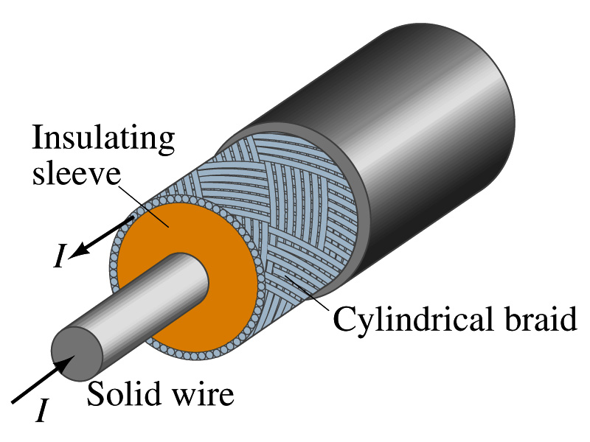
Example 28 – 7
Coaxial cable. A coaxial cable is a single wire surrounded by a cylindrical metallic braid, as shown in the figure. The two conductors are separated by an insulator. The central wire carries current to the other end of the cable, and the outer braid carries the return current and is usually considered ground. Describe the magnetic field (a) in the space between the conductors and (b) outside the cable.
(a) The magnetic field between the conductors is the same as the long, straight wire case since the current in the outer conductor does not impact the enclosed current.
(b) Outside the cable, we can draw a similar circular path, since we expect the field to have a circular symmetry. What is the sum of the total current inside the closed path?
So there is no magnetic field outside a coaxial cable. In other words, the coaxial cable self-shields. The outer conductor also shields against an external electric field. Cleaner signal and less noise.

