Slide 1
PHYS 1444 – Section 004 Lecture #17
Wednesday, April 4, 2012
Dr. Jaehoon Yu
Solenoid and Toroidal Magnetic Field
Biot-Savart Law
Magnetic Materials
Hysteresis
Induced EMF and EM Induction
Faraday’s Law of Induction

Slide 2
Announcements
Quiz #4
Beginning of the class Monday, Apr. 9
Covers Ch 28.1 through what we finish today (CH29.2)
Reading assignments
CH28.8, 9 and 10

Slide 3
Special Project #5
B due to current I in a straight wire. For the field near a long straight wire carrying a current I, show that
the Ampere’s law gives the same result as the simple long straight wire, B=μ₀I/2πR. (10 points)
That Biot-Savarat law gives the same result as the simple long straight wire, B=μ₀I/2πR. (10 points)
Must be your OWN work. No credit will be given for for copying straight out of the book, lecture notes or from your friends’ work.
Due is at the beginning of the exam on Wednesday, Apr. 18.

Slide 4
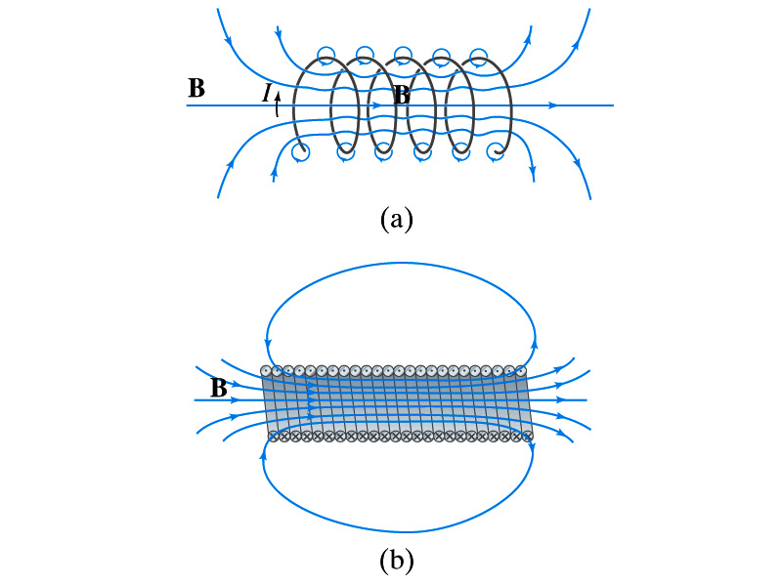
Solenoid and Its Magnetic Field
What is a solenoid?
A long coil of wire consisting of many loops
If the space between loops are wide
The field near the wires are nearly circular
Between any two wires, the fields due to each loop cancel
Toward the center of the solenoid, the fields add up to give a field that can be fairly large and uniform
For a long, densely packed loops
The field is nearly uniform and parallel to the solenoid axes within the entire cross section
The field outside the solenoid is very small compared to the field inside, except the ends
The same number of field lines spread out to an open space
Solenoid Axis

Slide 5
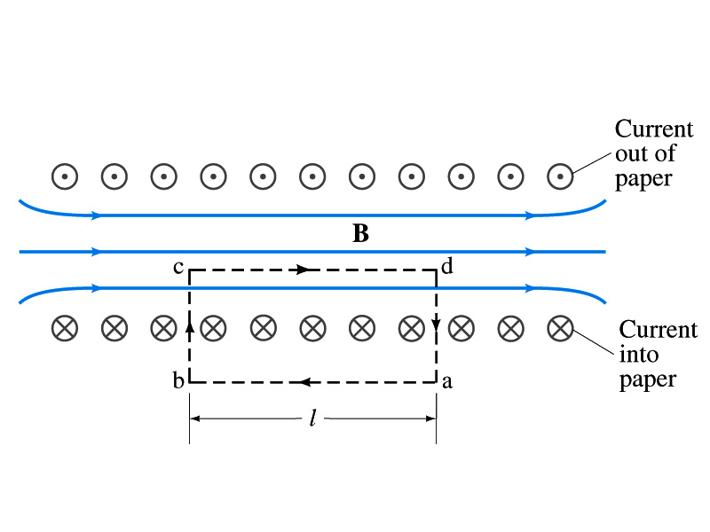
Solenoid Magnetic Field
Now let’s use Ampere’s law to determine the magnetic field inside a very long, densely packed solenoid
Let’s choose the path abcd, far away from the ends
We can consider four segments of the loop for integral
The field outside the solenoid is negligible. So the integral on a→b is 0.
Now the field B is perpendicular to the bc and da segments. So these integrals become 0, also.

Slide 6
Solenoid Magnetic Field
So the sum becomes:
If the current I flows in the wire of the solenoid, the total current enclosed by the closed path is NI
Where N is the number of loops (or turns of the coil) enclosed
Thus Ampere’s law gives us
If we let n=N/l be the number of loops per unit length, the magnitude of the magnetic field within the solenoid becomes
B depends on the number of loops per unit length, n, and the current I
Does not depend on the position within the solenoid but uniform inside it, like a bar magnet

Slide 7
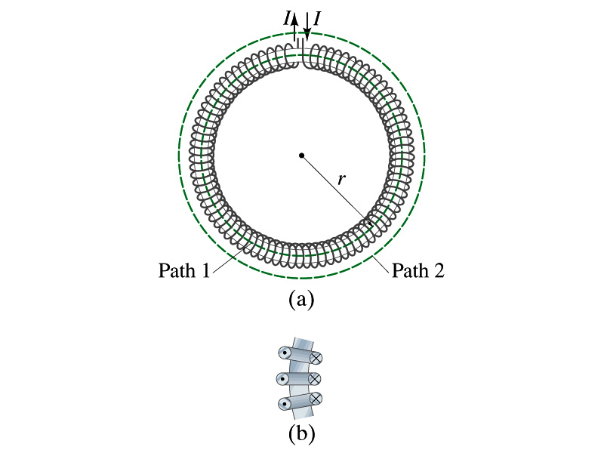
Example 28 – 10
Toroid. Use Ampere’s law to determine the magnetic field (a) inside and (b) outside a toroid, which is like a solenoid bent into the shape of a circle.
(a) How do you think the magnetic field lines inside the toroid look?
Since it is a bent solenoid, it should be a circle concentric with the toroid.
If we choose path of integration one of these field lines of radius r inside the toroid, path 1, to use the symmetry of the situation, making B the same at all points on the path, we obtain from Ampere’s law
Solving for B
So the magnetic field inside a toroid is not uniform. It is larger on the inner edge. However, the field will be uniform if the radius is large and the toroid is thin. The filed in this case is B = μ₀nI.
(b) Outside the solenoid, the field is 0 since the net enclosed current is 0.

Slide 8
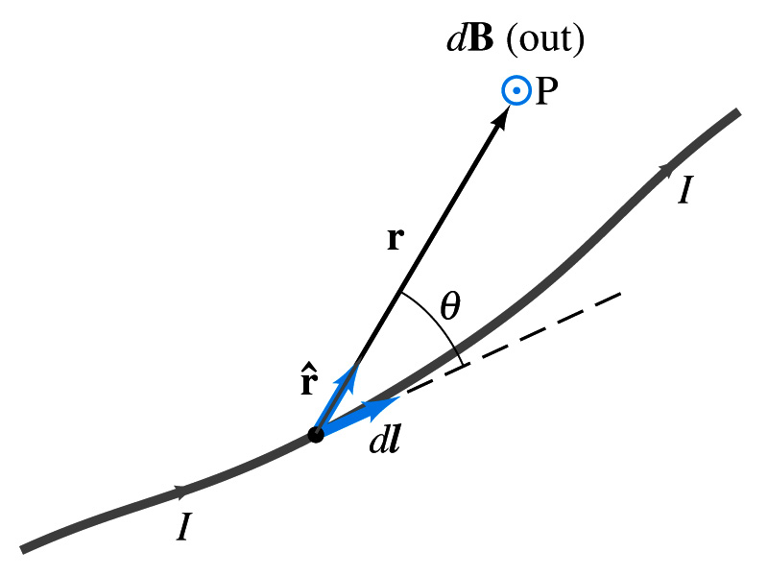
Biot-Savart Law
Ampere’s law is useful in determining magnetic field utilizing symmetry
But sometimes it is useful to have another method of using infinitesimal current segments for B field
Jean Baptiste Biot and Feilx Savart developed a law that a current I flowing in any path can be considered as many infinitesimal current elements
The infinitesimal magnetic field dB caused by the infinitesimal length dl that carries current I is
r is the displacement vector from the element dl to the point P
Biot-Savart law is the magnetic equivalent to Coulomb’s law
Biot-Savart Law
B field in Biot-Savart law is only that by the current, nothing else.

Slide 9
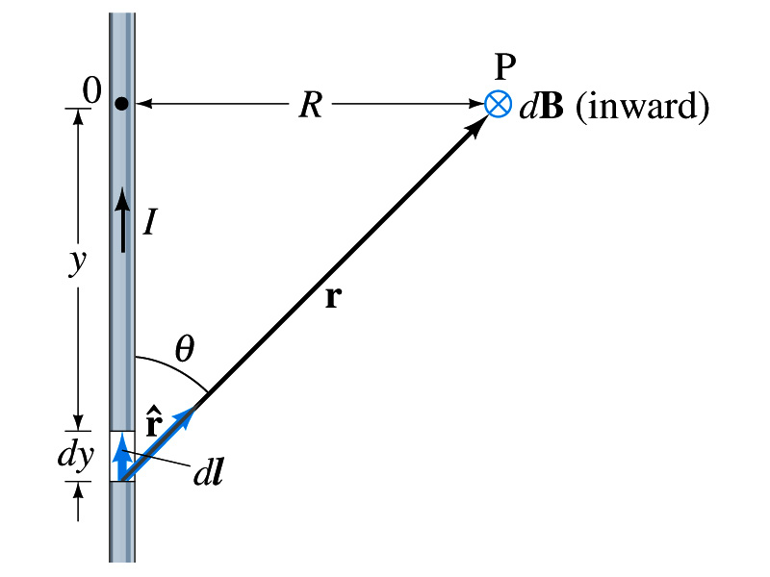
Example 28 – 11
B due to current I in a straight wire. For the field near a long straight wire carrying a current I, show that the Biot-Savarat law gives the same result as the simple long straight wire, B=μ₀I/2πR.
What is the direction of the field B at point P?
Going into the page.
All dB at point P has the same direction based on right-hand rule.
The magnitude of B using Biot-Savart law is
Where dy=dl and r²=R²+y² and since we obtain
Integral becomes
The same as the simple, long straight wire!! It works!!

Slide 10
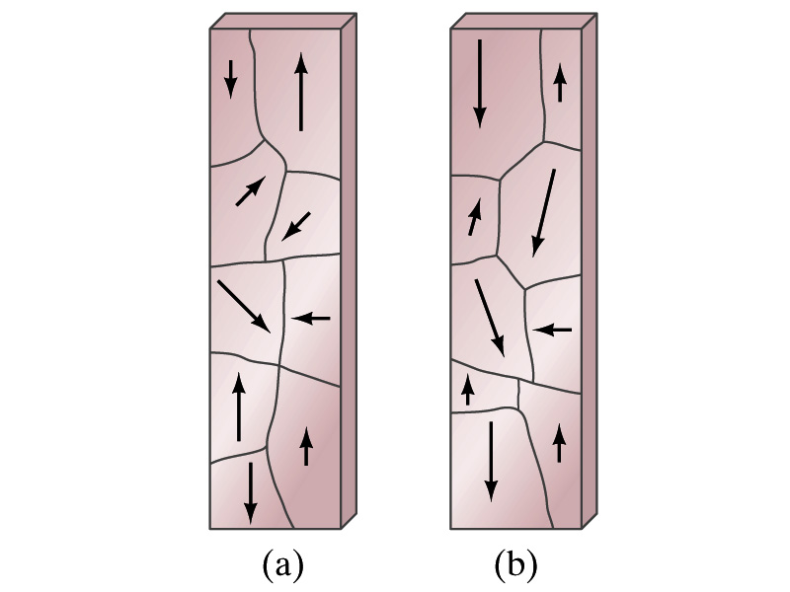
Magnetic Materials - Ferromagnetism
Iron is a material that can turn into a strong magnet
This kind of material is called ferromagnetic material
In microscopic sense, ferromagnetic materials consist of many tiny regions called domains
Domains are like little magnets usually smaller than 1mm in length or width
What do you think the alignment of domains are like when they are not magnetized?
Randomly arranged
What if they are magnetized?
The size of the domains aligned with the external magnetic field direction grows while those of the domains not aligned reduce
This gives magnetization to the material
How do we demagnetize a bar magnet?
Hit the magnet hard or heat it over the Curie temperature

Slide 11
B in Magnetic Materials
What is the magnetic field inside a solenoid?
Magnetic field in a long solenoid is directly proportional to the current.
This is valid only if air is inside the coil
What do you think will happen to B if we have something other than the air inside the solenoid?
It will be increased dramatically, when the current flows
Especially if a ferromagnetic material such as an iron is put inside, the field could increase by several orders of magnitude
Why?
Since the domains in the iron aligns permanently by the external field.
The resulting magnetic field is the sum of that due to current and due to the iron

Slide 12
B in Magnetic Materials
It is sometimes convenient to write the total field as the sum of two terms
B₀ is the field due only to the current in the wire, namely the external field
The field that would be present without a ferromagnetic material
B_{M} is the additional field due to the ferromagnetic material itself; often B_{M}>>B₀
The total field in this case can be written by replacing μ₀ with another proportionality constant μ, the magnetic permeability of the material
μ is a property of a magnetic material
μ is not a constant but varies with the external field

Slide 13
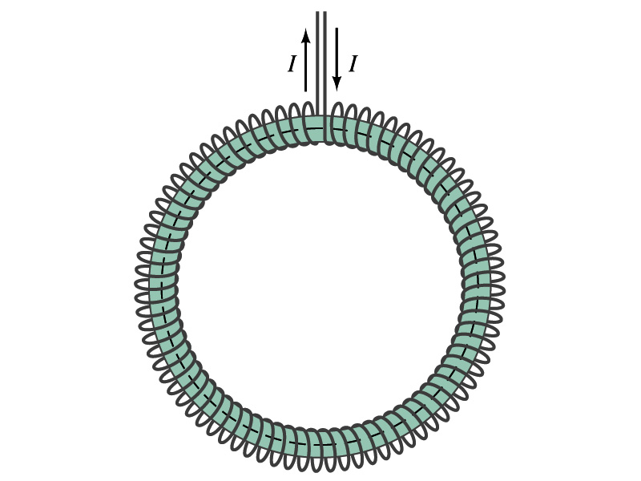
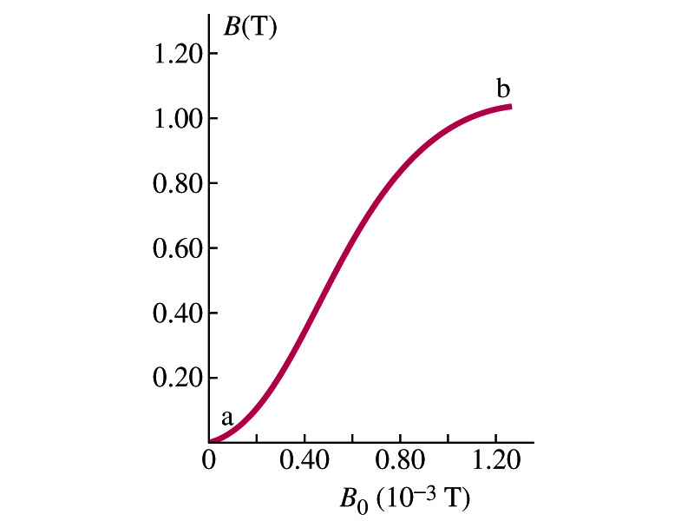
Hysteresis
Iron Core Toroid
What is a toroid?
A solenoid bent into a shape
Toroid can be used for magnetic field measurement
Why?
Since it does not leak magnetic field outside of itself, it fully contains all the magnetic field created within it.
Consider an un-magnetized iron core toroid, without any current flowing in the wire
What do you think will happen if the current slowly increases?
B₀ increases linearly with the current.
And B increases also but follows the curved line shown in the graph
As B₀ increases, the domains become more aligned until nearly all are aligned (point b on the graph)
The iron is said to be approaching saturation
Point b is typically at 70% of the max

Slide 14
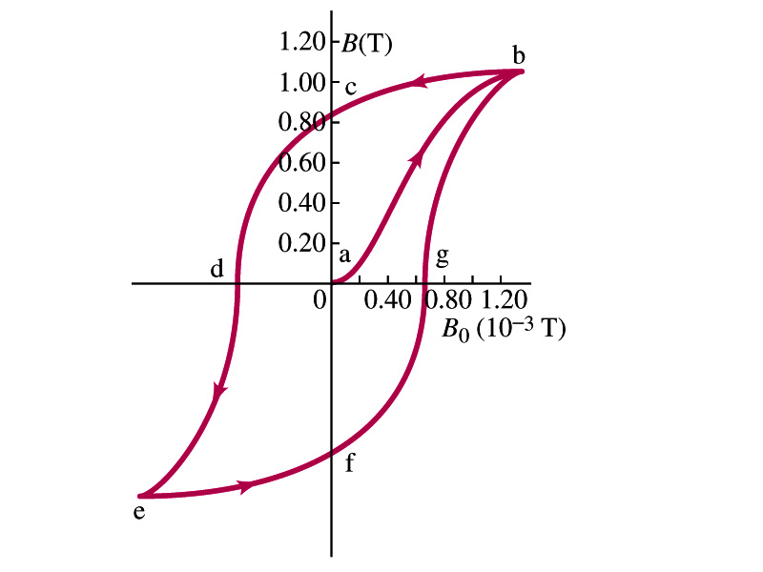
Hysteresis
What do you think will happen to B if the external field B₀ is reduced to 0 by decreasing the current in the coil?
Of course it goes to 0!!
Wrong! Wrong! Wrong! They do not go to 0. Why not?
The domains do not completely return to random alignment state
Now if the current direction is reversed, the external magnetic field direction is reversed, causing the total field B pass 0, and the direction reverses to the opposite side
If the current is reversed again, the total field B will increase but never goes through the origin
This kind of curve whose path does not retrace themselves and does not go through the origin is called the Hysteresis.

Slide 15
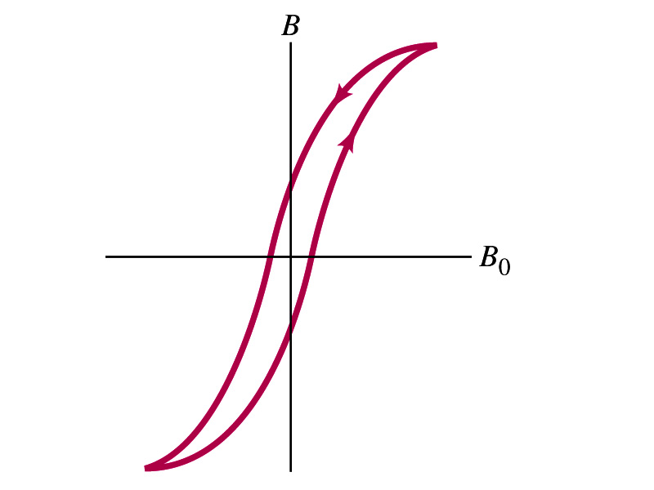
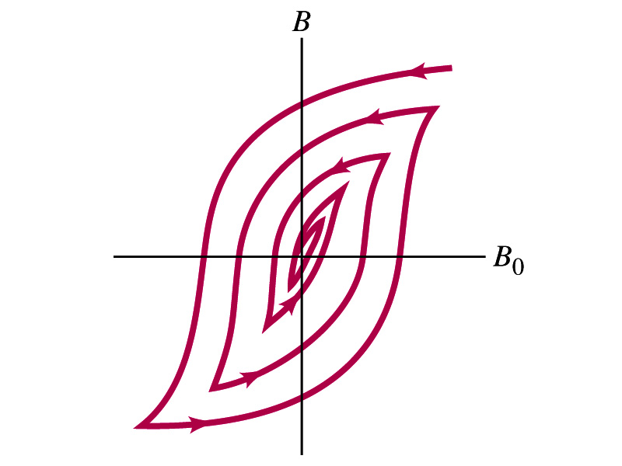
Magnetically Soft Material
In a hysteresis cycle, much energy is transformed to thermal energy. Why?
Due to the microscopic friction between domains as they change directions to align with the external field
The energy dissipated in the hysteresis cycle is proportional to the area of the hysteresis loop
Ferromagnetic material with large hysteresis area is called magnetically hard while the small ones are called soft
Which one do you think are preferred in electromagnets or transformers?
Soft. Why?
Since the energy loss is small and much easier to switch off the field
Then how do we demagnetize a ferromagnetic material?
Keep repeating the Hysteresis loop, reducing the range of B₀.

Slide 16
Induced EMF
It has been discovered by Oersted and company in early 19th century that
Magnetic field can be produced by the electric current
Magnetic field can exert force on the electric charge
So if you were scientists at that time, what would you wonder?
Yes, you are absolutely right! You would wonder if the magnetic field can create the electric current.
An American scientist Joseph Henry and an English scientist Michael Faraday independently found that it was possible
Though, Faraday was given the credit since he published his work before Henry did
He also did a lot of detailed studies on magnetic induction

Slide 17
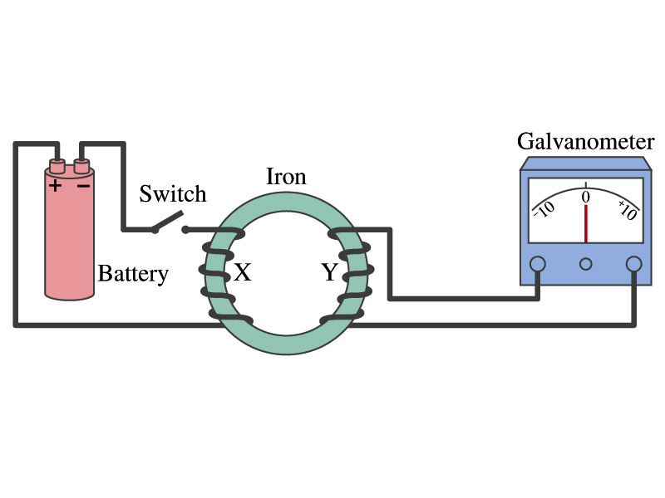
Electromagnetic Induction
Faraday used an apparatus below to show that magnetic field can induce current
Despite his hope he did not see steady current induced on the other side when the switch is thrown
But he did see that the needle on the Galvanometer turns strongly when the switch is initially thrown and is opened
When the magnetic field through coil Y changes, a current flows as if there were a source of emf
Thus he concluded that an induced emf is produced by a changing magnetic field ➔ Electromagnetic Induction

Slide 18
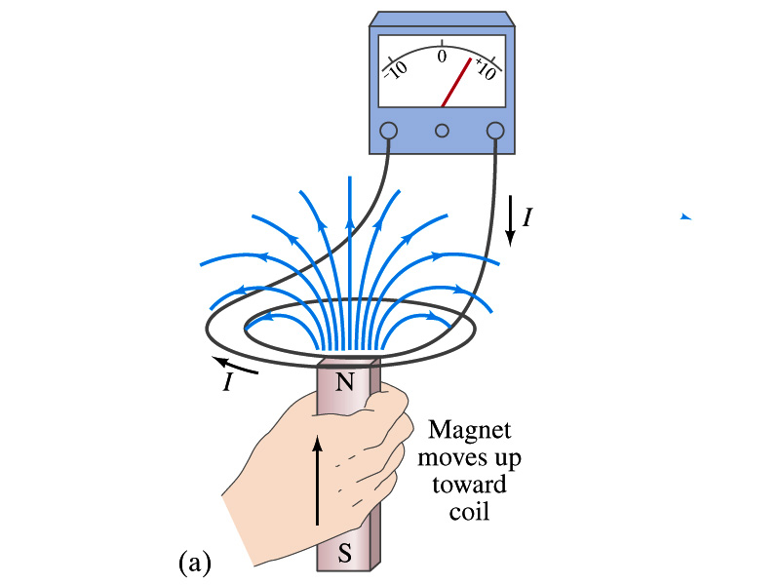
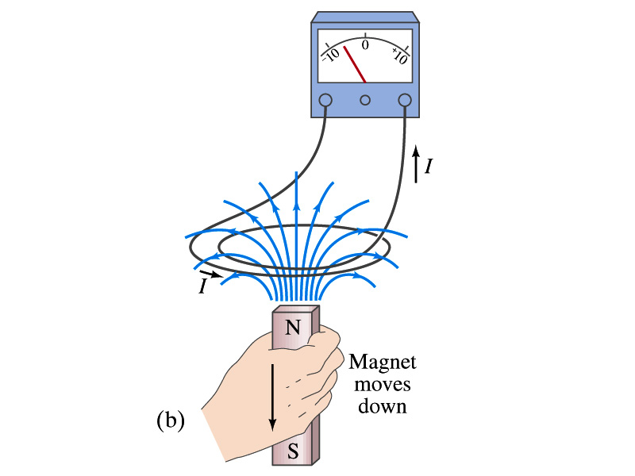
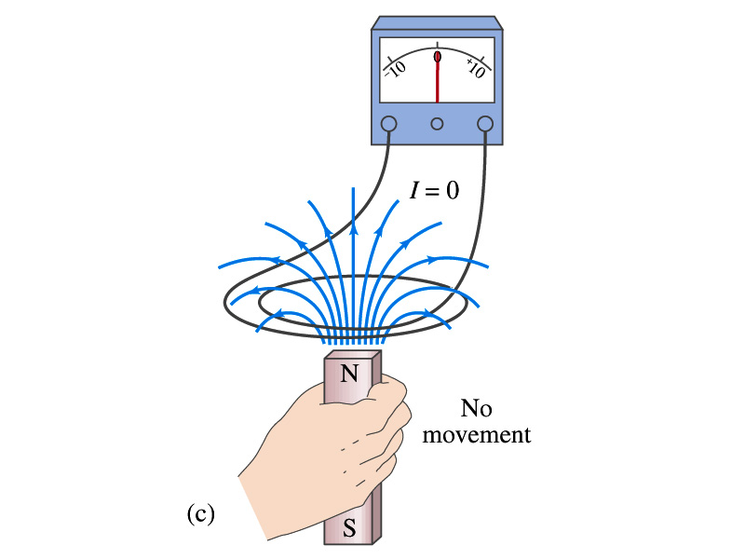
Electromagnetic Induction
Further studies on electromagnetic induction taught
If a magnet is moved quickly into a coil of wire, a current is induced in the wire.
If a magnet is removed from the coil, a current is induced in the wire in the opposite direction
By the same token, the current can also be induced if the magnet stays put but the coil moves toward or away from the magnet
Current is also induced if the coil rotates.
In other words, it does not matter whether the magnet or the coil moves. It is the relative motion that counts.

Slide 19
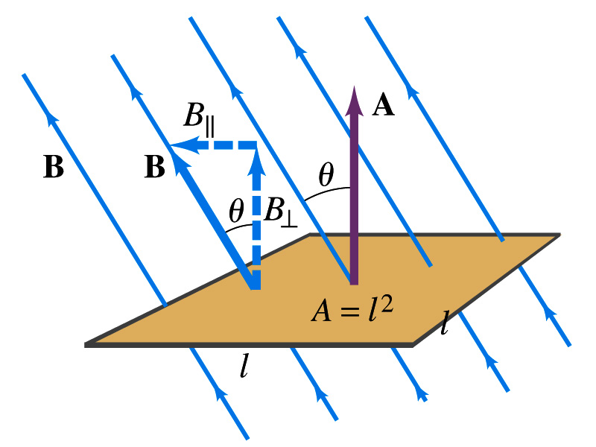
Magnetic Flux
So what do you think is the induced emf proportional to?
The rate of changes of the magnetic field?
the higher the changes the higher the induction
Not really, it rather depends on the rate of change of the magnetic flux, Φ_{B}.
Magnetic flux is defined as (just like the electric flux)
θ is the angle between B and the area vector A whose direction is perpendicular to the face of the loop based on the right-hand rule
What kind of quantity is the magnetic flux?
Scalar. Unit?
or weber
If the area of the loop is not simple or B is not uniform, the magnetic flux can be written as

Slide 20
Faraday’s Law of Induction
In terms of magnetic flux, we can formulate Faraday’s findings
The emf induced in a circuit is equal to the rate of change of magnetic flux through the circuit
If the circuit contains N closely wrapped loops, the total induced emf is the sum of emf induced in each loop
Why negative?
Has got a lot to do with the direction of induced emf…
Faraday’s Law of Induction

Slide 21
Lenz’s Law
It is experimentally found that
An induced emf gives rise to a current whose magnetic field opposes the original change in flux ➔ This is known as Lenz’s Law
In other words, an induced emf is always in a direction that opposes the original change in flux that caused it.
We can use Lenz’s law to explain the following cases in the figures
When the magnet is moving into the coil
Since the external flux increases, the field inside the coil takes the opposite direction to minimize the change and causes the current to flow clockwise
When the magnet is moving out
Since the external flux decreases, the field inside the coil takes the opposite direction to compensate the loss, causing the current to flow counter-clockwise
Which law is Lenz’s law result of?
Energy conservation. Why?

