Slide 1
PHYS 1444 – Section 004
Lecture #18
Monday, April 9, 2012
Dr. Jaehoon Yu
Induction of EMF
Electric Generators
DC Generator
Eddy Currents
Transformer
Today’s homework is #11, due 10pm, Tuesday, Apr. 17!!

Slide 2
Announcements
Term exam #2
  Non-comprehensive
  Date and time: 5:30 – 6:50pm, Wednesday, Apr. 25
  Location: SH103
  Coverage: CH. 27 – 1 to what we finish Monday, Apr. 23
  Please do NOT miss the exam!!
Reading assignments
  CH29 – 5 and CH29 – 8
No colloquium this week

Slide 3
Special Project #5
B due to current I in a straight wire. For the field near a long straight wire carrying a current I, show that
The Ampere’s law gives the same result as the simple long straight wire, B=μ₀I/2πR. (10 points)
That Biot-Savarat law gives the same result as the simple long straight wire, B=μ₀I/2πR. (10 points)
Must be your OWN work. No credit will be given for for copying straight out of the book, lecture notes or from your friends’ work.
Due is at the beginning of the class on Wednesday, Apr. 18.

Slide 4
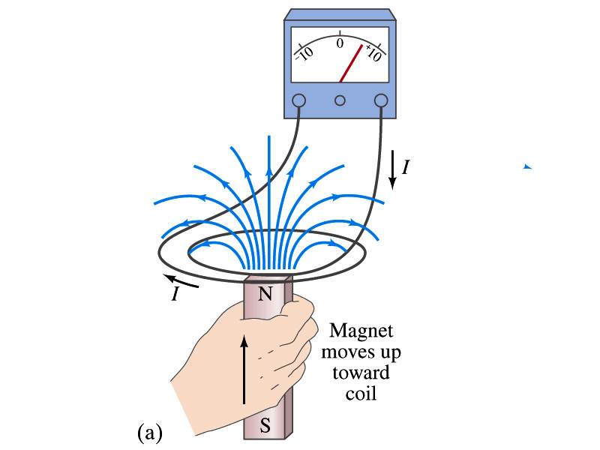
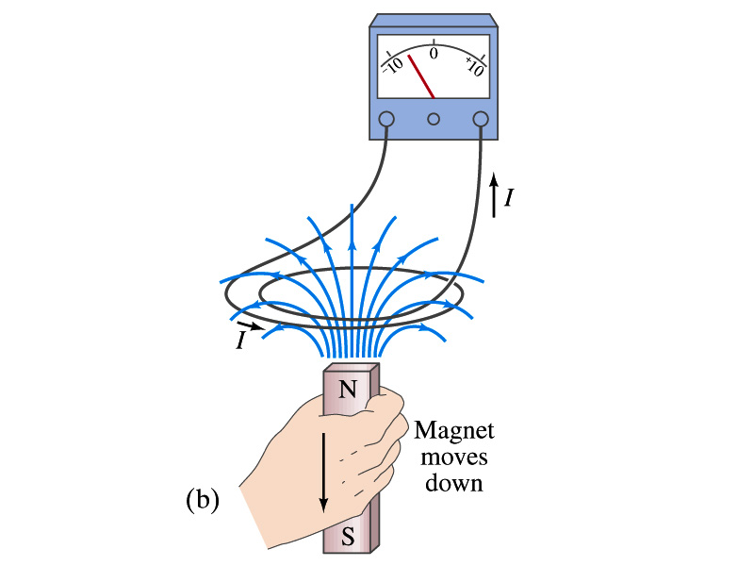
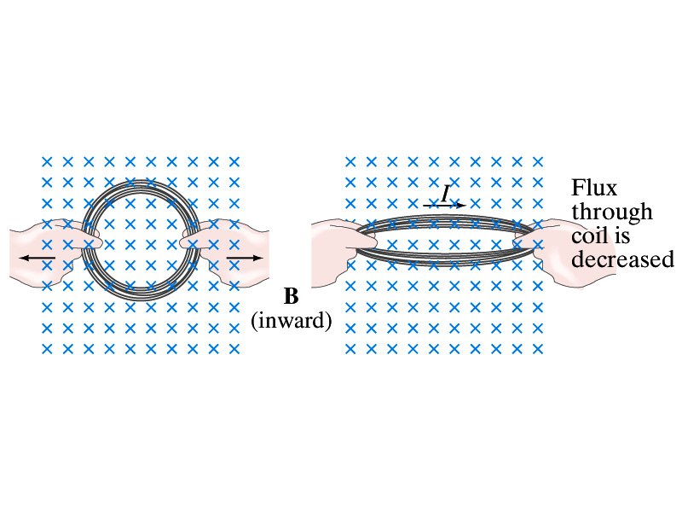
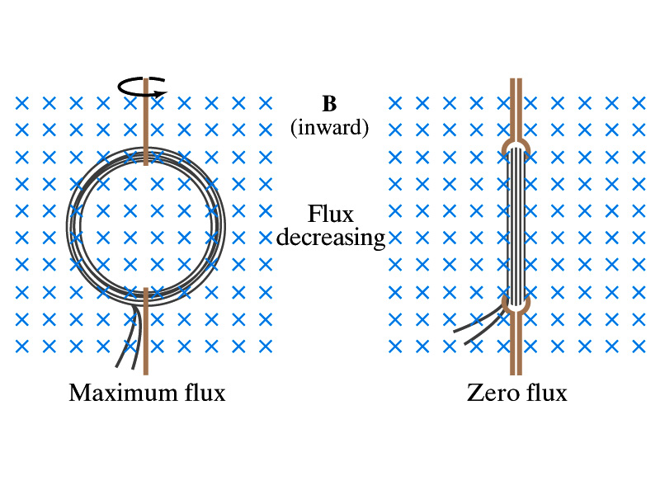
Induction of EMF
How can we induce emf?
Let’s look at the formula for the magnetic flux
What do you see? What are the things that can change with time to result in change of magnetic flux?
  Magnetic field
  The area of the loop
  The angle θ between the field and the area vector

Slide 5
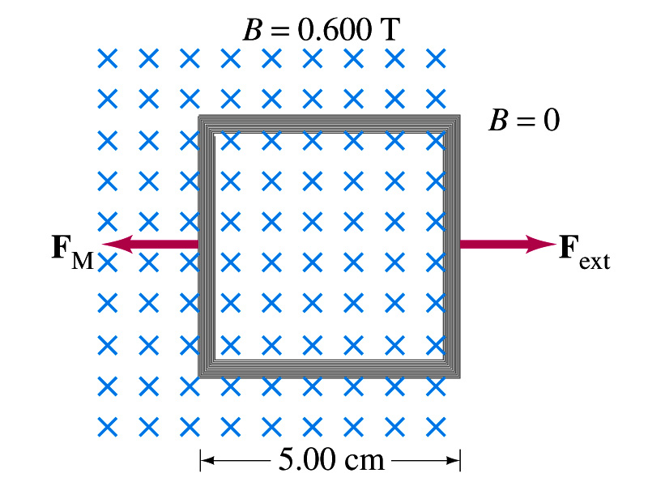
Example 29 – 5
Pulling a coil from a magnetic field. A square coil of wire with side 5.00cm contains 100 loops and is positioned perpendicular to a uniform 0.600-T magnetic field. It is quickly and uniformly pulled from the field (moving perpendicular to B) to a region where B drops abruptly to zero. At t=0, the right edge of the coil is at the edge of the field. It takes 0.100s for the whole coil to reach the field-free
region. Find (a) the rate of change in flux through the coil, (b) the emf and current induced, and (c) how much energy is dissipated in the coil if its resistance is 100Ω. (d) what was the average force required?
What should be computed first?
The initial flux at t=0.
The flux at t=0 is
The change of flux is
Thus the rate of change of the flux is

Slide 6
Example 29 – 5, cnt’d
Thus the total emf induced in this period is
The induced current in this period is
Which direction would the induced current flow?
Clockwise
The total energy dissipated is
Force for each coil is
Force for N coil is

Slide 7
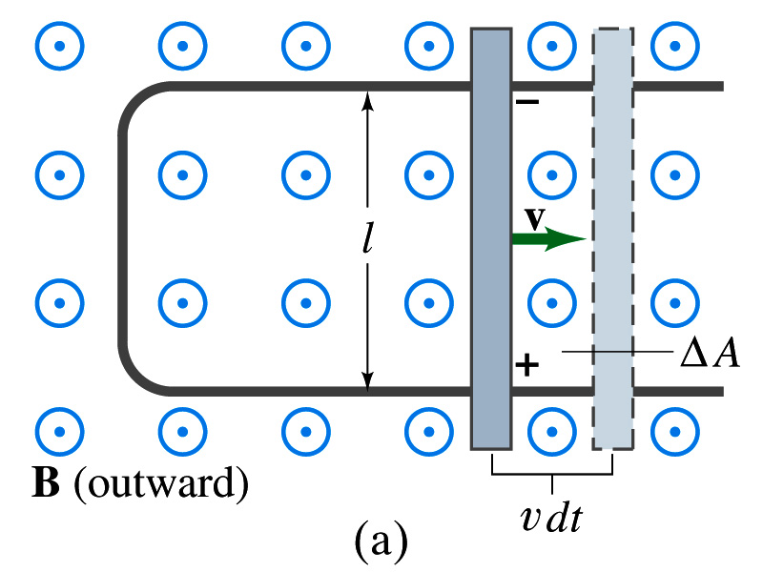
EMF Induced on a Moving Conductor
Another way of inducing emf is using a U shaped conductor with a movable rod resting on it.
As the rod moves at a speed v, it travels vdt in time dt, changing the area of the loop by dA=lvdt.
Using Faraday’s law, the induced emf for this loop is
  This equation is valid as long as B, l and v are perpendicular to each other. What do we do if not?
    Use the scalar product of vector quantities
An emf induced on a conductor moving in a magnetic field is called a motional emf

Slide 8
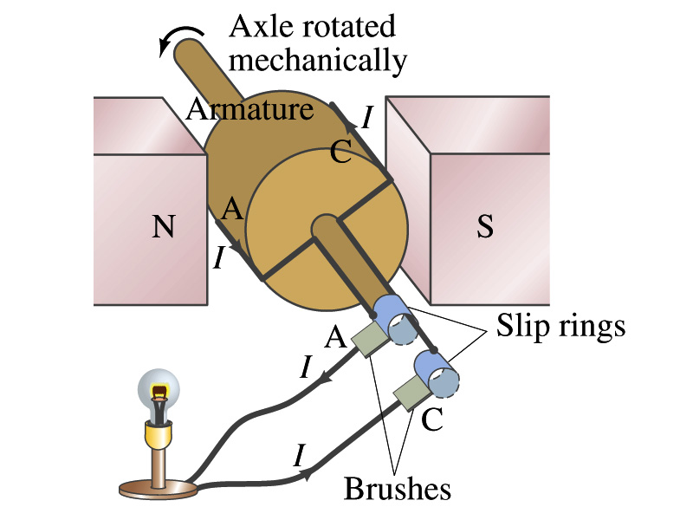
Electric Generators
What does a generator do?
  Transforms mechanical energy into the electrical energy
  What does this look like?
    An inverse of an electric motor which transforms electrical energy to mechanical energy
  An electric generator is also called a dynamo
Whose law does the generator based on?
  Faraday’s law of induction

Slide 9
How does an Electric Generator work?
An electric generator consists of
  Many coils of wires wound on an armature that can rotate by mechanical means in a magnetic field
An emf is induced in the rotating coil
Electric current is the output of a generator
Which direction does the output current flow when the armature rotates counterclockwise?
  The conventional current flows outward on wire A toward the brush
  After half the revolution the wire A will be where the wire C is and the current flow on A is reversed
Thus the current produced is alternating its direction

Slide 10
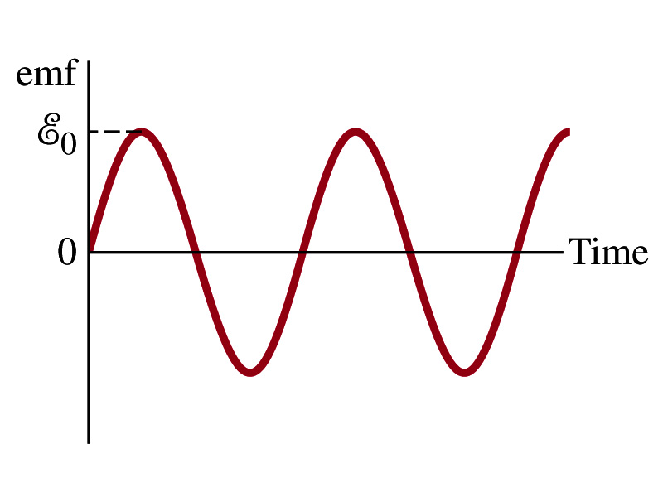
How does an Electric Generator work?
Let’s assume the loop is rotating in a uniform B field w/ a constant angular velocity ω. The induced emf is
What is the variable that changes above?
  The angle θ. What is dθ/dt?
    The angular speed ω.
  So θ=θ₀+ωt
  If we choose θ₀=0, we obtain
  If the coil contains N loops:
  What is the shape of the output?
    Sinusoidal w/ amplitude ε₀=NBAω
USA frequency is 60Hz. Europe is at 50Hz
  Most the U.S. power is generated at steam plants

Slide 11
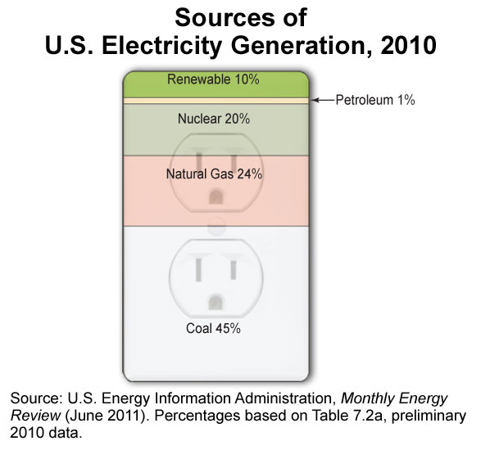
US Electricity Sources

Slide 12
The World Energy Consumption
In 2008, total worldwide energy consumption was 474 EJ (474×10¹⁸ J=132,000 TWh).
  Equivalent to an average energy consumption rate of 15 terawatts (1.504×10¹³ W)
The potential for renewable energy
  solar energy 1600 EJ (444,000 TWh)
  wind power 600 EJ (167,000 TWh)
  geothermal energy 500 EJ (139,000 TWh),
  biomass 250 EJ (70,000 TWh)
  hydropower 50 EJ (14,000 TWh) an
  ocean energy 1 EJ (280 TWh)

Slide 13
Example 29 – 9
An AC generator. The armature of a 60-Hz AC generator rotates in a 0.15-T magnetic field. If the area of the coil is 2.0x10⁻²m², how many loops must the coil contain if the peak output is to be ε₀=170V?
The maximum emf of a generator is
Solving for N
Since
We obtain

