Slide 1
PHYS 1444 – Section 004 Lecture #19
Wednesday, April 11, 2012
Dr. Jaehoon Yu
DC Generator
Transformer
Generalized Faraday’s Law
Mutual Inductance
Self Inductance

Slide 2
Announcements
Term exam #2
Non-comprehensive
Date and time: 5:30 – 6:50pm, Wednesday, Apr. 25
Location: SH103
Coverage: CH. 27 – 1 to what we finish Monday, Apr. 23
Please do NOT miss the exam!!
Reading assignments
CH29 – 5 and CH29 – 8

Slide 3
Special Project #5
B due to current I in a straight wire. For the field near a long straight wire carrying a current I, show that
The Ampere’s law gives the same result as the simple long straight wire, B=μ₀I/2πR. (10 points)
That Biot-Savarat law gives the same result as the simple long straight wire, B=μ₀I/2πR. (10 points)
Must be your OWN work. No credit will be given for for copying straight out of the book, lecture notes or from your friends’ work.
Due is at the beginning of the class on Wednesday, Apr. 18.

Slide 4
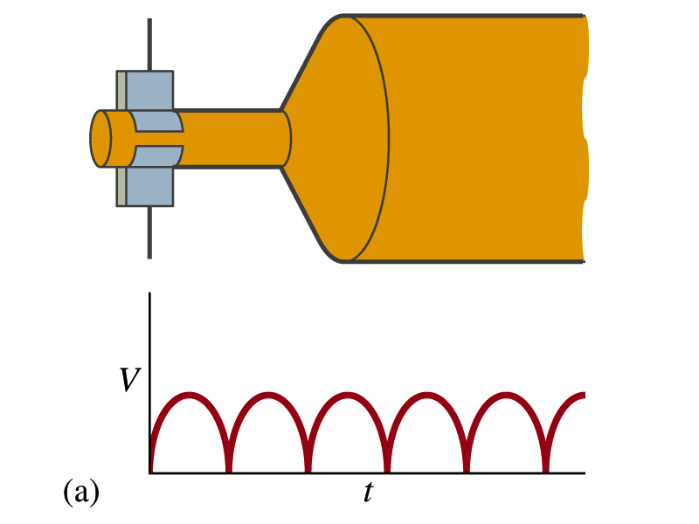
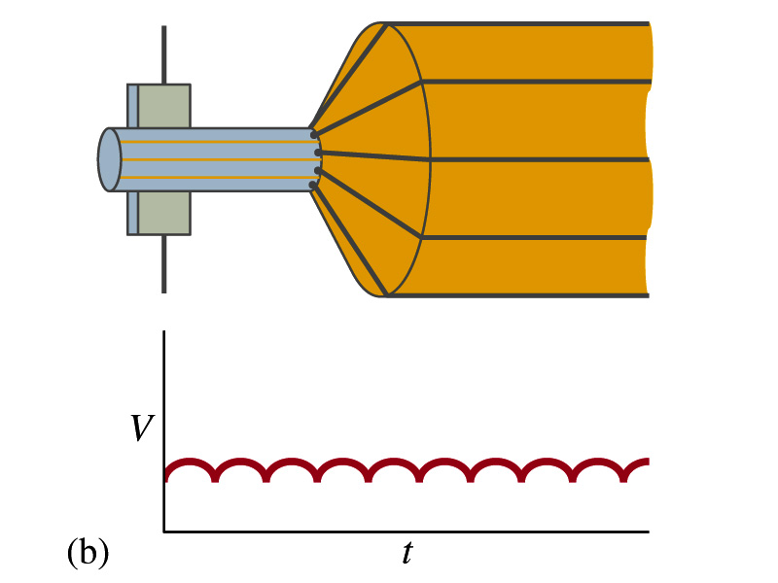
A DC Generator
A DC generator is almost the same as an AC generator except the slip rings are replaced by split-ring commutators
Output can be smoothed out by placing a capacitor on the output
More commonly done using many armature windings
Smooth output using many windings

Slide 5
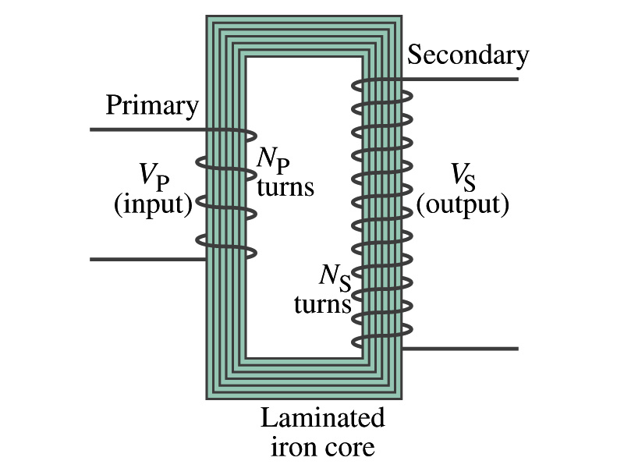
Transformer
What is a transformer?
A device for increasing or decreasing an AC voltage
A few examples?
TV sets to provide High Voltage to picture tubes, portable electronic device converters, transformers on the pole, etc
A transformer consists of two coils of wires known as the primary and the secondary
The two coils can be interwoven or linked by a laminated soft iron core to reduce losses due to Eddy current
Transformers are designed so that all magnetic flux produced by the primary coil pass through the secondary

Slide 6
How does a transformer work?
When an AC voltage is applied to the primary, the changing B it produces will induce voltage of the same frequency in the secondary wire
So how would we make the voltage different?
By varying the number of loops in each coil
From Faraday’s law, the induced emf in the secondary is
The input primary voltage is
Since dΦ_{B}/dt is the same, we obtain
Transformer Equation

Slide 7
Transformer Equation
The transformer equation does not work for DC current
Since there is no change of magnetic flux!!
If N_{S}>N_{P}, the output voltage is greater than the input so it is called a step-up transformer while N_{S}<N_{P} is called step-down transformer
Now, it looks like energy conservation is violated since we can get more emf from smaller ones, right?
Wrong! Wrong! Wrong! Energy is always conserved!
A well designed transformer can be more than 99% efficient
The power output is the same as the input:
The output current for step-up transformer will be lower than the input, while it is larger for step-down x-former than the input.

Slide 8
Example for A Transformer
Portable radio transformer. A transformer for home use of a portable radio reduces 120-V AC to 9.0V AC. The secondary contains 30 turns, and the radio draws 400mA. Calculate (a) the number of turns in the primary (b) the current in the primary and (c) the power transformed.
(a) What kind of a transformer is this?
A step-down x-former
Since
We obtain
We obtain
(b) Also from the transformer equation
(c) Thus the power transformed is
How about the input power?
The same assuming 100% efficiency.

Slide 9
Example 29 – 13: Power Transmission
Transmission lines. An average of 120kW of electric power is sent to a small town from a power plant 10km away. The transmission lines have a total resistance of 0.4Ω. Calculate the power loss if the power is transmitted at (a) 240V and (b) 24,000V.
We cannot use P=V²/R since we do not know the voltage along the transmission line. We, however, can use P=I²R.
(a) If 120kW is sent at 240V, the total current is
Thus the power loss due to transmission line is
(b) If 120kW is sent at 24,000V, the total current is
Thus the power loss due to transmission line is
The higher the transmission voltage, the smaller the current, causing less loss of energy. This is why power is transmitted w/ HV, as high as 170kV.

Slide 10
Electric Field due to Magnetic Flux Change
When the electric current flows through a wire, there is an electric field in the wire that moves electrons
We saw, however, that changing magnetic flux induces a current in the wire. What does this mean?
There must be an electric field induced by the changing magnetic flux.
In other words, a changing magnetic flux produces an electric field
This results apply not just to wires but to any conductor or any region in space

Slide 11
Generalized Form of Faraday’s Law
Recall the relationship between the electric field and the potential difference
Induced emf in a circuit is equal to the work done per unit charge by the electric field
So we obtain
The integral is taken around a path enclosing the area through which the magnetic flux Φ_{Β} is changing.

Slide 12
Inductance
Changing magnetic flux through a circuit induce an emf in that circuit
An electric current produces a magnetic field
From these, we can deduce
A changing current in one circuit must induce an emf in a nearby circuit ➔ Mutual inductance
Or induce an emf in itself ➔ Self inductance

Slide 13
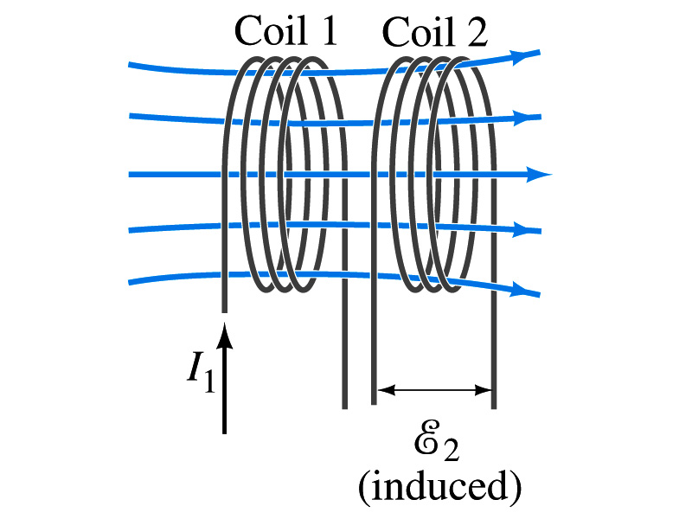
Mutual Inductance
If two coils of wire are placed near each other, a changing current in one will induce an emf in the other.
What is the induced emf, ε₂, in coil2 proportional to?
Rate of the change of the magnetic flux passing through it
This flux is due to current I₁ in coil 1
If Φ₂₁ is the magnetic flux in each loop of coil2 created by coil1 and N₂ is the number of closely packed loops in coil2, then N₂Φ₂₁ is the total flux passing through coil2.
If the two coils are fixed in space, N₂Φ₂₁ is proportional to the current I₁ in coil 1, .
The proportionality constant for this is called the Mutual Inductance and defined as .
The emf induced in coil2 due to the changing current in coil1 is

Slide 14
Mutual Inductance
The mutual induction of coil2 with respect to coil1, M₂₁,
is a constant and does not depend on I₁.
depends only on “geometric” factors such as the size, shape, number of turns and relative position of the two coils, and whether a ferromagnetic material is present
The farther apart the two coils are the less flux can pass through coil, 2, so M₂₁ will be less.
In most cases the mutual inductance is determined experimentally
Conversely, the changing current in coil2 will induce an emf in coil1
M₁₂ is the mutual inductance of coil1 with respect to coil2 and M₁₂ = M₂₁
We can put M=M₁₂=M₂₁ and obtain
SI unit for mutual inductance is henry (H)
What? Does this make sense?

Slide 15
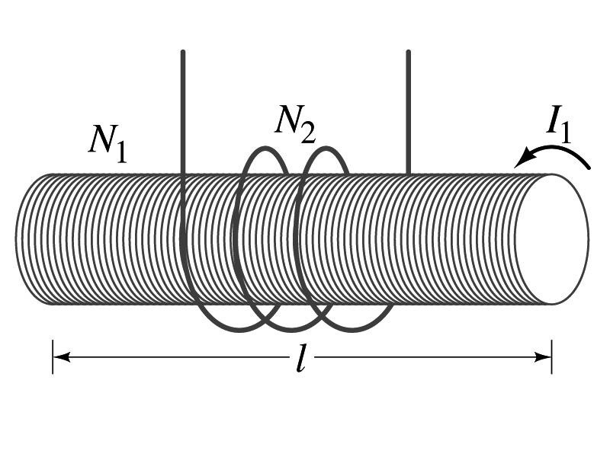
Example 30 – 1
Solenoid and coil. A long thin solenoid of length l and cross-sectional area A contains N₁ closely packed turns of wire. Wrapped around it is an insulated coil of N₂ turns. Assuming all the flux from coil 1 (the solenoid) passes through coil 2, calculate the mutual inductance.
First we need to determine the flux produced by the solenoid.
What is the magnetic field inside the solenoid?
Since the solenoid is closely packed, we can assume that the field lines are perpendicular to the surface area of the coils. Thus the flux through coil 2 is
Thus the mutual inductance of coil 2 is
Note that M₂₁ only depends on geometric factors!

Slide 16
Self Inductance
The concept of inductance applies to a single isolated coil of N turns. How does this happen?
When a changing current passes through a coil
A changing magnetic flux is produced inside the coil
The changing magnetic flux in turn induces an emf in the same coil
This emf opposes the change in flux. Whose law is this?
Lenz’s law
What would this do?
When the current through the coil is increasing?
The increasing magnetic flux induces an emf that opposes the original current
This tends to impedes its increase, trying to maintain the original current
When the current through the coil is decreasing?
The decreasing flux induces an emf in the same direction as the current
This tends to increase the flux, trying to maintain the original current

Slide 17
Self Inductance
Since the magnetic flux Φ_{B} passing through N turn coil is proportional to current I in the coil,
We define self-inductance, L:
The induced emf in a coil of self-inductance L is
What is the unit for self-inductance?
What does magnitude of L depend on?
Geometry and the presence of a ferromagnetic material
Self inductance can be defined for any circuit or part of a circuit
Self Inductance

Slide 18
So what in the world is the Inductance?
It is an impediment onto the electrical current due to the existence of changing flux
So what?
In other words, it behaves like a resistance to the varying current, such as AC, that causes the constant change of flux
But it also provides means to store energy, just like the capacitance

