Slide 1
PHYS 1444 – Section 004
Lecture #20
Monday, April 16, 2012
Dr. Jaehoon Yu
Inductor
Energy Stored in a Magnetic Field
LR circuit
AC Circuit w/ Resistance only
AC Circuit w/ Inductance only
AC Circuit w/ Capacitance only
Today’s homework is #12, due 10pm, Tuesday, Apr. 24!!

Slide 2
Announcements
Your planetarium extra credit
  Please bring your planetarium extra credit sheet by the beginning of the class next Monday, Apr. 30
  Be sure to tape one edge of the ticket stub with the title of the show on top
  Be sure to write your name onto the sheet
Term exam #2
  Non-comprehensive
  Date and time: 5:30 – 6:50pm, Wednesday, Apr. 25
  Location: SH103
  Coverage: CH. 27 – 1 to what we finish Monday, Apr. 23
  Please do NOT miss the exam!!
Reading Assignments
  CH30.9 – CH30.11
Colloquium this week
  Dr. Jean Gao of UTA

Slide 3


Slide 4
Special Project #5
B due to current I in a straight wire. For the field near a long straight wire carrying a current I, show that
The Ampere’s law gives the same result as the simple long straight wire, B=μ₀I/2πR. (10 points)
That Biot-Savarat law gives the same result as the simple long straight wire, B=μ₀I/2πR. (10 points)
Must be your OWN work. No credit will be given for for copying straight out of the book, lecture notes or from your friends’ work.
Due is at the beginning of the class this Wednesday, Apr. 18.

Slide 5
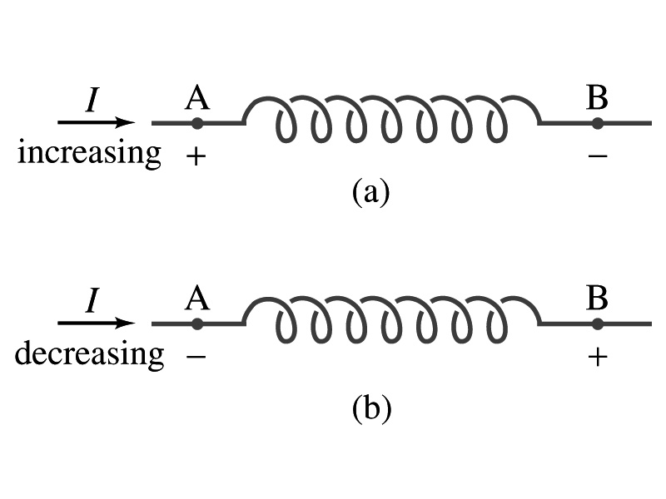
Inductor
An electrical circuit always contains some inductance but is normally negligibly small
  If a circuit contains a coil of many turns, it could have large inductance
A coil that has significant inductance, L, is called an inductor and is express with the symbol
  Precision resisters are normally wire wound
    Would have both resistance and inductance
    The inductance can be minimized by winding the wire back on itself in opposite direction to cancel magnetic flux
    This is called a “non-inductive winding”
If an inductor has negligible resistance, inductance controls the changing current
For an AC current, the greater the inductance the less the AC current
  An inductor thus acts like a resistor to impede the flow of alternating current (not to DC, though. Why?)
  The quality of an inductor is indicated by the term reactance or impedance

Slide 6
Example 30 – 3
Solenoid inductance. (a) Determine the formula for the self inductance L of a tightly wrapped solenoid ( a long coil) containing N turns of wire in its length l and whose cross-sectional area is A. (b) Calculate the value of L if N=100, l=5.0cm, A=0.30cm² and the solenoid is air filled. (c) calculate L if the solenoid has an iron core with μ=4000μ₀.
What is the magnetic field inside a solenoid?
The flux is, therefore,
Using the formula for self inductance:
(b) Using the formula above
(c) The magnetic field with an iron core solenoid is

Slide 7
Energy Stored in the Magnetic Field
When an inductor of inductance L is carrying current I which is changing at a rate dI/dt, energy is supplied to the inductor at a rate
What is the work needed to increase the current in an inductor from 0 to I?
  The work, dW, done in time dt is
  Thus the total work needed to bring the current from 0 to I in an inductor is

Slide 8
Energy Stored in the Magnetic Field
The work done to the system is the same as the energy stored in the inductor when it is carrying current I
  This is compared to the energy stored in a capacitor, C, when the potential difference across it is V:
  Just like the energy stored in a capacitor is considered to reside in the electric field between its plates
  The energy in an inductor can be considered to be stored in its magnetic field
Energy Stored in a magnetic field inside an inductor

Slide 9
Stored Energy in terms of B
So how is the stored energy written in terms of magnetic field B?
  Inductance of an ideal solenoid without a fringe effect
  The magnetic field in a solenoid is
  Thus the energy stored in an inductor is
  Thus the energy density is
  This formula is valid in any region of space
  If a ferromagnetic material is present, μ₀ becomes μ.
E
What is this?
E density
Volume V
What volume does Al represent?
The volume inside a solenoid!!

Slide 10
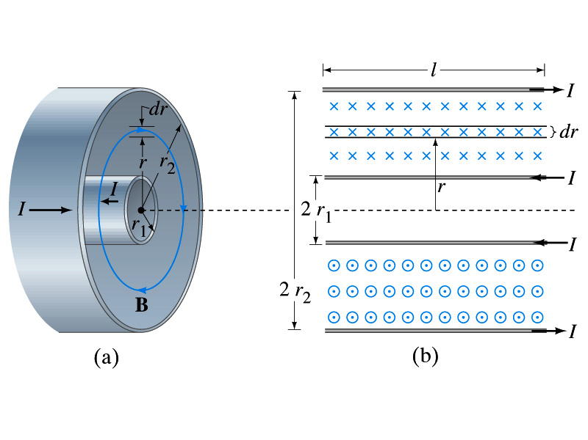
Example 30 – 5
Energy stored in a coaxial cable. (a) How much energy is being stored per unit length in a coaxial cable whose conductors have radii r₁ and r₂ and which carry a current I? (b) Where is the energy density highest?
(a) The total flux through l of the cable is
Thus inductance per unit length for a coaxial cable is
Thus the energy stored per unit length is
(b) Since the magnetic field is
The energy density is highest where B is highest. Since B is highest close to r=r₁, near the surface of the inner conductor.
And the energy density is

Slide 11
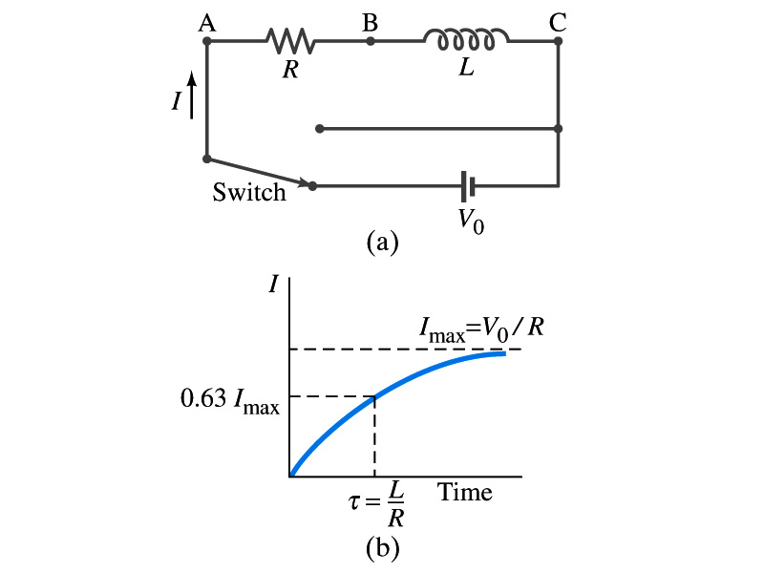
LR Circuits
What happens when an emf is applied to an inductor?
  An inductor has some resistance, however negligible
    So an inductor can be drawn as a circuit of separate resistance and coil. What is the name this kind of circuit?
  What happens at the instance the switch is thrown to apply emf to the circuit?
    The current starts to flow, gradually increasing from 0
    This change is opposed by the induced emf in the inductor ➔ the emf at point B is higher than point C
    However there is a voltage drop at the resistance which reduces the voltage across inductance
    Thus the current increases less rapidly
    The overall behavior of the current is a gradual increase, reaching to the maximum current I_{max}=V₀/R.
LR Circuit

Slide 12
LR Circuits
This can be shown w/ Kirchhoff loop rules
  The emfs in the circuit are the battery voltage V₀ and the emf ε=-L(dI/dt) in the inductor opposing the current increase
  The sum of the potential changes through the circuit is
  Where I is the current at any instance
  By rearranging the terms, we obtain a differential eq.
  We can integrate just as in RC circuit
  So the solution is
  Where τ=L/R
    This is the time constant τ of the LR circuit and is the time required for the current I to reach 0.63 of the maximum

Slide 13
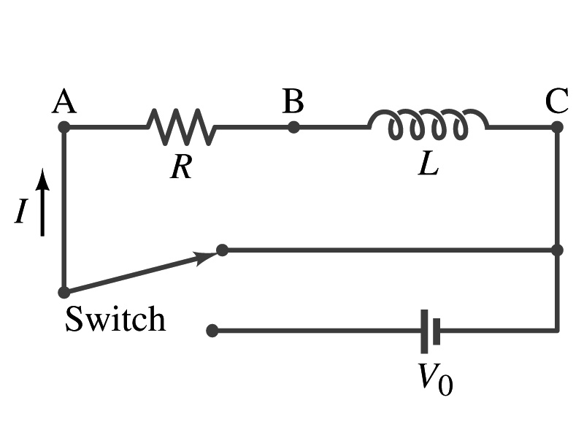
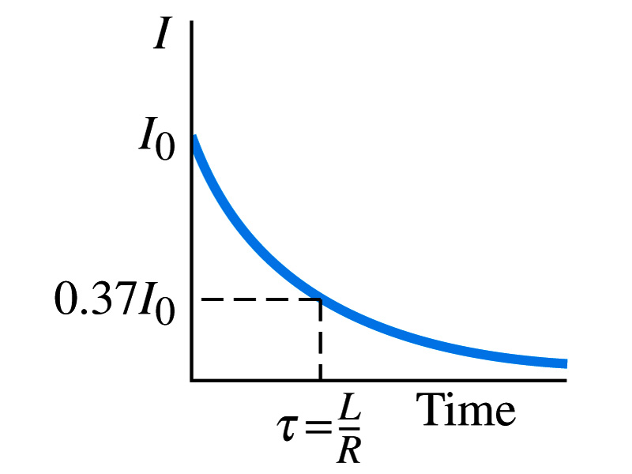
Discharge of LR Circuits
If the switch is flipped away from the battery
  The differential equation becomes
  So the integration is
  Which results in the solution
  The current decays exponentially to zero with the time constant τ=L/R
  So there always is a reaction time when a system with a coil, such as an electromagnet, is turned on or off.
  The current in LR circuit behaves almost the same as that in RC circuit but the time constant is inversely proportional to R in LR circuit unlike the RC circuit

Slide 14
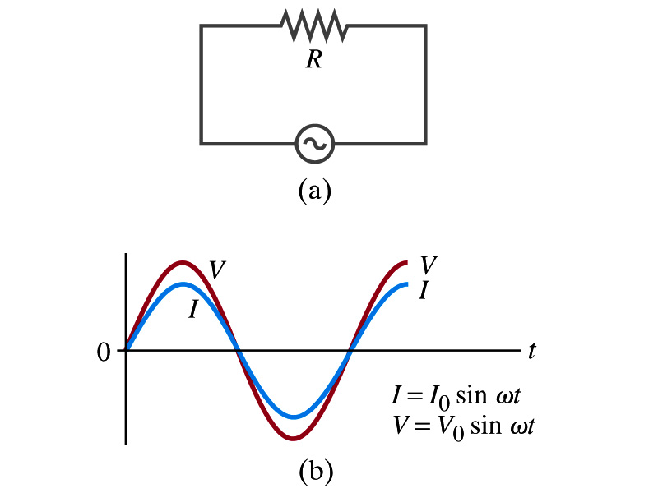
AC Circuit w/ Resistance only
What do you think will happen when an AC source is connected to a resistor?
From Kirchhoff’s loop rule, we obtain
Thus
  where
What does this mean?
  Current is 0 when voltage is 0 and current is in its peak when voltage is in its peak.
  Current and voltage are “in phase”
Energy is lost via the transformation into heat at an average rate

