Slide 1
PHYS 1444 – Section 004 Lecture #21
Wednesday, April 18, 2012
Dr. Jaehoon Yu
AC Circuit w/ Inductance only
AC Circuit w/ Capacitance only
LRC circuit
Achievements of Maxwell’s Equations

Slide 2
Announcements
Your planetarium extra credit
Please bring your planetarium extra credit sheet by the beginning of the class next Monday, Apr. 30
Be sure to tape one edge of the ticket stub with the title of the show on top
Term exam #2
Non-comprehensive
Date and time: 5:30 – 6:50pm, Wednesday, Apr. 25
Location: SH103
Coverage: CH. 27 – 1 to what we finish today (CH31.1?)
Please do NOT miss the exam!!
Evaluation
Bring your electronic device with a web capability on Apr. 30.
Reading Assignments
CH30.9 – CH30.11

Slide 3
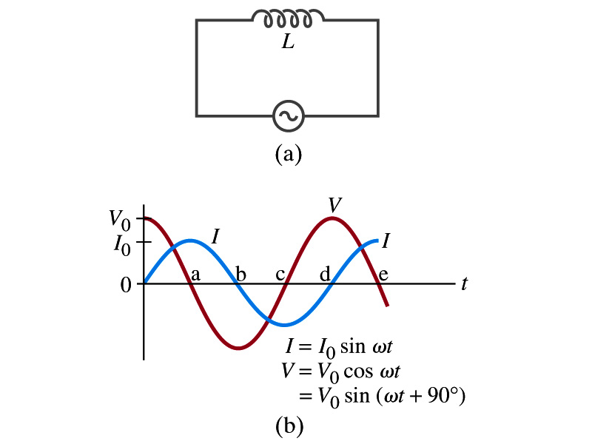
AC Circuit w/ Inductance only
From Kirchhoff’s loop rule, we obtain
Thus
Using the identity
where
What does this mean?
Current and voltage are “out of phase by π/2 or 90º”. In other words the current reaches its peak ¼ cycle after the voltage
What happens to the energy?
No energy is dissipated
The average power is 0 at all times
The energy is stored temporarily in the magnetic field
Then released back to the source

Slide 4
AC Circuit w/ Inductance only
How are the resistor and inductor different in terms of energy?
Inductor
Resistor
How are they the same?
They both impede the flow of charge
For a resistance R, the peak voltage and current are related to
Similarly, for an inductor we may write
Where X_{L} is the inductive reactance of the inductor
What do you think is the unit of the reactance?
The relationship is not valid at a particular instance. Why not?
Since V₀ and Ι₀ do not occur at the same time
Stores the energy temporarily in the magnetic field and then releases it back to the emf source
Does not store energy but transforms it to thermal energy, losing it to the environment
0 when ω=0.
Ω
is valid!

Slide 5
Example 30 – 9
Reactance of a coil. A coil has a resistance R=1.00Ω and an inductance of 0.300H. Determine the current in the coil if (a) 120 V DC is applied to it; (b) 120 V AC (rms) at 60.0Hz is applied.
Is there a reactance for DC?
Nope. Why not?
Since ω=0,
So for DC power, the current is from Kirchhoff’s rule
For an AC power with f =60Hz, the reactance is
Since the resistance can be ignored compared to the reactance, the rms current is

Slide 6
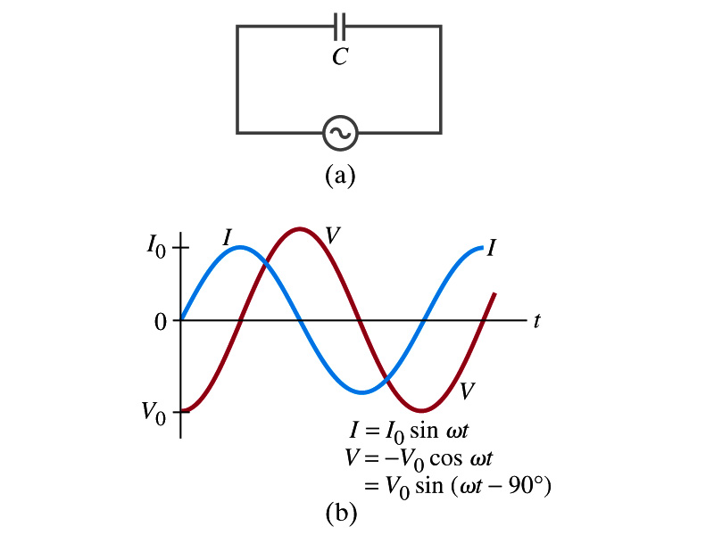
AC Circuit w/ Capacitance only
What happens when a capacitor is connected to a DC power source?
The capacitor quickly charges up.
There is no steady current flow in the circuit
Since the capacitor prevents the flow of the DC current
What do you think will happen if it is connected to an AC power source?
The current flows continuously. Why?
When the AC power turns on, charge begins to flow one direction, charging up the plates
When the direction of the power reverses, the charge flows in the opposite direction

Slide 7
AC Circuit w/ Capacitance only
From Kirchhoff’s loop rule, we obtain
The current at any instance is
The charge Q on the plate at any instance is
Thus the voltage across the capacitor is
Using the identity
Where

Slide 8
AC Circuit w/ Capacitance only
So the voltage is
What does this mean?
Current and voltage are “out of phase by π/2 or 90º” but in this case, the voltage reaches its peak ¼ cycle after the current
What happens to the energy?
No energy is dissipated
The average power is 0 at all times
The energy is stored temporarily in the electric field
Then released back to the source
Applied voltage and the current in the capacitor can be written as
Where the capacitive reactance X_{C} is defined as
Again, this relationship is only valid for rms quantities
Infinite when ω=0.

Slide 9
Example 30 – 10
Capacitor reactance. What are the peak and rms current in the circuit in the figure if C=1.0μF and V_{rms}=120V? Calculate for (a) f=60Hz, and then for (b) f=6.0x10⁵Hz.
The peak voltage is
The capacitance reactance is
Thus the peak current is
The rms current is

Slide 10
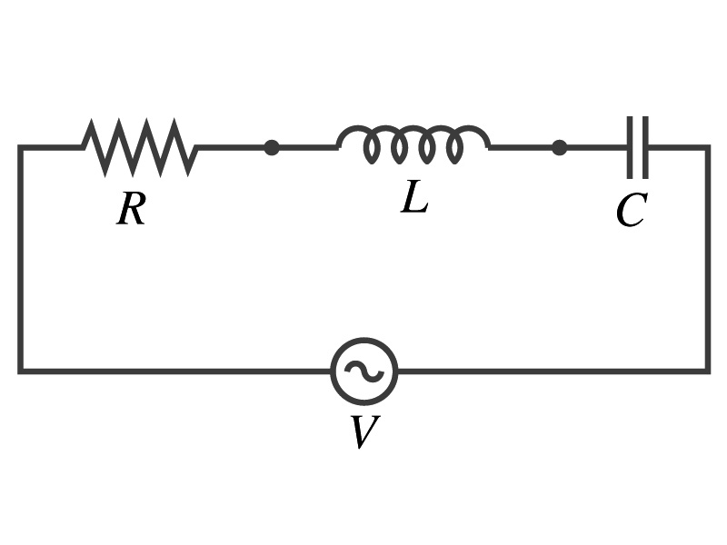
AC Circuit w/ LRC
The voltage across each element is
V_{R} is in phase with the current
V_{L} leads the current by 90º
V_{C} lags the current by 90º
From Kirchhoff’s loop rule
V=V_{R}+V_{L}+V_{C}
However since they do not reach the peak voltage at the same time, the peak voltage of the source V₀ will not equal V_{R0}+V_{L0}+V_{C0}
The rms voltage also will not be the simple sum of the three
Let’s try to find the total impedance, peak current Ι₀ and the phase difference between Ι₀ and V₀.

Slide 11
AC Circuit w/ LRC
The current at any instance is the same at all point in the circuit
The currents in each elements are in phase
Why?
Since the elements are in series
How about the voltage?
They are not in phase.
The current at any given time is
The analysis of LRC circuit is done using the “phasor” diagram in which arrows are drawn in an xy plane to represent the amplitude of each voltage, just like vectors
The lengths of the arrows represent the magnitudes of the peak voltages across each element; V_{R0}=I₀R, V_{L0}=I₀X_{L} and V_{C0}=I₀X_{C}
The angle of each arrow represents the phase of each voltage relative to the current, and the arrows rotate at the angular frequency ω to take into account the time dependence.
The projection of each arrow on y axis represents voltage across each element at any given time

Slide 12
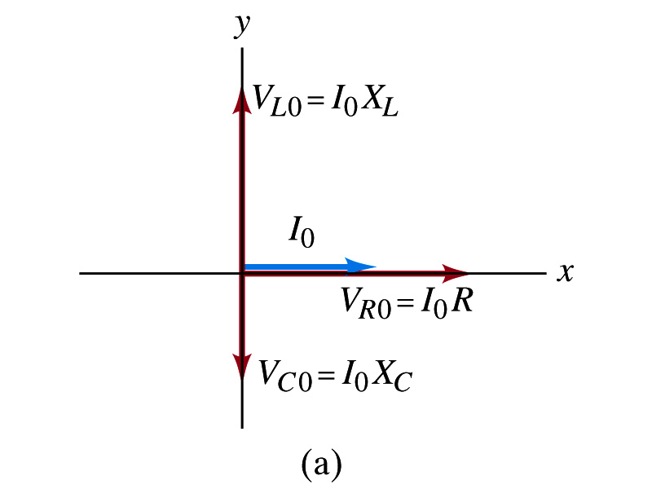
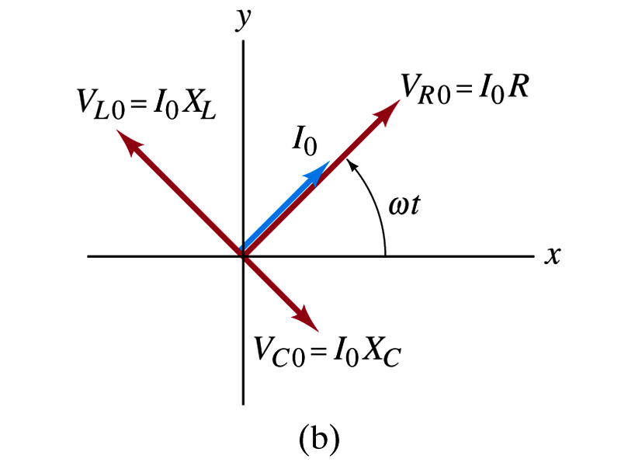
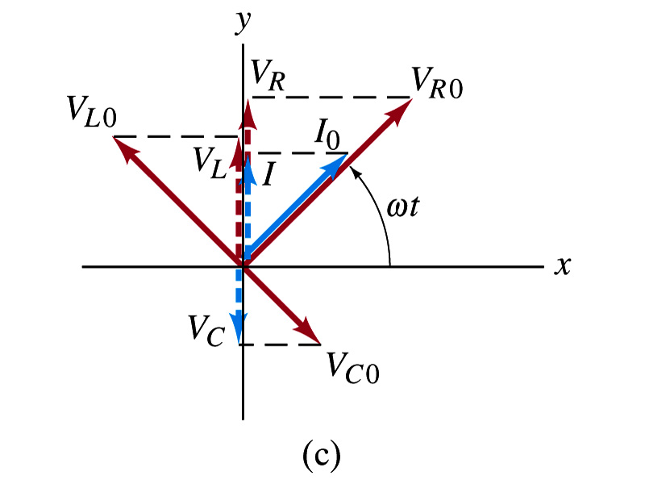
Phasor Diagrams
At t=0, Ι=0.
Thus V_{R0}=0, V_{L0}=Ι₀X_{L}, V_{C0}=Ι₀X_{C}
At t=t,
Thus, the voltages (y-projections) are
+90º
-90º

Slide 13
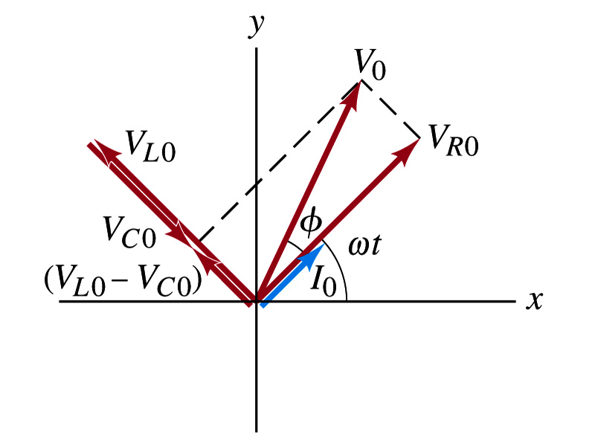
AC Circuit w/ LRC
Since the sum of the projections of the three vectors on the y axis is equal to the projection of their sum.
The sum of the projections represents the instantaneous voltage across the whole circuit which is the source voltage
So we can use the sum of all vectors as the representation of the peak source voltage V₀.
V₀ forms an angle φ to V_{R0} and rotates together with the other vectors as a function of time,
We determine the total impedance Z of the circuit defined by the relationship or
From Pythagorean theorem, we obtain
Thus the total impedance is

Slide 14
AC Circuit w/ LRC
The phase angle φ is
or
What is the power dissipated in the circuit?
Which element dissipates the power?
Only the resistor
The average power is
Since R=Zcosφ
We obtain
The factor cosφ is referred as the power factor of the circuit
For a pure resistor, cosφ=1 and
For a capacitor or inductor alone φ=-90º or +90º, so cosφ=0 and

Slide 15
Maxwell’s Equations
The development of EM theory by Oersted, Ampere and others was not done in terms of EM fields
The idea of fields was introduced somewhat by Faraday
Scottish physicist James C. Maxwell unified all the phenomena of electricity and magnetism in one theory with only four equations (Maxwell’s Equations) using the concept of fields
This theory provided the prediction of EM waves
As important as Newton’s law since it provides dynamics of electromagnetism
This theory is also in agreement with Einstein’s special relativity
The biggest achievement of 19th century electromagnetic theory is the prediction and experimental verifications that the electromagnetic waves can travel through the empty space
What do you think this accomplishment did?
Open a new world of communication
It also yielded the prediction that the light is an EM wave
Since all of Electromagnetism is contained in the four Maxwell’s equations, this is considered as one of the greatest achievements of human intellect

