Slide 1
PHYS 1444 – Section 004 Lecture #22
Monday, April 23, 2012
Dr. Jaehoon Yu
Extension of Ampere’s Law
Gauss’ Law of Magnetism
Maxwell’s Equations
Production of Electromagnetic Waves
Today’s homework is #13, due 10pm, Tuesday, May 1!!

Slide 2
Announcements
Your planetarium extra credit
Please bring your planetarium extra credit sheet by the beginning of the class next Monday, Apr. 30
Be sure to tape one edge of the ticket stub with the title of the show on top
Term exam #2
Non-comprehensive
Date and time: 5:30 – 6:50pm, this Wednesday, Apr. 25
Location: SH103
Coverage: CH. 27 – 1 to what we finish today (CH31.1)
Please do NOT miss the exam!!

Slide 3
Ampere’s Law
Do you remember the mathematical expression of Oersted discovery of a magnetic field produced by an electric current, given by Ampere?
We’ve learned that a varying magnetic field produces an electric field
Then can the reverse phenomena, that a changing electric field producing a magnetic field, possible?
If this is the case, it would demonstrate a beautiful symmetry in nature between electricity and magnetism

Slide 4
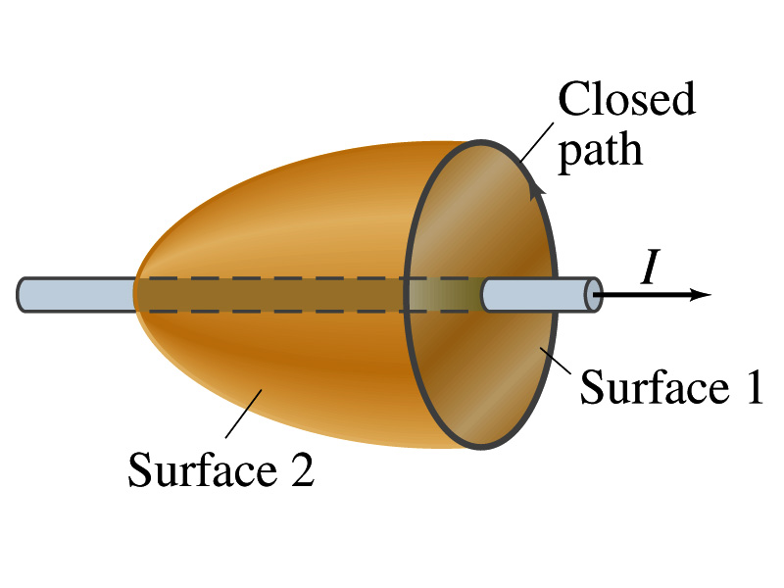
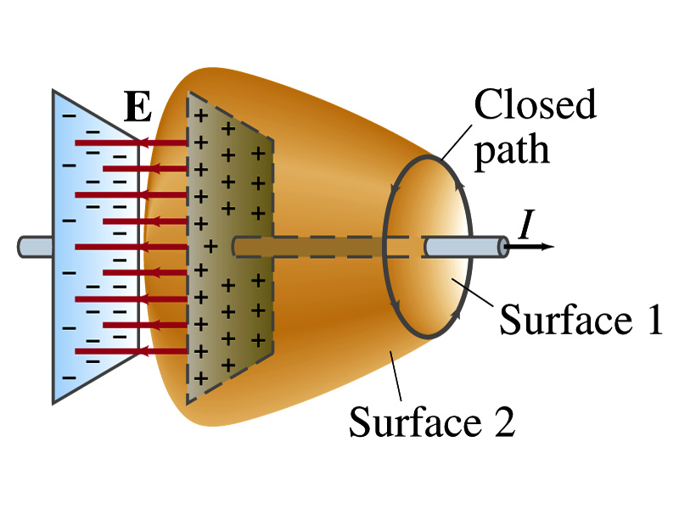
Expanding Ampere’s Law
Let’s consider a wire carrying current Ι
The current that is enclosed in the loop passes through the surface # 1 in the figure
We could imagine a different surface # 2 that shares the same enclosed path but cuts through the wire in a different location. What is the current that passes through the surface?
Still Ι.
So the Ampere’s law still works
We could then consider a capacitor being charged up or being discharged.
The current Ι enclosed in the loop passes through the surface #1
However the surface #2 that shares the same closed loop do not have any current passing through it.
There is magnetic field present since there is current ➔ In other words there is a changing electric field in between the plates
Maxwell resolved this by adding an additional term to Ampere’s law involving the changing electric field

Slide 5
Modifying Ampere’s Law
To determine what the extra term should be, we first have to figure out what the electric field between the two plates is
The charge Q on the capacitor with capacitance C is Q=CV
Where V is the potential difference between the plates
Since V=Ed
Where E is the uniform field between the plates, and d is the separation of the plates
And for parallel plate capacitor C=ε₀A/d
We obtain

Slide 6
Modifying Ampere’s Law
If the charge on the plate changes with time, we can write
Using the relationship between the current and charge we obtain
Where Φ_{Ε}=EA is the electric flux through the surface between the plates
So in order to make Ampere’s law work for the surface 2 in the figure, we must write it in the following form
This equation represents the general form of Ampere’s law
This means that a magnetic field can be caused not only by an ordinary electric current but also by a changing electric flux
Extra term by Maxwell

Slide 7
Example 31 – 1
Charging capacitor. A 30-pF air-gap capacitor has circular plates of area A=100cm². It is charged by a 70-V battery through a 2.0-Ω resistor. At the instance the battery is connected, the electric field between the plates is changing most rapidly. At this instance, calculate (a) the current into the plates, and (b) the rate of change of electric field between the plates. (c) Determine the magnetic field induced between the plates. Assume E is uniform between the plates at any instant and is zero at all points beyond the edges of the plates.
Since this is an RC circuit, the charge on the plates is:
For the initial current (t=0), we differentiate the charge with respect to time.
The electric field is
Change of the electric field is

Slide 8
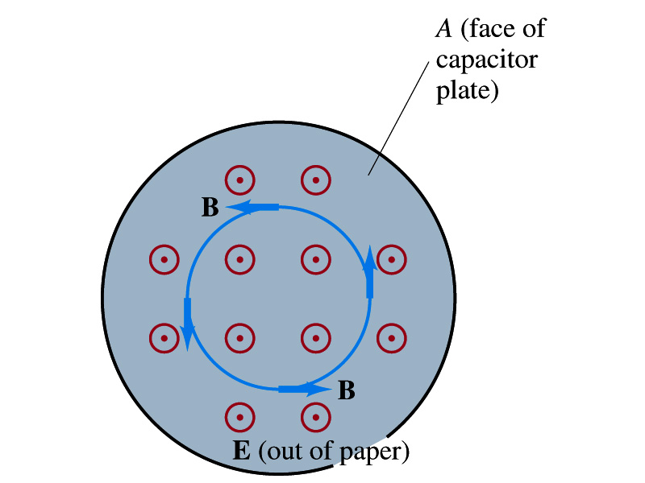
Example 31 – 1
(c) Determine the magnetic field induced between the plates. Assume E is uniform between the plates at any instant and is zero at all points beyond the edges of the plates.
The magnetic field lines generated by changing electric field is perpendicular to E and is circular due to symmetry
Whose law can we use to determine B?
Extended Ampere’s Law w/ Ι_{encl}=0!
We choose a circular path of radius r, centered at the center of the plane, following the B.
For r<r_{plate}, the electric flux is
since E is uniform throughout the plate
So from Ampere’s law, we obtain
Solving for B
For r<r_{plate}
Since we assume E=0 for r>r_{plate}, the electric flux beyond the plate is fully contained inside the surface.
So from Ampere’s law, we obtain
Solving for B
For r>r_{plate}

Slide 9
Displacement Current
Maxwell interpreted the second term in the generalized Ampere’s law equivalent to an electric current
He called this term as the displacement current, Ι_{D}
While the other term is called as the conduction current, Ι
Ampere’s law then can be written as
Where
While it is in effect equivalent to an electric current, a flow of electric charge, this actually does not have anything to do with the flow itself

Slide 10
Gauss’ Law for Magnetism
If there is a symmetry between electricity and magnetism, there must be an equivalent law in magnetism as the Gauss’ Law in electricity
For a magnetic field B, the magnetic flux Φ_{B} through the surface is defined as
Where the integration is over the area of either an open or a closed surface
The magnetic flux through a closed surface which completely encloses a volume is
What was the Gauss’ law in the electric case?
The electric flux through a closed surface is equal to the total net charge Q enclosed by the surface divided by ε₀.
Similarly, we can write Gauss’ law for magnetism as
Why is result of the integral zero?
There is no isolated magnetic poles, the magnetic equivalent of single electric charges
Gauss’ Law for electricity
Gauss’ Law for magnetism

Slide 11
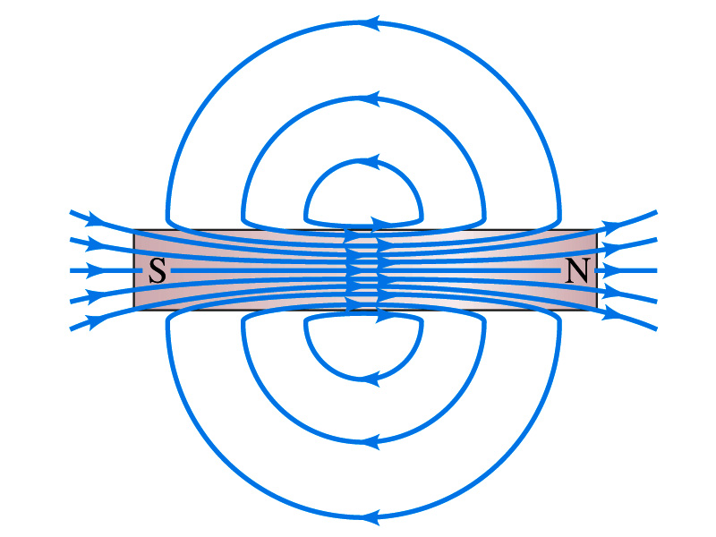
Gauss’ Law for Magnetism
What does the Gauss’ law in magnetism mean physically?
There are as many magnetic flux lines that enter the enclosed volume as leave it
If magnetic monopole does not exist, there is no starting or stopping point of the flux lines
Electricity do have the source and the sink
Magnetic field lines must be continuous
Even for bar magnets, the field lines exist both insides and outside of the magnet

Slide 12
Maxwell’s Equations
In the absence of dielectric or magnetic materials, the four equations developed by Maxwell are:
Gauss’ Law for electricity
A generalized form of Coulomb’s law relating electric field to its sources, the electric charge
Gauss’ Law for magnetism
A magnetic equivalent of Coulomb’s law relating magnetic field to its sources. This says there are no magnetic monopoles.
Faraday’s Law
An electric field is produced by a changing magnetic field
Ampére’s Law
A magnetic field is produced by an electric current or by a changing electric field

Slide 13
Maxwell’s Amazing Leap of Faith
According to Maxwell, a magnetic field will be produced even in an empty space if there is a changing electric field
He then took this concept one step further and concluded that
If a changing magnetic field produces an electric field, the electric field is also changing in time.
This changing electric field in turn produces the magnetic field that also changes.
This changing magnetic field then in turn produces the electric field that changes.
This process continues.
With the manipulation of the equations, Maxwell found that the net result of this interacting changing fields is a wave of electric and magnetic fields that can actually propagate (travel) through the space

Slide 14
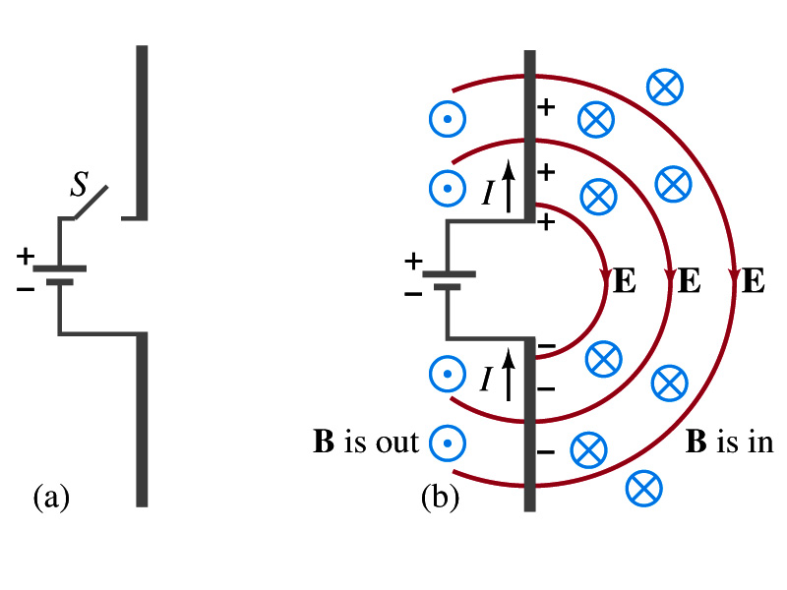
Production of EM Waves
Consider two conducting rods that will serve as an antenna are connected to a DC power source
What do you think will happen when the switch is closed?
The rod connected to the positive terminal is charged positive and the other negatively
Then the electric field will be generated between the two rods
Since there is current that flows through, the rods generates a magnetic field around them
How far would the electric and magnetic fields extend?
In static case, the field extends indefinitely
When the switch is closed, the fields are formed nearby the rods quickly but
The stored energy in the fields won’t propagate w/ infinite speed

Slide 15
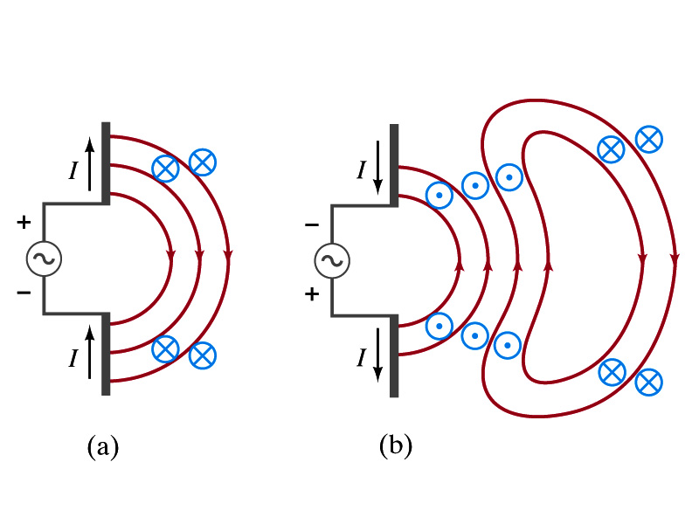
Production of EM Waves
What happens if the antenna is connected to an ac power source?
When the connection was initially made, the rods are charging up quickly w/ the current flowing in one direction as shown in the figure
The field lines form as in the dc case
The field lines propagate away from the antenna
Then the direction of the voltage reverses
The new field lines with the opposite direction forms
While the original field lines still propagates away from the rod reaching out far
Since the original field propagates through an empty space, the field lines must form a closed loop (no charge exist)
Since changing electric and magnetic fields produce changing magnetic and electric fields, the fields moving outward is self supporting and do not need antenna with flowing charge
The fields far from the antenna is called the radiation field
Both electric and magnetic fields form closed loops perpendicular to each other

Slide 16
Properties of Radiation Fields
The fields travel on the other side of the antenna as well
The field strength are the greatest in the direction perpendicular to the oscillating charge while along the direction is 0
The magnitude of E and B in the radiation field decrease with distance as 1/r
The energy carried by the EM wave is proportional to the square of the amplitude, E² or B²
So the intensity of wave decreases as 1/r²

Slide 17
Properties of Radiation Fields
The electric and magnetic fields at any point are perpendicular to each other and to the direction of motion
The fields alternate in direction
The field strengths vary from maximum in one direction, to 0 and to max in the opposite direction
The electric and magnetic fields are in phase
Very far from the antenna, the field lines are pretty flat over a reasonably large area
Called plane waves

Slide 18
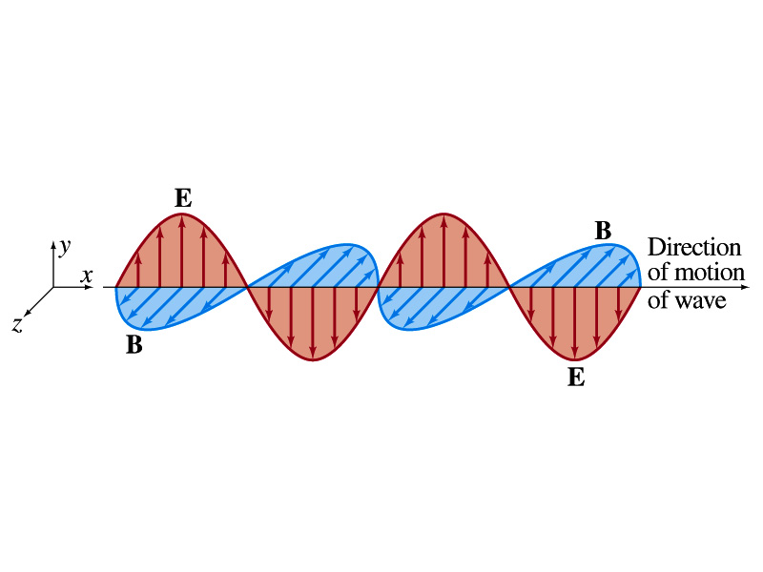
EM Waves
If the voltage of the source varies sinusoidally, the field strengths of the radiation field vary sinusoidally
We call these waves EM waves
They are transverse waves
EM waves are always waves of fields
Since these are fields, they can propagate through an empty space
In general accelerating electric charges give rise to electromagnetic waves
This prediction from Maxwell’s equations was experimentally by Heinrich Hertz through the discovery of radio waves

Slide 19
EM Waves and Their Speeds
Let’s consider a region of free space. What’s a free space?
An area of space where there is no charges or conduction currents
In other words, far from emf sources so that the wave fronts are essentially flat or not distorted over a reasonable area
What are these flat waves called?
Plane waves
At any instance E and B are uniform over a large plane perpendicular to the direction of propagation
So we can also assume that the wave is traveling in the x-direction w/ velocity, v=vi, and that E is parallel to y axis and B is parallel to z axis

Slide 20
Maxwell’s Equations w/ Q=Ι=0
In this region of free space, Q=0 and Ι=0, thus the four Maxwell’s equations become
Q_{encl}=0
No Changes
No Changes
I_{encl}=0
One can observe the symmetry between electricity and magnetism.
The last equation is the most important one for EM waves and their propagation!!

Slide 21
EM Waves from Maxwell’s Equations
If the wave is sinusoidal w/ wavelength λ and frequency f, such traveling wave can be written as
Where
What is v?
It is the speed of the traveling wave
What are E₀ and B₀?
The amplitudes of the EM wave. Maximum values of E and B field strengths.
Thus

