Slide 1
PHYS 1444 – Section 004 Lecture #23
Monday, April 30, 2012
Dr. Jaehoon Yu
EM Waves from Maxwell’s equations
Derivation of Speed of EM Waves
Light as EM Wave
Energy in EM Wave
Energy Transport and the Poynting Vector
Today’s homework is
None!!

Slide 2
Announcements
Final exam
Comprehensive
Date and time: 5:30 – 8:00pm, coming Monday, May 7
Location: SH103
Coverage: CH. 21 – 1 through CH31 – 10 plus Appendices A and B
Please do NOT miss the exam!!
Reading Assignments
CH31 – 9 and CH31 – 10
Please fill out the online teaching evaluation form
No class Wednesday, May 2
Colloquium 4pm, Wednesday, May 2
Dr. Haleh Hanavand

Slide 3
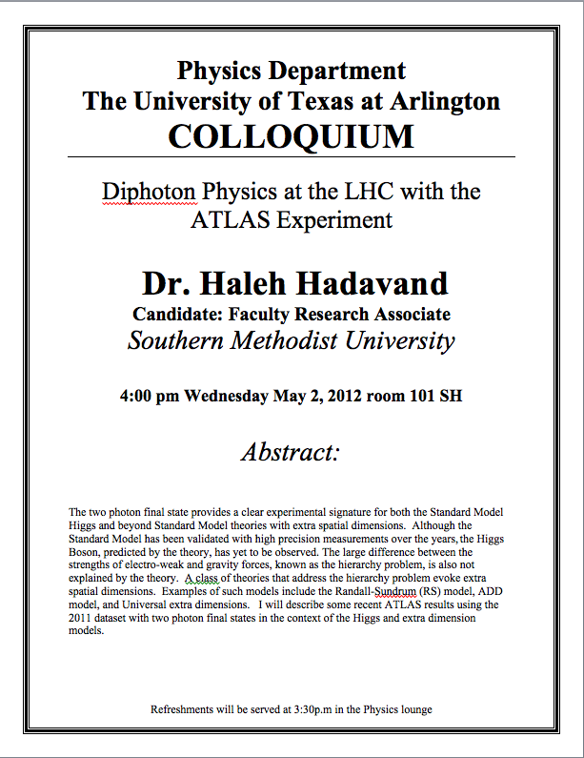

Slide 4
Maxwell’s Equations w/ Q=Ι=0
In the region of free space where Q=0 and Ι=0, the four Maxwell’s equations become
Q_{encl}=0
No Changes
No Changes
I_{encl}=0
One can observe the symmetry between electricity and magnetism.
The last equation is the most important one for EM waves and their propagation!!

Slide 5
EM Waves from Maxwell’s Equations
If the wave is sinusoidal w/ wavelength λ and frequency f, such traveling wave can be written as
Where
What is v?
It is the speed of the traveling wave
What are E₀ and B₀?
The amplitudes of the EM wave. Maximum values of E and B field strengths.
Thus

Slide 6
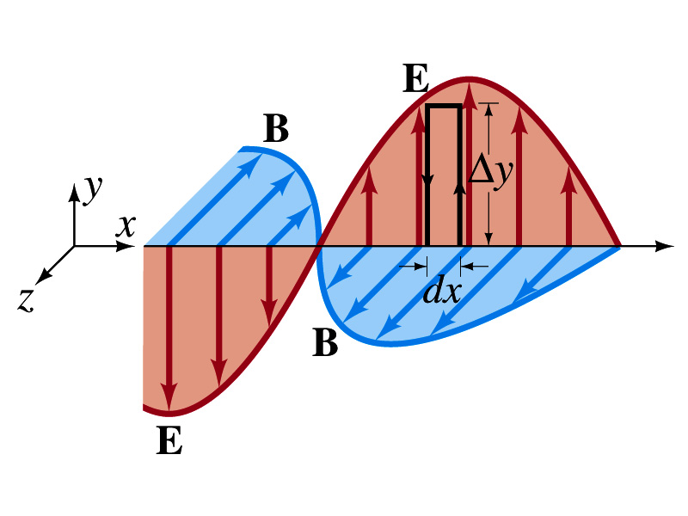
From Faraday’s Law
Let’s apply Faraday’s law
to the rectangular loop of height Δy and width dx
along the top and bottom of the loop is 0. Why?
Since E is perpendicular to dl.
So the result of the integral through the loop counterclockwise becomes
For the right-hand side of Faraday’s law, the magnetic flux through the loop changes as
Thus
Since E and B
depend on x and t

Slide 7
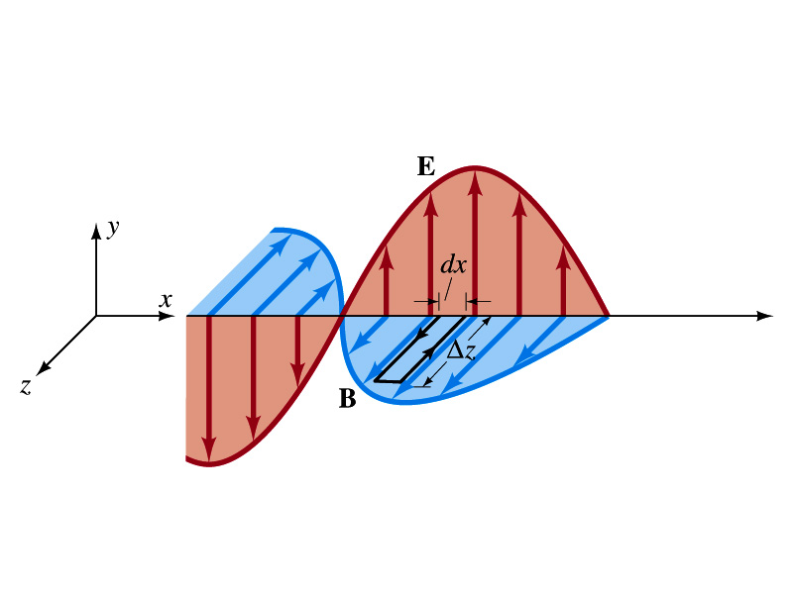
From Modified Ampére’s Law
Let’s apply Maxwell’s 4th equation
to the rectangular loop of length Δz and width dx
along the x-axis of the loop is 0
Since B is perpendicular to dl.
So the result of the integral through the loop counterclockwise becomes
For the right-hand side of the equation is
Thus
Since E and B
depend on x and t

Slide 8
Relationship between E, B and v
Let’s now use the relationship from Faraday’s law
Taking the derivatives of E and B as given their traveling wave form, we obtain
Since E and B are in phase, we can write
This is valid at any point and time in space. What is v?
The velocity of the wave
We obtain
Since
Thus

Slide 9
Speed of EM Waves
Let’s now use the relationship from Apmere’s law
Taking the derivatives of E and B as given their traveling wave form, we obtain
However, from the previous page we obtain
Thus
Since
We obtain
Thus
The speed of EM waves is the same as the speed of light. EM waves behaves like the light.

Slide 10
Speed of Light w/o Sinusoidal Wave Forms
Taking the time derivative on the relationship from Ampere’s laws, we obtain
By the same token, we take position derivative on the relationship from Faraday’s law
From these, we obtain
Since the equation for traveling wave is
By correspondence, we obtain
A natural outcome of Maxwell’s equations is that E and B obey the wave equation for waves traveling w/ speed
Maxwell predicted the existence of EM waves based on this
and

Slide 11
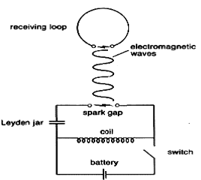
Light as EM Wave
People knew some 60 years before Maxwell that light behaves like a wave, but …
They did not know what kind of waves they are.
Most importantly what is it that oscillates in light?
Heinrich Hertz first generated and detected EM waves experimentally in 1887 using a spark gap apparatus
Charge was rushed back and forth in a short period of time, generating waves with frequency about 10⁹Hz (these are called radio waves)
He detected using a loop of wire in which an emf was produced when a changing magnetic field passed through
These waves were later shown to travel at the speed of light and behave exactly like the light just not visible

Slide 12
Light as EM Wave
The wavelengths of visible light were measured in the first decade of the 19th century
The visible light wave length were found to be between 4.0x10⁻⁷m (400nm) and 7.5x10⁻⁷m (750nm)
The frequency of visible light is fλ=c
Where f and λ are the frequency and the wavelength of the wave
What is the range of visible light frequency?
4.0x10¹⁴Hz to 7.5x10¹⁴Hz
c is 3x10⁸m/s, the speed of light
EM Waves, or EM radiation, are categorized using EM spectrum

Slide 13
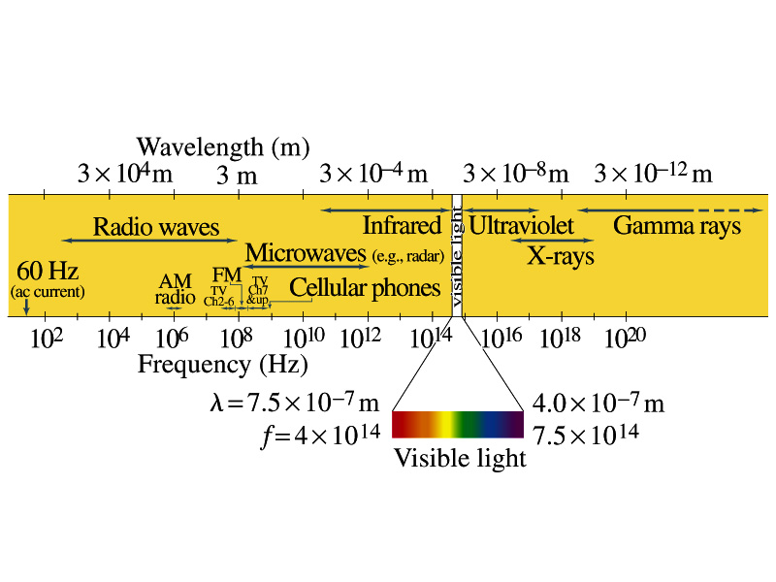
Electromagnetic Spectrum
Low frequency waves, such as radio waves or microwaves can be easily produced using electronic devices
Higher frequency waves are produced natural processes, such as emission from atoms, molecules or nuclei
Or they can be produced from acceleration of charged particles
Infrared radiation (IR) is mainly responsible for the heating effect of the Sun
The Sun emits visible lights, IR and UV
The molecules of our skin resonate at infrared frequencies so IR is preferentially absorbed and thus warm up

Slide 14
Example 31 – 3
Wavelength of EM waves. Calculate the wavelength (a) of a 60-Hz EM wave, (b) of a 93.3-MHz FM radio wave and (c) of a beam of visible red light from a laser at frequency 4.74x10¹⁴Hz.
What is the relationship between speed of light, frequency and the wavelength?
Thus, we obtain
For f=60Hz
For f=93.3MHz
For f=4.74x10¹⁴Hz

Slide 15
EM Wave in the Transmission Lines
Can EM waves travel through a wire?
Can it not just travel through the empty space?
Nope. It sure can travel through a wire.
When a source of emf is connected to a transmission line, the electric field within the wire does not set up immediately at all points along the line
When two wires are separated via air, the EM wave travel through the air at the speed of light, c.
However, through medium w/ permittivity ε and permeability μ, the speed of the EM wave is given
Is this faster than c?
Nope! It is slower.

Slide 16
Example 31 – 5
Phone call time lag. You make a telephone call from New York to London. Estimate the time the electrical signal to travel to reach London (a) carried on a 5000km telephone cable under the Atlantic Ocean and (b) sent via satellite 36,000km above the ocean. Would this cause a noticeable delay in either case?
Time delay via the cable:
Delay via satellite
So in case of satellite, the delay is likely noticeable!!

Slide 17
Energy in EM Waves
Since B=E/c and , we can rewrite the energy density
Note that the energy density associate with B field is the same as that associate with E
So each field contribute half to the total energy
By rewriting in B field only, we obtain
We can also rewrite to contain both E and B

Slide 18
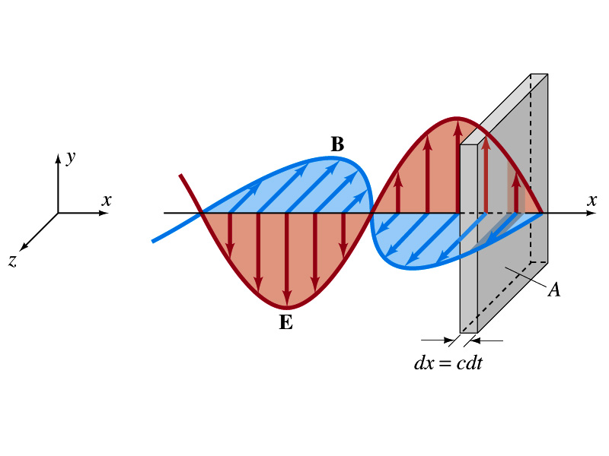
Energy Transport
What is the energy the wave transport per unit time per unit area?
This is given by the vector S, the Poynting vector
The unit of S is W/m².
The direction of S is the direction in which the energy is transported. Which direction is this?
The direction the wave is moving
Let’s consider a wave passing through an area A perpendicular to the x-axis, the axis of propagation
How much does the wave move in time dt?
dx=cdt
The energy that passes through A in time dt is the energy that occupies the volume dV,
Since the energy density is u=ε₀E², the total energy, dU, contained in the volume V is

Slide 19
Energy Transport
Thus, the energy crossing the area A per time dt is
Since E=cB and , we can also rewrite
Since the direction of S is along v, perpendicular to E and B, the Poynting vector S can be written
This gives the energy transported per unit area per unit time at any instant
What is the unit?
W/m²

Slide 20
Average Energy Transport
The average energy transport in an extended period of time is useful since sometimes we do not detect the rapid variation with respect to time because the frequency is so high.
If E and B are sinusoidal,
Thus we can write the magnitude of the average Poynting vector as
This time averaged value of S is the intensity, defined as the average power transferred across unit area. E₀ and B₀ are maximum values.
We can also write
Where E_{rms} and B_{rms} are the rms values ( )

Slide 21
Example 31 – 6
E and B from the Sun. Radiation from the Sun reaches the Earth (above the atmosphere) at a rate of about 1350W/m². Assume that this is a single EM wave and calculate the maximum values of E and B.
What is given in the problem?
The average S!!
For E₀,
For B₀

Slide 22
You have worked very hard and well !!
This was one of my best semesters!!
Good luck with your final exams!!
Have a safe summer!

