Slide 1
PHYS 1441 – Section 002
Lecture #1
Monday, Jan. 14, 2013
Dr. Jaehoon Yu
Who am I?
What is High Energy Physics?
What is the Higgs Particle?
How is this class organized?
What do we want from this class?

Slide 2
Announcements
Plea to you: Please turn off your cell-phones, pagers and computers in the class
Reading assignment #1: Read and follow through all sections in appendix A by Monday, Jan. 21
  A-1 through A-8
There will be a quiz on this and what we cover this Wednesday in the class Wednesday, Jan. 23.

Slide 3
Who am I?
Name: Dr. Jaehoon Yu (You can call me Dr. Yu)
Office: Rm 342, Chemistry and Physics Building
Extension: x22814, E-mail: jaehoonyu@uta.edu
My profession: High Energy Particle Physics (HEP)
  Collide particles (protons on anti-protons or electrons on anti-electrons, positrons) at the energies equivalent to 10,000 Trillion degrees
  To understand
    Fundamental constituents of matter
    Forces between the constituents (gravitational, electro-magnetic, weak and strong forces)
    Origin of Mass
    Creation of Universe (Big Bang Theory)
  A pure scientific research activity
    Direct use of the fundamental laws we find may take longer than we want but
    Indirect product of research contribute to every day lives; eg. WWW
  Why do we do with this?
    Make our everyday lives better

Slide 4
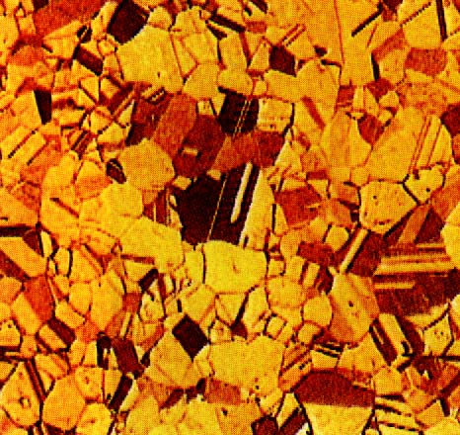
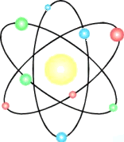


Structure of Matter
Matter
Molecule
Atom
Nucleus
Baryon
Quark
(Hadron)
u
10⁻²m
10⁻⁹m
10⁻¹⁰m
10⁻¹⁴m
10⁻¹⁵m
<10⁻¹⁹m
Condensed matter/Nano-Science/Chemistry
protons, neutrons,
mesons, etc.
π,Ω,Λ...
top, bottom,
charm, strange,
up, down
Atomic Physics
Nuclear
Physics
Electron
(Lepton)
<10⁻¹⁸m
High Energy Physics
Notes:
Give scale and relationship to the domain that high energy physicists work in.
Introduce the fundamental bits of matter loosely so that audience can point back to bulk matter.
Domain.

Slide 5
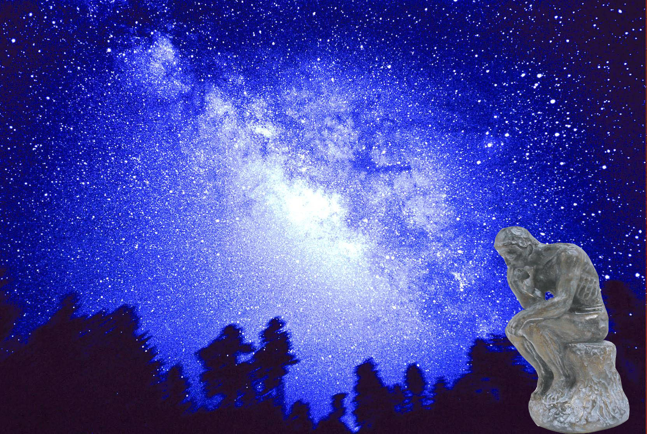

We always wonder…
What makes up the universe?
How does the universe work?
What holds the universe together?
How can we live in the universe well?
Where do we all come from?

Slide 6
Accelerators are Powerful Microscopes.
They make high energy particle beams
that allow us to see small things.
seen by
low energy beam
(poorer resolution)
seen by
high energy beam
(better resolution)

Slide 7
Accelerators are also Time Machines.
They make particles last seen
in the earliest moments of the universe.
Energy
particle beam
energy
anti-particle beam
energy
Particle and anti-particle annihilate.
E = mc²

Slide 8
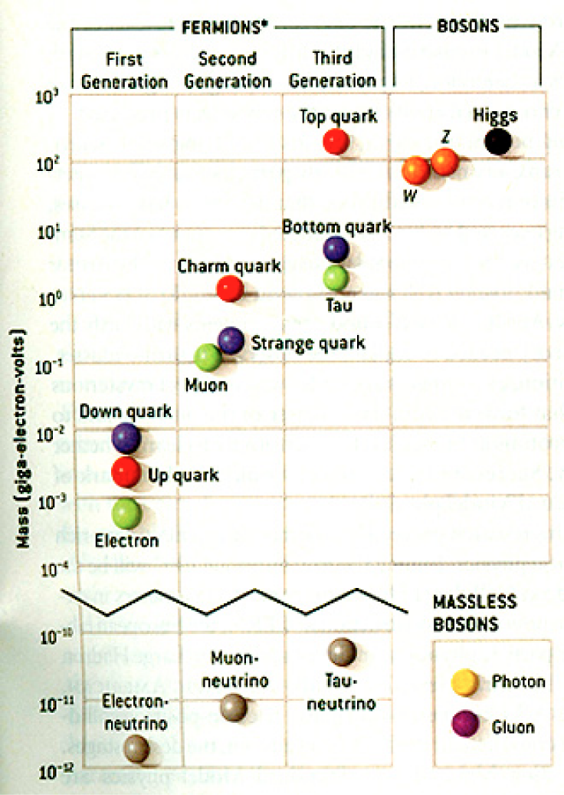
The Standard Model
Discovered in 1995, ~175m_{p}
Make up most ordinary matters ~0.1m_{p}
Total of 16 particles make up the matter in the universe! ➔ Simple and elegant!!!
Tested to a precision of 1 part per million!

Slide 9
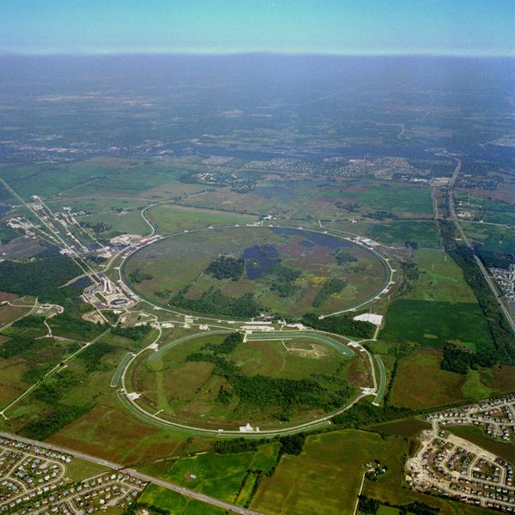
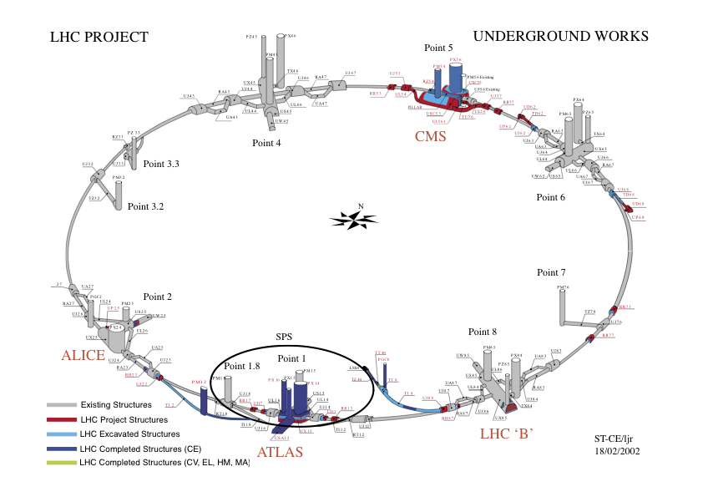
Fermilab Tevatron and LHC at CERN
World’s Highest Energy proton-anti-proton collider
  4km circumference
  E_{cm}=1.96 TeV (=6.3x10⁻⁷J/p➔ 13M Joules on the area smaller than 10⁻⁴m²)
  Equivalent to the kinetic energy of a 20t truck at the speed 81mi/hr➔ 130km/hr
    ~100,000 times the energy density at the ground 0 of the Hiroshima atom bomb
  Was shut down at 2pm CDT, Sept. 30, 2011
  Vibrant other programs running!!
World’s Highest Energy p-p collider
  27km circumference, 100m underground
  Design E_{cm}=14 TeV (=44x10⁻⁷J/p➔ 362M Joules on the area smaller than 10⁻⁴m²)
  Equivalent to the kinetic energy of a B727 (80tons) at the speed 193mi/hr ➔ 312km/hr
    ~3M times the energy density at the ground 0 of the Hiroshima atom bomb
First 7TeV collisions on 3/30/10 ➔ The highest energy humans ever achieved!!
Large amount of data accumulated in 2011 and 2012
2013 operation begun
Chicago
CDF
p
DØ
Tevatron
p

Slide 10
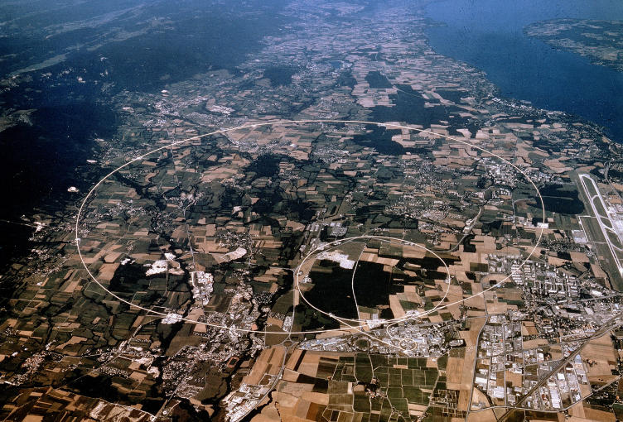


LHC @ CERN Aerial View
CMS
France
Geneva Airport
ATLAS
Swizerland

Slide 11
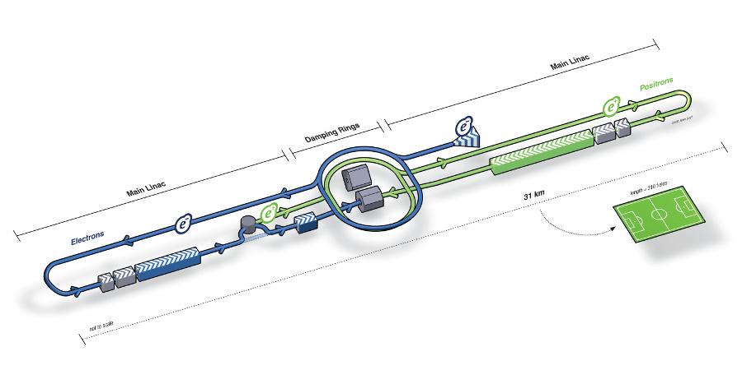
What next? Future Linear Collider
Now that we have found a new boson, precision measurement of the particle’s properties becomes important
An electron-positron collider on a straight line for precision measurements
10~15 years from now (In Dec. 2011, Japanese PM announced that they would bid for a LC in Japan)
  our Japanese colleagues have declared that they will bid for building a 250GeV machine in Japan!!
Takes 10 years to build the detector
L~31km
Circumference ~6.6km
~300 soccer fields

Slide 12
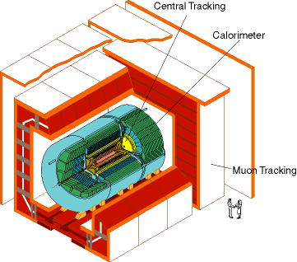
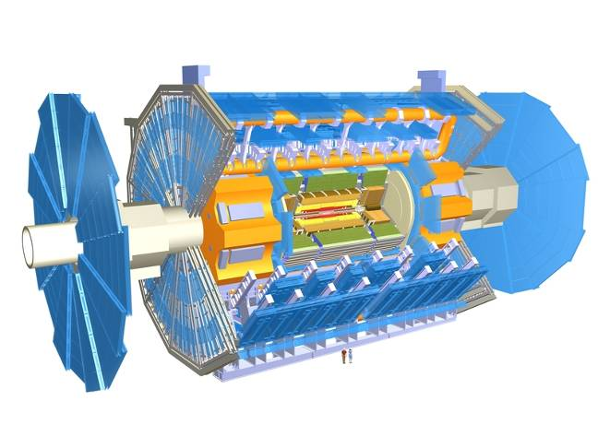
DØ Detector
ATLAS Detector
30’
30’
50’
Weighs 7000 tons and 10 story tall
Can inspect 1,000,000,000 collisions/second
Records 200 – 400 collisions/second
Records approximately 350,000,000 bytes/second
Record 2x10¹⁵ (2,000,000,000,000,000) bytes each year (2 PetaByte). ➔ 200*Printed material of the US Lib. of Congress
Weighs 5000 tons and 5 story tall
Can inspect 3,000,000 collisions/second
Record 100 collisions/second
Records approximately 10,000,000 bytes/second
Records 0.5x10¹⁵ (500,000,000,000,000) bytes per year (0.5 PetaBytes).

Slide 13
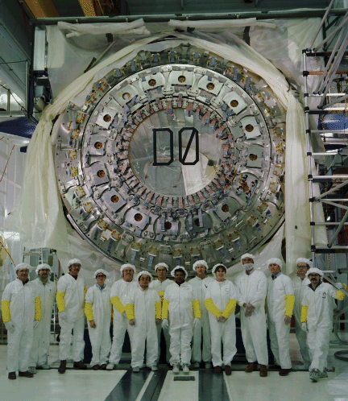
DØ Central Calorimeter 1990

Slide 14
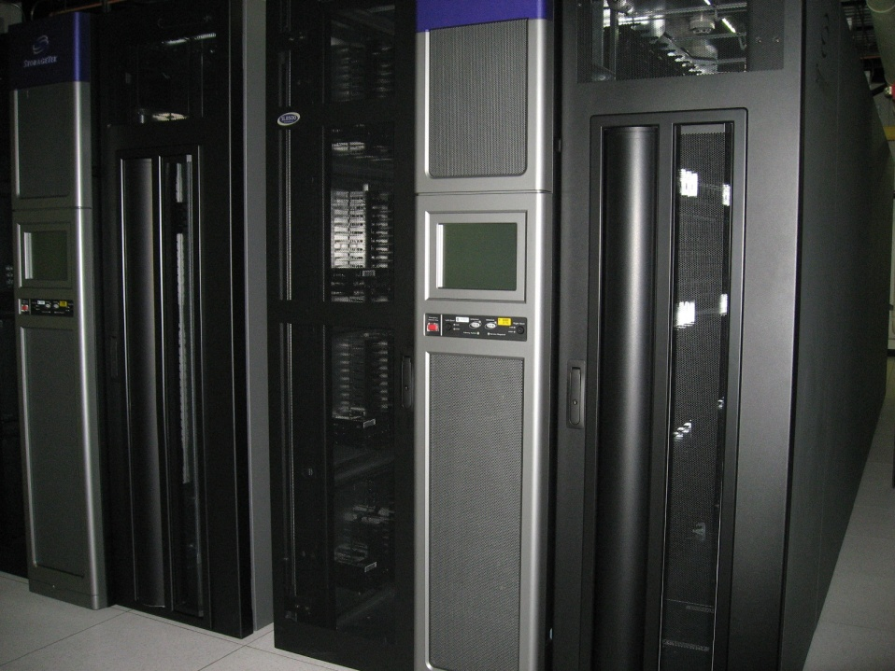
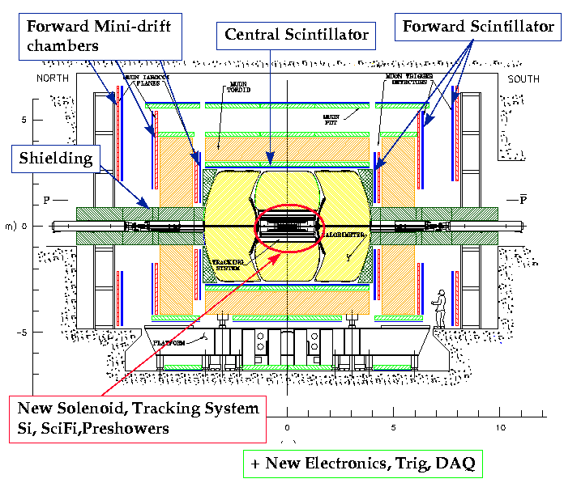
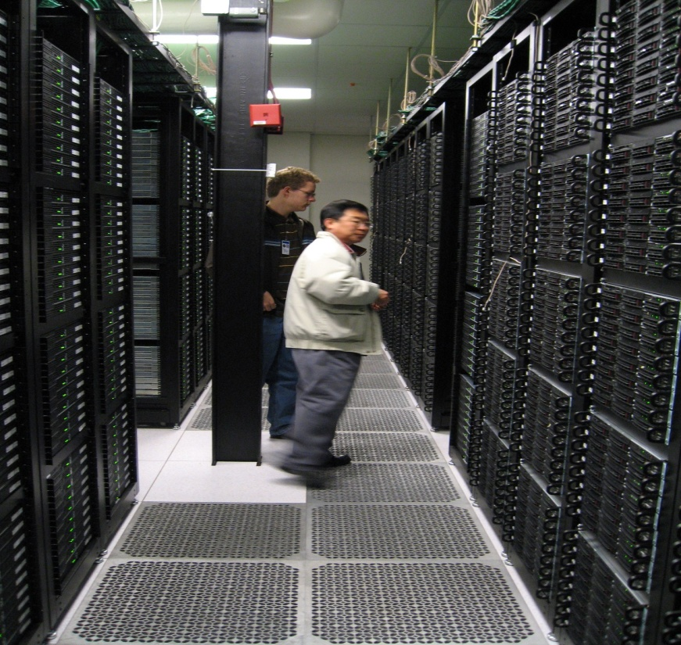
Computers put together a picture
Digital data
p
‾p
Data Reconstruction

Slide 15
How does an Event Look in a Collider Detector?
CH
Highest E_{T} dijet event at DØ
“calorimeter jet”
hadrons
FH
γ
EM
“particle jet”
Time
“parton jet”
Notes:
RECO [Slide 1]
Very briefly mention RECO version used.
Mention that these are fixed-cone jets of R=0.7 found by iterative algorithm, Et is the scalar Et sum of the towers.
List corrections we apply (basically) to RECO. No more is needed for AIDA restoration or Ht-revertexing at this point, but following three slides will be about eta bias -- so just briefly prepare listeners for this!

Slide 16
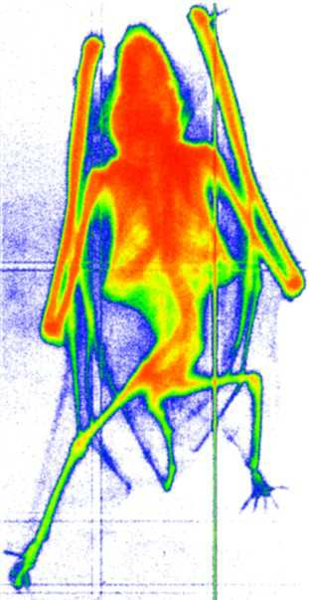
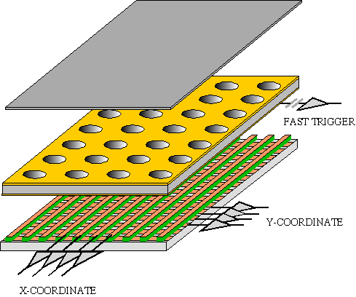
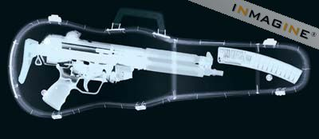
GEM Application Potential
FAST X-RAY IMAGING
Using the lower GEM signal, the readout can be self-triggered with energy discrimination:
9 keV absorption radiography of a small mammal (image size ~ 60 x 30 mm²)
A. Bressan et al,
Nucl. Instr. and Meth. A 425(1999)254
F. Sauli, Nucl. Instr. and Meth.A 461(2001)47

Slide 17
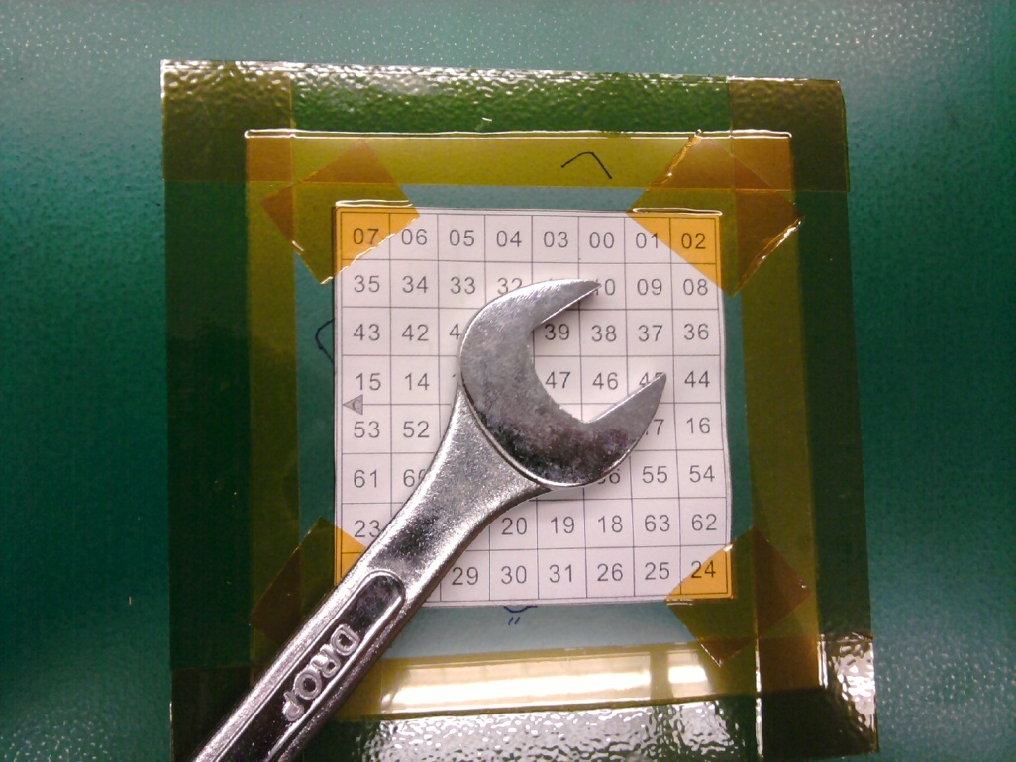
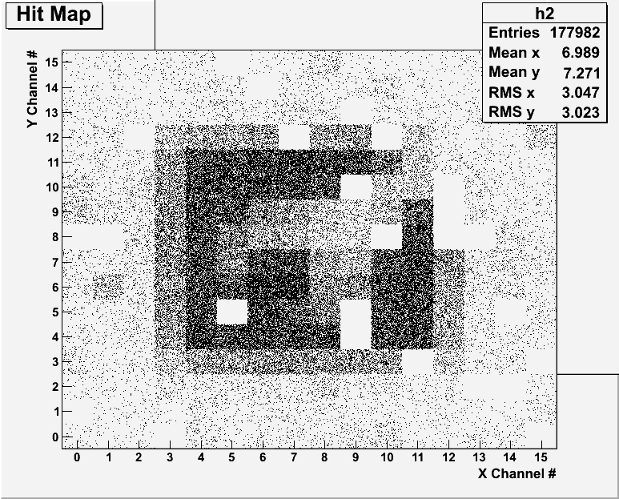
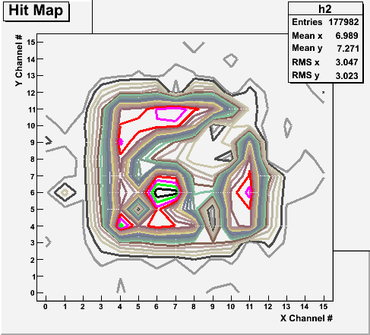
Radioactive Source Run with Internal Trigger
Can you see what the object is?

Slide 18
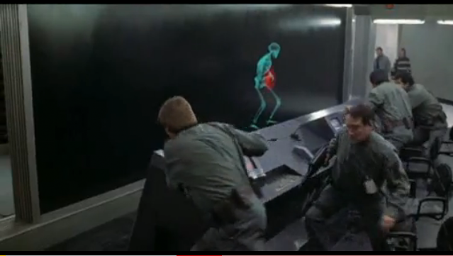
And in not too distant future, we could do …

Slide 19
What is the Higgs and What does it do?
When there is perfect symmetry, one cannot tell directions!
Only when symmetry is broken, can one tell directions
Higgs field works to break the perfect symmetry and give mass
  This field exists right now amongst us so that we have mass
Sometimes, this field spontaneously generates a particle, the Higgs particle
So the Higgs particle is the evidence of the existence of the Higgs field!

Slide 20
How do we look for the Higgs?
Higgs particle is so heavy they decay into some other particles very quickly
When one searches for a new particle, you look for the easiest way to get at them
Of these many signatures of the Higgs, some states are much easier to find, if it were the Standard Model one
  H→ γγ
  H → ZZ* → 4e, 4μ, 2e2μ, 2e2ν and 2μ2ν
  H→ WW*→2e2ν and 2μ2ν
  And many more complicated signatures

Slide 21
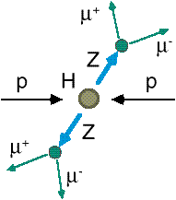
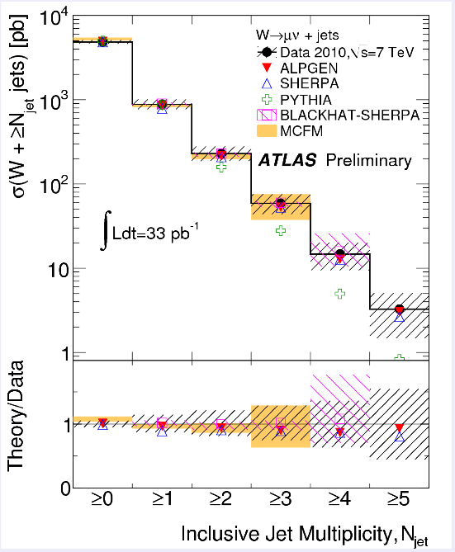
How do we look for the Higgs?
Identify Higgs candidate events
Understand fakes (backgrounds)
Look for a bump!!
e⁺ (μ⁺)
e⁻ (μ⁻)
e⁺
e⁻

Slide 22
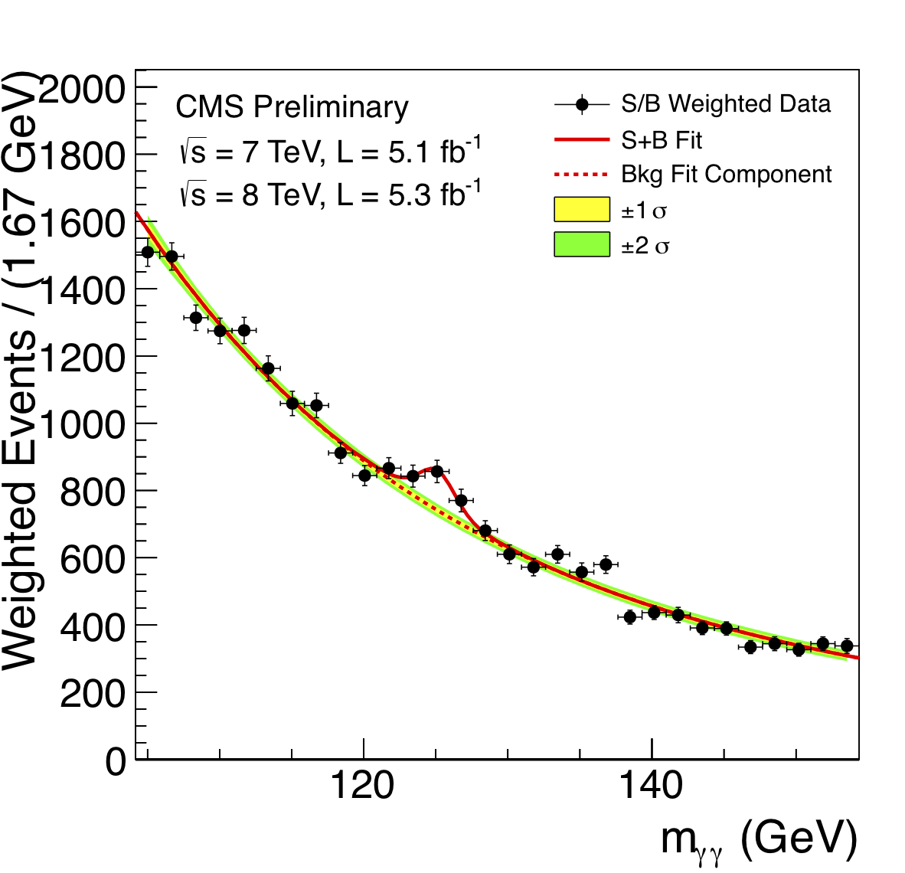
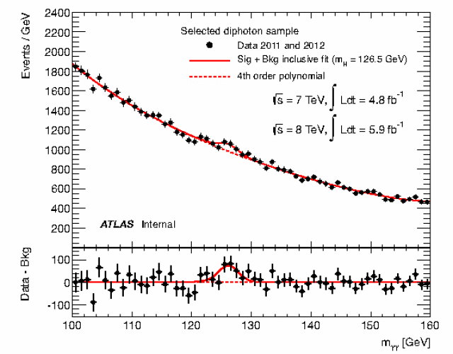
ATLAS and CMS Mass Bump Plots
ATLAS
CMS
LOOK, Ma! Bumps!!

Slide 23
So have we seen the Higgs particle?
The statistical significance of the finding is close to 6 standard deviations
  Level of significance: 99.999 999 8% (seven 9s!!)
  We can be wrong once if we do the same experiment 500,000,000 times
So did we find the Higgs particle?
  We have discovered a new particle, the heaviest boson we’ve seen thus far
  It has some properties consistent with the Standard Model Higgs particle
  We, however, do not have enough data to precisely measure all the properties – mass, life time, the rate at which this particle decays to certain other particles, etc – to definitively determine

Slide 24
So why is this discovery important?
This is the giant first step in completing the Standard Model
Will help understand the origin of mass and the mechanism at which mass is acquired
Will help understand the origin and the structure of the universe and the inter-relations of the forces
Will help us make our lives better
Generate excitements and interests on science and train the next generation
  A lecture at UTA by Nobel Laureate, prof. Steven Weinberg, was attended by 1200 people!!

Slide 25
Information & Communication Source
My web page: http://www-hep.uta.edu/~yu/
  Contact information & Class Schedule
  Syllabus
  Homework
  Holidays and Exam days
  Evaluation Policy
  Class Style & Communication
  Other information
Primary communication tool is e-mail: Make sure to subscribe to the class e-mail distribution list PHYS1441-002-SP13 by clicking on the link https://listserv.uta.edu/cgi-bin/wa.exe?A0=PHYS1441-002-SP13
  5 point extra credit if subscribed by Friday, Jan. 18.
  3 point extra credit if done by Tuesday, Jan. 22
  A test message will be sent out Wednesday, Jan. 23
Office Hours: 5:30 – 6:30pm, Mondays and Wednesdays or by appointments

Slide 26
Evaluation Policy
Homework: 25%
Exams
  Final Comprehensive Exams (5/6): 23%
  Mid-term Comprehensive Exam (3/20): 20%
  One better of the two term Exams: 12%
    Total of two non-comprehensive term exams (2/13 and 4/17)
    One better of the two exams will be used for the final grade
    Missing an exam is not permissible unless pre-approved
      No makeup test
      You will get an F if you miss any of the exams without a prior approval
Lab score: 10%
Pop-quizzes: 10%
Extra credits: 10% of the total
  Random attendances
  Physics department colloquium participation
  Strong participation in the class discussions
  Special projects
  Planetarium shows and Other many opportunities
Grading will be done on a sliding scale
100%

Slide 27
Homework
Solving homework problems is the only way to comprehend class material
A UT Quest electronic homework system has been setup for you
  Details are in the material distributed today and on the web
  https://quest.cns.utexas.edu/student/courses/list
  Choose the course 1441-Spring13, unique number 41302
    You will be charged $25 for registration
  Download homework #1, solve the problems and submit them online by 11pm Friday, Jan. 18, for 100% credit
  Multiple unsuccessful tries will deduct points
  Roster will close 10pm, Monday, Jan. 21 (I have to approve your enrollment!!!)
  You need a UT e-ID: Go and apply at the URL https://idmanager.its.utexas.edu/eid_self_help/?createEID&qwicap-page-id=EA027EFF7E2DA39E if you don’t have one.
Each homework carries the same weight
ALL homework grades will be used for the final grade
Home work will constitute 25% of the total ➔ A good way of keeping your grades high
Strongly encouraged to collaborate ➔ Does not mean you can copy

Slide 28
Attendances and Class Style
Attendances:
  Will be taken randomly
  Will be used for extra credits
Class style:
  Lectures will be on electronic media
    The lecture notes will be posted on the web AFTER each class
  Will be mixed with traditional methods
  Active participation through questions and discussions are STRONGLY encouraged ➔ Extra credit….
  Communication between you and me is extremely important
    If you have problems, please do not hesitate talking to me

Slide 29
Lab and Physics Clinic
Physics Labs:
  Starts Tuesday, Jan. 22
  Important to understand physical principles through experiments
  10% of the grade
  Lab syllabus is available in your assigned lab rooms.
    Go by the lab room between 8am - 6pm M – F and pick up the syllabus
Physics Clinic:
  Free service
  They provide general help on physics, including help solving homework problems
    Do not expect solutions of the problem from them!
    Do not expect them to tell you whether your answers are correct!
    It is your responsibility to make sure that you have done everything correctly!
  11am – 6pm, Mon – Fri in SH 007
  This service begins Wednesday, Jan. 15

Slide 30
Extra credit
10% addition to the total
  Could boost a B to A, C to B or D to C
What constitute for extra credit?
  Random attendances
  Physics department colloquium participation
    4pm Wednesdays
    Some could even be double or triple credit
  Strong participation in the class discussions
  Special projects (BIGGGGG!!!)
  Watch the valid planetarium shows
  Many other opportunities

Slide 31
Valid Planetarium Shows
Regular running shows
  2012: Mayan Prophecies – Fridays at 6:00, Saturdays at 2:30
  Astronaut – Thursdays at 6:00, Saturdays at 5:30, Sundays at 1:30
Shows that need special arrangements
  Black Holes (can watch up to 2 times)
  Experience the Aurora
  IBEX
  Magnificent Sun
  Nano Cam
  Stars of the Pharaohs
  Time Space
  Two Small Pieces of Glass
  Unseen Universe: The Vision of SOFIA
  Violent Universe
  Wonders of the Universe
How to submit for extra credit?
  Obtain the ticket stub that is signed and dated by the planetarium star lecturer of the day
  Collect the ticket stubs
  Tape all of them on a sheet of paper with your name and ID written on it
  Submit the sheet at the end of the semester when asked

Slide 32
What can you expect from this class?
All A’s would be perfect for you, wouldn’t it?
  But easy come easy go
  Must put in efforts to make it last and meaningful….
This class is going to be challenging!!
You will earn your grade in this class.
  You will need to put in sufficient time and sincere efforts
  Exams and quizzes will be tough!!
    Sometimes problems might not look exactly like what you learned in the class
    Just putting the right answer in free response problems does not work!
But you have a great control of your grade in your hands, up to 45%!!!
  Homework is 25% of the total grade!!
    Means you will have many homework problems
      Sometimes much more than any other classes
      Some homework problems will be something that you have yet to learn in class
      Exam problems will be easier than homework problems but the same principles!!
  Lab 10%
  Extra credit 10%
I will work with you so that your efforts are properly rewarded

Slide 33
What do we want to learn in this class?
Physics is everywhere around you.
Skills to understand the fundamental principles that surrounds you in everyday lives…
Skills to identify what laws of physics applies to what phenomena and use them appropriately
Understand the impact of physical laws and apply them
Learn skills to think, research and analyze observations.
Learn skills to express observations and measurements in mathematical language
Learn skills to express your research in systematic manner in writing
But most importantly the confidence in your physics ability and to take on any challenges laid in front of you!!
Most importantly, let us have a lot of FUN!!

Slide 34
In this course, you will learn…
Fundamentals of mechanics
Concepts of physical quantities that describe motions, such as velocity, speed, acceleration, etc
Kinematic equations and description of motions
Vector and scalar quantities
Concepts of force, energy and momentum and the relationship between them
Energy, momentum and angular momentum conservation laws
Techniques to use conservation laws for motions
Rotational motions and Equilibrium conditions
Fluid and wave motions and thermodynamics

