Slide 1
PHYS 1441 – Section 002 Lecture #2
Wednesday, Jan. 16, 2013
Dr. Jaehoon Yu
What is Physics?
Brief history of physics
Chapter 1
Standards and units
Estimates
Today’s homework is homework #2, due 11pm, Tuesday, Jan. 22!!

Slide 2
Announcements
Reminder for Reading assignment #1: Read and follow through all sections in appendix A by Tuesday, Jan. 22
There will be a quiz in class Wednesday, Jan. 23, on this reading assignment and what we learn today!
Homework
52 out of 105 registered so far... Excellent!!
The problem with Quest submission system issue is being investigated.
Once resolved, please pick any answer and submit. You don’t have to get it right!
Submitted your answers by 11pm Friday, Jan. 18!!!
Some homework tips
When inputting answers to the Quest homework system
Unless the problem explicitly asks for significant figures, input as many digits as you can
The Quest is dumb. So it does not know about anything other than numbers
More details are http://web4.cns.utexas.edu/quest/support/student/#Num
E-mail distribution list: 35/105
Extra credit for registration: 5points if done by Friday, Jan. 18; 3 points by Jan. 22
2

Slide 3
How to study for this course?
Keep up with the class for comprehensive understanding of materials
Come to the class and participate in the discussions and problems solving sessions
Follow through the lecture notes
Work out example problems in the book yourself without looking at the solution
Have many tons of fun in the class!!!!!
Keep up with the homework to put the last nail on the coffin
One can always input the answers as you solve problems. Do not wait till you are done with all the problems.
Form a study group and discuss how to solve problems with your friends, then work the problems out yourselves!
Prepare for upcoming classes
Read the textbook for the material to be covered in the next class
The extra mile
Work out additional problems in the back of the book starting the easiest problems to harder ones

Slide 4
Why do Physics?
Exp.{
To understand nature through experimental observations and measurements (Research)
Establish limited number of fundamental laws, usually with mathematical expressions
Predict the nature’s course
Theory and Experiment work hand-in-hand
Theory works generally under restricted conditions
Discrepancies between experimental measurements and theory are good for improvements
Improves our everyday lives, even though some laws can take a while till we see them amongst us
Theory {
4

Slide 5
Brief History of Physics
AD 18th century:
Newton’s Classical Mechanics: A theory of mechanics based on observations and measurements, , concepts of many kinematic parameters, including force
First unification of forces – planetary forces and forces on the Earth
AD 19th Century:
Electricity, Magnetism, and Thermodynamics
Late AD 19th and early 20th century (Modern Physics Era)
Einstein’s theory of relativity: Generalized theory of space, time, and energy (mechanics)
Quantum Mechanics: Theory of atomic phenomena
Physics has come very far, very fast, and is still progressing, yet we’ve got a long way to go
What is matter made of?
How do matters get mass?
How and why do matters interact with each other?
How is universe created?
5

Slide 6
Models, Theories and Laws
Models: An analogy or a mental image of a phenomena in terms of something we are familiar with
Thinking light as waves, behaving just like water waves
Often provide insights for new experiments and ideas
Theories: More systematically improved version of models
Can provide quantitative predictions that are testable and more precise
Laws: Certain concise but general statements about how nature behaves
Energy conservation
The statement must be found experimentally valid to become a law
Principles: Less general statements of how nature behaves
Has some level of arbitrariness
6

Slide 7
Uncertainties
Physical measurements have limited precision, however good they are, due to:
Number of measurements
Quality of instruments (meter stick vs micro-meter)
Experience of the person doing measurements
Etc
In many cases, uncertainties are more important and difficult to estimate than the central (or mean) values
Stat.{
{
Syst.
7

Slide 8
Significant Figures
Denote the precision of the measured values
The number 80 implies precision of +/- 1, between 79 and 81
If you are sure to +/-0.1, the number should be written 80.0
Significant figures: non-zero numbers or zeros that are not place-holders
34, 34.2, 0.001, 34.100
34 has two significant digits
34.2 has 3
0.001 has one because the 0’s before 1 are place holders to position “.”
34.100 has 5, because the 0’s after 1 indicates that the numbers in these digits are indeed 0’s.
When there are many 0’s, use scientific notation for simplicity:
31400000=3.14x10⁷ (if known to 3 sig. fig.)
0.00012=1.2x10⁻⁴
8

Slide 9
Significant Figures
Operational rules:
Addition or subtraction: Keep the smallest number of decimal place in the result, independent of the number of significant digits: 12.001+ 3.1=
Multiplication or Division: Keep the smallest number of significant digits in the result: 12.001 x 3.1 = , because the smallest significant figures is .
15.1
37
2
What does this mean?
The worst precision determines the precision the overall operation!!
In English?
Can’t get any better than the worst measurement!
9

Slide 10
Needs for Standards and Units
Seven fundamental quantities for physical measurements
Length, Mass, Time, Electric Current, Temperature, the Amount of substance and the Luminous intensity
Need a language that everyone can understand each other
Consistency is crucial for physical measurements
The same quantity measured by one must be comprehendible and reproducible by others
Practical matters contribute
A system of unit called SI (System Internationale) was established in 1960; The relevant quantities for this course are
Length in meters (m)
Mass in kilo-grams (kg)
Time in seconds (s)
10

Slide 11
Definition of Three Relevant Base Units
SI Units
Definitions
1 m (Length) = 100 cm
One meter is the length of the path traveled by light in vacuum during the time interval of 1/299,792,458 of a second.
1 kg (Mass) =
1000 g
It is equal to the mass of the international prototype of the kilogram, made of platinum-iridium in International Bureau of Weights and Measure in France.
1 s (Time)
One second is the duration of 9,192,631,770 periods of the radiation corresponding to the transition between the two hyperfine levels of the ground state of the Cesium 133 (C¹³³) atom.
There are total of seven base quantities (see table 1-5 in page 10)
There are prefixes that scales the units larger or smaller for convenience (see pg. 9)
Units for other quantities, such as Newtons for force and Joule for energy, for ease of use
11

Slide 12
Prefixes, expressions and their meanings
Larger
Smaller
deca (da): 10¹
hecto (h): 10²
kilo (k): 10³
mega (M): 10⁶
giga (G): 10⁹
tera (T): 10¹²
peta (P): 10¹⁵
exa (E): 10¹⁸
zetta (Z): 10²¹
yotta (Y): 10²⁴
deci (d): 10⁻¹
centi (c): 10⁻²
milli (m): 10⁻³
micro (μ): 10⁻⁶
nano (n): 10⁻⁹
pico (p): 10⁻¹²
femto (f): 10⁻¹⁵
atto (a): 10⁻¹⁸
zepto (z): 10⁻²¹
yocto (y): 10⁻²⁴
12

Slide 13
International Standard Institutes
International Bureau of Weights and Measure http://www.bipm.fr/
Base unit definitions: http://www.bipm.fr/enus/3_SI/base_units.html
Unit Conversions: http://www.bipm.fr/enus/3_SI/
US National Institute of Standards and Technology (NIST) http://www.nist.gov/
13

Slide 14
How do we convert quantities from one unit to another?
Unit 1 =
Conversion factor X
Unit 2
1 inch | 2.54 | cm
1 inch | 0.0254 | m
1 inch | 2.54x10⁻⁵ | km
1 ft | 30.3 | cm
1 ft | 0.303 | m
1 ft | 3.03x10⁻⁴ | km
1 hr | 60 | minutes
1 hr | 3600 | seconds
And many | More | Here….
14

Slide 15
Example for Unit Conversions
Ex: An apartment has a floor area of 880 square feet (ft²). Express this in square meters (m²).
What do we need to know?
Ex 1.4: Where the posted speed limit is 55 miles per hour (mi/h or mph), what is this speed (a) in meters per second (m/s) and (b) kilometers per hour (km/h)?
(a)
(b)
15

Slide 16
Estimates & Order-of-Magnitude Calculations
Estimate = Approximation
Useful for rough calculations to determine the necessity of higher precision
Usually done under certain assumptions
Might require modification of assumptions, if higher precision is necessary
Order of magnitude estimate: Estimates done to the precision of 10s or exponents of 10s;
Three orders of magnitude: 10³=1,000
Round up for Order of magnitude estimate; 8x10⁷ ~ 10⁸
Similar terms: “Ball-park-figures”, “guesstimates”, etc
16

Slide 17
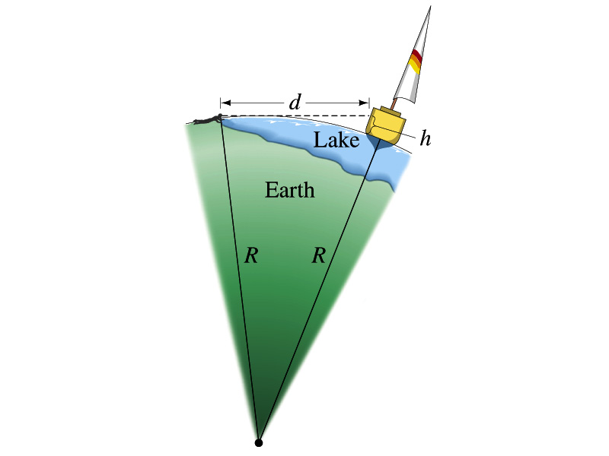
Example for estimates using trig..
Estimate the radius of the Earth using triangulation as shown in the picture when d=4.4km and h=1.5m.
Pythagorian theorem
d=4.4km
Solving for R
R
R+h
17

