Slide 1
PHYS 1441 – Section 002 Lecture #3
Wednesday, Jan. 23, 2013
Dr. Jaehoon Yu
Chapter 1
Dimensions and dimensional analysis
Chapter 2:
Some Fundamentals
One Dimensional Motion
Displacement
Speed and Velocity
Acceleration
Today’s homework is homework #3, due 11pm, Tuesday, Jan. 29!!

Slide 2
Announcements
E-mail subscription
75/104 subscribed! ➔ Please subscribe ASAP
A test message will be sent out this evening!
Thanks for your replies!
Please check your e-mail and reply to ME and ONLY ME!
Homework
94/104 registered ➔ You really need to get this done ASAP
Homework #2 deadline has been extended to 11pm tonight
Remember that I have to approve your enrollment!!
Some homework tips
When inputting answers to the Quest homework system
Unless the problem explicitly asks for significant figures, input as many digits as you can
The Quest is dumb. So it does not know about anything other than numbers

Slide 3
Special Project #1 for Extra Credit
Derive the quadratic equation for yx²-zx+v=0 ➔ 5 points
Derive the kinematic equation from first principles and the known kinematic equations ➔ 10 points
You must show your OWN work in detail to obtain the full credit
Must be in much more detail than in this lecture note!!!
Please do not copy from the lecture note or from your friends. You will all get 0!
Due Wednesday, Jan. 30

Slide 4
Dimension and Dimensional Analysis
An extremely useful concept in solving physical problems
Good to write physical laws in mathematical expressions
No matter what units are used the base quantities are the same
Length (distance) is length whether meter or inch is used to express the size: Usually denoted as [L]
The same is true for Mass ([M])and Time ([T])
One can say “Dimension of Length, Mass or Time”
Dimensions are treated as algebraic quantities: Can perform two algebraic operations; multiplication or division
4

Slide 5
Dimension and Dimensional Analysis cnt’d
One can use dimensions only to check the validity of one’s expression: Dimensional analysis
Eg: Speed [v] = [L]/[T]=[L][T⁻¹]
Distance (L) traveled by a car running at the speed V in time T
L = V*T = [L/T]*[T]=[L]
More general expression of dimensional analysis is using exponents: eg. [v]=[L^{n}T^{m}] =[L][T⁻¹] where n = 1 and m = -1
5

Slide 6
Examples
Show that the expression [v] = [at] is dimensionally correct
Speed: [v] =[L]/[T]
Acceleration: [a] =[L]/[T]²
Thus, [at] = (L/T²)xT=LT⁽⁻²⁺¹⁾ =LT⁻¹ =[L]/[T]= [v]
Suppose the acceleration a of a circularly moving particle with speed v and radius r is proportional to r^{n} and v^{m}. What are n andm?
a
r
v
Dimensionless
constant
Length
Speed
6

Slide 7
Some Fundamentals
Kinematics: Description of Motion without understanding the cause of the motion
Dynamics: Description of motion accompanied with understanding the cause of the motion
Vector and Scalar quantities:
Scalar: Physical quantities that require magnitude but no direction
Speed, length, mass, height, volume, area, magnitude of a vector quantity, etc
Vector: Physical quantities that require both magnitude and direction
Velocity, Acceleration, Force, Momentum
It does not make sense to say “I ran with velocity of 10miles/hour.”
Objects can be treated as point-like if their sizes are smaller than the scale in the problem
Earth can be treated as a point like object (or a particle)in celestial problems
Simplification of the problem (The first step in setting up to solve a problem…)
Any other examples?
7

Slide 8
Some More Fundamentals
Motions: Can be described as long as the position is known at any given time (or position is expressed as a function of time)
Translation: Linear motion along a line
Rotation: Repeated circular or elliptical motion about an axis
Vibration: Oscillation (repeated back-and-forth motion about the equillibrium position)
Dimensions (geometrical)
0 dimension: A point
1 dimension: Linear drag of a point, resulting in a line ➔ Motion in one-dimension is a motion on a line
2 dimension: Linear drag of a line resulting in a surface
3 dimension: Perpendicular Linear drag of a surface, resulting in a stereo object
8

Slide 9
Displacement, Velocity and Speed
One dimensional displacement is defined as:
A vector quantity
Displacement is the difference between initial and final potions of the motion and is a vector quantity. How is this different than distance?
Unit?
m
The average velocity is defined as:
Unit?
m/s
A vector quantity
Displacement per unit time in the period throughout the motion
The average speed is defined as:
Unit?
m/s
A scalar quantity

Slide 10
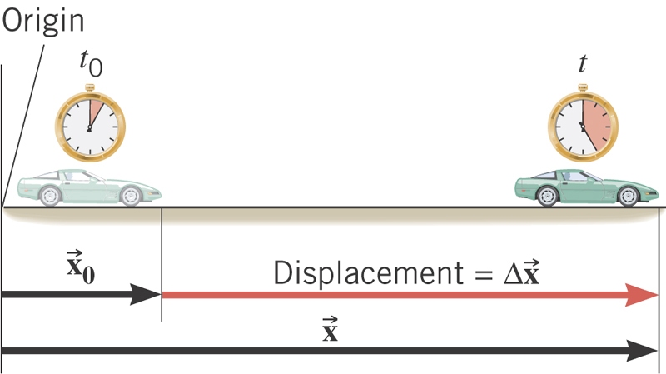
What is the displacement?
How much is the elapsed time?

Slide 11
Displacement, Velocity and Speed
One dimensional displacement is defined as:
Displacement is the difference between initial and final potions of the motion and is a vector quantity. How is this different than distance?
Unit?
m
The average velocity is defined as:
Unit?
m/s
Displacement per unit time in the period throughout the motion
The average speed is defined as:
Unit?
m/s
Can someone tell me what the difference between speed and velocity is?

Slide 12
Difference between Speed and Velocity
Let’s take a simple one dimensional translation that has many steps:
Let’s call this line as X-axis
Let’s have a couple of motions in a total time interval of 20 sec.
+10m
+15m
+5m
-5m
-10m
-15m
Total Displacement:
Average Velocity:
Total Distance Traveled:
Average Speed:
12

Slide 13
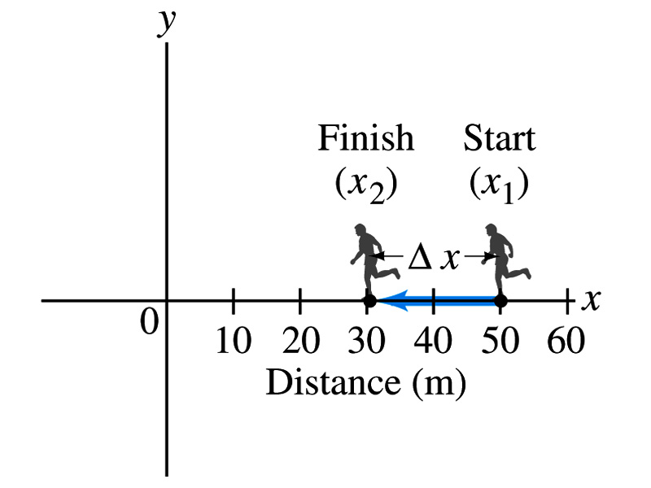
Example 2.1
The position of a runner as a function of time is plotted as moving along the x axis of a coordinate system. During a 3.00-s time interval, the runner’s position changes from x₁=50.0m to x₂=30.5 m, as shown in the figure. What was the runner’s average velocity? What was the average speed?
Displacement:
Average Velocity:
Average Speed:
13

