Slide 1
PHYS 1441 – Section 002 Lecture #4
Monday, Jan. 28, 2013
Dr. Jaehoon Yu
Chapter 2:
One Dimensional Motion
Instantaneous Velocity and Speed
Acceleration
Motion under constant acceleration

Slide 2
Announcements
Quiz results
Class average: 13/20
Equivalent to 65/100!
Top score: 20/20
E-mail subscription
79/104 subscribed! ➔ Please subscribe ASAP
A test message was sent out Thursday morning!
Thanks for your replies!
Please check your e-mail and reply to ME and ONLY ME if you haven’t done so yet!
Homework
97/104 registered ➔ You really need to get this done ASAP
Homework is 25% of your grade so without doing it well, it will be very hard for you to obtain good grade!
Please take an action TODAY if you aren’t already registered!!

Slide 3
Reminder: Special Project #1
Derive the quadratic equation for yx²-zx+v=0 ➔ 5 points
This means that you need to solve the above equation and find the solutions for x!
Derive the kinematic equation from first principles and the known kinematic equations ➔ 10 points
You must show your OWN work in detail to obtain the full credit
Must be in much more detail than in this lecture note!!!
Please do not copy from the lecture note or from your friends. You will all get 0!
Due Monday, Feb. 4

Slide 4
Refresher: Displacement, Velocity and Speed
One dimensional displacement is defined as:
Displacement is the difference between initial and final potions of the motion and is a vector quantity. How is this different than distance?
Unit?
m
The average velocity is defined as:
Unit?
m/s
Displacement per unit time in the period throughout the motion
The average speed is defined as:
Unit?
m/s

Slide 5
Example Distance Run by a Jogger
How far does a jogger run in 1.5 hours if his average speed is 2.22 m/s?

Slide 6
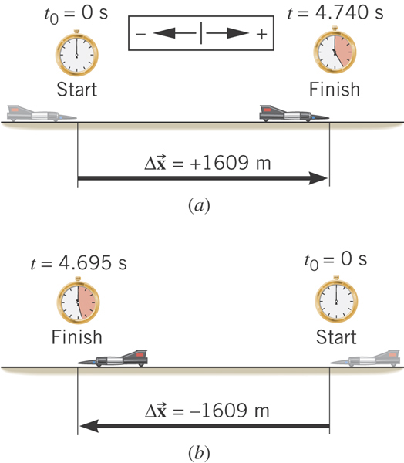
Example: The World’s Fastest Jet-Engine Car
Andy Green in the car ThrustSSC set a world record of 341.1 m/s in 1997. To establish such a record, the driver makes two runs through the course, one in each direction to nullify wind effects. From the data, determine the average speed for each run.
What is the speed?
Segment of a motion!!
What is the speed?
Segment of a motion!!

Slide 7
Instantaneous Velocity and Speed
Can average quantities tell you the detailed story of the whole motion?
NO!!
Instantaneous velocity is defined as:
What does this mean?
Displacement in an infinitesimal time interval
Average velocity over a very, very short amount of time
Instantaneous speed is the size (magnitude) of the velocity vector:
*Magnitude of Vectors are Expressed in absolute values

Slide 8
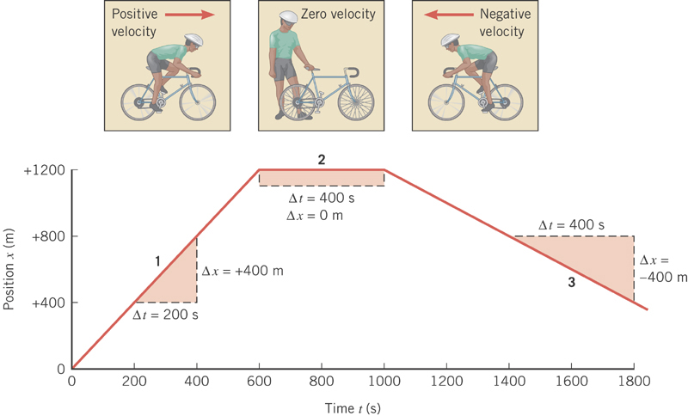
Position vs Time Plot
It is helpful to understand motions to draw them on position vs time plots.
Running at a constant velocity at a rate of +400m in 200s.
Velocity is 0 since stayed in the same location in 400s.
Running at a constant velocity but in the reverse direction as 1 at a rate of -400m in 400s.

Slide 9
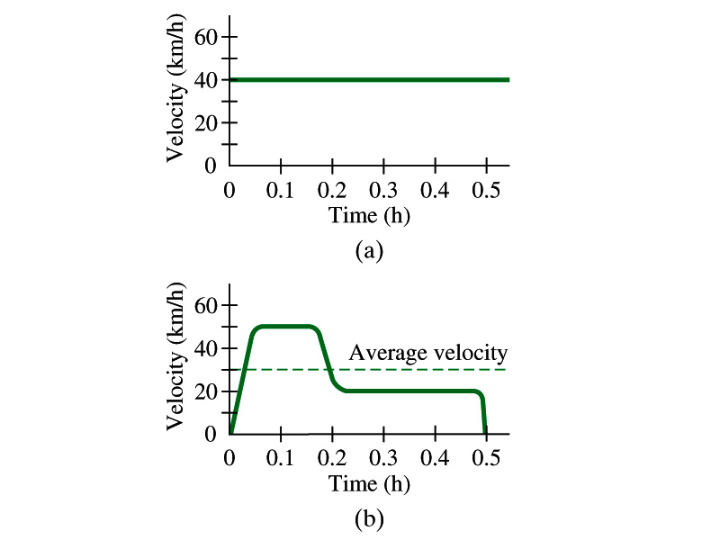
Velocity vs Time Plot

Slide 10
Displacement, Velocity and Speed
Displacement
Average velocity
Average speed
Instantaneous velocity
Instantaneous speed
10
10

Slide 11
Acceleration
Change of velocity in time (what kind of quantity is this?)
Vector!
Average acceleration:
analogs to
Dimension?
[LT⁻²]
Unit?
m/s²
Instantaneous acceleration: Average acceleration over a very short amount of time.
analogs to

Slide 12
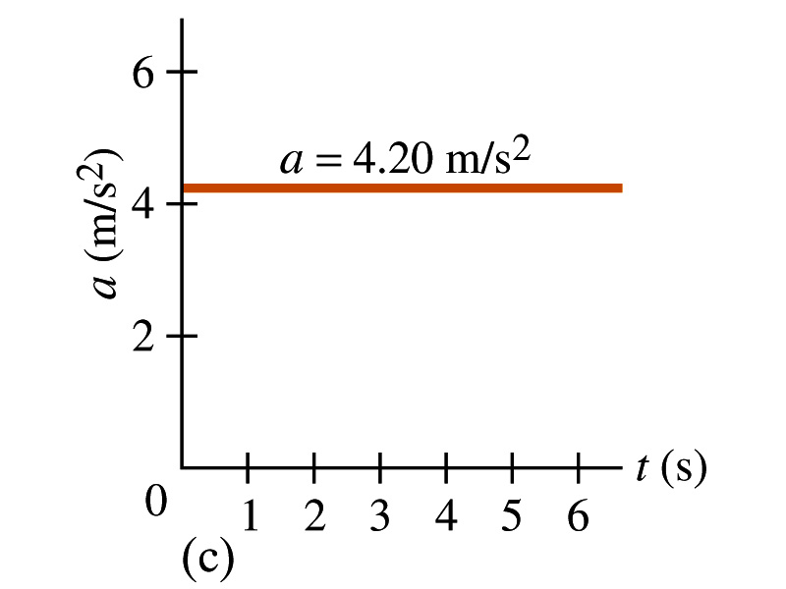
Acceleration vs Time Plot
What does this plot tell you?
Yes, you are right!!
The acceleration of this motion is a constant!!

Slide 13
Example 2.3
A car accelerates along a straight road from rest to 75km/h in 5.0s.
What is the magnitude of its average acceleration?

Slide 14
A Few Confusing Things on Acceleration
When an object is moving in a constant velocity (v=v₀), there is no acceleration (a=0)
Is there any acceleration when an object is not moving?
When an object is moving faster as time goes on, (v=v(t) ), acceleration is positive (a>0).
Incorrect, since the object might be moving in negative direction initially
When an object is moving slower as time goes on, (v=v(t) ), acceleration is negative (a<0)
Incorrect, since the object might be moving in negative direction initially
In all cases, velocity is positive, unless the direction of the movement changes.
Incorrect, since the object might be moving in negative direction initially
Is there acceleration if an object moves in a constant speed but changes direction?
The answer is YES!!

