Slide 1
PHYS 1441 – Section 002 Lecture #6
Monday, Feb. 4, 2013
Dr. Jaehoon Yu
Properties and operations of vectors
Components of the 2D Vector
Understanding the 2 Dimensional Motion
2D Kinematic Equations of Motion
Projectile Motion

Slide 2
Announcements
1st term exam
In class, Wednesday, Feb. 13
Coverage: CH1.1 – what we finish Monday, Feb. 11, plus Appendix A1 – A8
Mixture of free response problems and multiple choice problems
Please do not miss the exam! You will get an F if you miss any exams!
Quiz #2
Early in class this Wednesday, Feb. 6
Covers CH1.6 – what we finish today (CH3.4?)
Homework
I see that Quest now is accepting payments through Feb.25. Please take an action quickly so that your homework is undisrupted..

Slide 3
Vector and Scalar
Vector quantities have both magnitudes (sizes) and directions
Velocity, acceleration, force, momentum, etc
Normally denoted in BOLD letters, F, or a letter with arrow on top
Their sizes or magnitudes are denoted with normal letters, F, or absolute values:
Scalar quantities have magnitudes only
Can be completely specified with a value and its unit
Speed, energy, heat, mass, time, etc
Normally denoted in normal letters, E
Both have units!!!

Slide 4
Properties of Vectors
sizes
directions
Two vectors are the same if their and the are the same, no matter where they are on a coordinate system!! ➔ You can move them around as you wish as long as their directions and sizes are kept the same.
y
Which ones are the same vectors?
D
F
A=B=E=D
A
Why aren’t the others?
B
x
C: The same magnitude but opposite direction: C=-A:A negative vector
E
C
F: The same direction but different magnitude

Slide 5
Vector Operations
Addition:
Triangular Method: One can add vectors by connecting the head of one vector to the tail of the other (head-to-tail)
Parallelogram method: Connect the tails of the two vectors and extend
Addition is commutative: Changing order of operation does not affect the results A+B=B+A, A+B+C+D+E=E+C+A+B+D
A+B
A
A+B
B
=
OR
B
A+B
B
A
A
Subtraction:
The same as adding a negative vector:A - B = A + (-B)
A
-B
Since subtraction is the equivalent to adding a negative vector, subtraction is also commutative!!!
A-B
Multiplication by a scalar is increasing the magnitude A, B=2A
A
B=2A

Slide 6
Example for Vector Addition
A car travels 20.0km due north followed by 35.0km in a direction 60.0º West of North. Find the magnitude and direction of resultant displacement.
Bsin60º
N
B
60^{ο}
Bcos60^{ο}
20
r
θ
A
E
Do this using components!!

Slide 7
Components and Unit Vectors
Coordinate systems are useful in expressing vectors in their components
y
(+,+)
A_{y}
(A_{x},A_{y})
}Components
A
(-,+)
θ
x
} Magnitude
(-,-)
(+,-)
A_{x}

Slide 8
Unit Vectors
Unit vectors are the ones that tells us the directions of the components
Very powerful and makes vector notation and operations much easier!
Dimensionless
Magnitudes these vectors are exactly 1
Unit vectors are usually expressed in i, j, k or
So a vector A can be expressed as

Slide 9
Examples of Vector Operations
Find the resultant vector which is the sum of A=(2.0i+2.0j) and B =(2.0i-4.0j)
Find the resultant displacement of three consecutive displacements: d₁=(15i+30j +12k)cm, d₂=(23i+14j -5.0k)cm, and d₃=(-13i+15j)cm
Magnitude

Slide 10
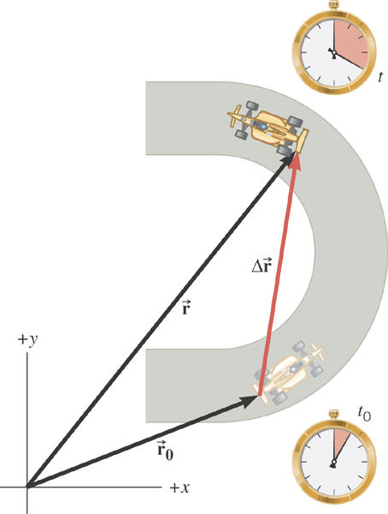
2D Displacement

Slide 11
2D Average Velocity
Average velocity is the
displacement divided by
the elapsed time.

Slide 12
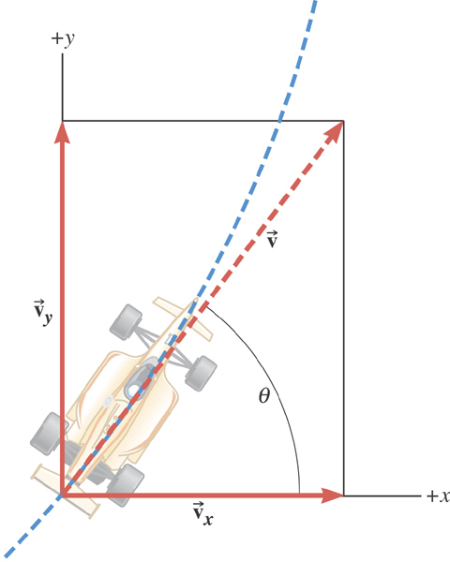
2D Instantaneous Velocity
The instantaneous velocity indicates how fast the car moves and the direction of motion at each instant of time.

Slide 13
2D Average Acceleration

Slide 14
Displacement, Velocity, and Acceleration in 2-dim
Displacement:
Average Velocity:
How is each of these quantities defined in 1-D?
Instantaneous Velocity:
Average Acceleration
Instantaneous Acceleration:

Slide 15
Kinematic Quantities in 1D and 2D
Quantities | 1 Dimension | 2 Dimension
Displacement
Average Velocity
Inst. Velocity
Average Acc.
Inst. Acc.
What is the difference between 1D and 2D quantities?

Slide 16
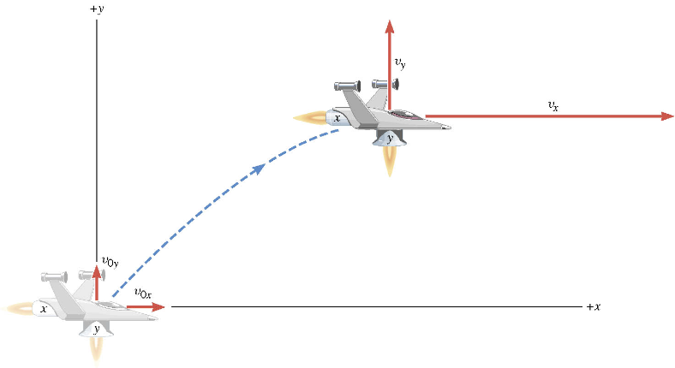
A Motion in 2 Dimension
This is a motion that could be viewed as two motions combined into one. (superposition…)

Slide 17
Motion in horizontal direction (x)

Slide 18
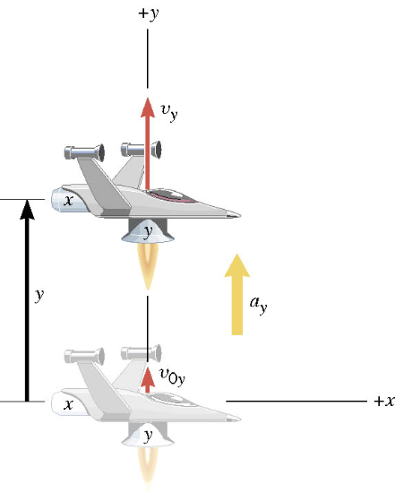
Motion in vertical direction (y)

Slide 19
A Motion in 2 Dimension
Imagine you add the two 1 dimensional motions on the left. It would make up a one 2 dimensional motion on the right.

Slide 20
Kinematic Equations in 2-Dim
x-component
y-component

Slide 21
Ex. A Moving Spacecraft
In the x direction, the spacecraft in zero-gravity zone has an initial velocity component of +22 m/s and an acceleration of +24 m/s². In the y direction, the analogous quantities are +14 m/s and an acceleration of +12 m/s². Find (a) x and v_{x}, (b) y and v_{y}, and (c) the final velocity of the spacecraft at time 7.0 s.

Slide 22
How do we solve this problem?
Visualize the problem ➔ Draw a picture!
Decide which directions are to be called positive (+) and negative (-).
Write down the values that are given for any of the five kinematic variables associated with each direction.
Verify that the information contains values for at least three of the kinematic variables. Do this for x and y separately. Select the appropriate equation.
When the motion is divided into segments, remember that the final velocity of one segment is the initial velocity for the next.
Keep in mind that there may be two possible answers to a kinematics problem.

Slide 23
Ex. continued
In the x direction, the spacecraft in a zero gravity zone has an initial velocity component of +22 m/s and an acceleration of +24 m/s². In the y direction, the analogous quantities are +14 m/s and an acceleration of +12 m/s². Find (a) x and v_{x}, (b) y and v_{y}, and (c) the final velocity of the spacecraft at time 7.0 s.
x | a_{x} | v_{x} | v_{ox} | t
? |  | ?
+24.0 m/s²
+22.0 m/s
7.0 s
y | a_{y} | v_{y} | v_{oy} | t
? |  | ?
+12.0 m/s²
+14.0 m/s
7.0 s

Slide 24
First, the motion in x-direciton…
x | a_{x} | v_{x} | v_{ox} | t
? | +24.0 m/s² | ? | +22 m/s | 7.0 s

Slide 25
Now, the motion in y-direction…
y | a_{y} | v_{y} | v_{oy} | t
? | +12.0 m/s² | ? | +14 m/s | 7.0 s

Slide 26
The final velocity…
A vector can be fully described when the magnitude and the direction are given. Any other way to describe it?
Yes, you are right! Using components and unit vectors!!

Slide 27
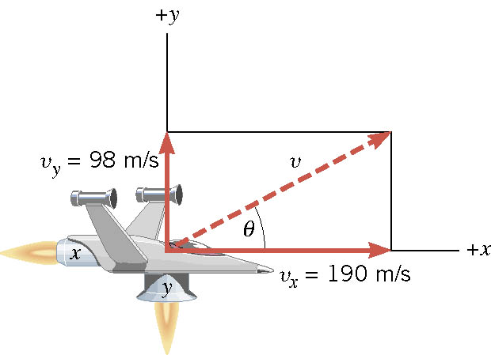
If we visualize the motion…

