Slide 1
PHYS 1441 – Section 002 Lecture #7
Wednesday, Feb. 6, 2013
Dr. Jaehoon Yu
What is the Projectile Motion?
How do we solve projectile motion problems?
Maximum Range and Height
Today’s homework is homework #5, due 11pm, Tuesday, Feb. 12!!

Slide 2
Announcements
1st term exam
In class, Wednesday, Feb. 13
Coverage: CH1.1 – what we finish Monday, Feb. 11, plus Appendix A1 – A8
Mixture of free response problems and multiple choice problems
Please do not miss the exam! You will get an F if you miss any exams!

Slide 3
Special Project #2 for Extra Credit
Show that the trajectory of a projectile motion is a parabola!!
20 points
Due: Monday, Feb. 18
You MUST show full details of your OWN computations to obtain any credit
Beyond what was covered in page 7 of this lecture note!!

Slide 4
What is the Projectile Motion?
A 2-dim motion of an object under the gravitational acceleration with the following assumptions
Free fall acceleration, g, is constant over the range of the motion
and
Air resistance and other effects are negligible
A motion under constant acceleration!!!! ➔ Superposition of two motions
Horizontal motion with constant velocity ( no acceleration )
Vertical motion under constant acceleration ( g )

Slide 5
Projectile Motion
But the object is still moving!!
Why?
Because it still has constant velocity in horizontal direction!!
Why?
Because there is no acceleration in horizontal direction!!
Maximum height
The only acceleration in this motion. It is a constant!!

Slide 6
Kinematic Equations for a projectile motion
x-component
y-component

Slide 7
Show that a projectile motion is a parabola!!!
x-component
y-component
In a projectile motion, the only acceleration is gravitational one whose direction is always toward the center of the earth (downward).
a_{x}=0
Plug t into
the above
What kind of parabola is this?

Slide 8
Example for a Projectile Motion
A ball is thrown with an initial velocity v=(20i+40j)m/s. Estimate the time of flight and the distance from the original position when the ball lands.
Which component determines the flight time and the distance?
Flight time is determined by the y component, because the ball stops moving when it is on the ground after the flight.
So the possible solutions are…
Distance is determined by the x component in 2-dim, because the ball is at y=0 position when it completed it’s flight.
Why isn’t 0 the solution?

Slide 9
Ex.3.5 The Height of a Kickoff
A placekicker kicks a football at an angle of 40.0 degrees and
the initial speed of the ball is 22 m/s. Ignoring air resistance,
determine the maximum height that the ball attains.

Slide 10
First, the initial velocity components

Slide 11
Motion in y-direction is of the interest..
y | a_{y} | v_{y} | v_{0y} | t
?
-9.8 m/s²
0 m/s
+14 m/s

Slide 12
Now the nitty, gritty calculations…
y | a_{y} | v_{y} | v_{0y} | t
? | -9.80 m/s² | 0 | 14 m/s
What happens at the maximum height?
The ball’s velocity in y-direction becomes 0!!
And the ball’s velocity in x-direction?
Stays the same!! Why?
Because there is no acceleration in x-direction!!
Which kinematic formula would you like to use?
Solve for y

Slide 13
Ex.3.9 extended: The Time of Flight of a Kickoff
What is the time of flight between kickoff and landing?

Slide 14
What is y when it reached the max range?
y | a_{y} | v_{y} | v_{oy} | t
 |  |  |  | ?
0 m
-9.80 m/s²
14 m/s

Slide 15
Now solve the kinematic equations in y direction!!
y | a_{y} | v_{y} | v_{oy} | t
0 | -9.80 m/s² |  | 14 m/s | ?
Since y=0
Two soultions
or
Solve for t

Slide 16
Ex.3.9 The Range of a Kickoff
Calculate the range R of the projectile.

Slide 17
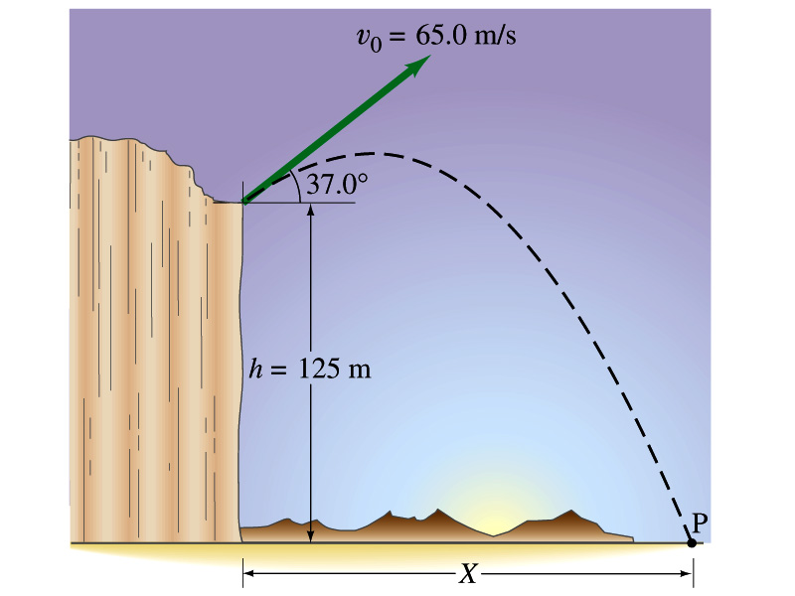
Example for a Projectile Motion
A stone was thrown upward from the top of a cliff at an angle of 37º to horizontal with initial speed of 65.0m/s. If the height of the cliff is 125.0m, how long is it before the stone hits the ground?
Becomes
Since negative time does not exist.
17

Slide 18
Example cont’d
What is the speed of the stone just before it hits the ground?
What are the maximum height and the maximum range of the stone?
Do these yourselves at home for fun!!!
18

