Slide 1
PHYS 1441 – Section 002 Lecture #8
Monday, Feb. 11, 2013
Dr. Jaehoon Yu
Maximum Range and Height
What is the Force?
Newton’s Second Law
Free Body Diagram

Slide 2
Announcements
Quiz 2 results
Class average: 21/35
Equivalent to 60/100
Quiz 1: 65/100
Top score: 35/35
1st term exam
In class this Wednesday, Feb. 13
Coverage: CH1.1 – what we finish today (CH4.4) plus Appendix A1 – A8
Mixture of free response problems and multiple choice problems
Please do not miss the exam! You will get an F if you miss any exams!

Slide 3
Reminder: Special Project #2
Show that the trajectory of a projectile motion is a parabola!!
20 points
Due: Monday, Feb. 18
You MUST show full details of your OWN computations to obtain any credit
Beyond what was covered in page 7 of this lecture note!!

Slide 4
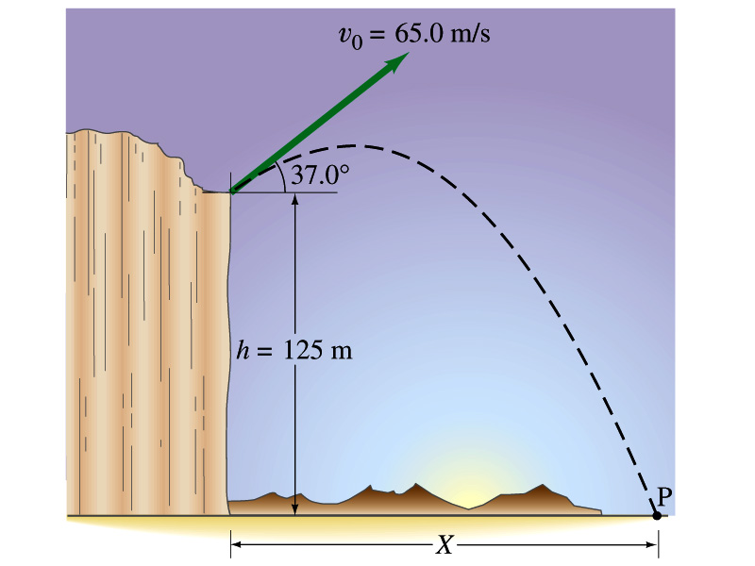
Example for a Projectile Motion
A stone was thrown upward from the top of a cliff at an angle of 37º to horizontal with initial speed of 65.0m/s. If the height of the cliff is 125.0m, how long is it before the stone hits the ground?
Becomes
Since negative time does not exist.
4

Slide 5
Example cont’d
What is the speed of the stone just before it hits the ground?
What are the maximum height and the maximum range of the stone?
Do these yourselves at home for fun!!!
5

Slide 6
Horizontal Range and Max Height
Based on what we have learned in the previous pages, one can analyze a projectile motion in more detail
Maximum height an object can reach
Maximum range
What happens at the maximum height?
At the maximum height the object’s vertical motion stops to turn around!!
g=9.8m/s²
Solve for t_{A}
Time to reach to the maximum height!!

Slide 7
Horizontal Range and Max Height
Since no acceleration is in x direction, it still flies even if v_{y}=0.
Range
Height

Slide 8
Maximum Range and Height
What are the conditions that give maximum height and range of a projectile motion?
This formula tells us that the maximum height can be achieved when θ₀=90º!!!
This formula tells us that the maximum range can be achieved when 2θ₀=90º, i.e., θ₀=45º!!!

Slide 9
Force
We’ve been learning kinematics; describing motion without understanding what the cause of the motion is. Now we are going to learn dynamics!!
FORCE is what causes an object to move.
Can someone tell me what FORCE is?
The above statement is not entirely correct. Why?
Because when an object is moving with a constant velocity no force is exerted on the object!!!
FORCEs are what cause changes to the velocity of an object!!
What does this statement mean?
When there is force, there is change of velocity!!
What does force cause?
It causes an acceleration.!!
What happens if there are several forces being exerted on an object?
Forces are vector quantities, so vector sum of all forces, the NET FORCE, determines the direction of the acceleration of the object.
F₁
F₂
NET FORCE, F= F₁+F₂
When the net force on an object is 0, it has constant velocity and is at its equilibrium!!

Slide 10
More Forces
There are various classes of forces
Contact Forces: Forces exerted by physical contact of objects
Examples of Contact Forces: Baseball hit by a bat, Car collisions
Field Forces: Forces exerted without physical contact of objects
Examples of Field Forces: Gravitational Force, Electro-magnetic force
What are possible ways to measure strength of a force?
A calibrated spring whose length changes linearly with the force exerted .
Forces are vector quantities, so the addition of multiple forces must be done following the rules of vector additions.

Slide 11
Newton’s First Law and Inertial Frames
Aristotle (384-322BC): A natural state of a body is rest. Thus force is required to move an object. To move faster, ones needs larger forces.
Galileo’s statement on natural states of matter: Any velocity once imparted to a moving body will be rigidly maintained as long as the external causes of retardation are removed!!
Galileo’s statement is formulated by Newton into the 1st law of motion (Law of Inertia): In the absence of external forces, an object at rest remains at rest and an object in motion continues in motion with a constant velocity.
What does this statement tell us?
When no net force is exerted on an object, the acceleration of the object is 0.
Any isolated object, the object that do not interact with its surroundings, is either at rest or moving at a constant velocity.
Objects would like to keep its current state of motion, as long as there are no net force that interferes with the motion. This tendency is called the Inertia.
A frame of reference that is moving at a constant velocity is called the Inertial Frame
Is a frame of reference with an acceleration an Inertial Frame?
NO!

Slide 12
Mass
Mass: A measure of the inertia of a body or the quantity of matter
Independent of the object’s surroundings: The same no matter where you go.
Independent of the method of measurement: The same no matter how you measure it.
The heavier the object, the bigger the inertia !!
It is harder to make changes of motion of a heavier object than a lighter one.
The same forces applied to two different masses result in different acceleration depending on the mass.
Note that the mass and the weight of an object are two different quantities!!
Weight of an object is the magnitude of the gravitational force exerted on the object.
Not an inherent property of an object!!!
Weight will change if you measure on the Earth or on the moon but the mass won’t!!
Unit of mass?

Slide 13
Newton’s Second Law of Motion
The acceleration of an object is directly proportional to the net force exerted on it and is inversely proportional to the object’s mass.
How do we write the above statement in a mathematical expression?
From this we obtain
Newton’s 2nd Law of Motion
Since it’s a vector expression, each component must also satisfy:

Slide 14
Unit of the Force
From the vector expression in the previous page, what do you conclude the dimension and the unit of the force are?
The dimension of force is
The unit of force in SI is
For ease of use, we define a new derived unit called, Newton (N)

Slide 15
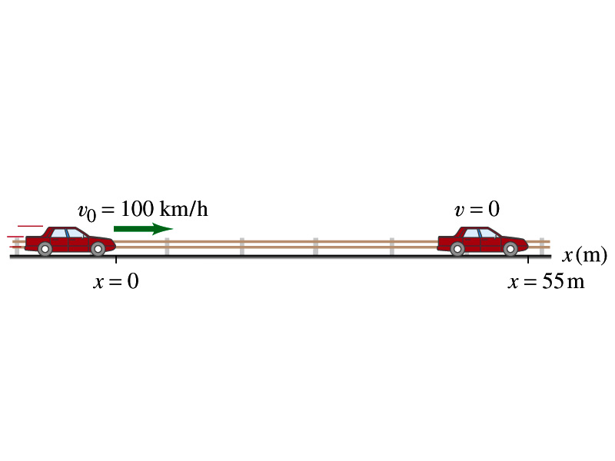
Example 4.3
What constant net force is required to bring a 1500kg car to rest from a speed of 100km/h within a distance of 55m?
What do we need to know to figure out the force?
Acceleration!!
What are given?
Initial speed:
Final speed:
Displacement:
This is a one dimensional motion. Which kinetic formula do we use to find acceleration?
Acceleration
Thus, the force needed to stop the car is
Linearly proportional to the mass of the car
Squarely proportional to the speed of the car
Inversely proportional to the force by the brake
Given the force how far does the car move till it stops?

