Slide 1
PHYS 1441 – Section 002 Lecture #9
Monday, Feb. 18, 2013
Dr. Jaehoon Yu
Free Body Diagram
Newton’s Third Law
Categories of forces

Slide 2
Announcements
Term exam results
Class average: 60/103
Equivalent to 58.2/100
Top score: 98.5/103
Evaluation policy
Homework: 25%
Final comprehensive exam: 23%
Midterm comprehensive exam: 20%
Better of the two term exams: 12%
Lab: 10%
Pop quizzes: 10%
Extra credit: 10%

Slide 3
Newton’s Second Law of Motion
The acceleration of an object is directly proportional to the net force exerted on it and is inversely proportional to the object’s mass.
How do we write the above statement in a mathematical expression?
From this we obtain
Newton’s 2nd Law of Motion
Since it’s a vector expression, each component must also satisfy:

Slide 4
Unit of the Force
From the vector expression in the previous page, what do you conclude the dimension and the unit of the force are?
The dimension of force is
The unit of force in SI is
For ease of use, we define a new derived unit called, Newton (N)

Slide 5
Free Body Diagram
A free-body-diagram is a diagram that represents the object and the forces that act on it.

Slide 6
Ex. Pushing a stalled car
What is the net force in this example?
F=
275 N
+ 395 N
– 560 N =
+110 N
Which direction?
The + x axis of the coordinate system.

Slide 7
What is the acceleration the car receives?
If the mass of the car is 1850 kg, then by Newton’s second law, the acceleration is
Since the motion is
in 1 dimension
Now we solve this
equation for a

Slide 8
Vector Nature of the Force
The direction of the force and the acceleration vectors can be taken into account by using x and y components.
is equivalent to

Slide 9
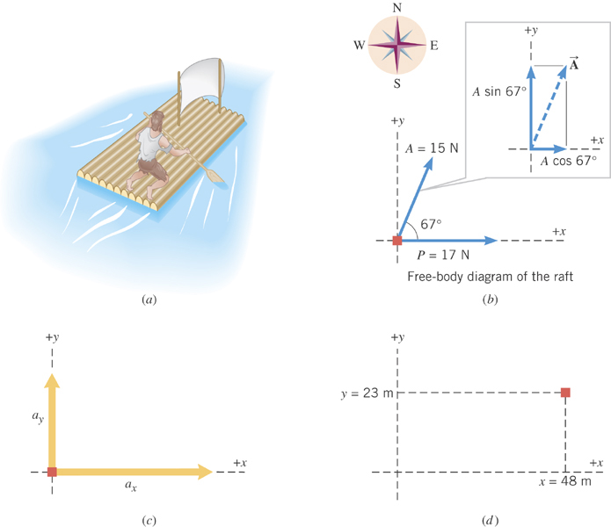
Ex. Stranded man on a raft
A man is stranded on a raft (mass of man and raft = 1300kg) as shown in the figure. By paddling, he causes an average force P of 17N to be applied to the raft in a direction due east (the +x direction). The wind also exerts a force A on the raft. This force has a magnitude of 15N and points 67º north of east. Ignoring any resistance from the water, find the x and y components of the rafts acceleration.

Slide 10
First, let’s compute the net force on the raft as follows:
Force | x component | y component
+17 N
0 N
+(15N)cos67º
+(15N)sin67º
+17+15cos67^{o=}
+15sin67º=
+23(N)
+14(N)

Slide 11
Now compute the acceleration components in x and y directions!!
And put them all together for the overall acceleration:

Slide 12
Example for Newton’s 2nd Law of Motion
Determine the magnitude and direction of the acceleration of the puck whose mass is 0.30kg and is being pulled by two forces, F1 and F2, as shown in the picture, whose magnitudes of the forces are 8.0 N and 5.0 N, respectively.
Components of F₁
F₁
θ₁=60^{ο}
Components of F₂
θ₂=−20^{ο}
F₂
Components of total force F
Magnitude and direction of acceleration a
Acceleration
Vector a
12

