Slide 1
PHYS 1441 – Section 002
Lecture #10
Wednesday, Feb. 20, 2013
Dr. Jaehoon Yu
Newton’s Third Law
Categories of forces
Application of Newton’s Laws
  Motion without friction
  Motion with friction
Today’s homework is homework #6, due 11pm, Tuesday, Feb. 26!!

Slide 2
Announcements
Quiz #3 Wednesday, Feb. 27
  At the beginning of the class
  Covers CH4.1 through what we learn Monday, Feb. 25
Please make sure that you pay for Quest homework access today!!
  The deadline is coming Monday, Feb. 25, but
  You will lose all access to your homework site and grades if you do not pay by Feb. 25
  No extension will be granted for a lost access!

Slide 3
Special Project #3 for Extra Credit
A large man and a small boy stand facing each other on frictionless ice. They put their hands together and push against each other so that they move apart. a) Who moves away with the higher speed, by how much and why? b) Who moves farther in the same elapsed time, by how much and why?
Derive the formulae for the two problems above in much more detail and explain your logic in a greater detail than what is in pages 7 and 8 of this lecture note.
Be sure to clearly define each variable used in your derivation.
Each problem is 10 points.
Due is Wednesday, Feb. 27

Slide 4
Newton’s Third Law (Law of Action and Reaction)
If two objects interact, the force F₂₁ that object 2 exerts on object 1 is equal in magnitude and opposite in direction to the force F₁₂ object 1 exerts on object 2.
F₁₂
F₂₁
2
1
The reaction force is equal in magnitude to the action force but in opposite direction. These two forces always act on different objects.
What is the reaction force to the force of a free falling object?
The gravitational force the object exerts on the Earth!
Stationary objects on top of a table has a reaction force (called the normal force) from table to balance the action force, the gravitational force.
4

Slide 5
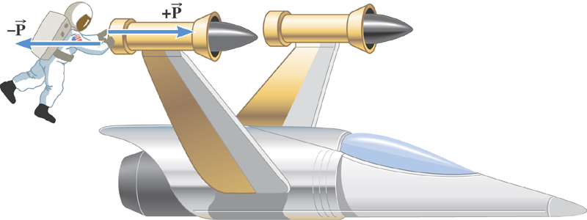
Ex. The Accelerations Produced by Action and Reaction Forces
Which one do you think will get larger acceleration?
Suppose that the magnitude of the force P is 36 N. If the mass of the spacecraft is 11,000 kg and the mass of the astronaut is 92 kg, what are the accelerations?

Slide 6
Ex. continued
Force exerted on the space craft by the astronaut
Force exerted on the astronaut by the space craft
space craft’s acceleration
Astronaut’s acceleration

Slide 7
Example of Newton’s 3rd Law
A large man and a small boy stand facing each other on frictionless ice. They put their hands together and push against each other so that they move apart. a) Who moves away with the higher speed and by how much?
F₁₂
F₂₁= - F₁₂
m
M
Since
and
Establish the
equation
Divide by m
7

Slide 8
Example of Newton’s 3rd Law, cnt’d
Man’s velocity
Boy’s velocity
So boy’s velocity is higher than man’s, if M>m, by the ratio of the masses.
b) Who moves farther while their hands are in contact?
Boy’s displacement
Man’s displacement
Given in the same time interval, since the boy has higher acceleration and thereby higher speed, he moves farther than the man.
8

Slide 9
Categories of Forces
Fundamental Forces: Truly unique forces that cannot be derived from any other forces
  Total of three fundamental forces
    Gravitational Force
    Electro-Weak Force
    Strong Nuclear Force
Non-fundamental forces: Forces that can be derived from fundamental forces
  Friction
  Tension in a rope
  Normal or support forces

Slide 10
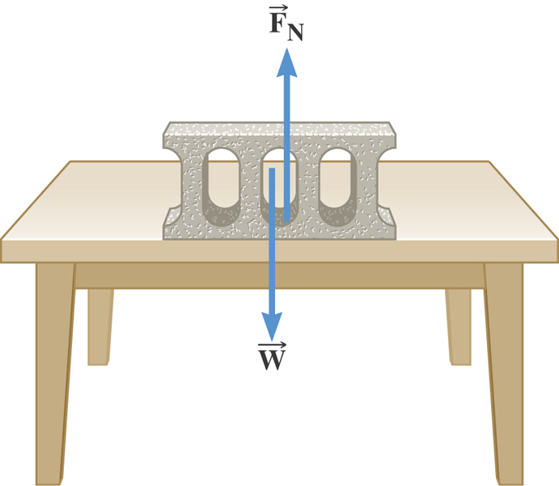
The Normal Force
The normal force is one component of the force that a surface exerts on an object with which it is in contact – namely, the component that is perpendicular to the surface.

Slide 11
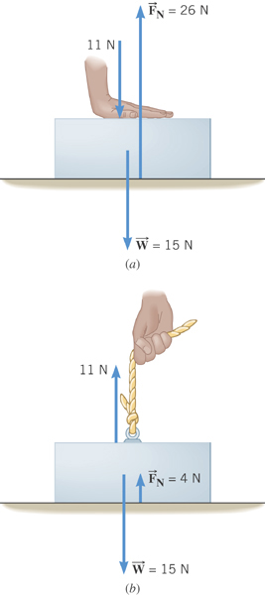
Some normal force exercises
Case 1: Hand pushing down on the book
Case 2: Hand pulling up the book

Slide 12
Some Basic Information
When Newton’s laws are applied, external forces are only of interest!!
Because, as described in Newton’s first law, an object will keep its current motion unless non-zero net external force is applied.
Why?
The force that reacts to action forces due to the surface structure of an object. Its direction is perpendicular to the surface.
Normal Force, n:
Tension, T:
The reactionary force by a stringy object against an external force exerted on it.
A graphical tool which is a diagram of external forces on an object and is extremely useful analyzing forces and motion!! Drawn only on an object.
Free-body diagram

