Slide 1
PHYS 1441 – Section 002 Lecture #12
Wednesday, Feb. 27, 2013
Dr. Jaehoon Yu
Uniform Circular Motion
Centripetal Acceleration
Newton’s Law & Uniform Circular Motion Example
Unbanked and Banked highways
Newton’s Law of Universal Gravitation
Today’s homework is homework #7, due 11pm, Tuesday, Mar. 5!!

Slide 2
Announcements
Homework #6 deadline has been extended to 11pm today!!
Please make sure that you pay for Quest homework access today!!
The deadline is Feb. 28!
You will lose all access to your homework site and grades if you do not pay by Feb. 28.
35 of you still haven’t paid!!
NO extension for homework submission will be granted if you lose your access!!
PLEASE do work on homework!
It will be very hard to pass this course without doing homework since it is 25%(!!!) of the entire grade!!

Slide 3
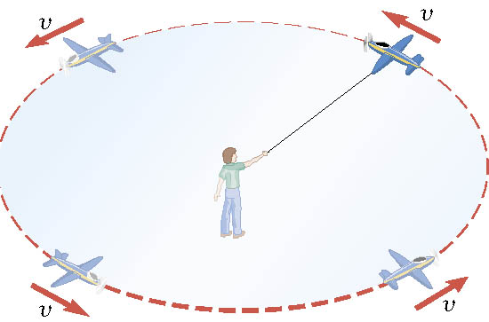
Definition of the Uniform Circular Motion
Uniform circular motion is the motion of an object traveling at a constant speed on a circular path.

Slide 4
Speed of a uniform circular motion?
Let T be the period of this motion, the time it takes for the object to travel once around the complete circle whose radius is r.

Slide 5
Ex. : A Tire-Balancing Machine
The wheel of a car has a radius of 0.29m and is being rotated at 830 revolutions per minute on a tire-balancing machine. Determine the speed at which the outer edge of the wheel is moving.

Slide 6
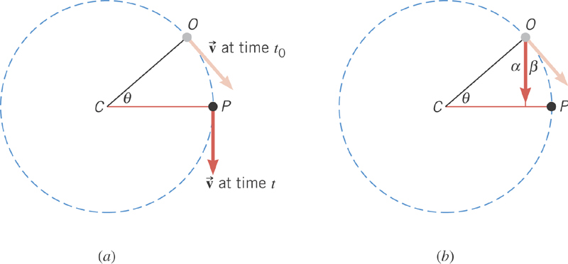
Centripetal Acceleration
In uniform circular motion, the speed is constant, but the direction of the velocity vector is not constant.

Slide 7
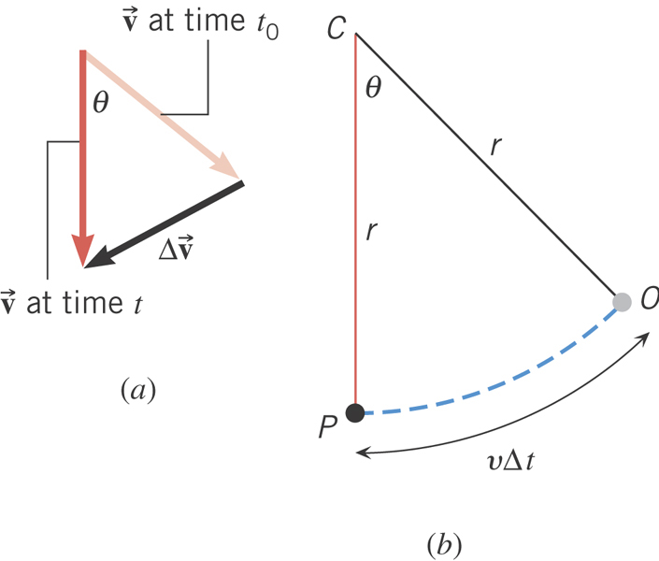
Centripetal Acceleration
From the geometry
What is the direction of a_{c}?
Always toward the center of circle!
Centripetal Acceleration

Slide 8
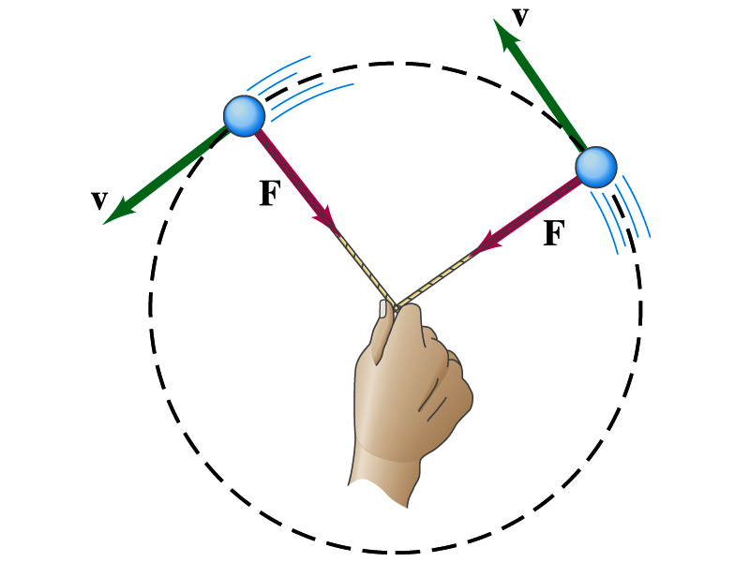
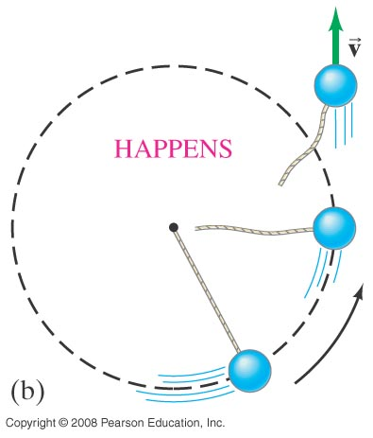
Newton’s Second Law & Centripetal Force
The centripetal * acceleration is always perpendicular to the velocity vector, v, and points to the center of the axis (radial direction) in a uniform circular motion.
Are there forces in this motion? If so, what do they do?
The force that causes the centripetal acceleration acts toward the center of the circular path and causes the change in the direction of the velocity vector. This force is called the centripetal force.
What do you think will happen to the ball if the string that holds the ball breaks?
The external force no longer exist. Therefore, based on Newton’s 1st law, the ball will continue its motion without changing its velocity and will fly away following the tangential direction to the circle.
*Mirriam Webster: Proceeding or acting in a direction toward a center or axis

Slide 9
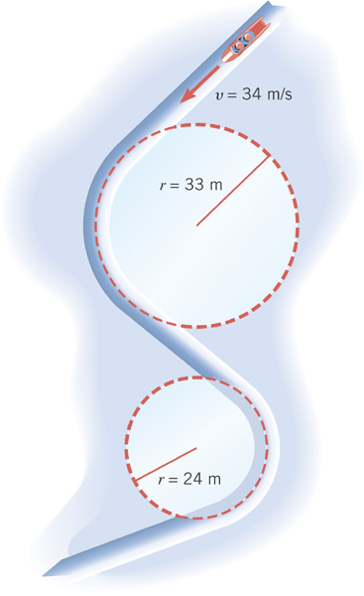
Ex. Effect of Radius on Centripetal Acceleration
The bobsled track at the 1994 Olympics in Lillehammer, Norway, contain turns with radii of 33m and 23m. Find the centripetal acceleration at each turn for a speed of 34m/s, a speed that was achieved in the two–man event. Express answers as multiples of g=9.8m/s².
Centripetal acceleration:
R=33m
R=24m

Slide 10
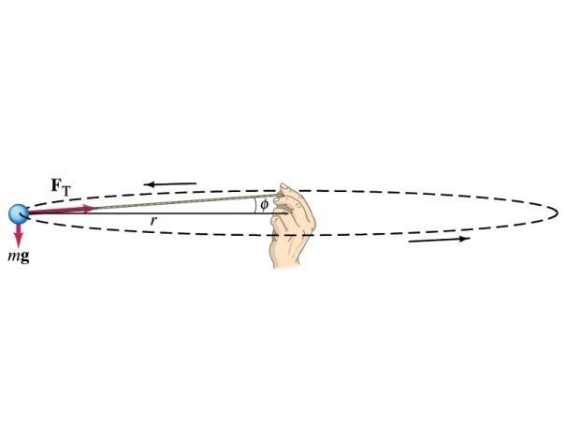
Example of Uniform Circular Motion
A ball of mass 0.500kg is attached to the end of a 1.50m long cord. The ball is moving in a horizontal circle. If the string can withstand maximum tension of 50.0 N, what is the maximum speed the ball can attain before the cord breaks?
Centripetal acceleration:
When does the string break?
when the required centripetal force is greater than the sustainable tension.
Calculate the tension of the cord when speed of the ball is 5.00m/s.

Slide 11
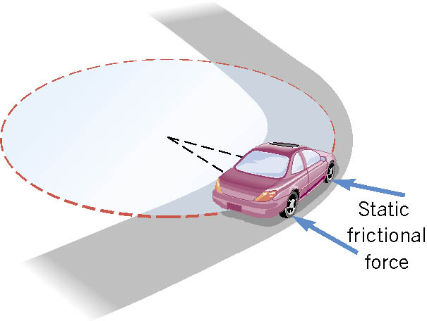
Unbanked Curve and Centripetal Force
On an unbanked curve, the static frictional force provides the centripetal force.

Slide 12
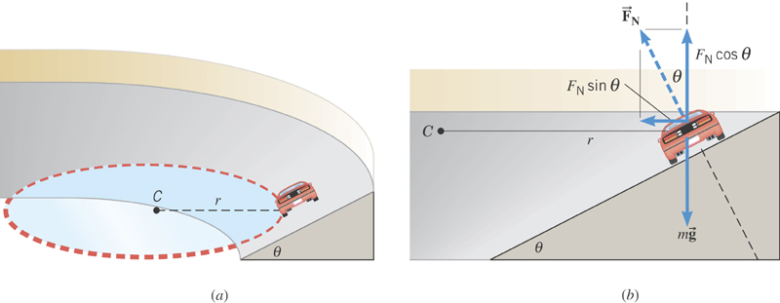
Banked Curves
On a frictionless banked curve, the centripetal force is the
horizontal component of the normal force. The vertical
component of the normal force balances the car’s weight.

Slide 13
Ex. The Daytona 500
The Daytona 500 is the major event of the NASCAR season. It is held at the Daytona International Speedway in Daytona, Florida. The turns in this oval track have a maximum radius (at the top) of r=316m and are banked steeply, with θ=31º. Suppose these maximum radius turns were frictionless. At what speed would the cars have to travel around them?
x comp.
y comp.
y
x

Slide 14
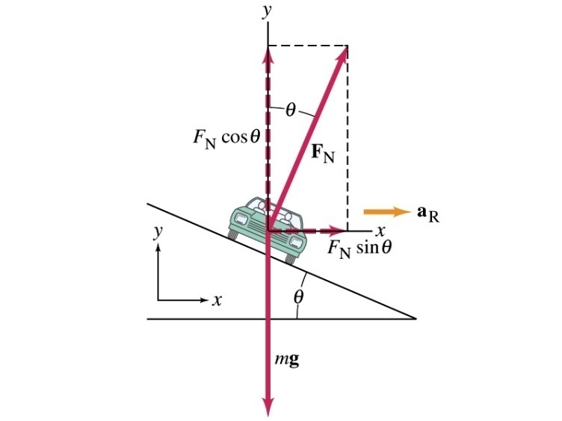
Ex. 5 – 7 Bank Angle
(a) For a car traveling with speed v around a curve of radius r, determine the formula for the angle at which the road should be banked so that no friction is required to keep the car from skidding.
y
x comp.
x
y comp.
(b) What is this angle for an expressway off-ramp curve of radius 50m at a design speed of 50km/h?

