Slide 1
PHYS 1441 – Section 002 Lecture #13
Monday, March 4, 2013
Dr. Jaehoon Yu
Newton’s Law of Universal Gravitation
Motion in Resistive Force
Work done by a constant force

Slide 2
Announcements
Quiz 3 Results
Class average: 21/40
Equivalent to 52.5/100
Previous scores: 65/100 and 60/100
Top score: 39/40
Midterm comprehensive exam
Wednesday, Mar. 20
In SH103
Covers CH1.1 through what we learn this Wednesday
Will prepare a 150 problem mid-term preparation set for you
Will distribute in class this Wednesday
Spring break next week
No class during the week!

Slide 3
Special Project #4
Using the fact that g=9.80m/s² on the Earth’s surface, find the average density of the Earth.
Use the following information only but without computing the volume explicitly
The gravitational constant
The radius of the Earth
20 point extra credit
Due: Monday, Mar. 25
You must show your OWN, detailed work to obtain any credit!!

Slide 4
Newton’s Law of Universal Gravitation
People have been very curious about the stars in the sky, making observations for a long~ time. The data people collected, however, have not been explained until Newton has discovered the law of gravitation.
Every object in the Universe attracts every other object with a force that is directly proportional to the product of their masses and inversely proportional to the square of the distance between them.
How would you write this law mathematically?
With G
G is the universal gravitational constant, and its value is
Unit?
This constant is not given by the theory but must be measured by experiments.
This form of forces is known as the inverse-square law, because the magnitude of the force is inversely proportional to the square of the distances between the objects.

Slide 5
Ex. Gravitational Attraction
What is the magnitude of the gravitational force that acts on each particle in the figure, assuming m₁=12kg, m₂=25kg, and r=1.2m?

Slide 6
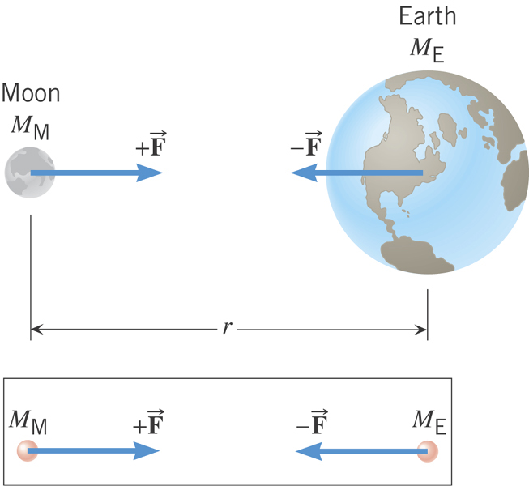
Why does the Moon orbit the Earth?

Slide 7
Gravitational Force and Weight
The attractive force exerted on an object by the Earth
Gravitational Force, F_{g}
Weight of an object with mass M is
What is the SI unit of weight?
N
Since weight depends on the magnitude of gravitational acceleration, g, it varies depending on geographical location.
By measuring the forces one can determine masses. This is why you can measure mass using the spring scale.

Slide 8
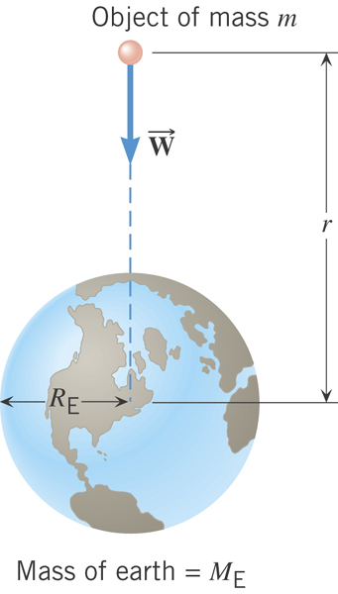
Gravitational Acceleration
Gravitational acceleration at distance r from the center of the earth!
What is the SI unit of g?
m/s²

Slide 9
Magnitude of the gravitational acceleration on the surface of the Earth
Gravitational force on the surface of the earth:

Slide 10
Example for Universal Gravitation
Using the fact that g=9.80m/s² on the Earth’s surface, find the average density of the Earth.
Since the gravitational acceleration is
Solving for g
Solving for M_{E}
Therefore the density of the Earth is

Slide 11
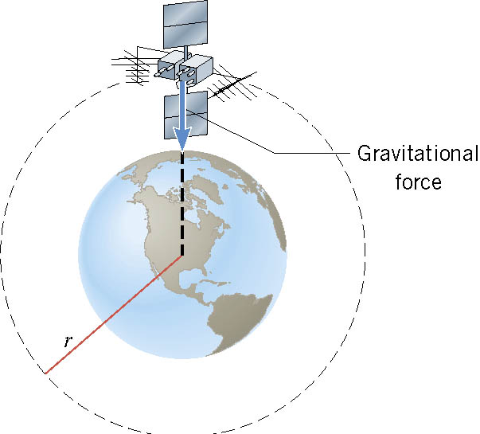
Satellite in Circular Orbits
There is only one speed that a satellite can have if the satellite is to remain in an orbit with a fixed radius.
What acts as the centripetal force?
The gravitational force of the earth pulling the satellite!

Slide 12
Ex. Orbital Speed of the Hubble Space Telescope
Determine the speed of the Hubble Space Telescope orbiting at a height of 598 km above the earth’s surface.

Slide 13
Period of a Satellite in an Orbit
Speed of a satellite
Square either side and solve for T2
Period of a satellite
Kepler’s 3rd Law
This is applicable to any satellite or even for planets and moons.

Slide 14
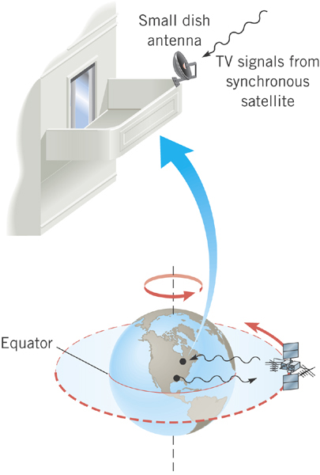
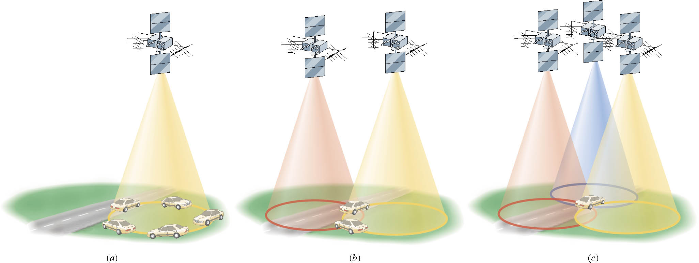
Geo-synchronous Satellites
Global Positioning System (GPS)
Satellite TV
What period should these satellites have?
The same as the earth!!
24 hours

Slide 15
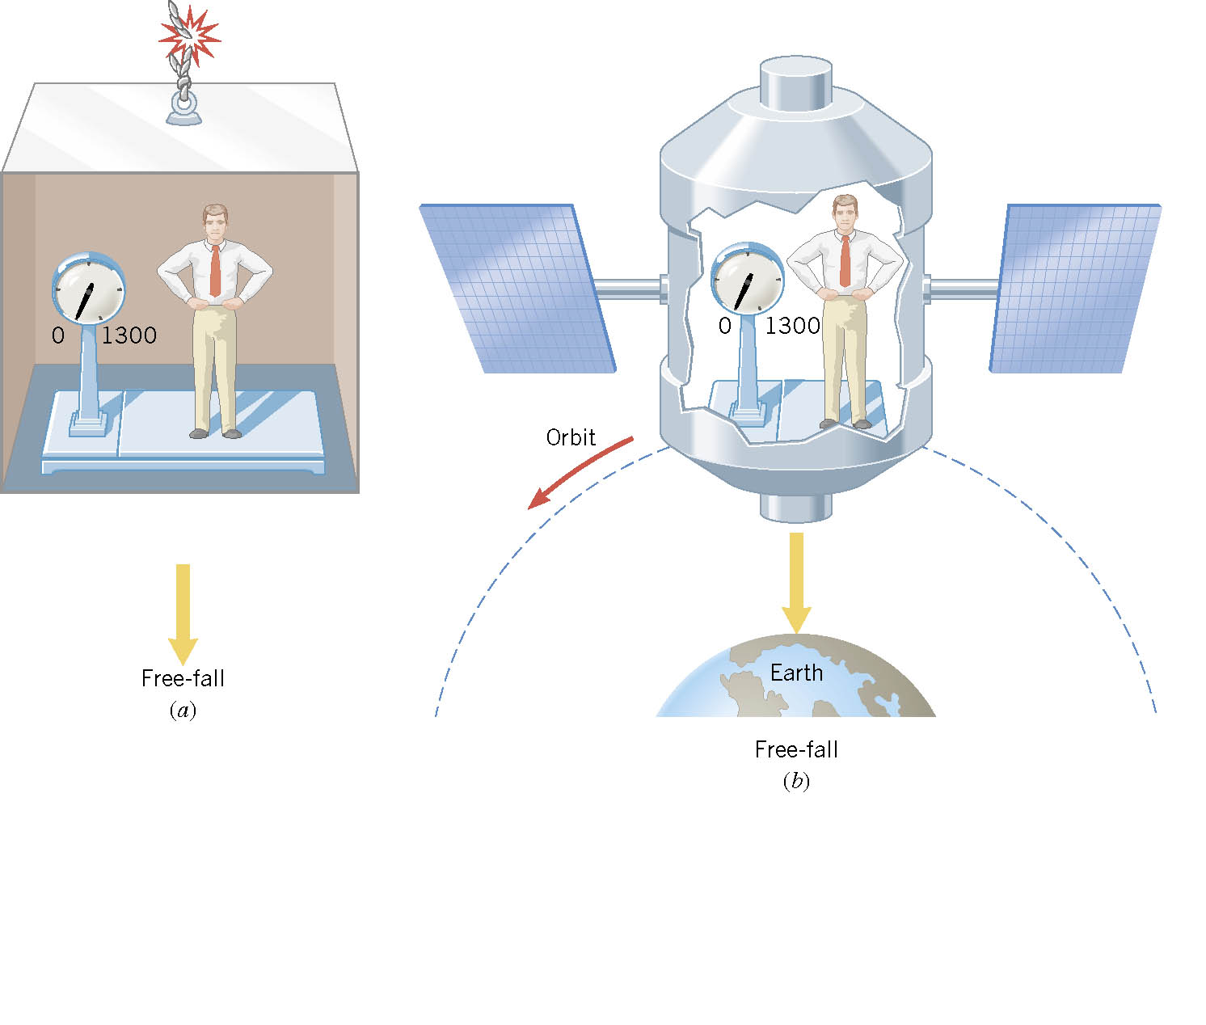
Ex. Apparent Weightlessness and Free Fall
0
0
In each case, what is the weight recorded by the scale?

Slide 16
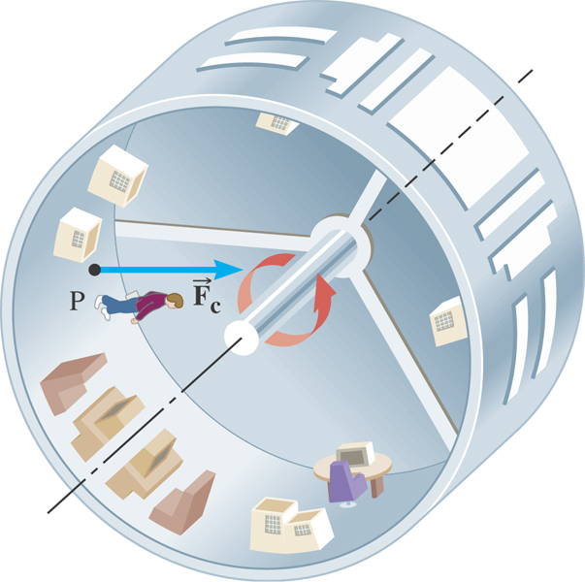
Ex. Artificial Gravity
At what speed must the surface of the space station move so that the astronaut experiences a push on his feet equal to his weight on earth? The radius is 1700 m.

Slide 17
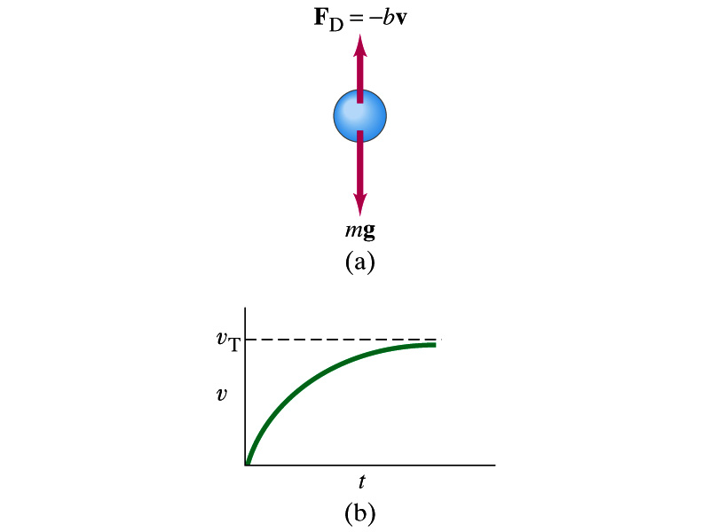
Motion in Resistive Forces
Medium can exert resistive forces on an object moving through it due to viscosity or other types frictional properties of the medium.
Some examples?
Air resistance, viscous force of liquid, etc
These forces are exerted on moving objects in opposite direction of the movement.
These forces are proportional to such factors as speed. They almost always increase with increasing speed.
Two different cases of proportionality:
Forces linearly proportional to speed: Slowly moving or very small objects
Forces proportional to square of speed: Large objects w/ reasonable speed

