Slide 1
PHYS 1441 – Section 002
Lecture #14
Wednesday, March 6, 2013
Dr. Jaehoon Yu
  Work done by a constant force
Scalar Product of the Vector
Work with friction
Work-Kinetic Energy Theorem
Potential Energy
Today’s homework is homework #8, due 11pm, Monday, Mar. 18!!

Slide 2
Announcements
Midterm comprehensive exam
  Wednesday, Mar. 20
  In SH103
  Covers CH1.1 through what we learn today (CH6.3?)
Spring break next week
  No class during the week!

Slide 3
Reminder: Special Project #4
Using the fact that g=9.80m/s² on the Earth’s surface, find the average density of the Earth.
  Use the following information only but without computing the volume explicitly
    The gravitational constant
    The radius of the Earth
20 point extra credit
Due: Monday, Mar. 25
You must show your OWN, detailed work to obtain any credit!!

Slide 4
Work Done by a Constant Force
A meaningful work in physics is done only when the net forces exerted on an object changes the energy of the object.
y
F
Free Body
Diagram
θ
M
M
θ
x
d
Which force did the work?
Force
Why?
What kind?
Scalar
Unit?
How much work did it do?
What does this mean?
Physically meaningful work is done only by the component of the force along the movement of the object.
Work is an energy transfer!!

Slide 5
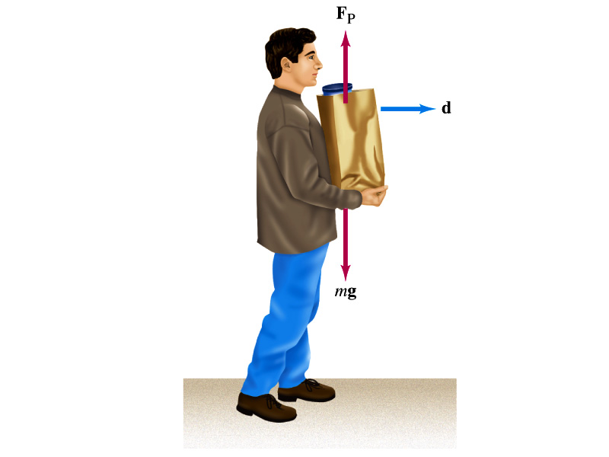
Let’s think about the meaning of work!
A person is holding a grocery bag and walking at a constant velocity.
Are his hands doing any work ON the bag?
  No
  Why not?
  Because the force hands exert on the bag, F_{p}, is perpendicular to the displacement!!
  This means that hands are not adding any energy to the bag.
So what does this mean?
  In order for a force to perform any meaningful work, the energy of the object the force exerts on must change due to that force!!
What happened to the person?
  He spends his energy just to keep the bag up but did not perform any work on the bag.

Slide 6
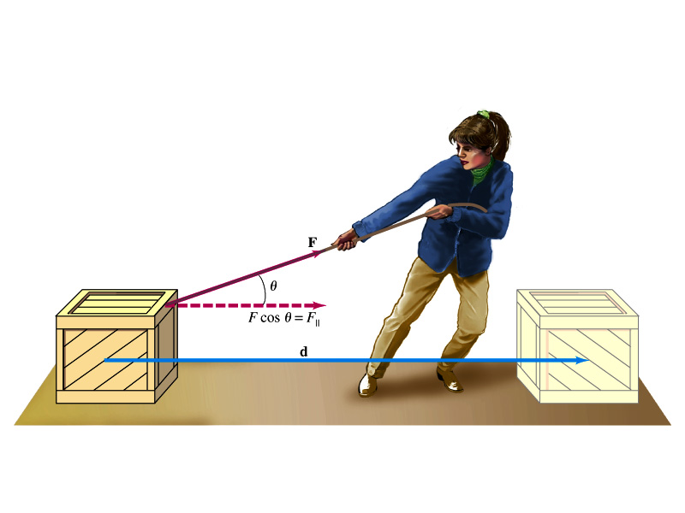
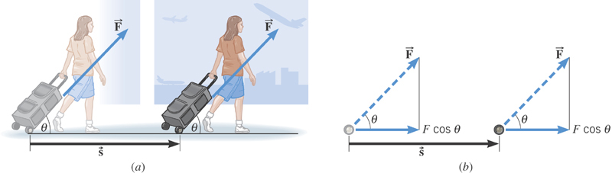
Work done by a constant force
s

Slide 7
Scalar Product of Two Vectors
Product of magnitude of the two vectors and the cosine of the angle between them
Operation is commutative
Operation follows the distribution law of multiplication
Scalar products of Unit Vectors
How does scalar product look in terms of components?
=0

Slide 8
Example of Work by Scalar Product
A particle moving on the xy plane undergoes a displacement d=(2.0i+3.0j)m as a constant force F=(5.0i+2.0j) N acts on the particle.
Y
a) Calculate the magnitude of the displacement and that of the force.
F
d
X
b) Calculate the work done by the force F.
Can you do this using the magnitudes and the angle between d and F?

Slide 9
Ex. Pulling A Suitcase-on-Wheel
Find the work done by a 45.0N force in pulling the suitcase in the figure at an angle 50.0º for a distance s=75.0m.
Does work depend on mass of the object being worked on?
Yes
Why don’t I see the mass term in the work at all then?
It is reflected in the force. If an object has smaller mass, it would take less force to move it at the same acceleration than a heavier object. So it would take less work. Which makes perfect sense, doesn’t it?

Slide 10
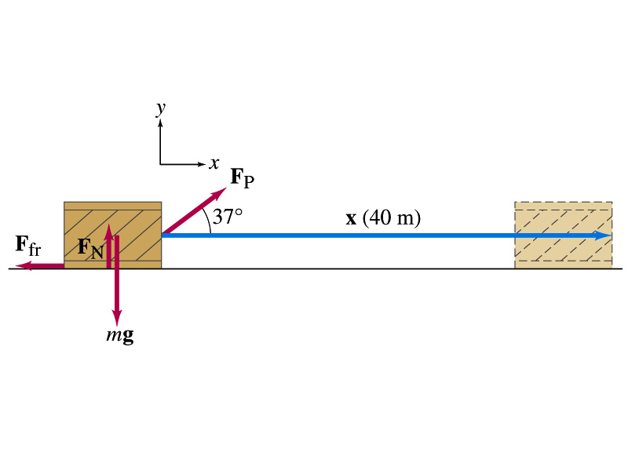
Ex. 6.1 Work done on a crate
A person pulls a 50kg crate 40m along a horizontal floor by a constant force F_{p}=100N, which acts at a 37º angle as shown in the figure. The floor is rough and exerts a friction force F_{fr}=50N. Determine (a) the work done by each force and (b) the net work done on the crate.
What are the forces exerting on the crate?
F_{p}
F_{fr}
F_{G}=-mg
F_{N}=+mg
Which force performs the work on the crate?
F_{p}
F_{fr}
Work done on the crate by F_{G}
Work done on the crate by F_{N}
Work done on the crate by F_{p}:
Work done on the crate by F_{fr}:
So the net work on the crate
This is the same as

Slide 11
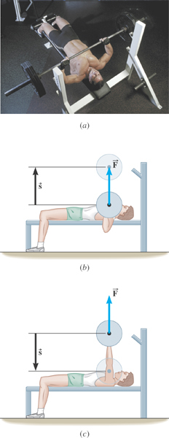
Ex. Bench Pressing and The Concept of Negative Work
A weight lifter is bench-pressing a barbell whose weight is 710N a distance of 0.65m above his chest. Then he lowers it the same distance. The weight is raised and lowered at a constant velocity. Determine the work in the two cases.
What is the angle between the force and the displacement?
What does the negative work mean?
The gravitational force does the work on the weight lifter!

Slide 12
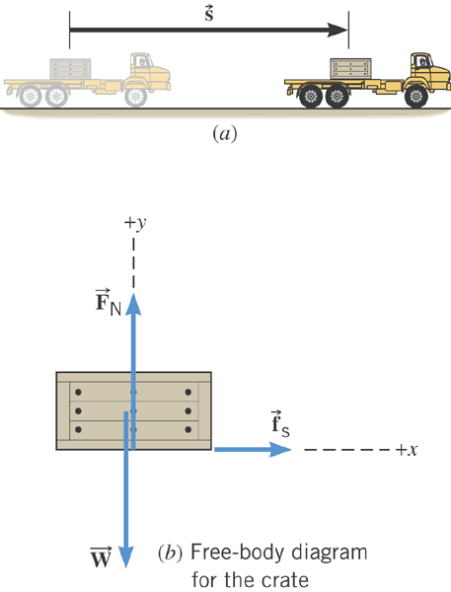
Ex. Accelerating a Crate
The truck is accelerating at a rate of +1.50 m/s². The mass of the crate is 120-kg and it does not slip. The magnitude of the displacement is 65 m. What is the total work done on the crate by all of the forces acting on it?
What are the forces acting in this motion?
Gravitational force on the crate, weight, W or F_{g}
Normal force force on the crate, F_{N}
Static frictional force on the crate, f_{s}

Slide 13
Ex. Continued…
Lets figure out what the work done by each of the forces in this motion is.
Work done by the gravitational force on the crate, W or F_{g}
Work done by Normal force force on the crate, F_{N}
Work done by the static frictional force on the crate, f_{s}
Which force did the work?
Static frictional force on the crate, f_{s}
How?
By holding on to the crate so that it moves with the truck!

Slide 14
Kinetic Energy and Work-Kinetic Energy Theorem
Some problems are hard to solve using Newton’s second law
  If forces exerting on an object during the motion are complicated
  Relate the work done on the object by the net force to the change of the speed of the object
ΣF
Suppose net force ΣF was exerted on an object for displacement d to increase its speed from v_{i} to v_{f}.
M
M
v_{i}
v_{f}
The work on the object by the net force ΣF is
s
Using the kinematic equation of motion
Kinetic Energy
Work
Work
Work done by the net force causes change in the object’s kinetic energy.
Work-Kinetic Energy Theorem

Slide 15
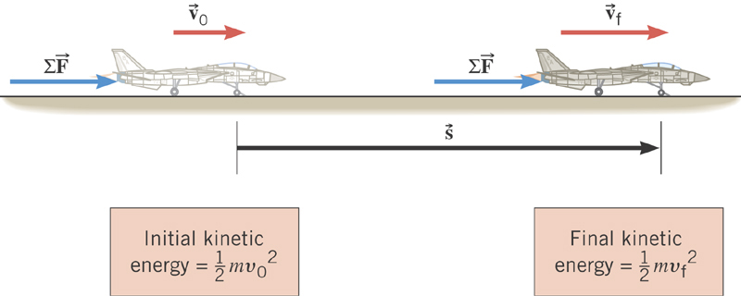
Work-Kinetic Energy Theorem
When a net external force by the jet engine does work on an object, the kinetic energy of the object changes according to

Slide 16
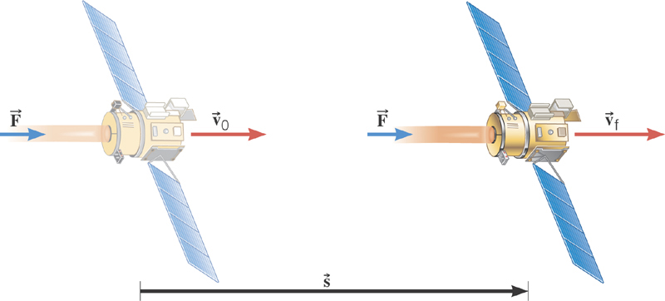
Ex. Deep Space 1
The mass of the space probe is 474-kg and its initial velocity is 275 m/s. If a 56.0-mN force acts on the probe parallel through a displacement of 2.42×10⁹m, what is its final speed?
Solve for v_{f}

Slide 17
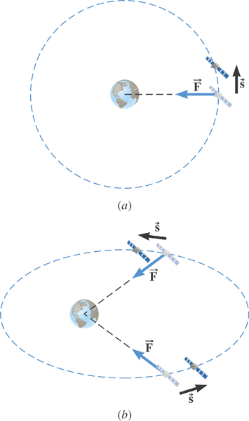
Ex. Satellite Motion and Work By the Gravity
A satellite is moving about the earth in a circular orbit and an elliptical orbit. For these two orbits, determine whether the kinetic energy of the satellite changes during the motion.
For a circular orbit
No change!
Why not?
Gravitational force is the only external force but it is perpendicular to the displacement. So no work.
For an elliptical orbit
Changes!
Why?
Gravitational force is the only external force but its angle with respect to the displacement varies. So it performs work.

