Slide 1
PHYS 1441 – Section 002
Lecture #15
Monday, March 18, 2013
Dr. Jaehoon Yu
  Work with friction
Potential Energy
Gravitational Potential Energy
Elastic Potential Energy
Mechanical Energy Conservation

Slide 2
Announcements
Midterm comprehensive exam
  This Wednesday, Mar. 20, in class in SH103
  Covers CH1.1 through CH6.3 plus Appendices A1 – A8
  Mixture of multiple choice and free response problems
  No scantron is necessary
  Bring your calculator but do NOT input formulae
  A formula sheet is going to be provided
  Bring a blank scrap sheet for working out problems
  Must transfer your work and answers to the exam!!
  GOOD LUCK!

Slide 3
Reminder: Special Project #4
Using the fact that g=9.80m/s² on the Earth’s surface, find the average density of the Earth.
  Use the following information only but without computing the volume explicitly
    The gravitational constant
    The radius of the Earth
20 point extra credit
Due: Monday, Mar. 25
You must show your OWN, detailed work to obtain any credit!!

Slide 4
Work and Energy Involving Kinetic Friction
What do you think the work looks like if there is friction?
  Static friction does not matter! Why?
  Then which friction matters?
It isn’t there when the object is moving.
Kinetic Friction
Friction force F_{fr} works on the object to slow down
F_{fr}
M
M
The work on the object by the friction F_{fr} is
v_{i}
v_{f}
d
The negative sign means that the work is done on the friction!!
The final kinetic energy of an object, including its initial kinetic energy, work by the friction force and all other sources of work, is
t=0, KE_{i}
Friction,
Engine work
t=T, KE_{f}

Slide 5
Example of Work Under Friction
A 6.0kg block initially at rest is pulled to East along a horizontal surface with coefficient of kinetic friction μ_{k}=0.15 by a constant horizontal force of 12N. Find the speed of the block after it has moved 3.0m.
M
F
M
Work done by the force F is
F_{k}
v_{i}=0
v_{f}
d=3.0m
Work done by friction F_{k} is
Thus the total work is
Using work-kinetic energy theorem and the fact that initial speed is 0, we obtain
Solving the equation
for v_{f}, we obtain

Slide 6
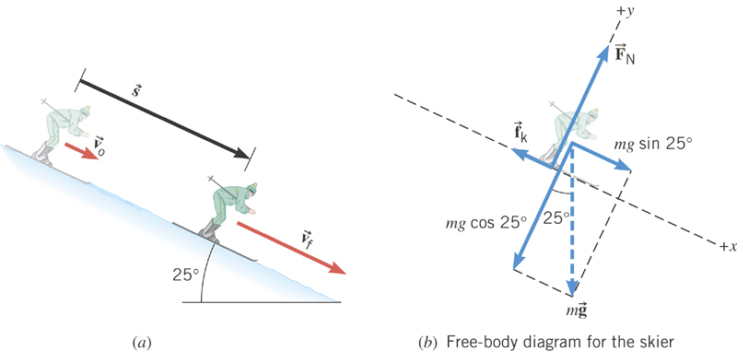
Ex. Downhill Skiing
A 58kg skier is coasting down a 25º slope. A kinetic frictional force of magnitude f_{k}=70N opposes her motion. At the top of the slope, the skier’s speed is v₀=3.6m/s. Ignoring air resistance, determine the speed v_{f} at the point that is displaced 57m downhill.
y
x
What are the forces in this motion?
Gravitational force: F_{g}
Normal force: F_{N}
Kinetic frictional force: f_{k}
What are the X and Y component of the net force in this motion?
Y component
From this we obtain
What is the coefficient of kinetic friction?

Slide 7
Ex. Now with the X component
X component
Total work by this force
From work-kinetic energy theorem
Solving for v_{f}
What is her acceleration?

Slide 8
Potential Energy
Energy associated with a system of objects ➔ Stored energy which has the potential or the possibility to work or to convert to kinetic energy
In order to describe potential energy, U, a system must be defined.
What does this mean?
The concept of potential energy can only be used under the special class of forces called the conservative force which results in the principle of conservation of mechanical energy.
What are other forms of energies in the universe?
Mechanical Energy
Chemical Energy
Biological Energy
Electromagnetic Energy
Nuclear Energy
Thermal Energy
These different types of energies are stored in the universe in many different forms!!!
If one takes into account ALL forms of energy, the total energy in the entire universe is conserved. It just transforms from one form to another.

Slide 9
Gravitational Potential Energy
This potential energy is given to an object by the gravitational field in the system of Earth by virtue of the object’s height from an arbitrary zero level
When an object is falling, the gravitational force, Mg, performs the work on the object, increasing the object’s kinetic energy. So the potential energy of an object at a height y, the potential to do work, is expressed as
m
h_{i}
mg
m
The work done on the object by the gravitational force as the brick drops from y_{i} to y_{f} is:
h_{f}
(since )
What does this mean?
Work by the gravitational force as the brick drops from y_{i} to y_{f} is the negative change of the system’s potential energy
➔ Potential energy was spent in order for the gravitational force to increase the brick’s kinetic energy.

Slide 10
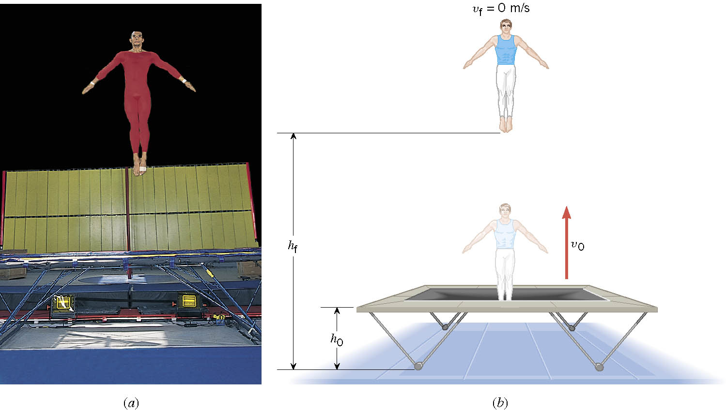
Ex. A Gymnast on a Trampoline
A gymnast leaves the trampoline at an initial height of 1.20 m and reaches a maximum height of 4.80 m before falling back down. What was the initial speed of the gymnast?

Slide 11
Ex. Continued
From the work-kinetic energy theorem
Work done by the gravitational force
Since at the maximum height, the final speed is 0. Using work-KE theorem, we obtain

Slide 12
Example for Potential Energy
A bowler drops bowling ball of mass 7kg on his toe. Choosing the floor level as y=0, estimate the total work done on the ball by the gravitational force as the ball falls on the toe.
Let’s assume the top of the toe is 0.03m from the floor and the hand was 0.5m above the floor.
M
b) Perform the same calculation using the top of the bowler’s head as the origin.
What has to change?
First we must re-compute the positions of the ball in his hand and on his toe.
Assuming the bowler’s height is 1.8m, the ball’s original position is –1.3m, and the toe is at –1.77m.

