Slide 1
PHYS 1441 – Section 002 Lecture #17
Monday, April 1, 2013
Dr. Jaehoon Yu
Linear Momentum
Linear Momentum and Impulse
Linear Momentum and Forces
Linear Momentum Conservation
Linear Momentum Conservation in a Two -body System
Today’s homework is homework #9, due 11pm, Tuesday, Apr. 9!!

Slide 2
Announcements
Midterm Exam Results
Class Average: 52.2/98
Equivalent to 53.3/100
Previous exam: 58.2/100
Top score: 75/98
Grading policy
Homework 25%, Final comp. exam 23%, Mid-term comp. 20%, better of the two term exams 12%, lab 10% and quizzes 10%
Plus up to 10% extra credit
Quiz #4
When: Beginning of class Monday, Apr. 8
Coverage: CH6.5 to what we cover this Wednesday

Slide 3
Reminder: Special Project #5
A ball of mass M at rest is dropped from the height h above the ground onto a spring on the ground, whose spring constant is k. Neglecting air resistance and assuming that the spring is in its equilibrium, express, in terms of the quantities given in this problem and the gravitational acceleration g, the distance x of which the spring is pressed down when the ball completely loses its energy. (10 points)
Find the x above if the ball’s initial speed is v_{i}. (10 points)
Due for the project is this Wednesday, Apr. 3
You must show the detail of your OWN work in order to obtain any credit.

Slide 4
Linear Momentum
The principle of energy conservation can be used to solve problems that are harder to solve just using Newton’s laws. It is used to describe motion of an object or a system of objects.
A new concept of linear momentum can also be used to solve physical problems, especially the problems involving collisions of objects.
Linear momentum of an object whose mass is m and is moving at the velocity of v is defined as
What can you tell from this definition about momentum?
Momentum is a vector quantity.
The heavier the object the higher the momentum
The higher the velocity the higher the momentum
Its unit is kg.m/s
What else can use see from the definition? Do you see force?
The change of momentum in a given time interval

Slide 5
Impulse and Linear Momentum
Net force causes change of momentum ➔ Newton’s second law
The quantity impulse is defined as the change of momentum
Effect of the force F acting on an object over the time interval Δt=t_{f}-t_{i} is equal to the change of the momentum of the object caused by that force. Impulse is the degree of which an external force changes an object’s momentum.
So what do you think an impulse is?
The above statement is called the impulse-momentum theorem and is equivalent to Newton’s second law.
What are the dimension and unit of Impulse? What is the direction of an impulse vector?
Defining a time-averaged force
Impulse can be rewritten
If force is constant
Impulse is a vector quantity!!

Slide 6
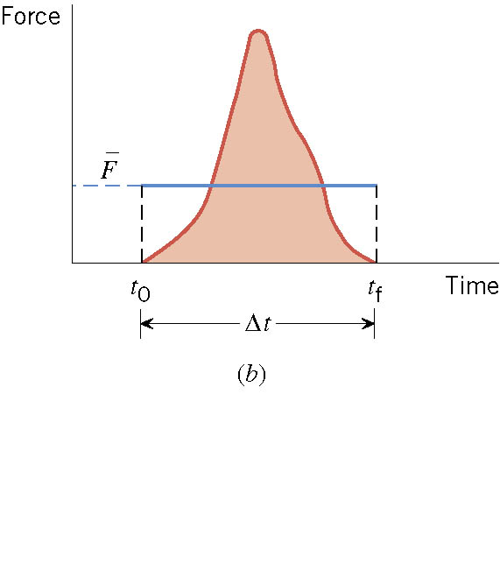
Impulse
There are many situations when the force on an object is not constant.

Slide 7
Ball Hit by a Bat
Multiply either side by Δt

Slide 8
Ex. A Well-Hit Ball
A baseball (m=0.14kg) has an initial velocity of v₀=-38m/s as it approaches a bat. We have chosen the direction of approach as the negative direction. The bat applies an average force F that is much larger than the weight of the ball, and the ball departs from the bat with a final velocity of v_{f}=+58m/s. (a) determine the impulse applied to the ball by the bat. (b) Assuming that the time of contact is Δt=1.6x10⁻³s, find the average force exerted on the ball by the bat.
What are the forces involved in this motion?
The force by the bat and the force by the gravity.
Since the force by the bat is much greater than the weight, we ignore the ball’s weight.
(a) Using the impulse-momentum theorem
(b)Since the impulse is known and the time during which the contact occurs are know, we can compute the average force exerted on the ball during the contact
How large is this force?

Slide 9
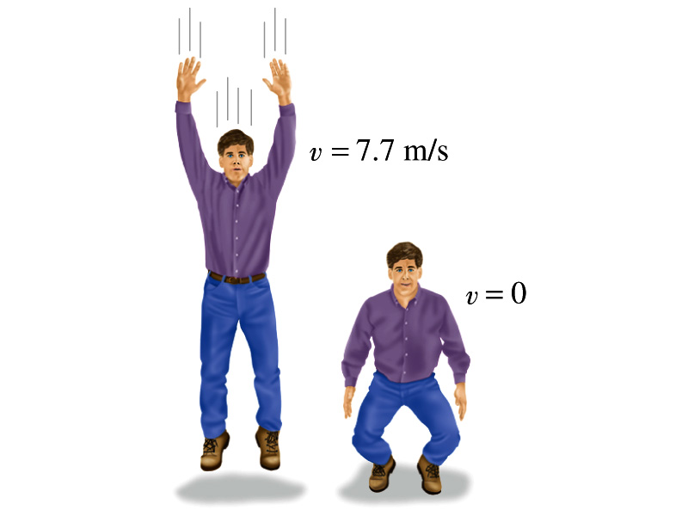
Example 7.6 for Impulse
(a) Calculate the impulse experienced when a 70 kg person lands on firm ground after jumping from a height of 3.0 m. Then estimate the average force exerted on the person’s feet by the ground, if the landing is (b) stiff-legged and (c) with bent legs. In the former case, assume the body moves 1.0cm during the impact, and in the second case, when the legs are bent, about 50 cm.
We don’t know the force. How do we do this?
Obtain velocity of the person before striking the ground.
Solving the above for velocity v, we obtain
Then as the person strikes the ground, the momentum becomes 0 quickly giving the impulse

Slide 10
Example 7.6 cont’d
In coming to rest, the body decelerates from 7.7m/s to 0m/s in a distance d=1.0cm=0.01m.
The average speed during this period is
The time period the collision lasts is
Since the magnitude of impulse is
The average force on the feet during this landing is
How large is this average force?
If landed in stiff legged, the feet must sustain 300 times the body weight. The person will likely break his leg.
For bent legged landing:

Slide 11
Linear Momentum and Forces
What can we learn from this force-momentum relationship?
The rate of the change of particle’s momentum is the same as the net force exerted on it.
When the net force is 0, the particle’s linear momentum is a constant as a function of time.
If a particle is isolated, the particle experiences no net force. Therefore its momentum does not change and is conserved.
Something else we can do with this relationship. What do you think it is?
The relationship can be used to study the case where the mass changes as a function of time.
Can you think of a few cases like this?
Motion of a meteorite
Motion of a rocket

Slide 12
Conservation of Linear Momentum in a Two Particle System
Consider an isolated system of two particles that do not have any external forces exerting on it. What is the impact of Newton’s 3rd Law?
If particle#1 exerts force on particle #2, there must be a reaction force that the particle #2 exerts on #1. Both the forces are internal forces, and the net force in the entire SYSTEM is still 0.
Now how would the momenta of these particles look like?
Let say that the particle #1 has momentum p₁ and #2 has p₂ at some point of time.
Using momentum-force relationship
and
And since net force of this system is 0
Therefore
The total linear momentum of the system is conserved!!!

Slide 13
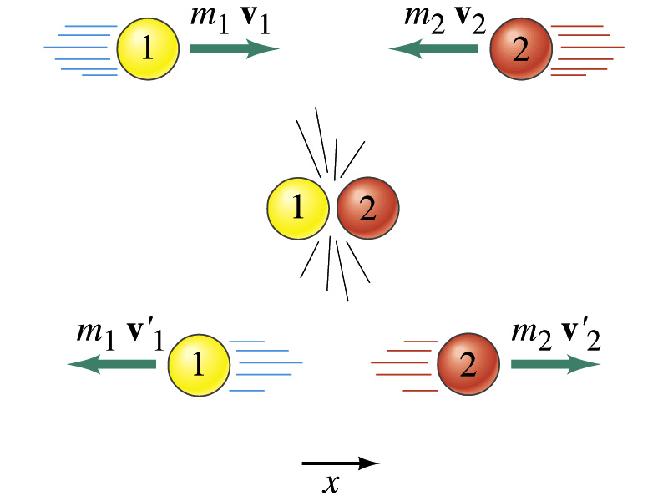
Linear Momentum Conservation
Initial
Final

Slide 14
More on Conservation of Linear Momentum in a Two Body System
From the previous slide we’ve learned that the total momentum of the system is conserved if no external forces are exerted on the system.
What does this mean?
As in the case of energy conservation, this means that the total vector sum of all momenta in the system is the same before and after any interactions
Mathematically this statement can be written as
This can be generalized into conservation of linear momentum in many particle systems.
Whenever two or more particles in an isolated system interact, the total momentum of the system remains constant.

Slide 15
How do we apply momentum conservation?
Define your system by deciding which objects would be included in it.
Identify the internal and external forces with respect to the system.
Verify that the system is isolated.
Set the final momentum of the system equal to its initial momentum. Remember that momentum is a vector.

Slide 16
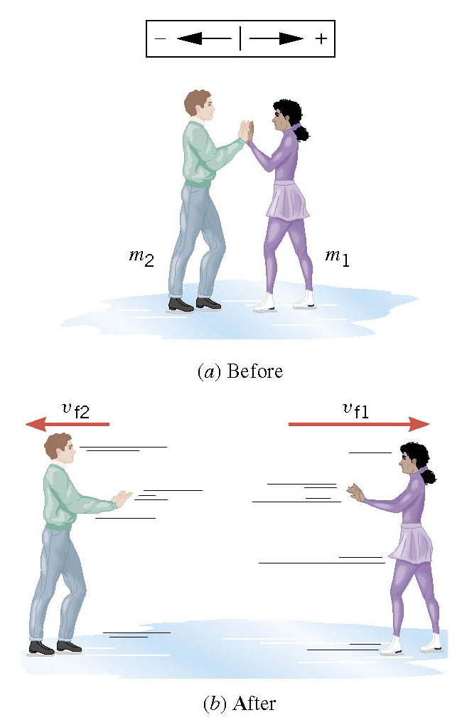
Ex. Ice Skaters
Starting from rest, two skaters push off against each other on ice where friction is negligible. One is a 54-kg woman and one is a 88-kg man. The woman moves away with a speed of +2.5 m/s. Find the recoil velocity of the man.
No net external force ➔ momentum conserved
Solve for V_{f2}

