Slide 1
PHYS 1441 – Section 002 Lecture #18
Wednesday, April 3, 2013
Dr. Jaehoon Yu
Collisions
Elastic Collisions
Perfectly Inelastic Collisions
Concept of the Center of Mass
Fundamentals of the Rotational Motion
Rotational Kinematics

Slide 2
Announcements
Quiz #4
When: Beginning of class Monday, Apr. 8
Coverage: CH6.3 to what we cover this Wednesday
Second non-comp term exam
Date and time: 4:00pm, Wednesday, April 17 in class
Coverage: CH6.3 through what we finish Monday, April 15
Special colloquium for 15 point extra credit
Wednesday, April 24, University Hall RM116
Class will be substituted by this colloquium
Dr. Ketevi Assamagan from Brookhaven National Laboratory on Higgs Discovery in ATLAS
Please mark your calendars!!

Slide 3
Collisions
Generalized collisions must cover not only the physical contact but also the collisions without physical contact such as that of electromagnetic ones in a microscopic scale.
The collisions of these ions never involve physical contact because the electromagnetic repulsive force between these two become great as they get closer causing a collision.
Consider a case of a collision between a proton on a helium ion.
F
F₁₂
Assuming no external forces, the force exerted on particle 1 by particle 2, F₂₁, changes the momentum of particle 1 by
t
F₂₁
Likewise for particle 2 by particle 1
Using Newton’s 3rd law we obtain
So the momentum change of the system in the collision is 0, and the momentum is conserved

Slide 4
Elastic and Inelastic Collisions
Momentum is conserved in any collisions as long as external forces are negligible.
Collisions are classified as elastic or inelastic based on whether the kinetic energy is conserved, meaning whether the KE is the same before and after the collision.
Elastic Collision
A collision in which the total kinetic energy and momentum are the same before and after the collision.
Inelastic Collision
A collision in which the total kinetic energy is not the same before and after the collision, but momentum is.
Two types of inelastic collisions: Perfectly inelastic and inelastic
Perfectly Inelastic: Two objects stick together after the collision, moving together at a certain velocity.
Inelastic: Colliding objects do not stick together after the collision but some kinetic energy is lost.
Note: Momentum is constant in all collisions but kinetic energy is only in elastic collisions.

Slide 5
Elastic and Perfectly Inelastic Collisions
In perfectly inelastic collisions, the objects stick together after the collision, moving together. Momentum is conserved in this collision, so the final velocity of the stuck system is
How about the elastic collision?
In elastic collisions, both the momentum and the kinetic energy are conserved. Therefore, the final speeds in an elastic collision can be obtained in terms of initial speeds as
From momentum
conservation above
What happens when the two masses are the same?

Slide 6
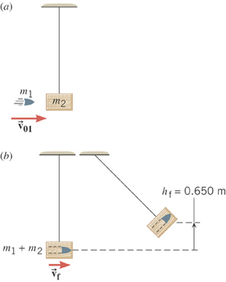
Ex. A Ballistic Pendulum
The mass of the block of wood is 2.50-kg and the mass of the bullet is 0.0100-kg. The block swings to a maximum height of 0.650 m above the initial position. Find the initial speed of the bullet.
What kind of collision?
Perfectly inelastic collision
No net external force ➔ momentum conserved
Solve for V₀₁
What do we not know?
The final speed!!
How can we get it?
Using the mechanical energy conservation!

Slide 7
Ex. A Ballistic Pendulum, cnt’d
Now using the mechanical energy conservation
Solve for V_{f}
Using the solution obtained previously, we obtain

Slide 8
Two dimensional Collisions
In two dimension, one needs to use components of momentum and apply momentum conservation to solve physical problems.
v_{1i}
m₁
x-comp.
m₂
y-comp.
v_{1f}
m₁
θ
Consider a system of two particle collisions and scatters in two dimension as shown in the picture. (This is the case at fixed target accelerator experiments.) The momentum conservation tells us:
φ
m₂
v_{2f}
And for the elastic collisions, the kinetic energy is conserved:
What do you think we can learn from these relationships?

Slide 9
Example for Two Dimensional Collisions
Proton #1 with a speed 3.50x10⁵ m/s collides elastically with proton #2 initially at rest. After the collision, proton #1 moves at an angle of 37º to the horizontal axis and proton #2 deflects at an angle φ to the same axis. Find the final speeds of the two protons and the scattering angle of proton #2, φ.
v_{1i}
Since both the particles are protons m₁=m₂=m_{p}.
m₁
m₂
Using momentum conservation, one obtains
v_{1f}
x-comp.
m₁
θ
y-comp.
φ
Canceling m_{p} and putting in all known quantities, one obtains
m₂
v_{2f}
From kinetic energy conservation:
Solving Eqs. 1-3 equations, one gets
Do this at home☺

Slide 10
Center of Mass
We’ve been solving physical problems treating objects as sizeless points with masses, but in realistic situations objects have shapes with masses distributed throughout the body.
Center of mass of a system is the average position of the system’s mass and represents the motion of the system as if all the mass is on that point.
What does above statement tell you concerning the forces being exerted on the system?
The total external force exerted on the system of total mass M causes the center of mass to move at an acceleration given by as if the entire mass of the system is on the center of mass.
Consider a massless rod with two balls attached at either end.
m₁
m₂
x₁
x₂
The position of the center of mass of this system is the mass averaged position of the system
x_{CM}
CM is closer to the heavier object

Slide 11
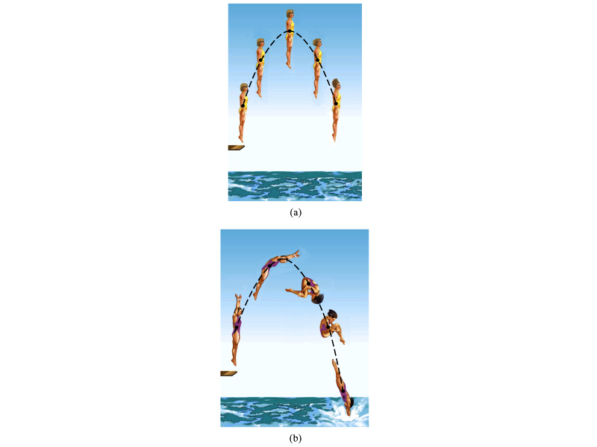
Motion of a Diver and the Center of Mass
Diver performs a simple dive.
The motion of the center of mass follows a parabola since it is a projectile motion.
Diver performs a complicated dive.
The motion of the center of mass still follows the same parabola since it still is a projectile motion.
The motion of the center of mass of the diver is always the same.

Slide 12
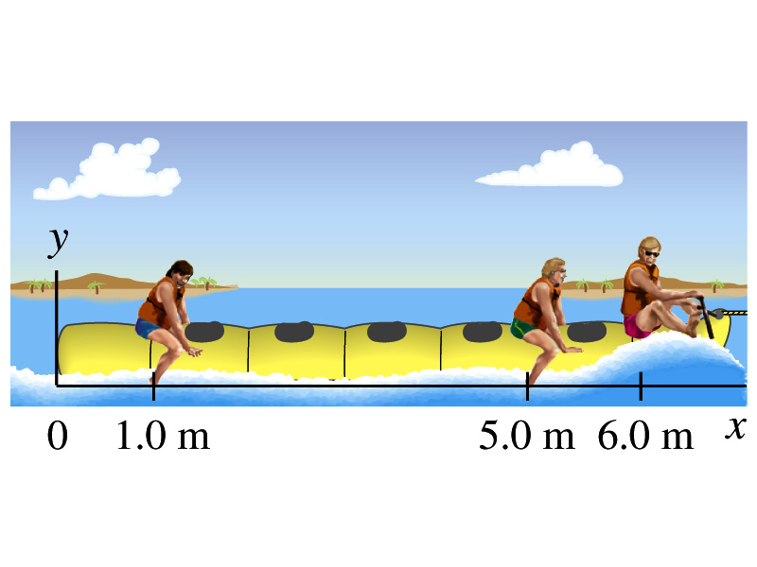
Ex. 7 – 12 Center of Mass
Thee people of roughly equivalent mass M on a lightweight (air-filled) banana boat sit along the x axis at positions x₁=1.0m, x₂=5.0m, and x₃=6.0m. Find the position of CM.
Using the formula for CM

Slide 13
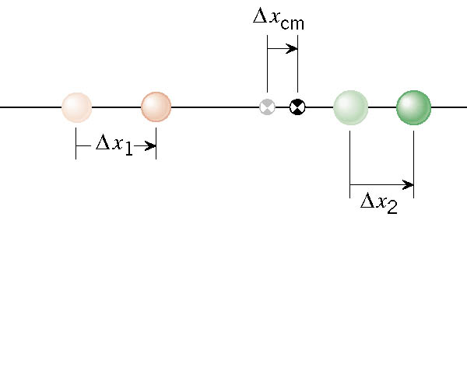
Velocity of the Center of Mass
In an isolated system, the total linear momentum does not change, therefore the velocity of the center of mass does not change.

Slide 14
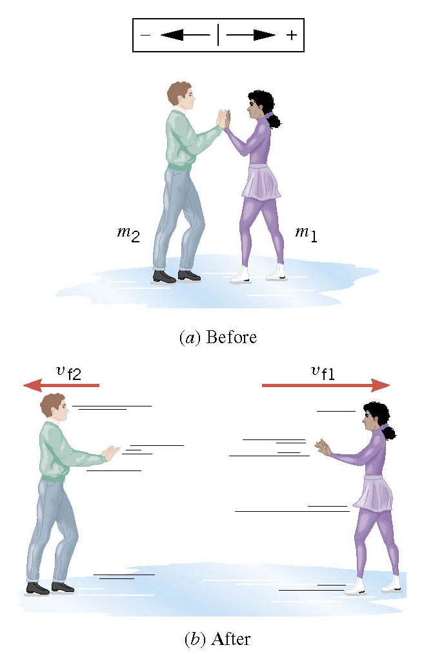
Another Look at the Ice Skater Problem
Starting from rest, two skaters push off against each other on ice where friction is negligible. One is a 54-kg woman and one is a 88-kg man. The woman moves away with a speed of +2.5 m/s.

