Slide 1
PHYS 1441 – Section 002 Lecture #19
Monday, April 8, 2013
Dr. Jaehoon Yu
Fundamentals of the Rotational Motion
Rotational Kinematics
Equations of Rotational Kinematics
Relationship Between Angular and Linear Quantities
Rolling Motion of a Rigid Body
Today’s homework is homework #10, due 11pm, Monday, Apr. 15!!

Slide 2
Announcements
Second non-comp term exam
Date and time: 4:00pm, Wednesday, April 17 in class
Coverage: CH6.1 through what we finish Monday, April 15
This exam could replace the first term exam if better
Special colloquium for 15 point extra credit
Wednesday, April 24, University Hall RM116
Class will be substituted by this colloquium
Dr. Ketevi Assamagan from Brookhaven National Laboratory on Higgs Discovery in ATLAS
Please mark your calendars!!

Slide 3
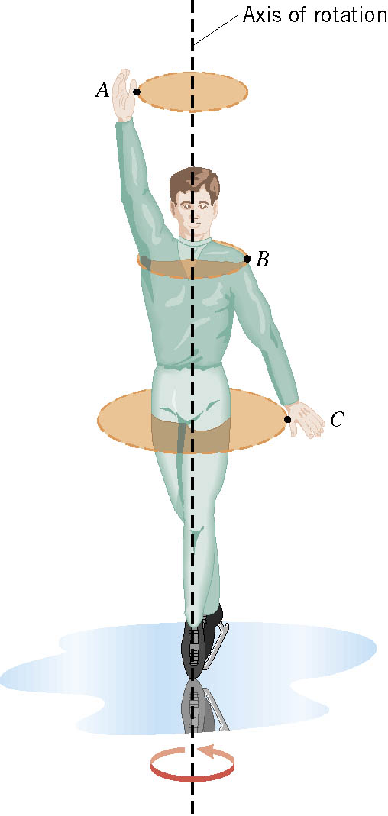
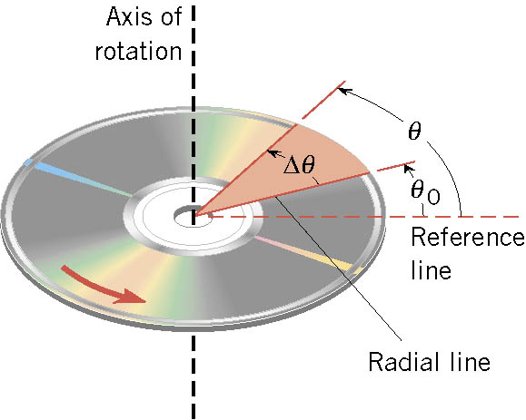
Rotational Motion and Angular Displacement
In the simplest kind of rotation, points on a rigid object move on circular paths around an axis of rotation.
The angle swept out by the line passing through any point on the body and intersecting the axis of rotation perpendicularly is called the angular displacement.
It’s a vector!! So there must be a direction…
How do we define directions?
+:if counter-clockwise
-:if clockwise
The direction vector points gets determined based on the right-hand rule.
These are just conventions!!

Slide 4
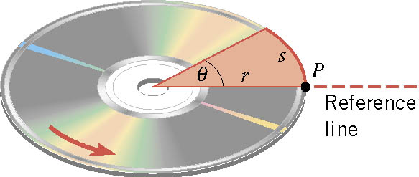
SI Unit of the Angular Displacement
Dimension?
None
For one full revolution:
Since the circumference of a circle is
2πr
One radian is an angle subtended by an arc of the same length as the radius!

Slide 5
Unit of the Angular Displacement
How many degrees are in one radian?
1 radian is
How radians is one degree?
And one degrees is
How many radians are in 10.5 revolutions?
Very important: In solving angular problems, all units, degrees or revolutions, must be converted to radians.

Slide 6
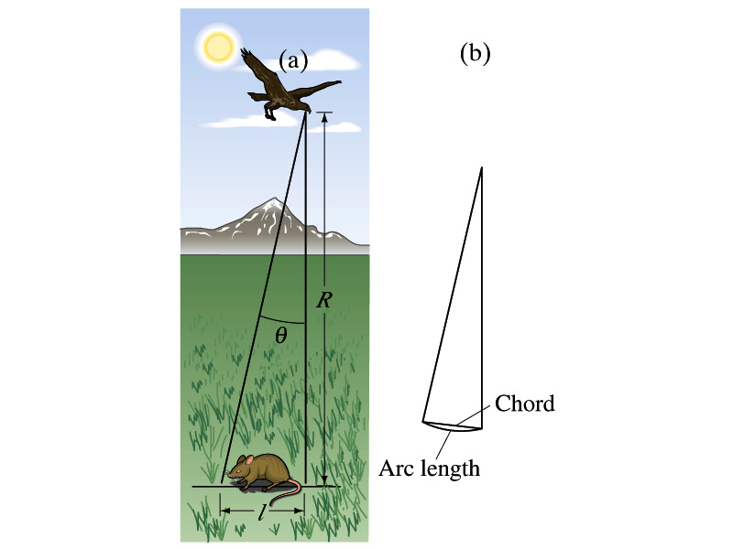
Example 8-2
A particular bird’s eyes can just distinguish objects that subtend an angle no smaller than about 3x10-4 rad. (a) How many degrees is this? (b) How small an object can the bird just distinguish when flying at a height of 100m?
(a) One radian is 360º/2π. Thus
(b) Since l=rθ and for small angle arc length is approximately the same as the chord length.

Slide 7
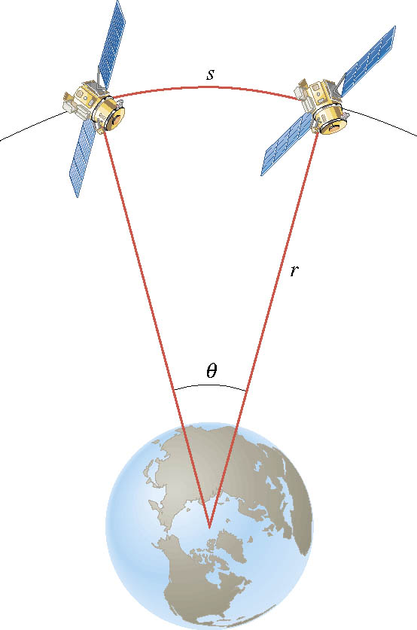
Ex. Adjacent Synchronous Satellites
Synchronous satellites are put into an orbit whose radius is 4.23×10⁷m. If the angular separation of the two satellites is 2.00 degrees, find the arc length that separates them.
What do we need to find out?
The Arc length!!!
Convert degrees to radians

Slide 8
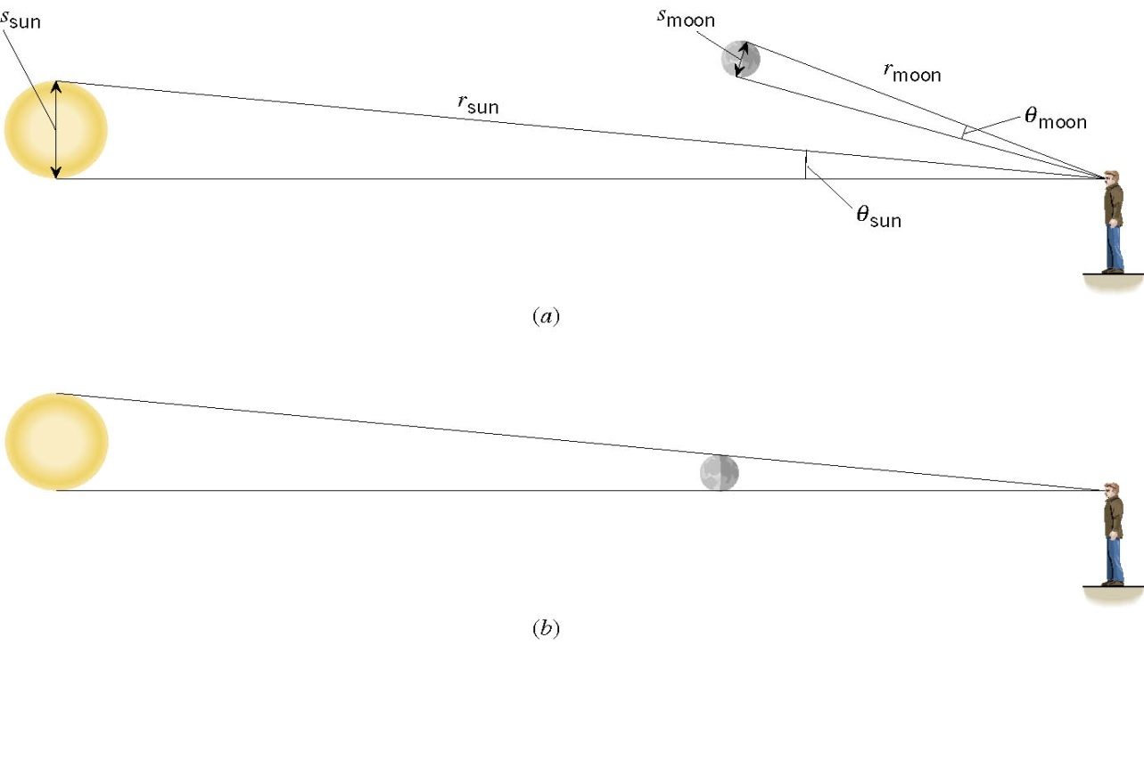
Ex. A Total Eclipse of the Sun
The diameter of the sun is about 400 times greater than that of the moon. By coincidence, the sun is also about 400 times farther from the earth than is the moon. For an observer on the earth, compare the angle subtended by the moon to the angle subtended by the sun and explain why this result leads to a total solar eclipse.
I can even cover the entire sun with my thumb!! Why?
Because the distance (r) from my eyes to my thumb is far shorter than that to the sun.

Slide 9
Angular Displacement, Velocity, and Acceleration
Angular displacement is defined as
θ_{f}
θ_{i}
How about the average angular velocity, the rate of change of angular displacement?
Unit?
rad/s
Dimension?
[T⁻¹]
By the same token, the average angular acceleration, rate of change of the angular velocity, is defined as…
Unit?
rad/s²
Dimension?
[T⁻²]
When rotating about a fixed axis, every particle on a rigid object rotates through the same angle and has the same angular speed and angular acceleration.

Slide 10
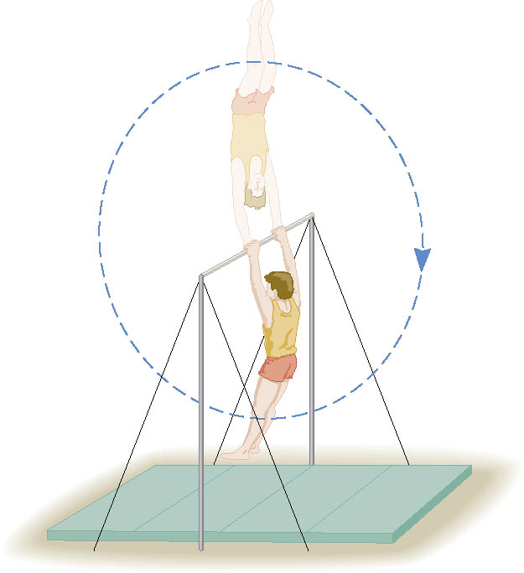
Ex. Gymnast on a High Bar
A gymnast on a high bar swings through two revolutions in a time of 1.90 s. Find the average angular velocity of the gymnast.
What is the angular displacement?
Why negative?
Because he is rotating clockwise!!

Slide 11
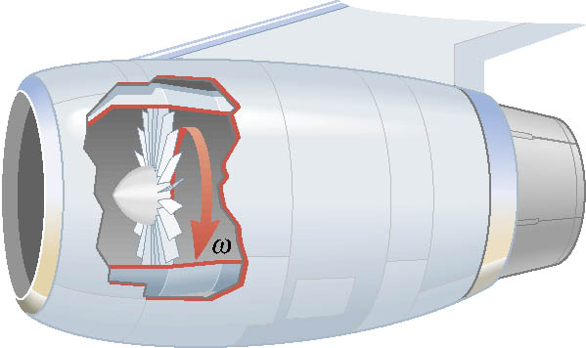
Ex. A Jet Revving Its Engines
As seen from the front of the engine, the fan blades are rotating with an angular speed of -110 rad/s. As the
plane takes off, the angular velocity of the blades reaches -330 rad/s in a time of 14 s. Find the angular acceleration, assuming it to be constant.

Slide 12
Rotational Kinematics
The first type of motion we have learned in linear kinematics was under a constant acceleration. We will learn about the rotational motion under constant angular acceleration (α), because these are the simplest motions in both cases.
Just like the case in linear motion, one can obtain
Angular velocity under constant angular acceleration:
Linear kinematics
Angular displacement under constant angular acceleration:
Linear kinematics
One can also obtain
Linear kinematics

Slide 13
Problem Solving Strategy
Visualize the problem by drawing a picture.
Write down the values that are given for any of the five kinematic variables and convert them to SI units.
Remember that the unit of the angle must be in radians!!
Verify that the information contains values for at least three of the five kinematic variables. Select the appropriate equation.
When the motion is divided into segments, remember that the final angular velocity of one segment is the initial velocity for the next.
Keep in mind that there may be two possible answers to a kinematics problem.

