Slide 1
PHYS 1441 – Section 002 Lecture #20
Wednesday, April 10, 2013
Dr. Jaehoon Yu
Equations of Rotational Kinematics
Relationship Between Angular and Linear Quantities
Rolling Motion of a Rigid Body
Torque
Moment of Inertia

Slide 2
Announcements
Second non-comp term exam
Date and time: 4:00pm, Wednesday, April 17 in class
Coverage: CH6.1 through what we finish Monday, April 15
This exam could replace the first term exam if better
Remember that the lab final exams are next week!!
Special colloquium for 15 point extra credit!!
Wednesday, April 24, University Hall RM116
Class will be substituted by this colloquium
Dr. Ketevi Assamagan from Brookhaven National Laboratory on Higgs Discovery in ATLAS
Please mark your calendars!!

Slide 3
Rotational Kinematics
The first type of motion we have learned in linear kinematics was under a constant acceleration. We will learn about the rotational motion under constant angular acceleration (α), because these are the simplest motions in both cases.
Just like the case in linear motion, one can obtain
Angular velocity under constant angular acceleration:
Linear kinematics
Angular displacement under constant angular acceleration:
Linear kinematics
One can also obtain
Linear kinematics

Slide 4
Rotational Kinematics Problem Solving Strategy
Visualize the problem by drawing a picture.
Write down the values that are given for any of the five kinematic variables and convert them to SI units.
Remember that the unit of the angle must be in radians!!
Verify that the information contains values for at least three of the five kinematic variables. Select the appropriate equation.
When the motion is divided into segments, remember that the final angular velocity of one segment is the initial velocity for the next.
Keep in mind that there may be two possible answers to a kinematics problem.

Slide 5
Example for Rotational Kinematics
A wheel rotates with a constant angular acceleration of 3.50 rad/s². If the angular speed of the wheel is 2.00 rad/s at t_{i}=0, a) through what angle does the wheel rotate in 2.00s?
Using the angular displacement formula in the previous slide, one gets

Slide 6
Example for Rotational Kinematics cnt’d
What is the angular speed at t=2.00s?
Using the angular speed and acceleration relationship
Find the angle through which the wheel rotates between t=2.00 s and t=3.00 s.
Using the angular kinematic formula
At t=2.00s
At t=3.00s
Angular displacement

Slide 7
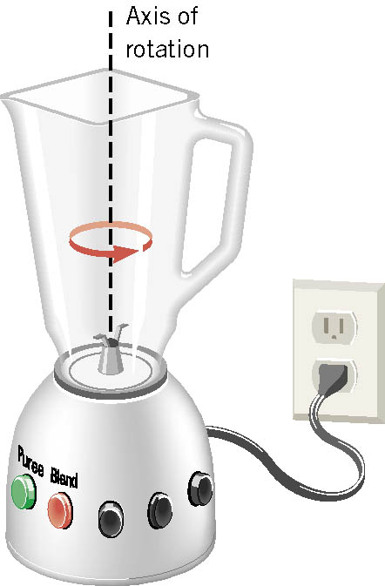
Ex. Blending with a Blender
The blade is whirling with an angular velocity of +375 rad/s when the “puree” button is pushed in. When the “blend” button is pushed, the blade accelerates and reaches a greater angular velocity after the blade has rotated through an angular displacement of +44.0 rad. The angular acceleration has a constant value of +1740 rad/s². Find the final angular velocity of the blade.
θ | α | ω | ω_{o} | t
+44.0rad
+1740rad/s²
?
+375rad/s
Which kinematic eq?
Which sign?
Why?
Because the blade is accelerating in counter-clockwise!

Slide 8
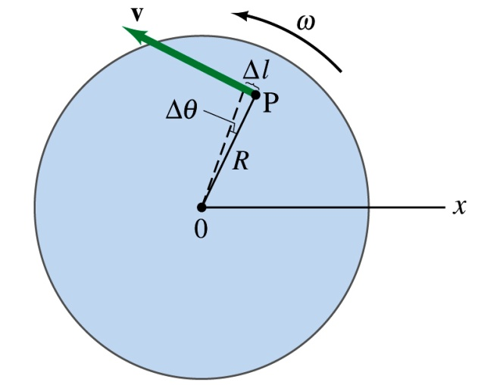
Relationship Between Angular and Linear Quantities
What do we know about a rigid object that rotates about a fixed axis of rotation?
Every particle (or masslet) in an object moves in a circle centered at the same axis of rotation with the same angular velocity.
When a point rotates, it has both the linear and angular components in its motion.
What is the linear component of the motion you see?
The direction of ω follows the right-hand rule.
Linear velocity along the tangential direction.
How do we related this linear component of the motion with angular component?
The arc-length is
So the tangential speed v is
What does this relationship tell you about the tangential speed of the points in the object and their angular speed?
Although every particle in the object has the same angular speed, its tangential speed differs and is proportional to its distance from the axis of rotation.
The farther away the particle is from the center of rotation, the higher the tangential speed.

Slide 9
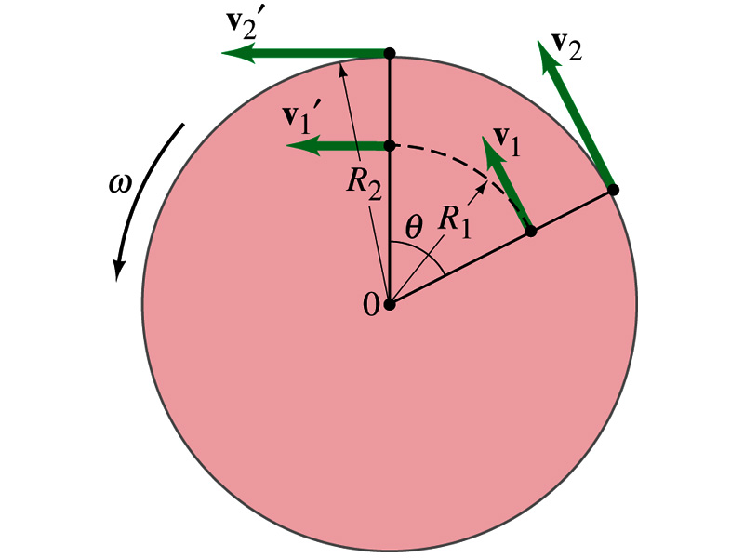
Is the lion faster than the horse?
A rotating carousel has one child sitting on the horse near the outer edge and another child on the lion halfway out from the center. (a) Which child has the greater linear speed? (b) Which child has the greater angular speed?
Linear speed is the distance traveled divided by the time interval. So the child sitting at the outer edge travels more distance within the given time than the child sitting closer to the center. Thus, the horse is faster than the lion.
(b) Angular speed is the angle traveled divided by the time interval. The angle both the children travel in the given time interval is the same. Thus, both the horse and the lion have the same angular speed.

Slide 10
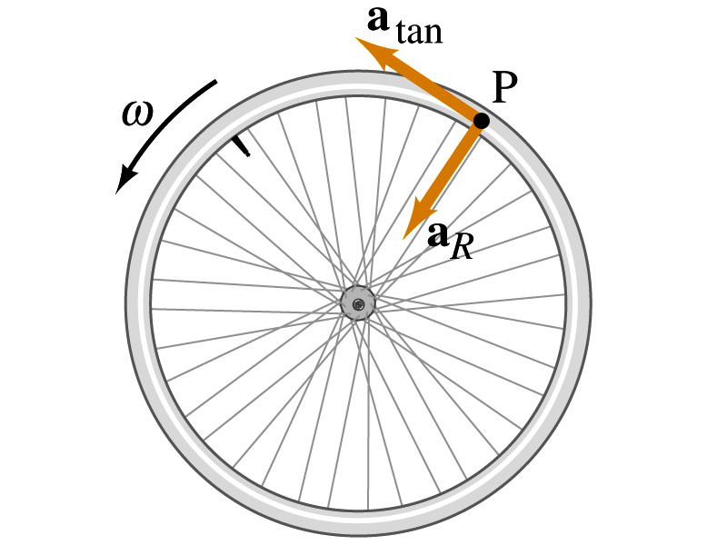
How about the acceleration?
How many different linear acceleration components do you see in a circular motion and what are they?
Two
Tangential, a_{t}, and the radial acceleration, a_{r}.
Since the tangential speed v is
The magnitude of tangential acceleration a_{t} is
What does this relationship tell you?
Although every particle in the object has the same angular acceleration, its tangential acceleration differs proportional to its distance from the axis of rotation.
The radial or centripetal acceleration a_{r} is
What does this tell you?
The father away the particle is from the rotation axis, the more radial acceleration it receives. In other words, it receives more centripetal force.
Total linear acceleration is

Slide 11
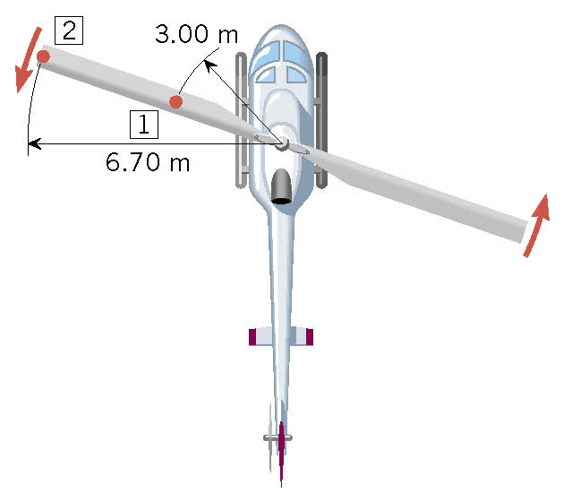
Ex. A Helicopter Blade
A helicopter blade has an angular speed of 6.50 rev/s and an angular acceleration of 1.30 rev/s². For point 1 on the blade, find the magnitude of (a) the tangential speed and (b) the tangential acceleration.

Slide 12
Rolling Motion of a Rigid Body
What is a rolling motion?
A more generalized case of a motion where the rotational axis moves together with an object
A rotational motion about a moving axis
To simplify the discussion, let’s make a few assumptions
Limit our discussion on very symmetric objects, such as cylinders, spheres, etc
The object rolls on a flat surface
Let’s consider a cylinder rolling on a flat surface, without slipping.
Under what condition does this “Pure Rolling” happen?
The total linear distance the CM of the cylinder moved is
Thus the linear speed of the CM is
R
θ
s
s=Rθ
The condition for a “Pure Rolling motion”

Slide 13
More Rolling Motion of a Rigid Body
The magnitude of the linear acceleration of the CM is
As we learned in rotational motion, all points in a rigid body moves at the same angular speed but at different linear speeds.
P’
2v_{CM}
CM
v_{CM}
CM is moving at the same speed at all times.
At any given time, the point that comes to P has 0 linear speed while the point at P’ has twice the speed of CM
P
Why??
A rolling motion can be interpreted as the sum of Translation and Rotation
v_{CM}
v=Rω
2v_{CM}
P’
P’
P’
CM
+
CM
=
CM
v_{CM}
v=0
v_{CM}
P
v=Rω
P
P
v_{CM}

Slide 14
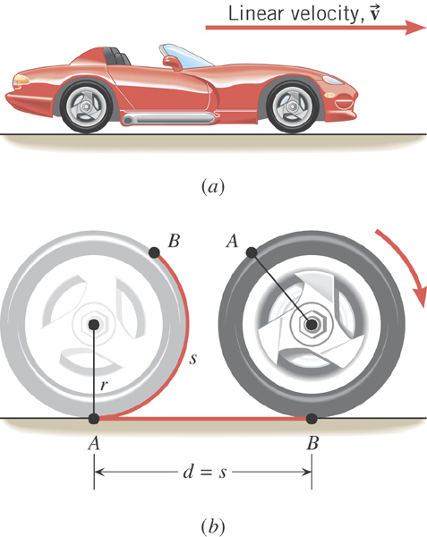
Ex. An Accelerating Car
Starting from rest, the car accelerates for 20.0 s with a constant linear acceleration of 0.800 m/s². The radius of the tires is 0.330 m. What is the angle through which each wheel has rotated?
θ | α | ω | ω_{o} | t
?
-2.42 rad/s²
0 rad/s
20.0 s

Slide 15
Torque
Torque is the tendency of a force to rotate an object about an axis. Torque, τ, is a vector quantity.
F
Consider an object pivoting about the point P by the force F being exerted at a distance r from P.
φ
r
The line of Action
The line that extends out of the tail of the force vector is called the line of action.
P
l₂
l₁
The perpendicular distance from the pivoting point P to the line of action is called the moment arm.
F₂
Moment arm
Magnitude of torque is defined as the product of the force exerted on the object to rotate it and the moment arm.
When there are more than one force being exerted on certain points of the object, one can sum up the torque generated by each force vectorially. The convention for sign of the torque is positive if rotation is in counter-clockwise and negative if clockwise.
Unit?

Slide 16
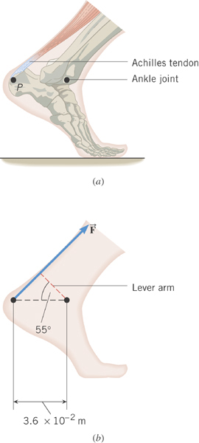
Ex. The Achilles Tendon
The tendon exerts a force of magnitude 790 N on the point P. Determine the torque (magnitude and direction) of this force about the ankle joint which is located 3.6x10⁻²m away from point P.
3.6x10⁻²m
First, let’s find the lever arm length
790 N
So the torque is
Since the rotation is in clock-wise

