Slide 1
PHYS 1441 – Section 002
Lecture #21
Monday, April 15, 2013
Dr. Jaehoon Yu
Moment of Inertia
Torque and Angular Acceleration
Rotational Kinetic Energy
Today’s homework is homework #11, due 11pm, Tuesday, Apr. 23!!

Slide 2
Announcements
Quiz #4 results
  Class average: 30.1/70
    Equivalent to 43/100
    Previous quizzes: 65/100, 60/100 and 52.5/100
  Top score: 70/70
Second non-comp term exam
  Date and time: 4:00pm, this Wednesday, April 17 in class
  Coverage: CH6.1 through what we finish today (CH8.9)
  This exam could replace the first term exam if better
Remember that the lab final exams are this week!!
Special colloquium for 15 point extra credit!!
  Wednesday, April 24, University Hall RM116
  Class will be substituted by this colloquium

Slide 3
Moment of Inertia
Rotational Inertia:
Measure of resistance of an object to changes in its rotational motion. Equivalent to mass in linear motion.
For a group of objects
For a rigid body
What are the dimension and unit of Moment of Inertia?
Determining Moment of Inertia is extremely important for computing equilibrium of a rigid body, such as a building.
Dependent on the axis of rotation!!!

Slide 4
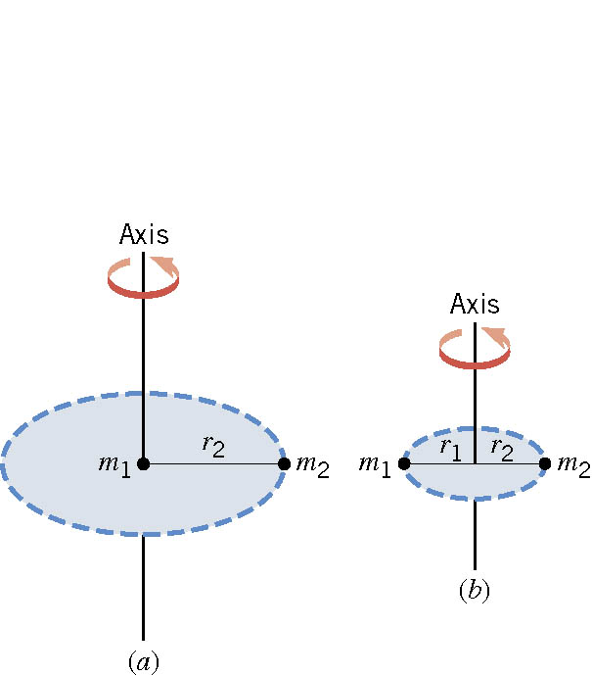
Ex. The Moment of Inertia Depends on Where the Axis Is.
Two particles each have mass m₁ and m₂ and are fixed at the ends of a thin rigid rod. The length of the rod is L. Find the moment of inertia when this object rotates relative to an axis that is perpendicular to the rod at (a) one end and (b) the center.
(a)
Which case is easier to spin?
(b)
Case (b)
Why?
Because the moment of inertia is smaller

Slide 5
Example for Moment of Inertia
In a system of four small spheres as shown in the figure, assuming the radii are negligible and the rods connecting the particles are massless, compute the moment of inertia and the rotational kinetic energy when the system rotates about the y-axis at angular speed ω.
y
m
b
Since the rotation is about y axis, the moment of inertia about y axis, I_{y}, is
l
l
M
O
M
x
b
m
Why are some 0s?
This is because the rotation is done about the y axis, and the radii of the spheres are negligible.

Slide 6
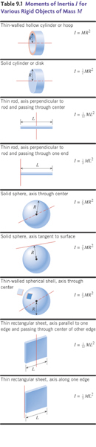
Check out Figure 8 – 21 for moment of inertia for various shaped objects

Slide 7
Torque & Angular Acceleration
F_{t}
Let’s consider a point object with mass m rotating on a circle.
m
What forces do you see in this motion?
r
F_{r}
The tangential force F_{t} and the radial force F_{r}
The tangential force F_{t} is
The torque due to tangential force F_{t} is
What do you see from the above relationship?
What does this mean?
Torque acting on a particle is proportional to the angular acceleration.
What law do you see from this relationship?
Analogs to Newton’s 2nd law of motion in rotation.
How about a rigid object?
The external tangential force δF_{t} is
δF_{t}
δm
The torque due to tangential force F_{t} is
The total torque is
r
What is the contribution due to radial force and why?
Contribution from radial force is 0, because its line of action passes through the pivoting point, making the moment arm 0.
O

Slide 8
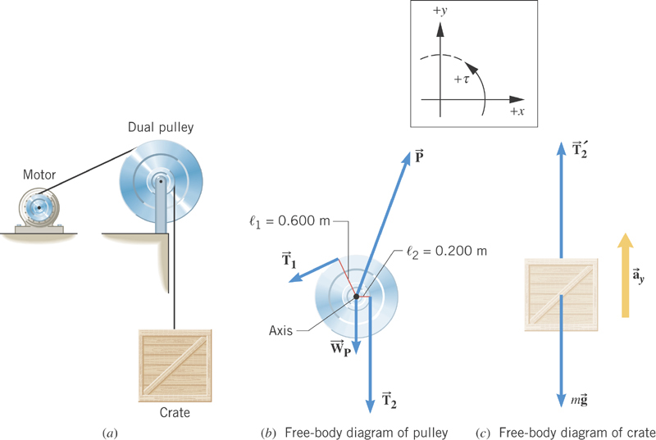
Ex. Hoisting a Crate
The combined moment of inertia of the dual pulley is 50.0 kg·m². The crate weighs 4420 N. A tension of 2150 N is maintained in the cable attached to the motor. Find the angular acceleration of the dual pulley.

Slide 9
Rotational Kinetic Energy
y
v_{i}
What do you think the kinetic energy of a rigid object that is undergoing a circular motion is?
m_{i}
r_{i}
θ
Kinetic energy of a masslet, m_{i}, moving at a tangential speed, v_{i}, is
O
x
Since a rigid body is a collection of masslets, the total kinetic energy of the rigid object is
Since moment of Inertia, I, is defined as
The above expression is simplified as

Slide 10
Example for Moment of Inertia
In a system of four small spheres as shown in the figure, assuming the radii are negligible and the rods connecting the particles are massless, compute the moment of inertia and the rotational kinetic energy when the system rotates about the y-axis at angular speed ω.
y
m
Since the rotation is about y axis, the moment of inertia about y axis, I_{y}, is
b
l
l
M
O
M
x
b
This is because the rotation is done about y axis, and the radii of the spheres are negligible.
Why are some 0s?
m
Thus, the rotational kinetic energy is
Find the moment of inertia and rotational kinetic energy when the system rotates on the x-y plane about the z-axis that goes through the origin O.

Slide 11
Kinetic Energy of a Rolling Sphere
R
Let’s consider a sphere with radius R rolling down the hill without slipping.
h
x
ω
θ
v_{CM}
Since v_{CM}=Rω
What is the speed of the CM in terms of known quantities and how do you find this out?
Since the kinetic energy at the bottom of the hill must be equal to the potential energy at the top of the hill

Slide 12
Example for Rolling Kinetic Energy
For solid sphere as shown in the figure, calculate the linear speed of the CM at the bottom of the hill and the magnitude of linear acceleration of the CM. Solve this problem using Newton’s second law, the dynamic method.
n
What are the forces involved in this motion?
f
y
Gravitational Force,
Frictional Force,
Normal Force
M
h
x
Newton’s second law applied to the CM gives
x
Mg
θ
Since the forces Mg and n go through the CM, their moment arm is 0 and do not contribute to torque, while the static friction f causes torque
We know that
We obtain
Substituting f in dynamic equations

