Slide 1
PHYS 1441 – Section 002 Lecture #22
Monday, April 22, 2013
Dr. Jaehoon Yu
Work, Power and Energy in Rotation
Angular Momentum
Angular Momentum Conservation
Similarities Between Linear and Rotational Quantities
Conditions for Equilibrium
Elastic Properties of Solids
Today’s homework is homework #12, due 11pm, Tuesday, Apr. 30!!

Slide 2
Announcements
2nd Non-comprehensive exam results
Class average: 39.7/101
Equivalent to 39.3/100
Previous exams: 58.2/100 and 53.3/100
Top score: 79/101
Final comprehensive exam
Date and time: 2:00 – 4:30pm, Wednesday, May 8
Coverage: CH1.1 through what we finish Wednesday, May 1, plus appendices
150 practice problems will be distributed in class Monday, Apr. 29
Please hit homeruns on this exam!!!
Remember the special colloquium for 15 point extra credit!!
This Wednesday, April 24, University Hall RM116
Class will be substituted by this colloquium

Slide 3
Work, Power, and Energy in Rotation
F
Let’s consider the motion of a rigid body with a single external force F exerting on the point P, moving the object by Δs.
Fsinφ
φ
Δs
The work done by the force F as the object rotates through the infinitesimal distance Δs=rΔθ is
Δθ
r
Fcosφ
O
What is Fsinϕ?
The tangential component of the force F.
What is the work done by radial component Fcosϕ?
Zero, because it is perpendicular to the displacement.
Since the magnitude of torque is rFsinϕ,
How was the power defined in linear motion?
The rate of work, or power, becomes
The rotational work done by an external force equals the change in rotational Kinetic energy.
The work put in by the external force then

Slide 4
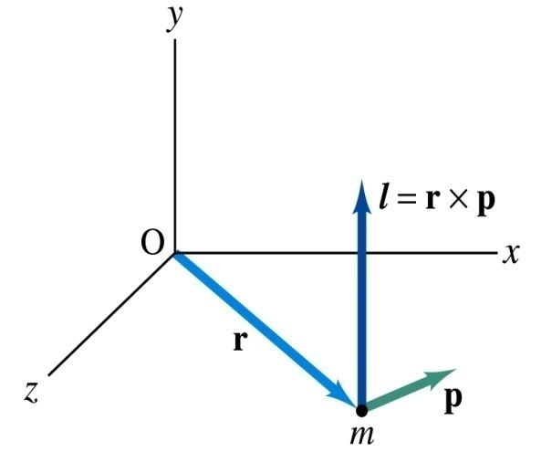
Angular Momentum of a Particle
If you grab onto a pole while running, your body will rotate about the pole, gaining angular momentum. We’ve used the linear momentum to solve physical problems with linear motions, the angular momentum will do the same for rotational motions.
z
Let’s consider a point-like object ( particle) with mass m located at the vector location r and moving with linear velocity v
The angular momentum L of this particle relative to the origin O is
y
What is the unit and dimension of angular momentum?
x
Note that L depends on origin O.
Why?
Because r changes
What else do you learn?
The direction of L is +z.
Since p is mv, the magnitude of L becomes
What do you learn from this?
If the direction of linear velocity points to the origin of rotation, the particle does not have any angular momentum.
If the linear velocity is perpendicular to position vector, the particle moves exactly the same way as a point on a rim.

Slide 5
Angular Momentum of a System of Particles
The total angular momentum of a system of particles about some point is the vector sum of the angular momenta of the individual particles
Since the individual angular momentum can change, the total angular momentum of the system can change.
Both internal and external forces can exert torque on individual particles. However, the internal forces do not generate net torque due to Newton’s third law.
Let’s consider a two particle system where the two exert forces on each other.
Since these forces are the action and reaction forces with directions lie on the line connecting the two particles, the vector sum of the torque from these two becomes 0.
Thus the time rate change of the angular momentum of a system of particles is equal to only the net external torque acting on the system
Just like
For a rigid body, the external torque is written

Slide 6
Example for Rigid Body Angular Momentum
A rigid rod of mass M and length l is pivoted without friction at its center. Two particles of mass m₁ and m₂ are attached to either end of the rod. The combination rotates on a vertical plane with an angular speed of ω. Find an expression for the magnitude of the angular momentum.
y
The moment of inertia of this system is
m₂
l
m₂ g
θ
O
x
m₁
Find an expression for the magnitude of the angular acceleration of the system when the rod makes an angle θ with the horizon.
m₁ g
If m₁ = m₂, no change of angular momentum because the net torque is 0.
If θ=+/−π/2, at equilibrium so no angular momentum.
First compute the net external torque
Thus α becomes

Slide 7
Conservation of Angular Momentum
Remember under what condition the linear momentum is conserved?
Linear momentum is conserved when the net external force is 0.
By the same token, the angular momentum of a system is constant in both magnitude and direction, if the resultant external torque acting on the system is 0.
What does this mean?
Angular momentum of the system before and after a certain change is the same.
Three important conservation laws for isolated system that does not get affected by external forces
Mechanical Energy
Linear Momentum
Angular Momentum

Slide 8
Example for Angular Momentum Conservation
A star rotates with a period of 30 days about an axis through its center. After the star undergoes a supernova explosion, the stellar core, which had a radius of 1.0x10⁴km, collapses into a neutron star of radius 3.0km. Determine the period of rotation of the neutron star.
What is your guess about the answer?
The period will be significantly shorter, because its radius got smaller.
Let’s make some assumptions:
There is no external torque acting on it
The shape remains spherical
Its mass remains constant
Using angular momentum conservation
The angular speed of the star with the period T is
Thus

Slide 9
Similarity Between Linear and Rotational Motions
All physical quantities in linear and rotational motions show striking similarity.
Quantities | Linear | Rotational
Mass | Mass | Moment of Inertia
Length of motion | Distance | Angle (Radian)
Speed
Acceleration
Force | Force | Torque
Work | Work | Work
Power
Momentum
Kinetic Energy | Kinetic | Rotational

Slide 10
Conditions for Equilibrium
What do you think the term “An object is at its equilibrium” means?
The object is either at rest (Static Equilibrium) or its center of mass is moving at a constant velocity (Dynamic Equilibrium).
When do you think an object is at its equilibrium?
Translational Equilibrium: Equilibrium in linear motion
Is this it?
The above condition is sufficient for a point-like object to be at its translational equilibrium. However for an object with size this is not sufficient. One more condition is needed. What is it?
Let’s consider two forces equal in magnitude but in opposite direction acting on a rigid object as shown in the figure. What do you think will happen?
F
d
CM
The object will rotate about the CM. Since the net torque acting on the object about a rotational axis is not 0.
d
-F
For an object to be at its static equilibrium, the object should not have linear or angular speed.

Slide 11
More on Conditions for Equilibrium
To simplify the problem, we will only deal with forces acting on x-y plane, giving torque only along z-axis. What do you think the conditions for equilibrium be in this case?
The six possible equations from the two vector equations turns to three equations.
AND
What happens if there are many forces exerting on an object?
If an object is at its translational static equilibrium, and if the net torque acting on the object is 0 about one axis, the net torque must be 0 about any arbitrary axis.
F₁
F₂
O
r’
r₅
O’
F₃
F₅
Why is this true?
F₄
Because the object is not moving, no matter what the rotational axis is, there should not be any motion. It is simply a matter of mathematical manipulation.

Slide 12
How do we solve static equilibrium problems?
Select the object to which the equations for equilibrium are to be applied.
Identify all the forces and draw a free-body diagram with them indicated on it with their directions and locations properly indicated
Choose a convenient set of x and y axes and write down the force equation for each x and y component with correct signs.
Apply the equations that specify the balance of forces at equilibrium. Set the net force in the x and y directions equal to 0.
Select the most optimal rotational axis for torque calculations ➔ Selecting the axis such that the torque of one or more of the unknown forces become 0 makes the problem much easier to solve.
Write down the torque equation with proper signs.
Solve the force and torque equations for the desired unknown quantities.

