Slide 1
PHYS 1441 – Section 002 Lecture #23
Monday, April 29, 2013
Dr. Jaehoon Yu
Conditions for Equilibrium
Elastic Properties of Solids
Young’s Modulus
Bulk Modulus
Density and Specific Gravity
Fluid and Pressure
Today’s homework is
NONE!!

Slide 2
Announcements
Final comprehensive exam
Date and time: 2:00 – 4:30pm, Wednesday, May 8
Coverage: CH1.1 through what we finish this Wednesday, May 1, plus appendices
Please hit homeruns on this exam!!!
I will prepare a formula sheet for you this time!
Planetarium extra credit
Deadline next Wednesday, May, 8
Student Feedback Survey
Must be done by May 3
No class next week!!

Slide 3
More on Conditions for Equilibrium
To simplify the problem, we will only deal with forces acting on x-y plane, giving torque only along z-axis. What do you think the conditions for equilibrium be in this case?
The six possible equations from the two vector equations turns to three equations.
AND
What happens if there are many forces exerting on an object?
If an object is at its translational static equilibrium, and if the net torque acting on the object is 0 about one axis, the net torque must be 0 about any arbitrary axis.
F₁
F₂
O
r’
r₅
O’
F₃
F₅
Why is this true?
F₄
Because the object is not moving, no matter what the rotational axis is, there should not be any motion. It is simply a matter of mathematical manipulation.

Slide 4
How do we solve static equilibrium problems?
Select the object to which the equations for equilibrium are to be applied.
Identify all the forces and draw a free-body diagram with them indicated on it with their directions and locations properly indicated
Choose a convenient set of x and y axes and write down the force equation for each x and y component with correct signs.
Apply the equations that specify the balance of forces at equilibrium. Set the net force in the x and y directions equal to 0.
Select the most optimal rotational axis for torque calculations ➔ Selecting the axis such that the torque of one or more of the unknown forces become 0 makes the problem much easier to solve.
Write down the torque equation with proper signs.
Solve the force and torque equations for the desired unknown quantities.

Slide 5
Example for Mechanical Equilibrium
A uniform 40.0 N board supports the father and the daughter each weighing 800 N and 350 N, respectively, and is not moving. If the support (or fulcrum) is under the center of gravity of the board, and the father is 1.00 m from the center of gravity (CoG), what is the magnitude of the normal force n exerted on the board by the support?
1m
x
Since there is no linear motion, this system is in its translational equilibrium
n
F
D
M_{F}g
M_{D}g
M_{B}g
Therefore the magnitude of the normal force
Determine where the child should sit to balance the system.
The net torque about the fulcrum by the three forces are
Therefore to balance the system the daughter must sit

Slide 6
Example for Mech. Equilibrium Cont’d
Determine the position of the child to balance the system for different position of axis of rotation.
Rotational axis
1m
x
n
x/2
F
D
M_{F}g
M_{F}g
The net torque about the axis of rotation by all the forces are
M_{B}g
Since the normal force is
The net torque can be rewritten
What do we learn?
Therefore
No matter where the rotation axis is, net effect of the torque is identical.

Slide 7
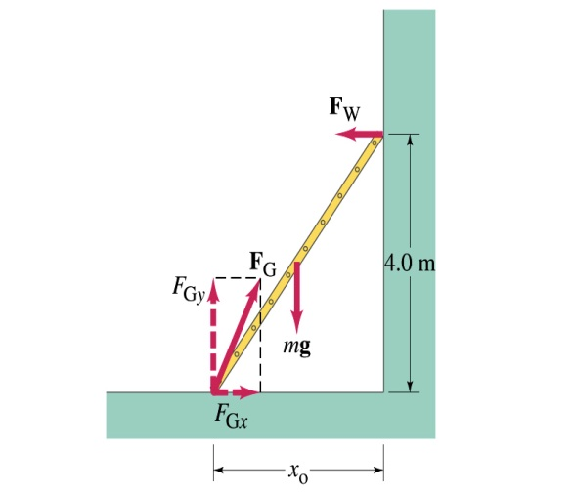
Example 9 – 7
A 5.0 m long ladder leans against a wall at a point 4.0m above the ground. The ladder is uniform and has mass 12.0kg. Assuming the wall is frictionless (but ground is not), determine the forces exerted on the ladder by the ground and the wall.
F_{W}
First the translational equilibrium, using components
FBD
F_{Gy}
mg
O
F_{Gx}
Thus, the y component of the force by the ground is
The length x₀ is, from Pythagorian theorem

Slide 8
Example 9 – 7 cont’d
From the rotational equilibrium
Thus the force exerted on the ladder by the wall is
The x component of the force by the ground is
Solve for F_{Gx}
Thus the force exerted on the ladder by the ground is
The angle between the ground force to the floor

Slide 9
Ex. 9.8 for Mechanical Equilibrium
A person holds a 50.0N sphere in his hand. The forearm is horizontal. The biceps muscle is attached 3.00 cm from the joint, and the sphere is 35.0cm from the joint. Find the upward force exerted by the biceps on the forearm and the downward force exerted by the upper arm on the forearm and acting at the joint. Neglect the weight of forearm.
Since the system is in equilibrium, from the translational equilibrium condition
F_{B}
d
O
F_{U}
l
mg
From the rotational equilibrium condition
Thus, the force exerted by the biceps muscle is
Force exerted by the upper arm is

Slide 10
Elastic Properties of Solids
We have been assuming that the objects do not change their shapes when external forces are exerting on it. It this realistic?
No. In reality, the objects get deformed as external forces act on it, though the internal forces resist the deformation as it takes place.
Deformation of solids can be understood in terms of Stress and Strain
Stress: A quantity proportional to the force causing the deformation.
Strain: Measure of the degree of deformation
Elastic Limit: Point of elongation under which an object returns to its original shape
It is empirically known that for small stresses, strain is proportional to stress
The constants of proportionality are called Elastic Modulus
Three types of Elastic Modulus
Young’s modulus: Measure of the elasticity in a length
Shear modulus: Measure of the elasticity in an area
Bulk modulus: Measure of the elasticity in a volume

Slide 11
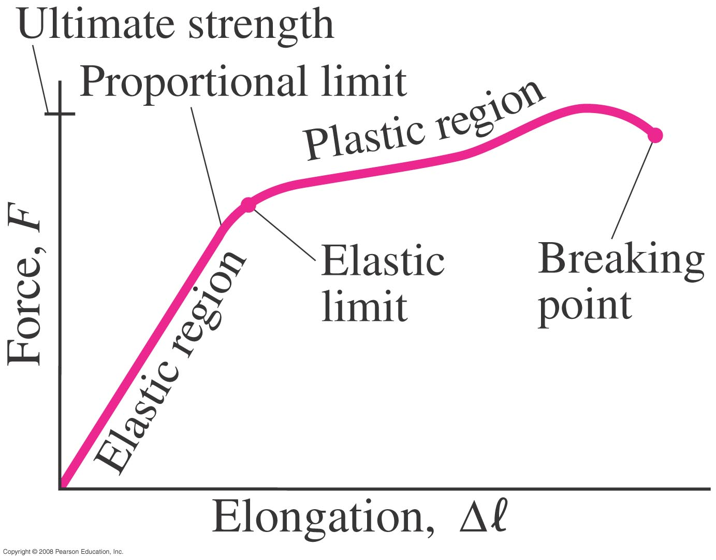
Applied force vs elongation

Slide 12
Young’s Modulus
Let’s consider a long bar with cross sectional area A and initial length L_{i}.
L_{i}
After the stretch
L_{f}=L_{i}+ΔL
F_{ex}
F_{ex}
F_{in}
A:cross sectional area
F_{ex}=F_{in}
Tensile stress
Tensile strain
Used to characterize a rod or wire stressed under tension or compression
Young’s Modulus is defined as
What is the unit of Young’s Modulus?
Force per unit area
Experimental Observations
For a fixed external force, the change in length is proportional to the original length
The necessary force to produce the given strain is proportional to the cross sectional area
Elastic limit: Maximum stress that can be applied to the substance before it becomes permanently deformed

Slide 13
Bulk Modulus
Bulk Modulus characterizes the response of a substance to uniform squeezing or reduction of pressure.
F
V
After the pressure change
F
V’
F
F
Volume stress =pressure
If the pressure on an object changes by ΔP=ΔF/A, the object will undergo a volume change ΔV.
Bulk Modulus is defined as
Because the change of volume is reverse to change of pressure.
Compressibility is the reciprocal of Bulk Modulus

Slide 14
Example for Solid’s Elastic Property
A solid brass sphere is initially under normal atmospheric pressure of 1.0x10⁵N/m². The sphere is lowered into the ocean to a depth at which the pressures is 2.0x10⁷N/m². The volume of the sphere in air is 0.5m³. By how much its volume change once the sphere is submerged?
Since bulk modulus is
The amount of volume change is
From table 12.1, bulk modulus of brass is 6.1x10¹⁰ N/m²
The pressure change ΔP is
Therefore the resulting volume change ΔV is
The volume has decreased.

Slide 15
Density and Specific Gravity
Density, ρ(rho), of an object is defined as mass per unit volume
Unit?
Dimension?
Specific Gravity of a substance is defined as the ratio of the density of the substance to that of water at 4.0 ºC (ρ_{H2O}=1.00g/cm³).
Unit?
None
Dimension?
None
What do you think would happen of a substance in the water dependent on SG?
Sink in the water
Float on the surface

