Slide 1
PHYS 1441 – Section 002 Lecture #24
Wednesday, May 1, 2013
Dr. Jaehoon Yu
Fluid and Pressure
Pascal’s Principle
Absolute and Relative Pressure
Buoyant Forces and Archimedes’ Principle
Flow Rate and Equation of Continuity
Bernoulli’s Principle

Slide 2
Announcements
Final comprehensive exam
Date and time: 2:00 – 4:30pm, Wednesday, May 8
Coverage: CH1.1 through what we finish today (CH10.8?) + Appendices A1 – A8
I will prepare a formula sheet for you this time!
Planetarium extra credit
Deadline next Wednesday, May, 8
Student Feedback Survey
Must be done by May 3
No class next week!!

Slide 3
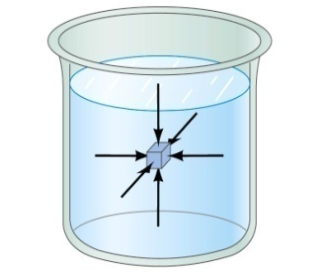
Fluid and Pressure
What are the three states of matter?
Solid, Liquid and Gas
How do you distinguish them?
Using the time it takes for a particular substance to change its shape in reaction to external forces.
What is a fluid?
A collection of molecules that are randomly arranged and loosely bound by forces between them or by an external container.
We will first learn about mechanics of fluid at rest, fluid statics.
In what ways do you think fluid exerts stress on the object submerged in it?
Fluid cannot exert shearing or tensile stress. Thus, the only force the fluid exerts on an object immersed in it is the force perpendicular to the surface of the object.
This force by the fluid on an object usually is expressed in the form of the force per unit area at the given depth, the pressure, defined as
Expression of pressure for an infinitesimal area dA by the force dF is
Note that pressure is a scalar quantity because it is the magnitude of the force per unit surface area A.
What is the unit and the dimension of pressure?
Unit:N/m²
Dim.: [M][L⁻¹][T⁻²]
Special SI unit for pressure is Pascal

Slide 4
Example for Pressure
The mattress of a water bed is 2.00m long by 2.00m wide and 30.0cm deep. a) Find the weight of the water in the mattress.
The volume density of water at the normal condition (0ºC and 1 atm) is 1000kg/m³. So the total mass of the water in the mattress is
Therefore the weight of the water in the mattress is
b) Find the pressure exerted by the water on the floor when the bed rests in its normal position, assuming the entire lower surface of the mattress makes contact with the floor.
Since the surface area of the mattress is 4.00 m², the pressure exerted on the floor is

Slide 5
Variation of Pressure and Depth
Water pressure increases as a function of depth, and the air pressure decreases as a function of altitude. Why?
P₀A
It seems that the pressure has a lot to do with the total mass of the fluid above the object that puts weight on the object.
Let’s imagine the liquid contained in a cylinder with height h and the cross sectional area A immersed in a fluid of density ρ at rest, as shown in the figure, and the system is in its equilibrium.
h
Mg
If the liquid in the cylinder is the same substance as the fluid, the mass of the liquid in the cylinder is
PA
Since the system is in its equilibrium
Therefore, we obtain
The pressure at the depth h below the surface of the fluid open to the atmosphere is greater than the atmospheric pressure by ρgh.
Atmospheric pressure P₀ is

Slide 6
Pascal’s Principle and Hydraulics
A change in the pressure applied to a fluid is transmitted undiminished to every point of the fluid and to the walls of the container.
What happens if P₀is changed?
The resultant pressure P at any given depth h increases as much as the change in P₀.
This is the principle behind hydraulic pressure. How?
A₂
Since the pressure change caused by the the force F₁ applied onto the area A₁ is transmitted to the F₂ on an area A₂.
d₁
F₁
d₂
A₁
F₂
In other words, the force gets multiplied by the ratio of the areas A₂/A₁ and is transmitted to the force F₂ on the surface.
Therefore, the resultant force F₂ is
This seems to violate some kind of conservation law, doesn’t it?
No, the actual displaced volume of the fluid is the same. And the work done by the forces are still the same.

Slide 7
Example for Pascal’s Principle
In a car lift used in a service station, compressed air exerts a force on a small piston that has a circular cross section and a radius of 5.00cm. This pressure is transmitted by a liquid to a piston that has a radius of 15.0cm. What force must the compressed air exert to lift a car weighing 13,300N? What air pressure produces this force?
Using the Pascal’s principle, one can deduce the relationship between the forces, the force exerted by the compressed air is
Therefore the necessary pressure of the compressed air is

Slide 8
Example for Pascal’s Principle
Estimate the force exerted on your eardrum due to the water above when you are swimming at the bottom of the pool with a depth 5.0 m. Assume the surface area of the eardrum is 1.0cm².
We first need to find out the pressure difference that is being exerted on the eardrum. Then estimate the area of the eardrum to find out the force exerted on the eardrum.
Since the outward pressure in the middle of the eardrum is the same as normal air pressure
Estimating the surface area of the eardrum at 1.0cm²=1.0x10⁻⁴ m², we obtain

Slide 9
Absolute and Relative Pressure
How can one measure pressure?
One can measure the pressure using an open-tube manometer, where one end is connected to the system with unknown pressure P and the other open to air with pressure P₀.
P
P₀
h
The measured pressure of the system is
This is called the absolute pressure, because it is the actual value of the system’s pressure.
In many cases we measure the pressure difference with respect to the atmospheric pressure to avoid the effect of the changes in P₀ that depends on the environment. This is called gauge or relative pressure.
The common barometer which consists of a mercury column with one end closed at vacuum and the other open to the atmosphere was invented by Evangelista Torricelli.
Since the closed end is at vacuum, it does not exert any force. 1 atm of air pressure pushes mercury up 76cm. So 1 atm is
If one measures the tire pressure with a gauge at 220kPa the actual pressure is 101kPa+220kPa=303kPa.

Slide 10
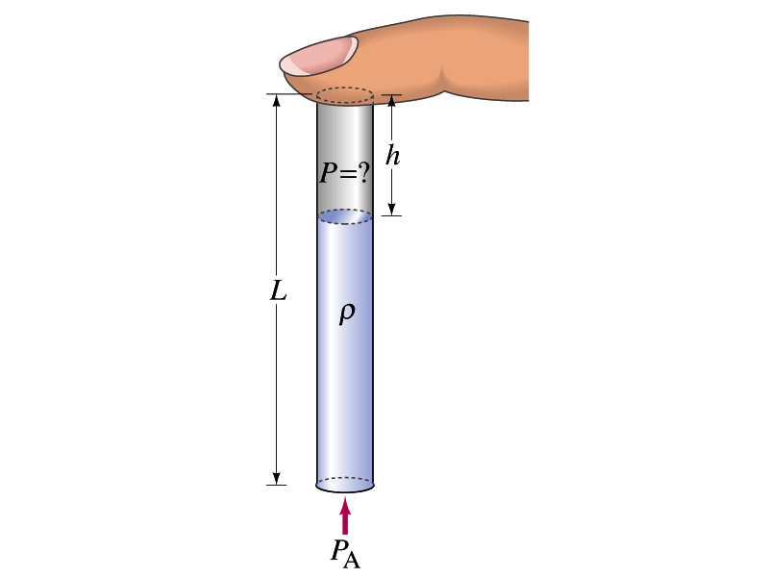
Finger Holds Water in Straw
You insert a straw of length L into a tall glass of your favorite beverage. You place your finger over the top of the straw so that no air can get in or out, and then lift the straw from the liquid. You find that the straw strains the liquid such that the distance from the bottom of your finger to the top of the liquid is h. Does the air in the space between your finger and the top of the liquid in the straw have a pressure P that is (a) greater than, (b) equal to, or (c) less than, the atmospheric pressure P_{A} outside the straw?
p_{in}A
Less
What are the forces in this problem?
Gravitational force on the mass of the liquid
Force exerted on the top surface of the liquid by inside air pressure
Force exerted on the bottom surface of the liquid by the outside air
mg
Since it is at equilibrium
Cancel A and
solve for p_{in}
p_{A}A
So p_{in} is less than P_{A} by ρg(L-h).

Slide 11
Congratulations!!!!
You all are impressive and have done very well!!!
I certainly had a lot of fun with ya’ll and am truly proud of you!
Good luck with your exam!!!
Have safe holidays!!

