Slide 1
PHYS 3313 – Section 001
Lecture #1
Monday, Jan. 13, 2014
Dr. Jaehoon Yu
Who am I?
From Higgs to Dark Matter!!
How is this class organized?
What do we want from this class?
What is Physics?
Brief history of modern physics

Slide 2
Announcements
Plea to you: Please turn off your cell-phones, pagers and computers in the class
Reading assignment #1: Read and follow through appendices 3, 5, 6 and 7 by Tuesday, Jan. 21
  There will be a quiz next Wednesday, Jan. 22, on these reading assignments
No class Monday, Martin Luther King Day

Slide 3
Who am I?
Name: Dr. Jaehoon Yu (You can call me Dr. Yu)
Office: Rm 342, Chemistry and Physics Building
Extension: x22814, E-mail: jaehoonyu@uta.edu
My profession: High Energy Particle Physics (HEP)
  Collide particles (protons on anti-protons or electrons on anti-electrons, positrons) at the energies equivalent to 10,000 Trillion degrees
  To understand
    Fundamental constituents of matter
    Forces between the constituents (gravitational, electro-magnetic, weak and strong forces)
    Origin of Mass
    Creation of Universe (Big Bang Theory)
  A pure scientific research activity
    Direct use of the fundamental laws we find may take longer than we want but
    Indirect product of research contribute to every day lives; eg. WWW
  Why do we do with this?
    Make our everyday lives better

Slide 4
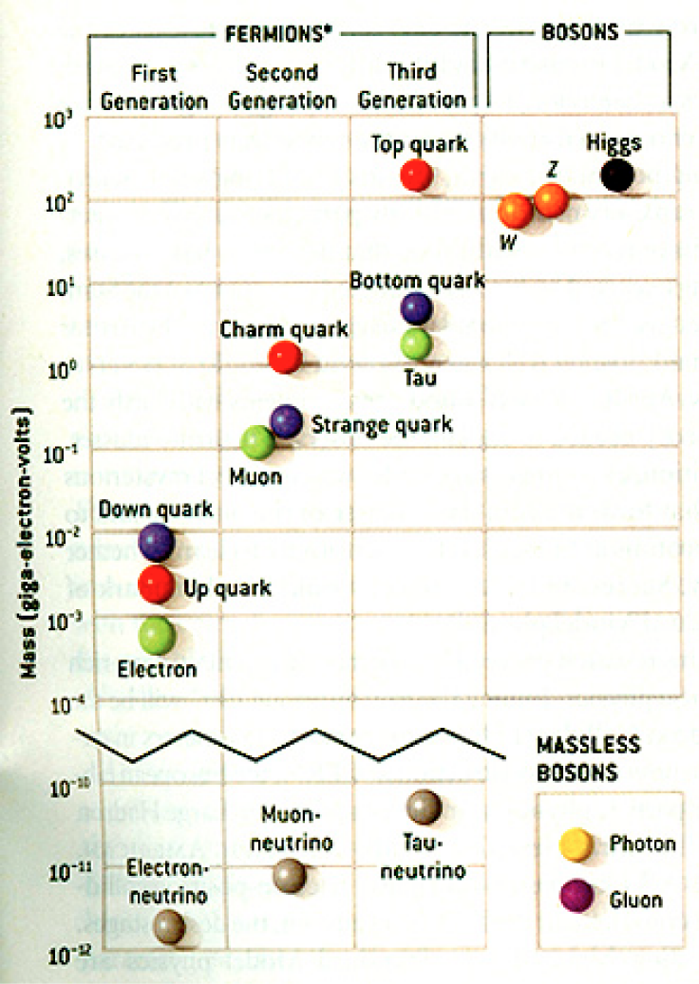
HEP and the Standard Model
HEP: A field of physics that studies the fundamental constituents of matter and basic principles of interactions between them.
Discovered in 1995, ~175m_{p}
Make up most ordinary matters ~0.1m_{p}
Total of 16 particles (12+4 force mediators) make up all the visible matter in the universe! ➔ Simple and elegant!!!
Tested to a precision of 1 part per million!

Slide 5
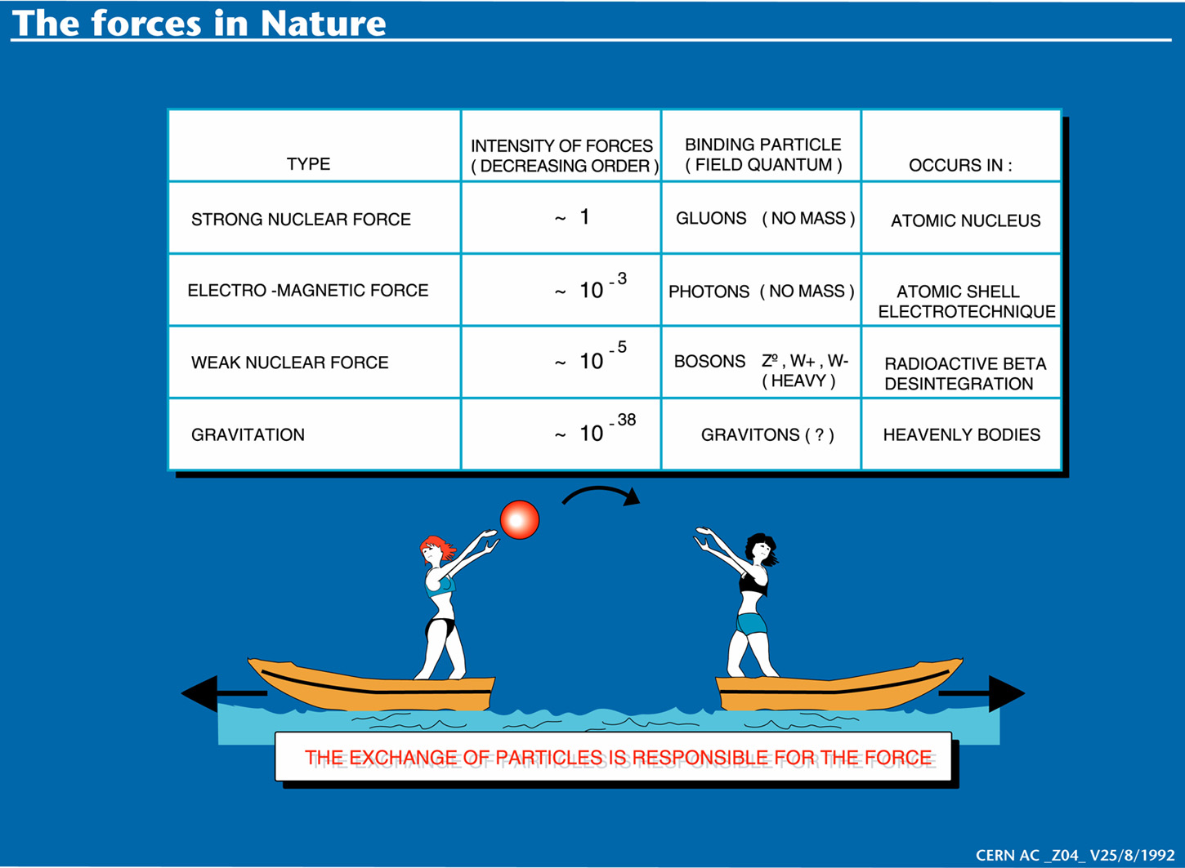

Slide 6
Accelerators are Powerful Microscopes.
They make high energy particle beams
that allow us to see small things.
seen by
low energy beam
(poorer resolution)
seen by
high energy beam
(better resolution)

Slide 7
Accelerators are also Time Machines.
They make particles last seen
in the earliest moments of the universe.
Energy
particle beam
energy
anti-particle beam
energy
Particle and anti-particle annihilate.
E = mc²

Slide 8
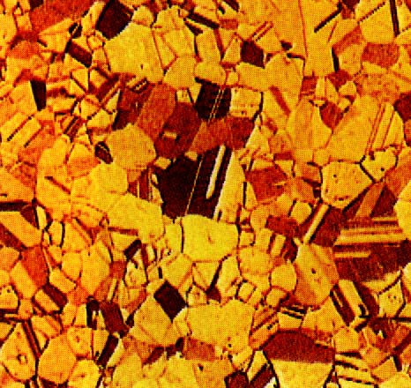
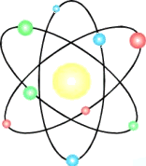


Structure of Matter
Matter
Molecule
Atom
Nucleus
Baryon
Quark
(Hadron)
u
10⁻²m
10⁻⁹m
10⁻¹⁰m
10⁻¹⁴m
10⁻¹⁵m
<10⁻¹⁹m
Condensed matter/Nano-Science/Chemistry
protons, neutrons,
mesons, etc.
π,Ω,Λ...
top, bottom,
charm, strange,
up, down
Atomic Physics
Nuclear
Physics
Electron
(Lepton)
<10⁻¹⁸m
High Energy Physics
Notes:
Give scale and relationship to the domain that high energy physicists work in.
Introduce the fundamental bits of matter loosely so that audience can point back to bulk matter.
Domain.

Slide 9
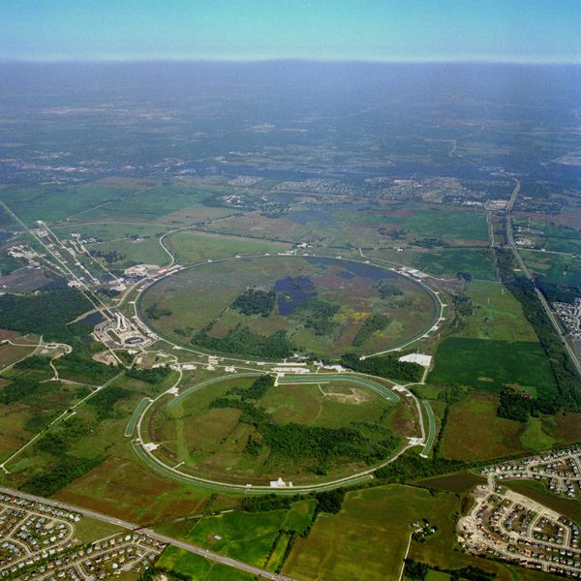
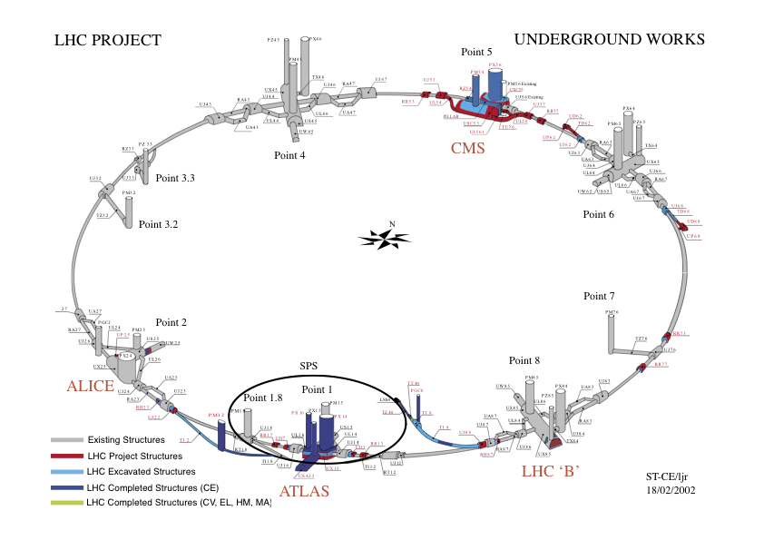
Fermilab Tevatron and LHC at CERN
World’s Highest Energy proton-anti-proton collider
  4km circumference
  E_{cm}=1.96 TeV (=6.3x10⁻⁷J/p➔ 13M Joules on the area smaller than 10⁻⁴m²)
  Equivalent to the kinetic energy of a 20t truck at the speed 81mi/hr➔ 130km/hr
    ~100,000 times the energy density at the ground 0 of the Hiroshima atom bomb
  Tevatron was shut down on Sept. 30, 2011
  Vibrant other programs running, including the search for dark matter!!
World’s Highest Energy p-p collider
  27km circumference, 100m underground
  Design E_{cm}=14 TeV (=44x10⁻⁷J/p➔ 362M Joules on the area smaller than 10⁻⁴m²)
  Equivalent to the kinetic energy of a B727 (80tons) at the speed 193mi/hr ➔ 312km/hr
    ~3M times the energy density at the ground 0 of the Hiroshima atom bomb
First 7TeV collisions 2010 ➔ The highest energy humans ever achieved!!
Large amount of data accumulated in 2011 – 2013
Shutdown in Feb. 2013 for 18mo for upgrade
Chicago
CDF
p
DØ
Tevatron
p

Slide 10
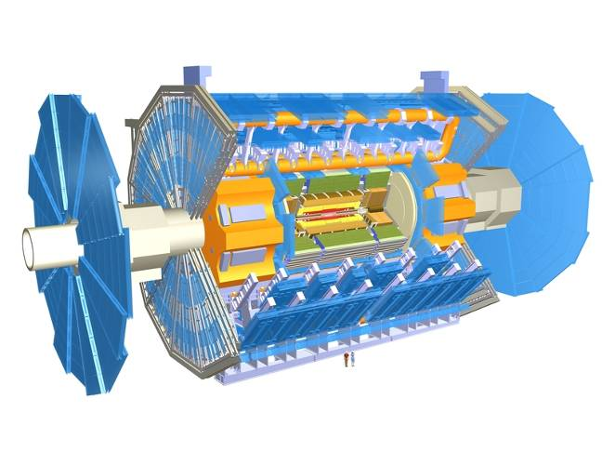
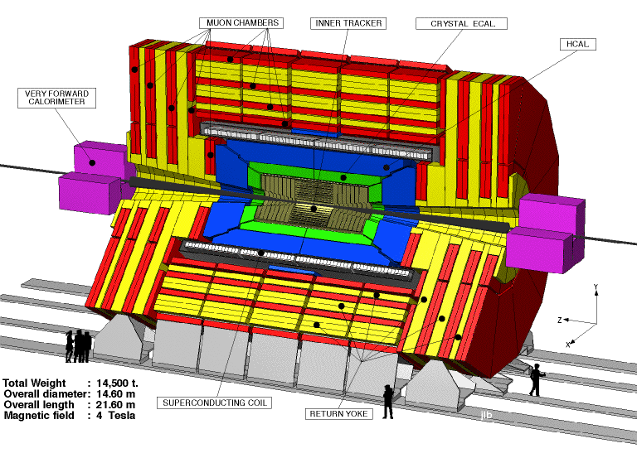
The ATLAS and CMS Detectors
Fully multi-purpose detectors with emphasis on lepton ID & precision E & P
Weighs 7000 tons and 10 story tall
Records 200 – 400 collisions/second
Records approximately 350 MB/second
Record ~2 PB per year ➔ 200*Printed material of the US Lib. of Congress

Slide 11
What is the Higgs and What does it do?
When there is perfect symmetry, one cannot tell directions!

Slide 12

What? What’s the symmetry?
Where is the head of the table?
Without a broken symmetry, one cannot tell directional information!!

Slide 13
What is the Higgs and What does it do?
When there is perfect symmetry, one cannot tell directions!
Only when symmetry is broken, can one tell directions
Higgs field works to break the perfect symmetry and gives mass to all fundamental particles
Sometimes, this field spontaneously generates a particle, the Higgs particle
So the Higgs particle is the evidence of the existence of the Higgs field!

Slide 14



So how does Higgs Field work again?
Person in space ➔ no symmetry breaking
Person in air ➔ symmetry can be broken
Sometimes, you get
Just like a tornado is a piece of evidence of the existence of air, Higgs particle is a piece of evidence of Higgs mechanism

Slide 15

Higgs Production X-sec and BR
130GeV
Higgs mass is not given in the theory!!

Slide 16
Information & Communication Source
Course web page: http://www-hep.uta.edu/%7Eyu/teaching/spring14-3313-001/spring14-3313-001.html
  Contact information & Class Schedule
  Syllabus
  Homework
  Holidays and Exam days
  Evaluation Policy
  Class Style & Communication
  Other information
Primary communication tool is e-mail: Make sure that your e-mail at the time of course registration is the one you most frequently read!!
Office Hours: 2:30 – 3:40pm, Mondays and Wednesdays or by appointments

Slide 17
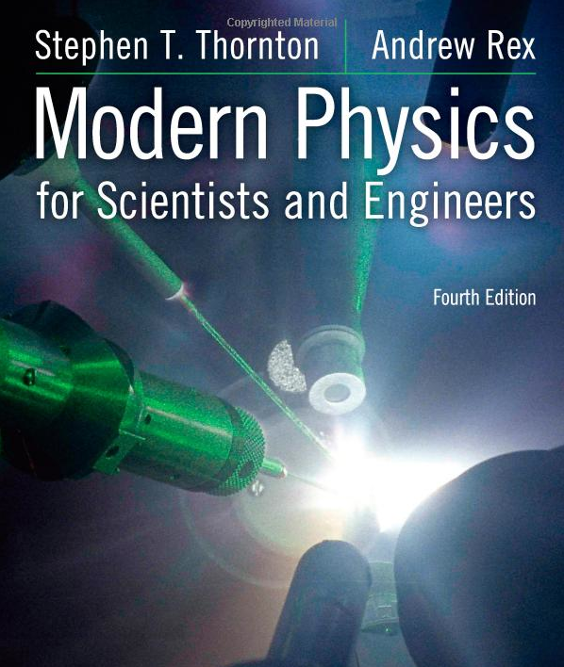
Textbook
Title: Modern Physics for Scientists and Engineers
  4th edition
Authors: S.T. Thornton and A. Rex
ISBN: 978-1-133-10372-1

Slide 18
Evaluation Policy
Homework: 30%
Exams
  Mid-term Exam (Wed., Mar. 5): 20%
  Final Comprehensive Exam (11 – 1:30pm, Mon, May. 5): 25%
  Missing an exam is not permissible unless pre-approved
    No makeup test
    You will get an F if you miss any of the exams without a prior approval
Group Research Project: 15%
Pop-quizzes: 10%
Extra credits: 10% of the total
Grading will be done on a sliding scale
55% of the grade is in your hand!!
100%

Slide 19
Homework
Solving homework problems is the only way to comprehend class material
Consists of a lot of reading, deriving and writing
Each homework carries the same weight
ALL homework grades will be used for the final grade
Home work will constitute 30% of the total
  A good way of keeping your grades high
Strongly encouraged to collaborate
  Just make sure to submit your own answers written in your OWN way!!

Slide 20
Attendances and Class Style
Attendances:
  Will be taken randomly
  Will be used for extra credits
Class style:
  Lectures will be on electronic media
    The lecture notes will be posted on the web AFTER each class
  Will be mixed with traditional methods
  Active participation through questions and discussions are STRONGLY encouraged ➔ Extra credit….
  Communication between you and me is extremely important
    If you have problems, please do not hesitate talking to me

Slide 21
Extra credit
Up to 10% addition to the total
  Could boost a B to A, C to B or D to C
What constitute for extra credit?
  Random attendances
  Physics Colloquium Participations
  Strong participation in the class discussions
  Special projects
  Watch the valid planetarium shows
  Many other opportunities

Slide 22
Valid Planetarium Shows
Regular running shows
  Expoplanets – Thursdays at 6:00, Saturdays at 5:30pm and Sundays at 1:30pm
  Back to Moon for Good – Fridays at 6:00pm and Saturdays at 2:30pm
Shows that need special arrangements
  Astronaut
  Bad Astronomy
  Black Holes (can watch up to 2 times!)
  Experience the Aurora
  IBEX
  Ice Worlds
  Magnificent Sun
  Mayan Prophecies
  Nanocam
  Stars of Pharaoes
  Two Small Pieces of Glass
  Unseen Universe: The Vision of SOFIA
  Violent Universe
  We Are Astronomers
How to submit for extra credit?
  Obtain the ticket stub that is signed and dated by the planetarium star lecturer of the day
  Collect the ticket stubs
  Tape all of them on a sheet of paper with your name and ID written on it
  Submit the sheet at the end of the semester when asked

Slide 23
What can you expect from this class?
All A’s would be perfect for you, wouldn’t it?
  But easy come easy go
  Must put in efforts to make it last and meaningful….
This class is going to be challenging!!
You will earn your grade in this class.
  You will need to put in sufficient time and sincere efforts
  Exams and quizzes will be tough!!
    Sometimes problems might not look exactly like what you learned in the class
    Just putting the right answer in free response problems does not work!
But you have a great control of your grade in your hands, up to 45%!!!
  Homework is 30% of the total grade!!
    Means you will have many homework problems
      Sometimes much more than any other classes
      Sometimes homework problems will be something that you have yet to learn in class
      Exam’s problems will be easier that homework problems but the same principles!!
  Extra credit 10%
I will work with you so that your efforts are properly rewarded

Slide 24
What do we want to learn in this class?
The physics that provided fundamentals to the technical progress for us
Learn concepts of quantum theory for microscopic phenomena and relativity for phenomena with high speed
Learn physical principles that we still exploit
Learn skills to express observations and measurements in mathematical language
Learn skills to research literatures and express your research in systematic manner in writing
Build up confidence in your physics abilities and to take on any challenges laid in front of you!!
Most importantly, let us have a lot of FUN!!

Slide 25
In this course, you will learn…
Concepts and derivation of many of the modern physics
  History at the beginning of the new era
  Special relativity
  Quantum theory
  Atomic physics
  Condensed Matter physics
  Nuclear physics
  Particle Physics
Focus on learning about the concepts with less complicated math
  You will learn some Quantum calculations and understand the concept of probabilities
Expectation at the end of the semester: You will be able to understand what fundamental physics provides bases for the current technology

