Slide 1
PHYS 3313 – Section 001
Lecture #3
Wednesday, Jan. 22, 2014
Dr. Jaehoon Yu
Atomic Theory of Matter
Unsolved Questions of 1895 and New Horizon
Unsolved Questions Today!
Galilean Transformation
Do we need Ether?
Michelson-Morley Experiment
Einstein’s postulates

Slide 2
Announcements
Reading assignments: CH 2.10 (special topic), 2.13 and 2.14
  Please go through eq. 2.45 through eq. 2.49 and example 2.9
Homework #1
  chapter 2 end of the chapter problems
  17, 21, 23, 24, 32, 59, 61, 66, 68, 81 and 96
  Due is by the beginning of the class, Monday, Feb. 3
  Work in study groups together with other students but PLEASE do write your answer in your own way!
Colloquium today
  Dr. Patrick Dholabhai, Los Alamos National Laboratory

Slide 3
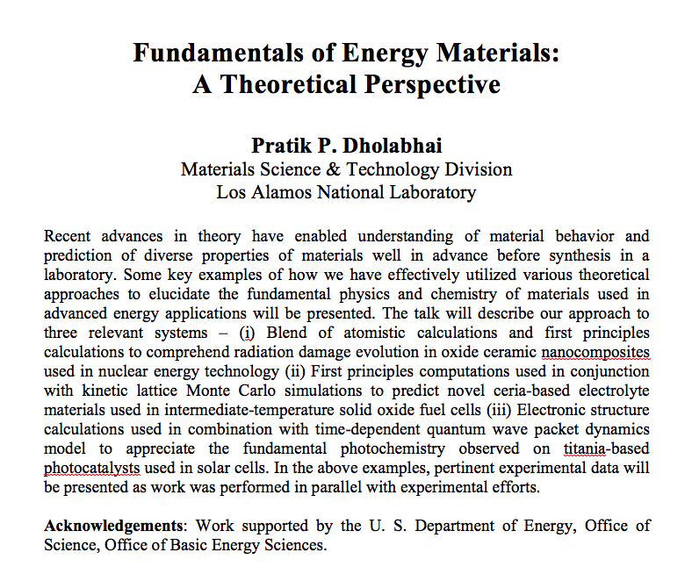

Slide 4
Reminder: Special Project #1
Compute the electric force between the two protons separate the farthest in an intact U²³⁸ nucleus. Use the actual size of the U²³⁸ nucleus. (10 points)
Compute the gravitational force between the two protons separate the farthest in an intact U²³⁸ nucleus. (10 points)
Express the electric force in #1 above in terms of the gravitational force in #2. (5 points)
You must look up the mass of the proton, actual size of the U²³⁸ nucleus, etc, and clearly write them on your project report
You MUST have your own, independent answers to the above three questions even if you worked together with others. All those who share the answers will get 0 credit if copied.
Due for the submission is Monday, Jan. 27!

Slide 5
Group, Topic & Presentation Association
Research Group | Research Topic | Presentation Date and Order
1 | 7 | 4/30 – 2
2 | 3 | 4/28 – 3
3 | 2 | 4/30 – 4
4 | 4 | 4/28 – 2
5 | 1 | 4/28 – 4
6 | 8 | 4/28 – 1
7 | 5 | 4/30 – 1
8 | 6 | 4/30 – 3

Slide 6
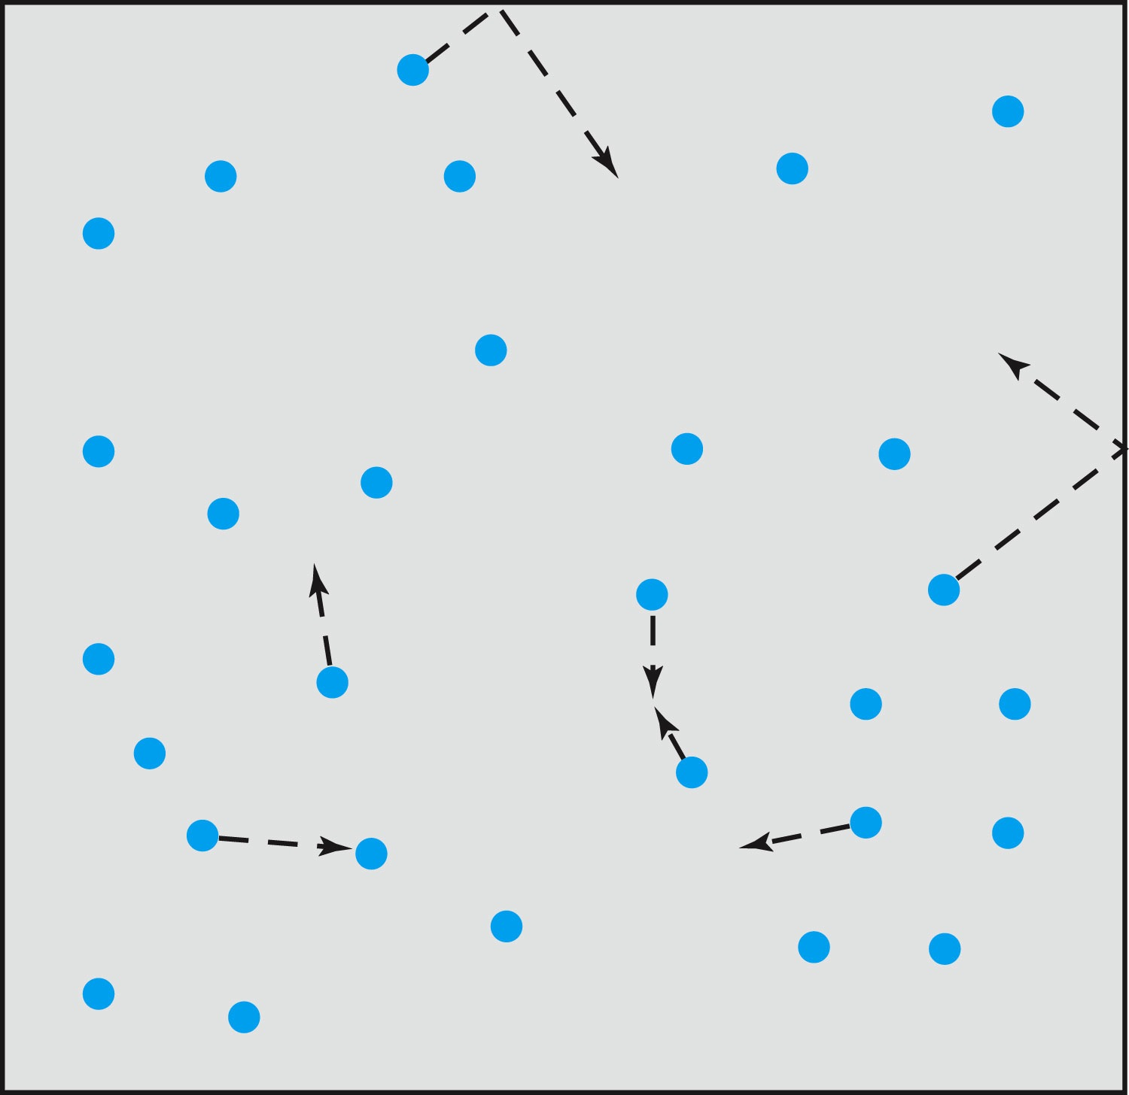
Relevance of Gas Concept to Atoms
The idea of gas (17th century) as a collection of small particles bouncing around with kinetic energy enabled concept of small, unseen objects
This concept formed the bases of existence something small that makes up matter

Slide 7
The Atomic Theory of Matter
Concept initiated by Democritus and Leucippus (~450 B.C.)
(first to use the Greek atomos, meaning “indivisible”)
In addition to fundamental contributions by Boyle, Charles, and Gay-Lussac, Proust (1754 – 1826) proposes the law of definite proportions➔ A compound of 2 or more elements, the weight proportion of the elements is always same
Dalton advances the atomic theory of matter to explain the law of definite proportions
Avogadro proposed that all gases at the same temperature, pressure, and volume contain the same number of molecules (atoms); viz. 6.02 × 10²³ atoms
Cannizzaro (1826 – 1910) makes a distinction between atoms and molecules advancing the ideas of Avogadro.

Slide 8
Further Advances in Atomic Theory
Maxwell derives the speed distribution of atoms in a gas
Robert Brown (1753 – 1858) observes microscopic “random” motion of suspended grains of pollen in water (Brownian motion)
Einstein in the 20th century explains this random motion using atomic theory

Slide 9
Opposition to the Atomic Theory
Ernst Mach (1838 – 1916) opposes the theory on the basis of logical positivism, i.e., atoms being “unseen” questions their reality
Wilhelm Ostwald (1853 – 1932) supports this premise and called atoms hypothetical structures for bookkeeping based on experimental results of radioactivity, discrete spectral lines, and the formation of molecular structures

Slide 10
Overwhelming Evidence for Existence of Atoms
Max Planck (1858 – 1947) advances the concept to explain blackbody radiation, using submicroscopic “quanta”
Boltzmann requires existence of atoms for advances in statistical mechanics
Albert Einstein (1879 – 1955) uses molecules to explain Brownian motion and determines the approximate value of their size and mass
Jean Perrin (1870 – 1942) experimentally verifies Einstein’s predictions

Slide 11
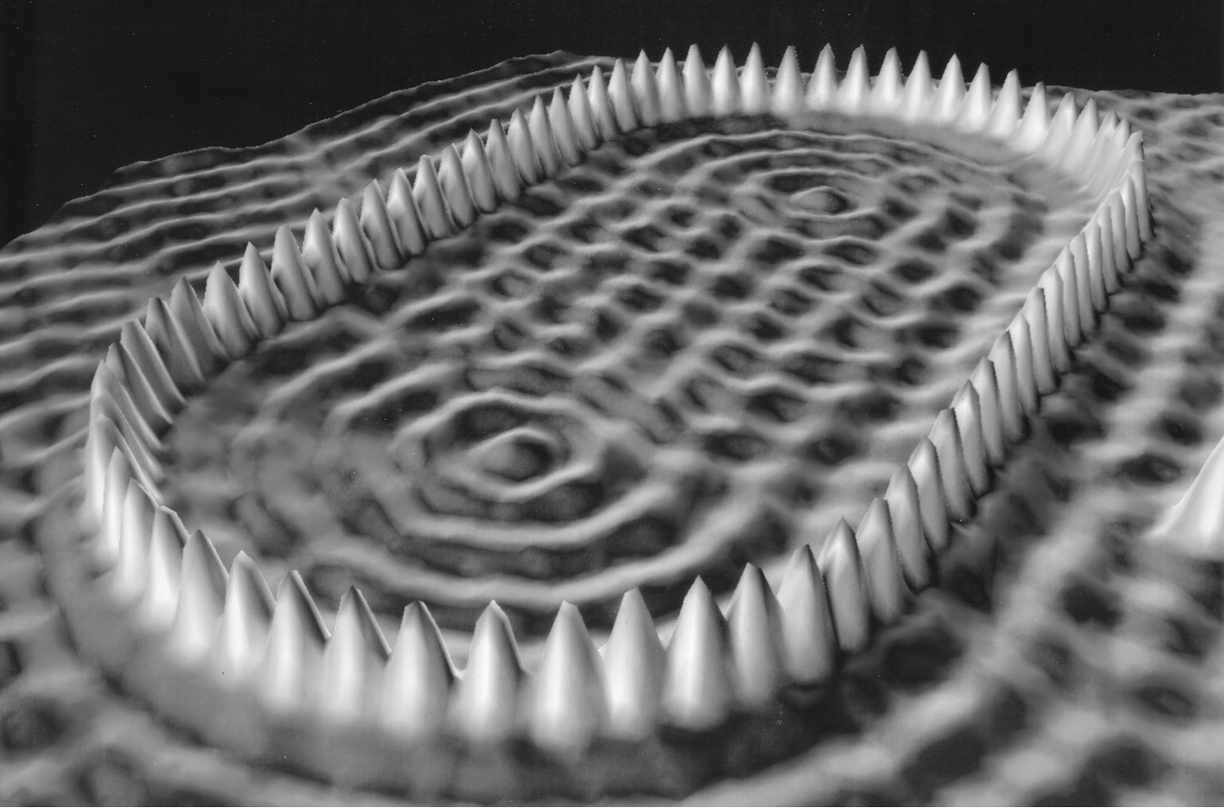
Unresolved Questions and New Horizons
The atomic theory controversy raises fundamental questions
  It was not universally accepted
  The constituents (if any) of atoms became a significant question
  The structure of matter remained unknown with certainty
  Experimental precisions were insufficient to discern this level of small scale

Slide 12
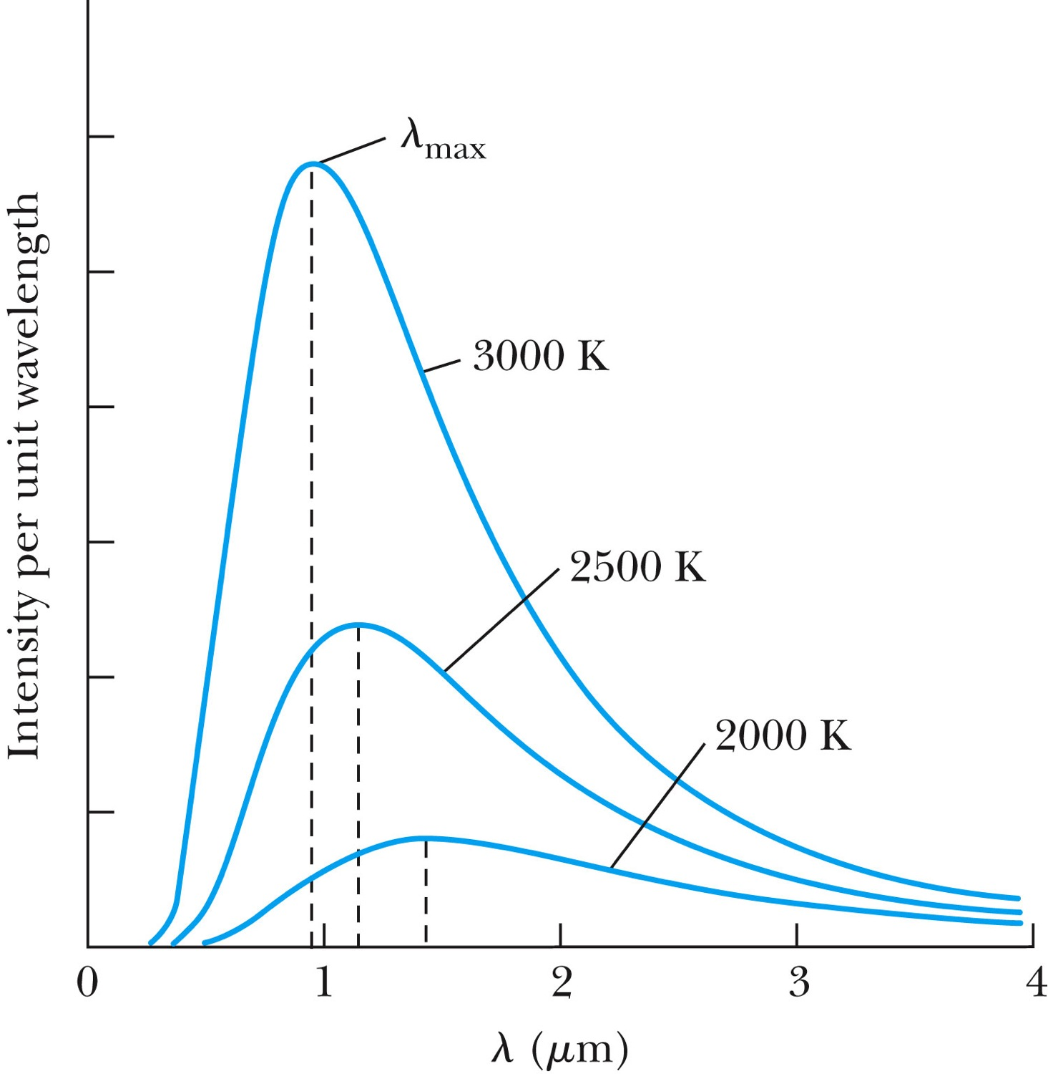
Further Complications
Three fundamental problems:
The (non) existence of a medium that transmits light waves from the sun
The observed differences in the electric and magnetic field between stationary and moving reference systems
The failure of classical physics to explain blackbody radiation in which characteristic spectra of radiation that cover the entire EM wavelengths were observed depending on temperature not on the body itself

Slide 13
Additional Experimental Discoveries Contribute to the Complications
Discovery of x-rays (1895, Rontgen)
Discovery of radioactivity (1896, Becquerel)
Discovery of the electron (1897, Thompson)
Discovery of the Zeeman effect (1896, Zeeman) dependence of spectral frequency on magnetic field

Slide 14
The Beginnings of Modern Physics
These new discoveries and the many resulting complications required a revision of the fundamental physical assumptions culminated in the successes of the classical foundations
To this end, the introduction of the modern theory of relativity and quantum mechanics becomes the starting point of this most fascinating revision

Slide 15
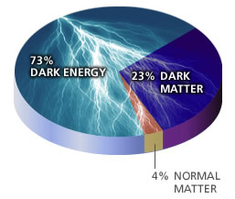
Unsolved Problems Today!
Why are there three families of quarks and leptons?
Why is the mass range so large (0.1m_{p} – 175 m_{p})?
How do matters acquire mass?
  Is the new particle we’ve discovered the Higgs particle?
Why is the matter in the universe made only of particles?
  What happened to anti-particles? Or anti-matters?
Do neutrinos have mass& what are the mixing parameters?
Why are there only three apparent forces?
Is the picture we present the real thing?
  What makes up the 96% of the universe?
  How about extra-dimensions?
How is the universe created?
Are there any other theories that describe the universe better?
Many more questions to be answered!!

Slide 16
Newtonian (Classical) Relativity
It is assumed that Newton’s laws of motion must be measured with respect to (relative to) some reference frame.
A reference frame is called an inertial frame if Newton laws are valid in that frame.
Such a frame is established when a body, not subjected to net external forces, is observed to move in rectilinear motion at constant velocity
➔ Newtonian Principle of Relativity (Galilean Invariance): If Newton’s laws are valid in one reference frame, then they are also valid in another reference frame moving at a uniform velocity relative to the first system.

Slide 17
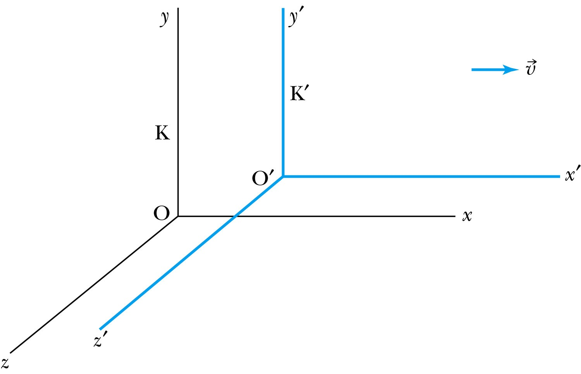
Inertial Frames K and K’
K is at rest and K’ is moving with a constant velocity
Axes are parallel
K and K’ are said to be INERTIAL COORDINATE SYSTEMS

Slide 18
The Galilean Transformation
For a point P
  In system K: P = (x, y, z, t)
  In system K’: P = (x’, y’, z’, t’)
P
x
K
K’
x’-axis
x-axis

Slide 19
Conditions of the Galilean Transformation
Parallel axes between the two inertial reference frames
K’ has a constant relative velocity in the x-direction with respect to K
Time (t) for all observers is a Fundamental invariant, i.e., the same for all inertial observers
  Space and time are separate!!

Slide 20
The Inverse Relations
Step 1. Replace with
Step 2. Replace “primed” quantities with
“unprimed” and “unprimed” with “primed”

