Slide 1
PHYS 3313 – Section 001 Lecture #4
Monday, Jan. 27, 2014
Dr. Jaehoon Yu
Galilean Transformation
Do we need Ether?
Michelson-Morley Experiment
Einstein’s postulates
Lorentz Transformations
Time Dilation & Length Contraction

Slide 2
Announcements
Quiz results
Class average: 19.4/65
Equivalent to 30/65
Top score: 65/65
Reminder for homework #1
Chapter 2 end of the chapter problems
17, 21, 23, 24, 32, 59, 61, 66, 68, 81 and 96
Due is by the beginning of the class, Monday, Feb. 3
Work in study groups together with other students but PLEASE do write your answer in your own way!

Slide 3
The Transition to Modern Relativity
Although Newton’s laws of motion had the same form under the Galilean transformation, Maxwell’s equations did not.
In 1905, Albert Einstein proposed a fundamental connection between space and time and that Newton’s laws are only an approximation.

Slide 4
They Needed Ether!!
The wave nature of light suggested that there existed a propagation medium called the luminiferous ether or just ether.
Provides an inertial reference frame
The properties of ether
Very low density for planets to move through it without loss of energy
Sufficiently high elasticity to support the high velocity of light waves (c=?)

Slide 5
Ether as the Absolute Reference System
In Maxwell’s theory, the speed of light is given by
The velocity of light between moving systems must be a constant.
Can you see why?
Needed a system of medium that keeps this constant!
Ether proposed as the absolute reference system in which the speed of light is constant and from which other measurements could be made.
The Michelson-Morley experiment was an attempt to show the existence of ether.

Slide 6
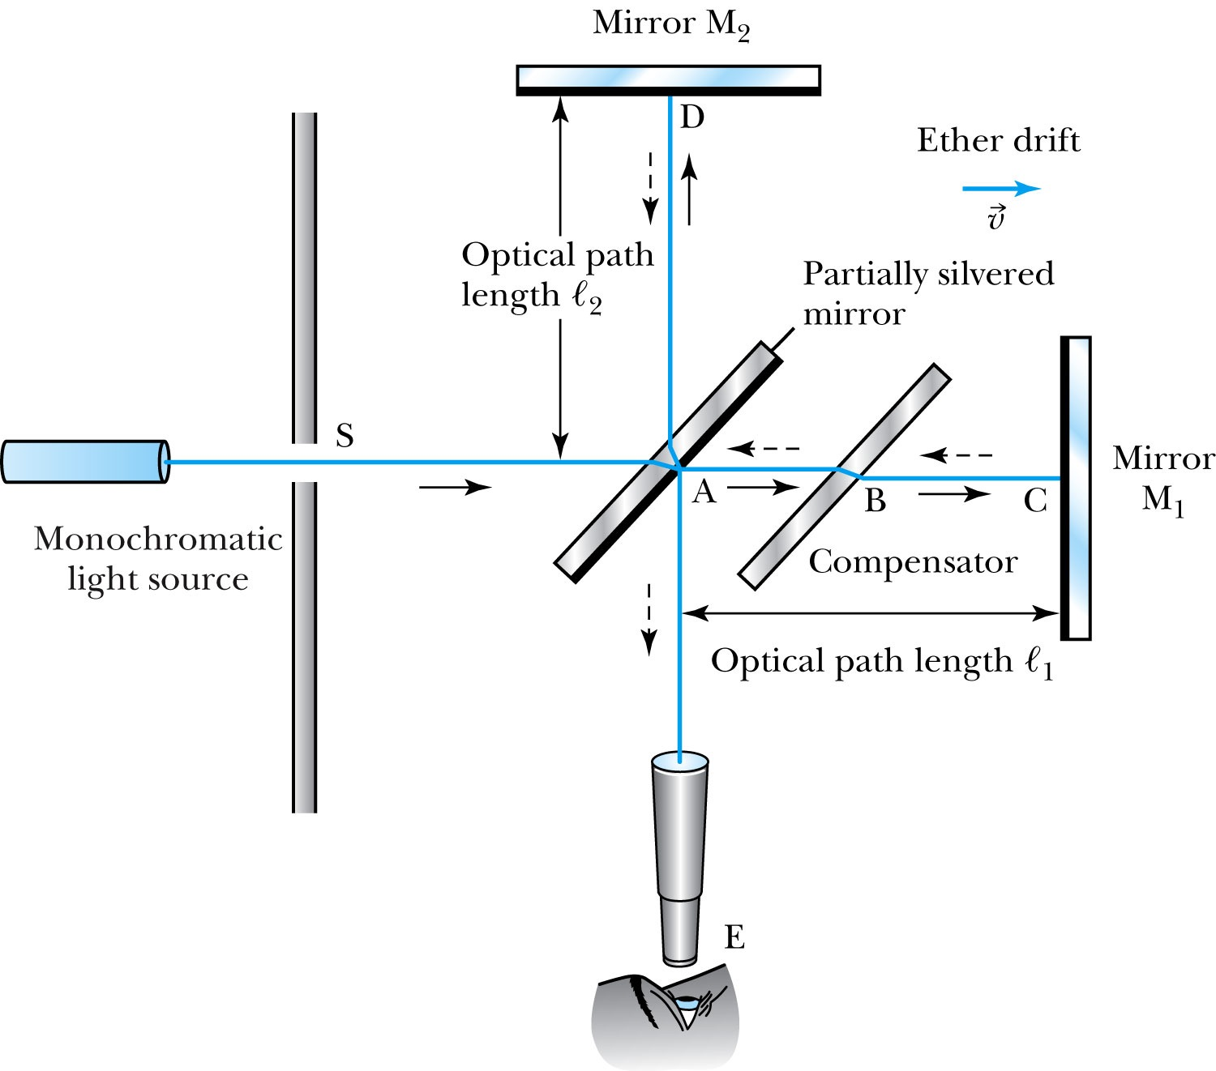
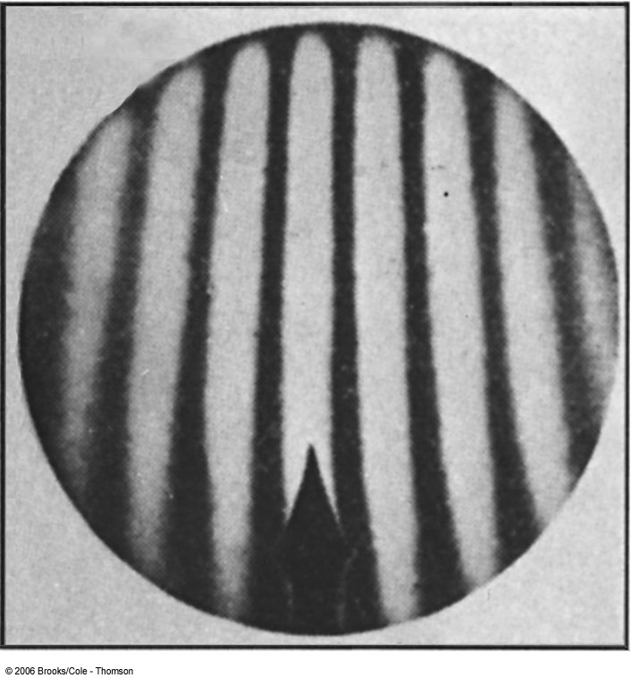
The Michelson-Morley Experiment
Albert Michelson (1852–1931) built an extremely precise device called the interferometer to measure the phase difference between two light waves traveling in orthogonal directions.

Slide 7
How does Michelson Interferometer work?
AC is parallel to the motion of the Earth inducing an “ether wind”
Light from source S is split by mirror A and travels to mirrors C and D in mutually perpendicular directions
After reflection the beams recombine at A slightly out of phase due to the “ether wind” as viewed by telescope E.
Ether

Slide 8
The analysis – Galilean X-formation
Travel time t₁ for a round trip over AC (the ether direction) is
Travel time t₂ for a round trip over AD (perpendicular direction to ether) is
The time difference is

Slide 9
The analysis
After rotating the machine by 90º, the time difference becomes
The difference of the time differences
Since v (the Earth’s speed) is 10⁻⁴ of c, we can do binomial expansion of the above

Slide 10
The Results
Using the Earth’s orbital speed as:
V = 3 × 10⁴ m/s
together with
ℓ₁ ≈ ℓ₂ = 1.2 m
So that the time difference becomes
Δt’ − Δt ≈ v²(ℓ₁ + ℓ₂)/c³ = 8 × 10⁻¹⁷ s
Although a very small number, it was within the experimental range of measurement for light waves.
Later with Morley, they increased the path lengths to 11m and improved precision better than a factor of 10
Yet, Michelson FAILED to “see” the expected interference pattern

Slide 11
Conclusions of Michelson Experiment
Michelson noted that he should be able to detect a phase shift of light due to the time difference between path lengths but found none.
He thus concluded that the hypothesis of the stationary ether must be incorrect.
After several repeats and refinements with assistance from Edward Morley (1893-1923), again a null result.
Thus, ether does not seem to exist!
Many explanations ensued afterward but none worked out!
This experiment shattered the popular belief of light being waves

Slide 12
The Lorentz-FitzGerald Contraction
Another hypothesis proposed independently by both H. A. Lorentz and G. F. FitzGerald suggested that the length ℓ₁, in the direction of the motion was contracted by a factor of
Thus making the path lengths equal to account for the zero phase shift.
This, however, was an ad hoc assumption that could not be experimentally tested.

Slide 13
Einstein’s Postulates
Fundamental assumption: Maxwell’s equations must be valid in all inertial frames
The principle of relativity: The laws of physics are the same in all inertial systems. There is no way to detect absolute motion, and no preferred inertial system exists
Published a paper in 1905 at the age 26
Believed to be fundamental
The constancy of the speed of light: Observers in all inertial systems measure the same value for the speed of light in a vacuum.

Slide 14
The Lorentz Transformations
General linear transformation relationship between P=(x, y, z, t) in frame S and P’=(x’,y’,z’,t’) in frame S’ ➔ these assume measurements are made in S frame and transferred to S’ frame
preserve the constancy of the speed of light between inertial observers
account for the problem of simultaneity between these observers
With the definitions and

Slide 15
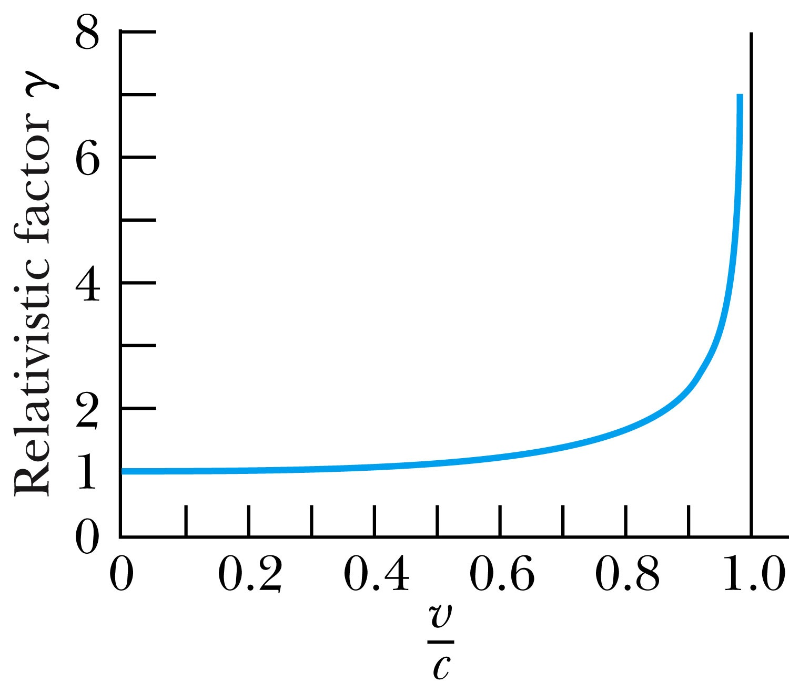
Properties of the Relativistic Factor γ
What is the property of the relativistic factor, γ?
Is it bigger or smaller than 1?
Recall Einstein’s postulate, β = v/c < 1 for all observers
γ= 1 only when v = 0

Slide 16
The complete Lorentz Transformations
Some things to note
What happens when β~0 (or v~0)?
The Lorentz x-formation becomes Galilean x-formation
Space-time are not separated
For non-imaginary x-formations, the frame speed cannot exceed c!

Slide 17
Time Dilation and Length Contraction
Direct consequences of the Lorentz Transformation:
Time Dilation:
Clocks in a moving inertial reference frame K’ run slower with respect to stationary clocks in K.
Length Contraction:
Lengths measured in a moving inertial reference frame K’ are shorter with respect to the same lengths stationary in K.

Slide 18
Time Dilation
To understand time dilation the idea of proper time must be understood:
proper time,T₀, is the time difference between two events occurring at the same position in a system as measured by a clock at that position.
Same location (spark “on” then off”)

Slide 19
Time Dilation
Is this a Proper Time?
spark “on” then spark “off”
Beginning and ending of the event occur at different positions

Slide 20
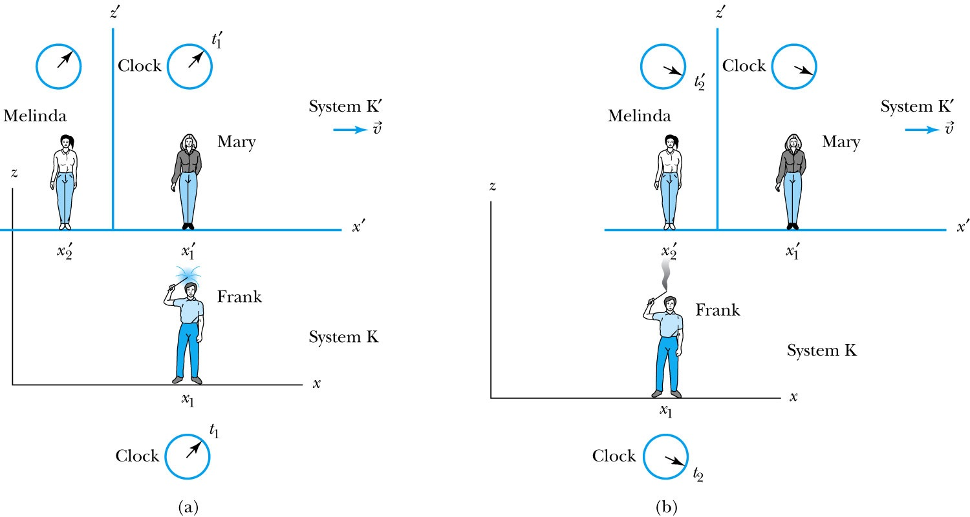
Time Dilation with Mary, Frank, and Melinda
Frank’s clock is at the same position in system K when the sparkler is lit in (a) (t=t₁) and when it goes out in (b) (t=t₂). ➔ The proper time T₀=t₂-t₁
Mary, in the moving system K’, is beside the sparkler when it was lit (t=t₁’)
Melinda then moves into the position where and when the sparkler extinguishes (t=t₂’)
Thus, Melinda, at the new position, measures the time in system K’ when the sparkler goes out in (b).

Slide 21
According to Mary and Melinda…
Mary and Melinda measure the two times for the sparkler to be lit and to go out in system K’ as times t₁’and t₂’ so that by the Lorentz transformation:
Note here that Frank records x₂ – x₁ = 0 in K with a proper time: T₀ = t₂ – t₁ or

Slide 22
Time Dilation: Moving Clocks Run Slow
1) T ‘> T₀ or the time measured between two events at different positions is greater than the time between the same events at one position: time dilation.
The proper time is always the shortest time!!
2) The events do not occur at the same space and time coordinates in the two systems
3) System K requires 1 clock and K’ requires 2 clocks.

Slide 23
Time Dilation Example: muon lifetime
Muons are essentially heavy electrons (~200 times heavier)
Muons are typically generated in collisions of cosmic rays in upper atmosphere and, unlike electrons, decay ( μsec)
For a muon incident on Earth with v=0.998c, an observer on Earth would see what lifetime of the muon?
2.2 μsec?
t=35 μsec
Moving clocks run slow so when an outside observer measures, they see a longer time than the muon itself sees.

Slide 24
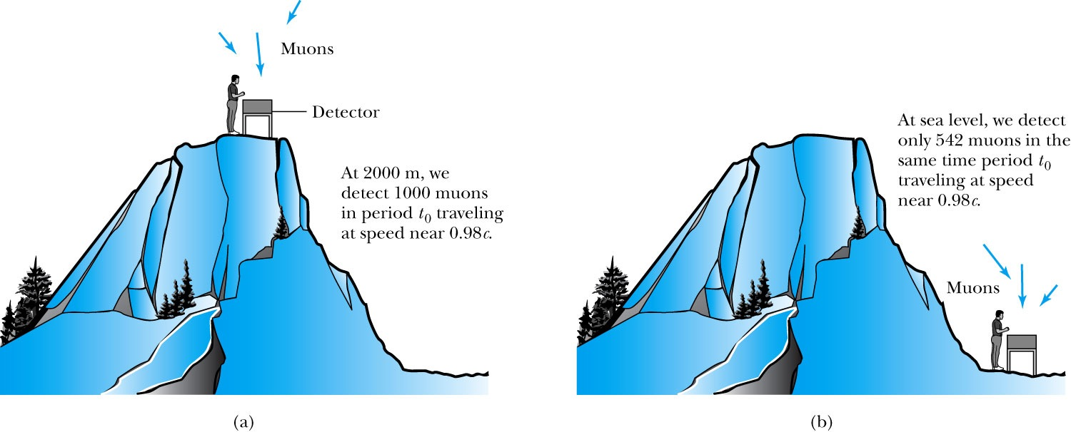
Experimental Verification of Time Dilation
Arrival of Muons on the Earth’s Surface
The number of muons detected with speeds near 0.98c is much different (a) on top of a mountain than
(b) at sea level, because of the muon’s decay. The experimental result agrees with our time dilation equation.

Slide 25
Length Contraction
To understand length contraction the idea of proper length must be understood:
Let an observer in each system K and K’ have a meter stick at rest in their own system such that each measures the same length at rest.
The length as measured at rest at the same time is called the proper length.
Notes:
Added “their own system”; changed measure to measures

Slide 26
Length Contraction cont’d
Each observer lays the stick down along his or her respective x axis, putting the left end at x_{ℓ} (or x’_{ℓ}) and the right end at x_{r} (or x’_{r}).
Thus, in the rest frame K, Frank measures his stick to be:
Similarly, in the moving frame K’, Mary measures her stick at rest to be:
Frank in his rest frame measures the moving length in Mary’s frame moving with velocity v.
Thus using the Lorentz transformations Frank measures the length of the stick in K’ as:
Where both ends of the stick must be measured simultaneously, i.e, t_{r} = t_{ℓ}
Here Mary’s proper length is L’₀ = x’_{r} – x’_{ℓ}
and Frank’s measured length is L = x_{r} – x_{ℓ}

Slide 27
Measurement in Rest Frame
The observer in the rest frame measures the moving length as L given by
but since both Mary and Frank in their respective frames measure L’₀ = L₀
and L₀ > L, i.e. the moving stick shrinks

