Slide 1
PHYS 3313 – Section 001 Lecture #5
Wednesday, Jan. 29, 2014
Dr. Jaehoon Yu
Length Contraction
Relativistic Velocity Addition
The Twin Paradox
Space-time Diagram
The Doppler Effect

Slide 2
Announcements
Reminder for homework #1
Chapter 2 end of the chapter problems
17, 21, 23, 24, 32, 59, 61, 66, 68, 81 and 96
Due is by the beginning of the class, Monday, Feb. 3
Work in study groups together with other students but PLEASE do write your answer in your own way!
Colloquium at 4pm today in SH101
Dr. James LeBeau of NCSU

Slide 3
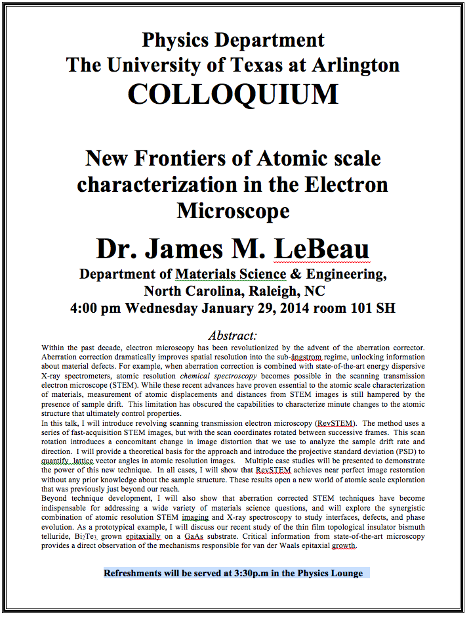

Slide 4
Special Project #2
Derive the three Lorentz velocity transformation equations, starting from Lorentz coordinate transformation equations. (10 points)
Derive the three reverse Lorentz velocity transformation equations, starting from Lorentz coordinate transformation equations. (10 points)
Prove that the space-time invariant quantity s²=x²-(ct)² is indeed invariant, i.e. s²=s’², in Lorentz Transformation. (5 points)
You must derive each one separately starting from the Lorentz spatial coordinate transformation equations to obtain any credit.
Just switching the signs and primes will be insufficient!
Must take the simplest form of the equations, using β and γ.
You MUST have your own, independent answers to the above three questions even if you worked together with others. All those who share the answers will get 0 credit if copied.
Due for the submission is Wednesday, Feb. 5!

Slide 5
Length Contraction
To understand length contraction the idea of proper length must be understood:
Let an observer in each system K and K’ have a meter stick at rest in their own system such that each measures the same length at rest.
The length as measured at rest at the same time is called the proper length.
Notes:
Added “their own system”; changed measure to measures

Slide 6
The Complete Lorentz Transformations

Slide 7
Length Contraction cont’d
Each observer lays the stick down along his or her respective x axis, putting the left end at x_{ℓ} (or x’_{ℓ}) and the right end at x_{r} (or x’_{r}).
Thus, in the rest frame K, Frank measures his stick to be:
Similarly, in the moving frame K’, Mary measures her stick at rest to be:
Frank in his rest frame measures the moving length in Mary’s frame moving with velocity v.
Thus using the Lorentz transformations Frank measures the length of the stick in K’ as:
Where both ends of the stick must be measured simultaneously, i.e, t_{r} = t_{ℓ}
Here Mary’s proper length is L’₀ = x’_{r} – x’_{ℓ}
and Frank’s measured length of Mary’s stick is L = x_{r} – x_{ℓ}

Slide 8
Measurement in Rest Frame
The observer in the rest frame measures the moving length as L given by
but since both Mary and Frank in their respective frames measure L’₀ = L₀
and L₀ > L, i.e. the moving stick shrinks

Slide 9
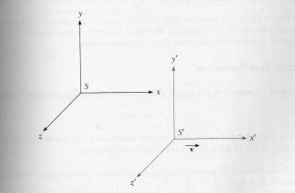
Length Contraction Summary
Proper length (length of object in its own frame:
Length of object in observer’s frame:
Since γ>1, the length is shorter in the direction of motion (length contraction!)

Slide 10
More about Muons
Rate: 1/cm²/minute at Earth’s surface (so for a person with 600 cm² surface area, the rate would be 600/60=10 muons/sec passing through the body!)
They are typically produced in atmosphere about 6 km above surface of Earth and often have velocities that are a substantial fraction of speed of light, v=.998 c for example and life time 2.2 μsec
How do they reach the Earth if they only go 660 m and not 6000 m?
The time dilation stretches life time to t=35 μsec not 2.2 μsec, thus they can travel 16 times further, or about 10 km, implying they easily reach the ground
But riding on a muon, the trip takes only 2.2 μsec, so how do they reach the ground???
Muon-rider sees the ground moving towards him, so the length he has to travel contracts and is only
At 1000 km/sec, it would take 5 seconds to cross U.S., pretty fast, but does it give length contraction? {not much contraction}
(for v=0.9c, the length is reduced by 44%)

Slide 11
Addition of Velocities
How do we add velocities in a relativistic case?
Taking differentials of the Lorentz transformation, relative velocities may be calculated:

Slide 12
So that…
defining velocities as: u_{x} = dx/dt, u_{y} = dy/dt, u’_{x} = dx’/dt’, etc. it can be shown that:
With similar relations for u_{y} and u_{z:}

Slide 13
The Lorentz Velocity Transformations
In addition to the previous relations, the Lorentz velocity transformations for u’_{x}, u’_{y} , and u’_{z} can be obtained by switching primed and unprimed and changing v to –v:

Slide 14
Velocity Addition Summary
Galilean Velocity addition where and
From inverse Lorentz transform and
So
Thus
What would be the measured speed of light in S frame?
Since we get
Observer in S frame measures c too! Strange but true!

Slide 15
Velocity Addition Example
Yu Darvish is riding his bike at 0.8c relative to observer. He throws a ball at 0.7c in the direction of his motion. What speed does the observer see?
What if he threw it just a bit harder?
Doesn’t help—asymptotically approach c, can’t exceed (it’s not just a postulate it’s the law)

Slide 16
A test of Lorentz velocity addition: π⁰ decay
How can one test experimentally the correctness of the Lorentz velocity transformation vs Galilean one?
In 1964, T. Alvager and company performed a measurements of the arrival time of two photons resulting from the decay of a π⁰ in two detectors separated by 30m.
Each photon has a speed of 0.99975c. What are the speed predicted by Galilean and Lorentz x-mation?
v_{G}=c+0.99975c=1.99975c
How much time does the photon take to arrive at the detector?

