Slide 1
PHYS 3313 – Section 001 Lecture #8
Monday, Feb. 10, 2014
Dr. Jaehoon Yu
Binding Energy
Quantization
Discovery of the X-ray and the Electron
Determination of Electron Charge
Line Spectra
Blackbody Radiation
Photoelectric Effect

Slide 2
Announcements
Reading assignments: CH3.9
Homework #2
CH3 end of the chapter problems: 2, 19, 27, 36, 41, 47 and 57
Due Wednesday, Feb. 19
Quiz #2 Wednesday, Feb. 19
Beginning of the class
Covers CH1.1 – what we finish this Monday, Feb. 17

Slide 3
Binding Energy
The potential energy associated with the force keeping a system together ➔ E_{B}.
The difference between the rest energy of the individual particles and the rest energy of the combined bound system.

Slide 4
Examples 2.13 and 2.15
Ex. 2.13: A 2-GeV proton hits another 2-GeV proton in a head on collision. (proton rest mass = 938MeV/c²)
Compute v, β, p, K and E for each of the initial protons
What happens to the kinetic energy?
Ex. 2.15: What is the minimum kinetic energy the protons must have in the head-on collision in the reaction p+p→π⁺+d, in order to produce the positively charged pion and a deuteron. The mass of pion is 139.6MeV/c².

Slide 5
What does the word “Quantize” mean?
Dictionary: To restrict to discrete values
To consist of indivisible discrete quantities instead of continuous quantities
Integer is a quantized set with respect to real numbers
Some examples of quantization?
Digital photos
Lego blocks
Electric charge
Photon (a quanta of light) energy
Angular momentum
Etc…

Slide 6
Discovery of the X Ray and the Electron
X rays were discovered by Wilhelm Röntgen in 1895.
Observed X rays emitted by cathode rays bombarding glass
Electrons were discovered by J. J. Thomson.
Observed that cathode rays were charged particles

Slide 7
Cathode Ray Experiments
In the 1890’s scientists and engineers were familiar with cathode rays, generated from one of the metal plates in an evacuated tube across a large electric potential
People thought cathode rays had something to do with atoms.
It was known that cathode rays could penetrate matter and their properties were under intense investigation during the 1890’s.

Slide 8
Observation of x Rays
Wilhelm Röntgen studied the effect of cathode rays passing through various materials.
He noticed that a nearby phosphorescent screen glowed during some of these experiments.
These rays were unaffected by magnetic fields and penetrated materials more than cathode rays.
He called them x rays and deduced that they were produced by the cathode rays bombarding the glass walls of his vacuum tube

Slide 9
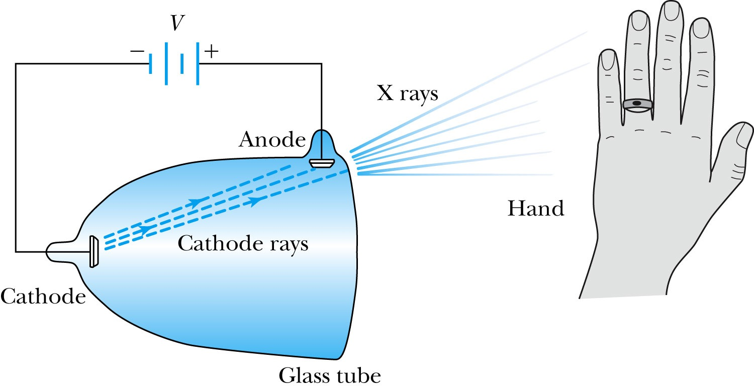
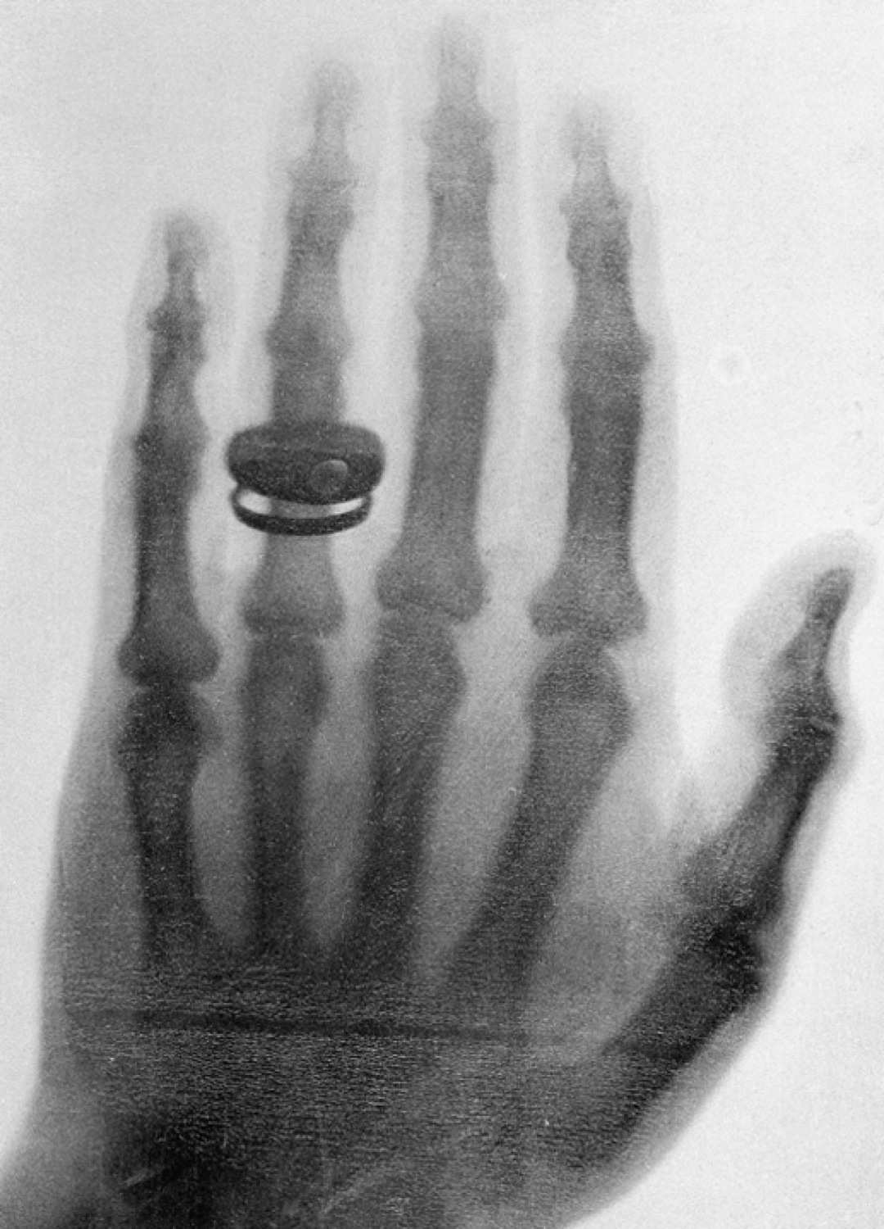
Röntgen’s X Ray Tube
Röntgen produced X-ray by allowing cathode rays to impact the glass wall of the tube.
Took image the bones of a hand on a phosphorescent screen.
Tremendous contribution to medical imaging, and Röntgen received the 1st Nobel Prize for this!

Slide 10
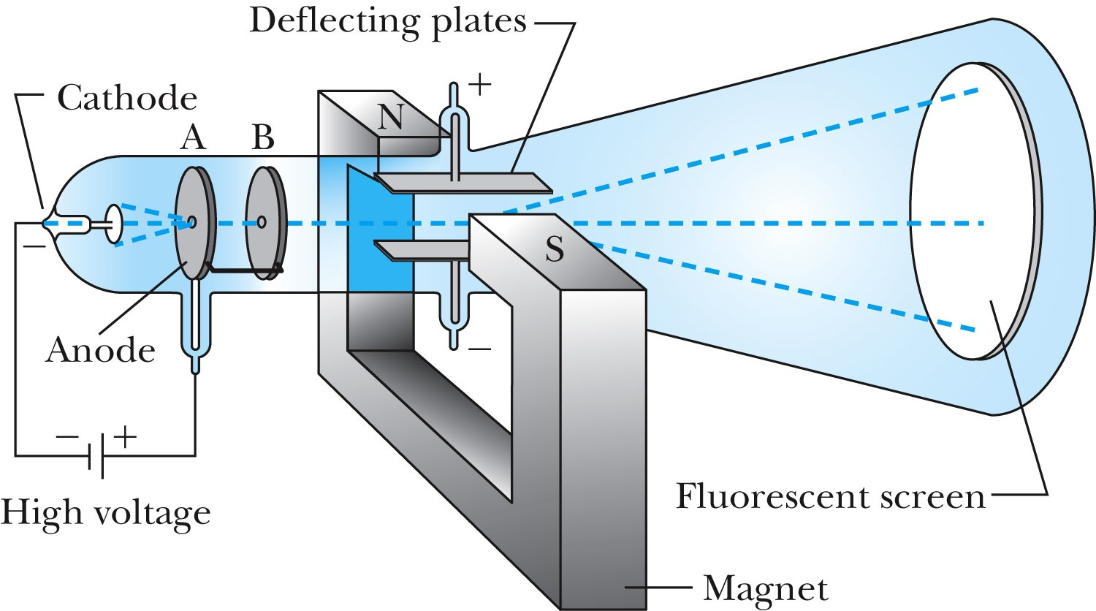
J.J. Thomson’s Cathode-Ray Experiment
Thomson showed that the cathode rays were negatively charged particles (electrons)! How?
By deflecting them in electric and magnetic fields.

Slide 11
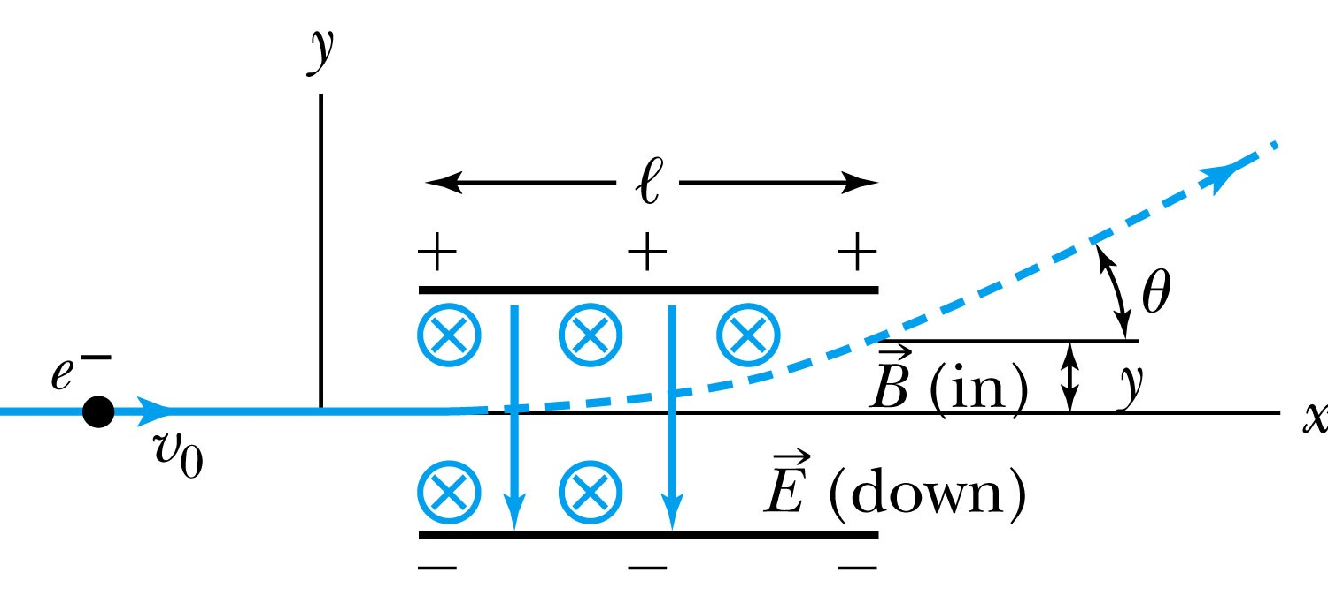
Thomson’s Experiment
Thomson measured the ratio of the electron’s charge to mass by sending electrons through a region containing a magnetic field perpendicular to an electric field.
Measure the deflection angle with only E!
Turn on and adjust B field till no deflection!
What do we know?
l, B, E and θ
What do we not know?
v₀, q and m

Slide 12
Calculation of q/m
An electron moving through the electric field w/o magnetic field is accelerated by the force:
Electron angle of deflection:
Adjust the perpendicular magnetic field until it balances E and keeps electrons from deflecting in y-direction
Charge to mass ratio:

Slide 13
Ex 3.1: Thomson’s experiment
In an experiment similar to Thomson’s, we use deflecting plates 5.0cm in length with an electric field of 1.2x10⁴V/m. Without the magnetic field, we find an angular deflection of 30º, and with a magnetic field of 8.8x10⁻⁴T we find no deflection. What is the initial velocity of the electron and its q/m?
First v₀ using E and B, we obtain:
q/m is then
What is the actual value of q/m using the known quantities?

